Slide 1
Monte Carlo Techniques

Slide 2
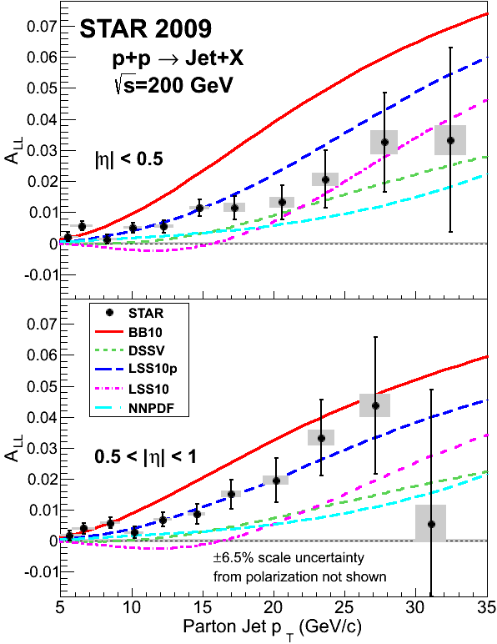
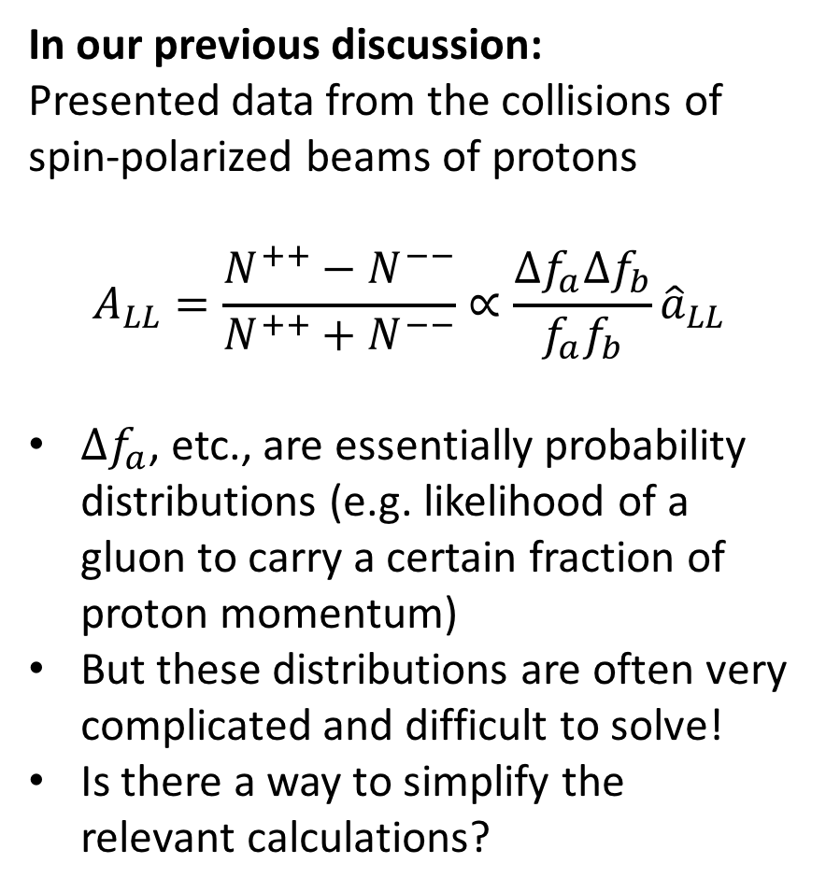
Last Time: Polarized Gluons
In our previous discussion:
Presented data from the collisions of spin-polarized beams of protons
$$A_{LL}=\frac{N^{++}−N^{−−}}{N^{++}+N^{−−}}∝\frac{Δf_{a}Δf_{b}}{f_{a}f_{b}}{\hat{a}}_{LL}$$
$Δf_{a}$, etc., are essentially probability distributions (e.g. likelihood of a gluon to carry a certain fraction of proton momentum)
But these distributions are often very complicated and difficult to solve!
Is there a way to simplify the relevant calculations?
STAR
PRL 115, 092002

Slide 3
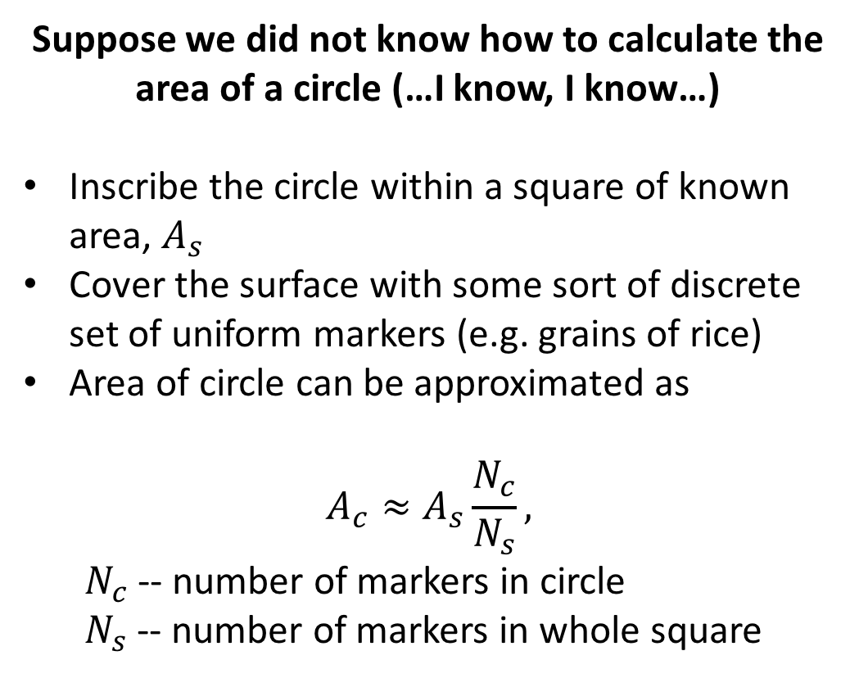
Simple Example: Area Calculation
Suppose we did not know how to calculate the area of a circle (…I know, I know…)
Inscribe the circle within a square of known area, $A_{s}$
Cover the surface with some sort of discrete set of uniform markers (e.g. grains of rice)
Area of circle can be approximated as
$$A_{c}≈A_{s}\frac{N_{c}}{N_{s}},$$
  $N_{c}$ -- number of markers in circle
  $N_{s}$ -- number of markers in whole square

Slide 4
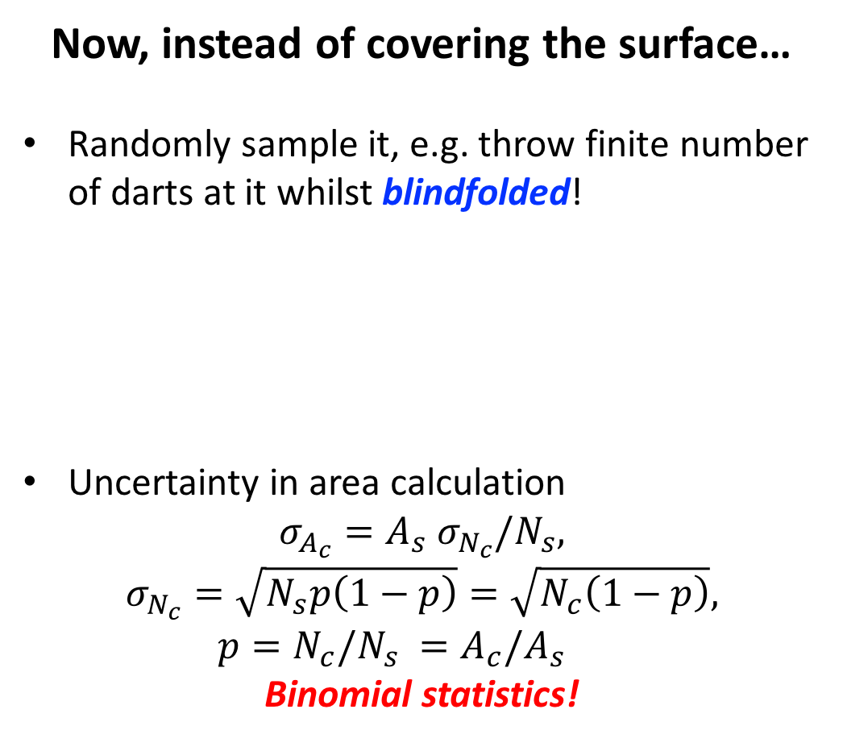
Simple Example: Area Calculation
Now, instead of covering the surface…
Randomly sample it, e.g. throw finite number of darts at it whilst blindfolded!
Uncertainty in area calculation
$$σ_{A_{c}}=A_{s} σ_{N_{c}}/N_{s},$$
$$σ_{N_{c}}=\sqrt{N_{s}p\left(1−p\right)}=\sqrt{N_{c}\left(1−p\right)},$$
  $$p=N_{c}/N_{s} =A_{c}/A_{s}$$
Binomial statistics!

Slide 5
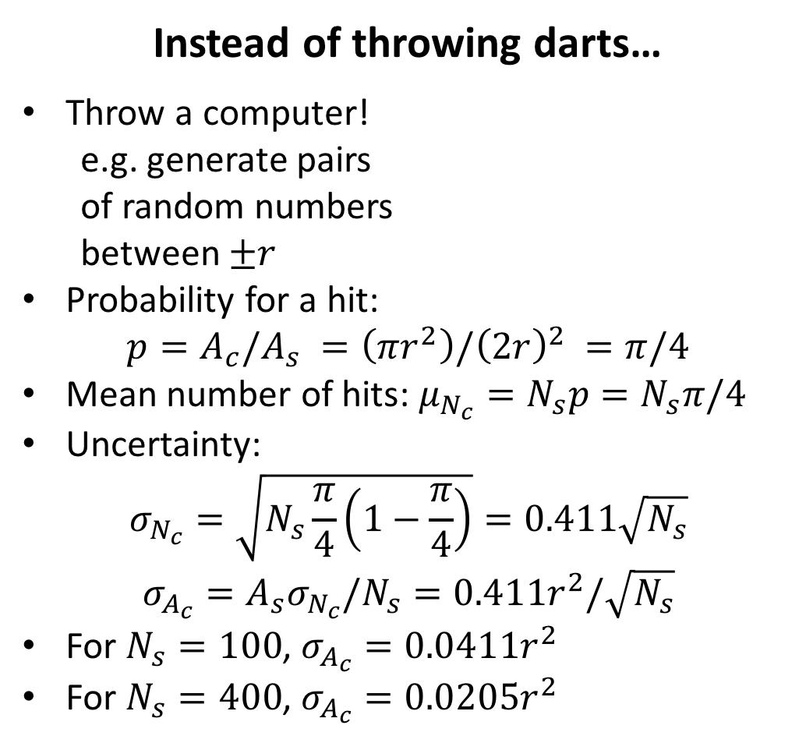


Simple Example: Area Calculation
Instead of throwing darts…
Throw a computer!
e.g. generate pairs
of random numbers
between $±r$
Probability for a hit:
$$p=A_{c}/A_{s} =\left(πr^{2}\right)/{\left(2r\right)}^{2} =π/4$$
Mean number of hits: $μ_{N_{c}}=N_{s}p=N_{s}π/4$
Uncertainty:
$$σ_{N_{c}}=\sqrt{N_{s}\frac{π}{4}\left(1−\frac{π}{4}\right)}=0.411\sqrt{N_{s}}$$
$$σ_{A_{c}}=A_{s}σ_{N_{c}}/N_{s}=0.411r^{2}/\sqrt{N_{s}}$$
For $N_{s}=100$, $σ_{A_{c}}=0.0411r^{2}$
For $N_{s}=400$, $σ_{A_{c}}=0.0205r^{2}$
$$2r$$
$$2r$$

Slide 6
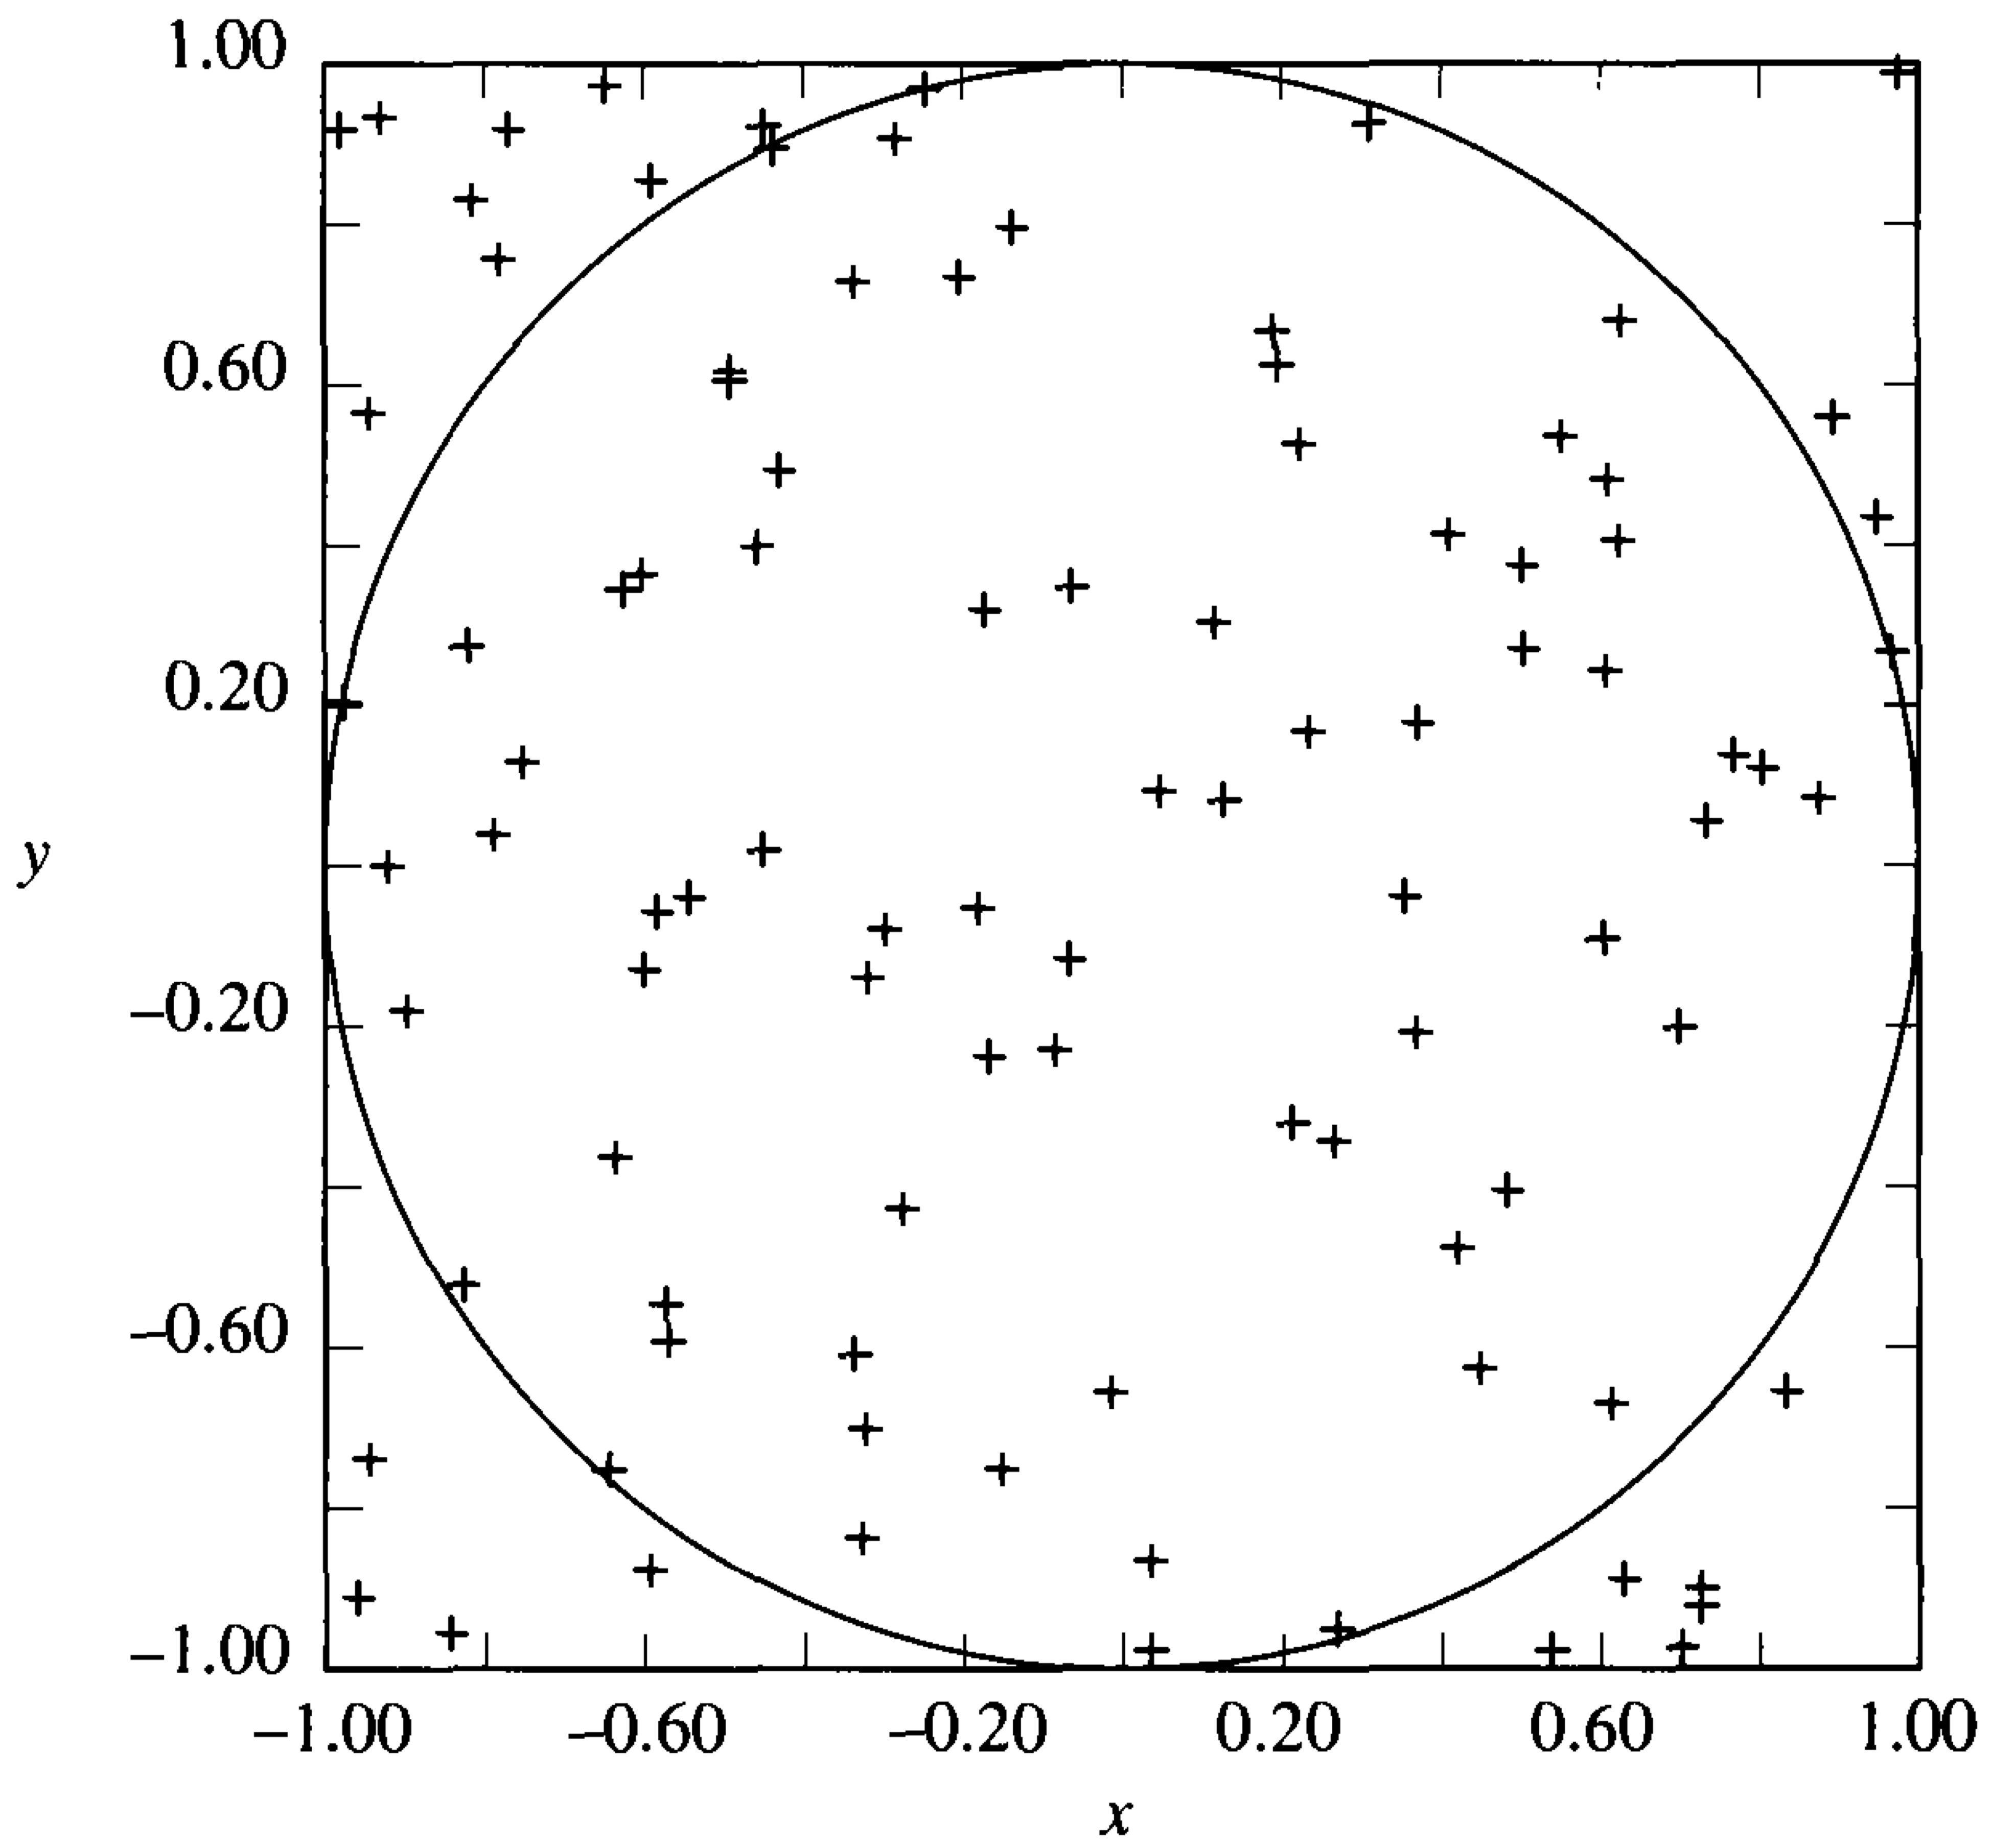
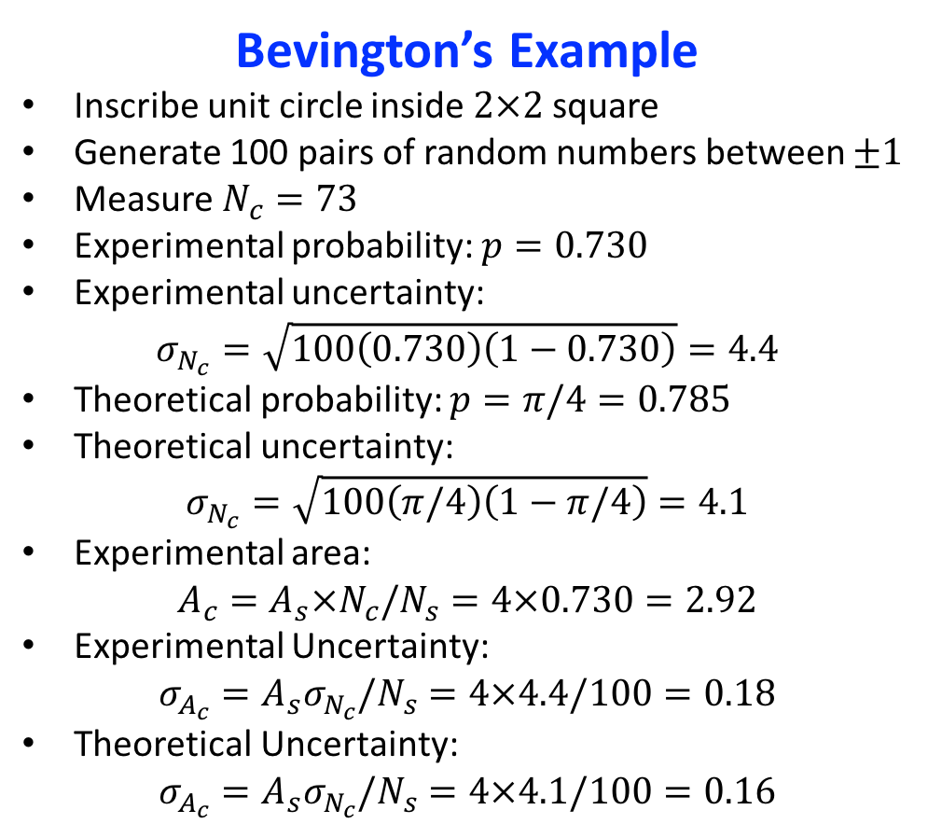
Simple Example: Area Calculation
Bevington’s Example
Inscribe unit circle inside $2×2$ square
Generate 100 pairs of random numbers between $±1$
Measure $N_{c}=73$
Experimental probability: $p=0.730$
Experimental uncertainty:
$$σ_{N_{c}}=\sqrt{100\left(0.730\right)\left(1−0.730\right)}=4.4$$
Theoretical probability: $p=π/4=0.785$
Theoretical uncertainty:
$$σ_{N_{c}}=\sqrt{100\left(π/4\right)\left(1−π/4\right)}=4.1$$
Experimental area:
$$A_{c}=A_{s}×N_{c}/N_{s}=4×0.730=2.92$$
Experimental Uncertainty:
$$σ_{A_{c}}=A_{s}σ_{N_{c}}/N_{s}=4×4.4/100=0.18$$
Theoretical Uncertainty:
$$σ_{A_{c}}=A_{s}σ_{N_{c}}/N_{s}=4×4.1/100=0.16$$

Slide 7
What Do You Need for Monte Carlo?
At its heart: random numbers!
Truly random numbers are difficult and typically impractical
Generally rely on pseudorandom numbers
Pseudorandom Numbers
Generated by computer algorithm
Approximately uncorrelated and uniformly distributed
Calculation follows a single sequence that is reproducible, e.g. same list of numbers for a given start value or “seed”

Slide 8
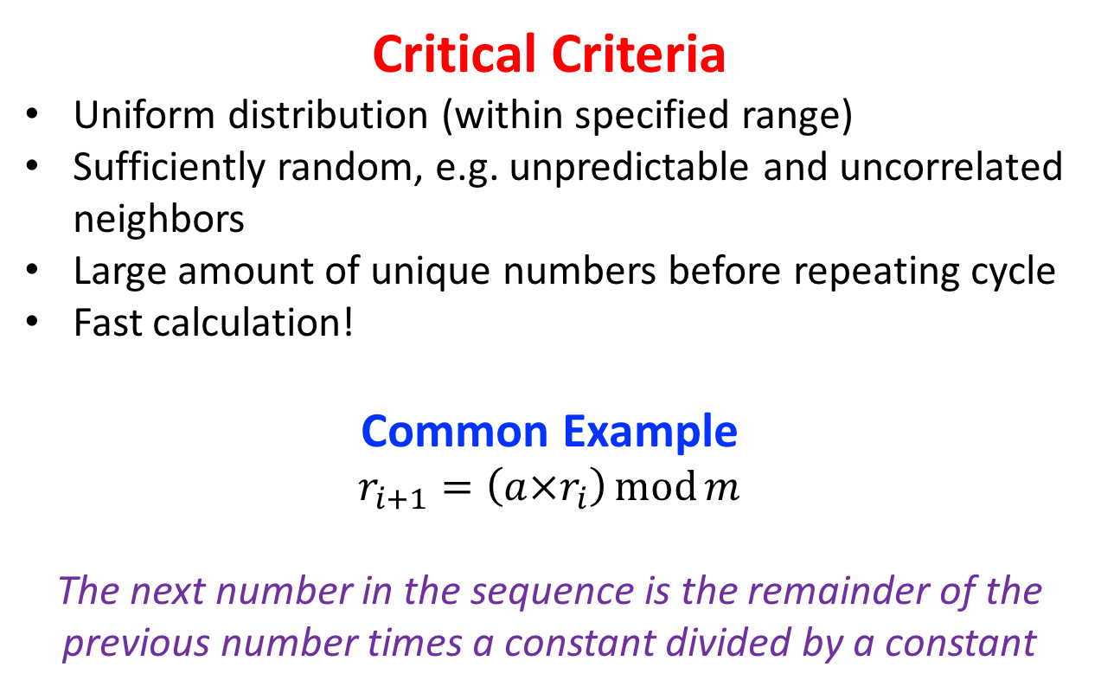
What Do You Need for Monte Carlo?
Critical Criteria
Uniform distribution (within specified range)
Sufficiently random, e.g. unpredictable and uncorrelated neighbors
Large amount of unique numbers before repeating cycle
Fast calculation!
Common Example
$$r_{i+1}=\left(a×r_{i}\right)\operatorname{mod}{m}$$
The next number in the sequence is the remainder of the previous number times a constant divided by a constant

Slide 9
What Do You Need for Monte Carlo?
Some Common Tricks
Limit residual correlation via “shuffling” two sets of numbers generated with different constants
Always set the length of generated numbers to be less than the generation cycle
When generating multiple sets, e.g. parallel batch processes on a computer farm, set seeds to batch index or least counts on the computer clock
Never treat prepackaged programs as a “black box”!

Slide 10
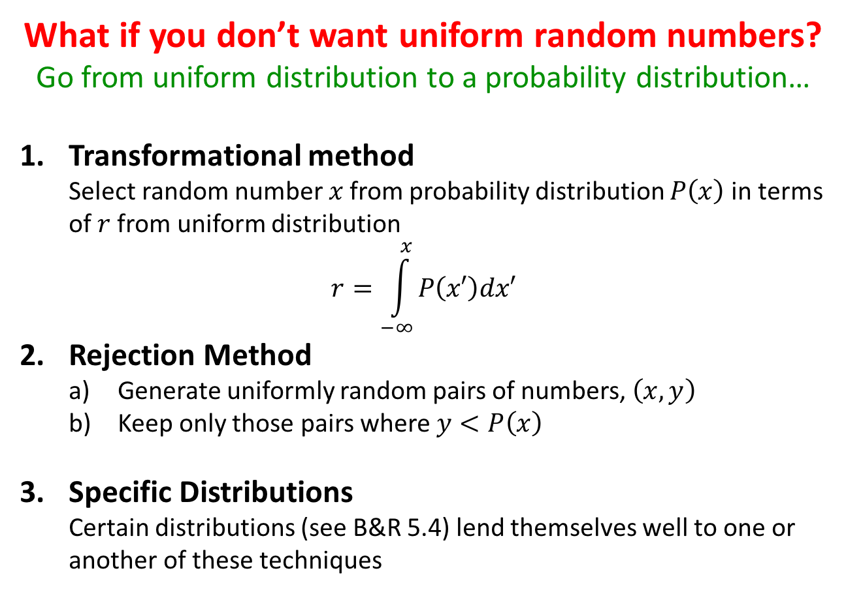
Probability Distributions
What if you don’t want uniform random numbers?
Go from uniform distribution to a probability distribution…
Transformational method
Select random number $x$ from probability distribution $P\left(x\right)$ in terms of $r$ from uniform distribution
$$r=\int_{−∞}^{x}{P\left(x′\right)dx′}$$
Rejection Method
  Generate uniformly random pairs of numbers, $\left(x,y\right)$
  Keep only those pairs where $y<P\left(x\right)$
Specific Distributions
Certain distributions (see B&R 5.4) lend themselves well to one or another of these techniques

Slide 11
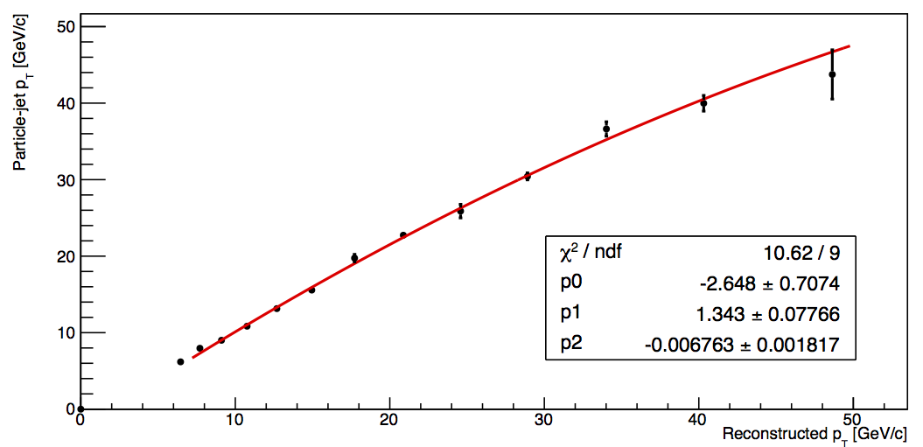
Realistic Example
Jet energy-scale Correction!
Impractical (impossible?!) to solve analytically detector response and imperfections
Use Monte Carlo techniques to simulate data
Compare reconstructed detector information to the “right” answers from the generator information

Slide 12
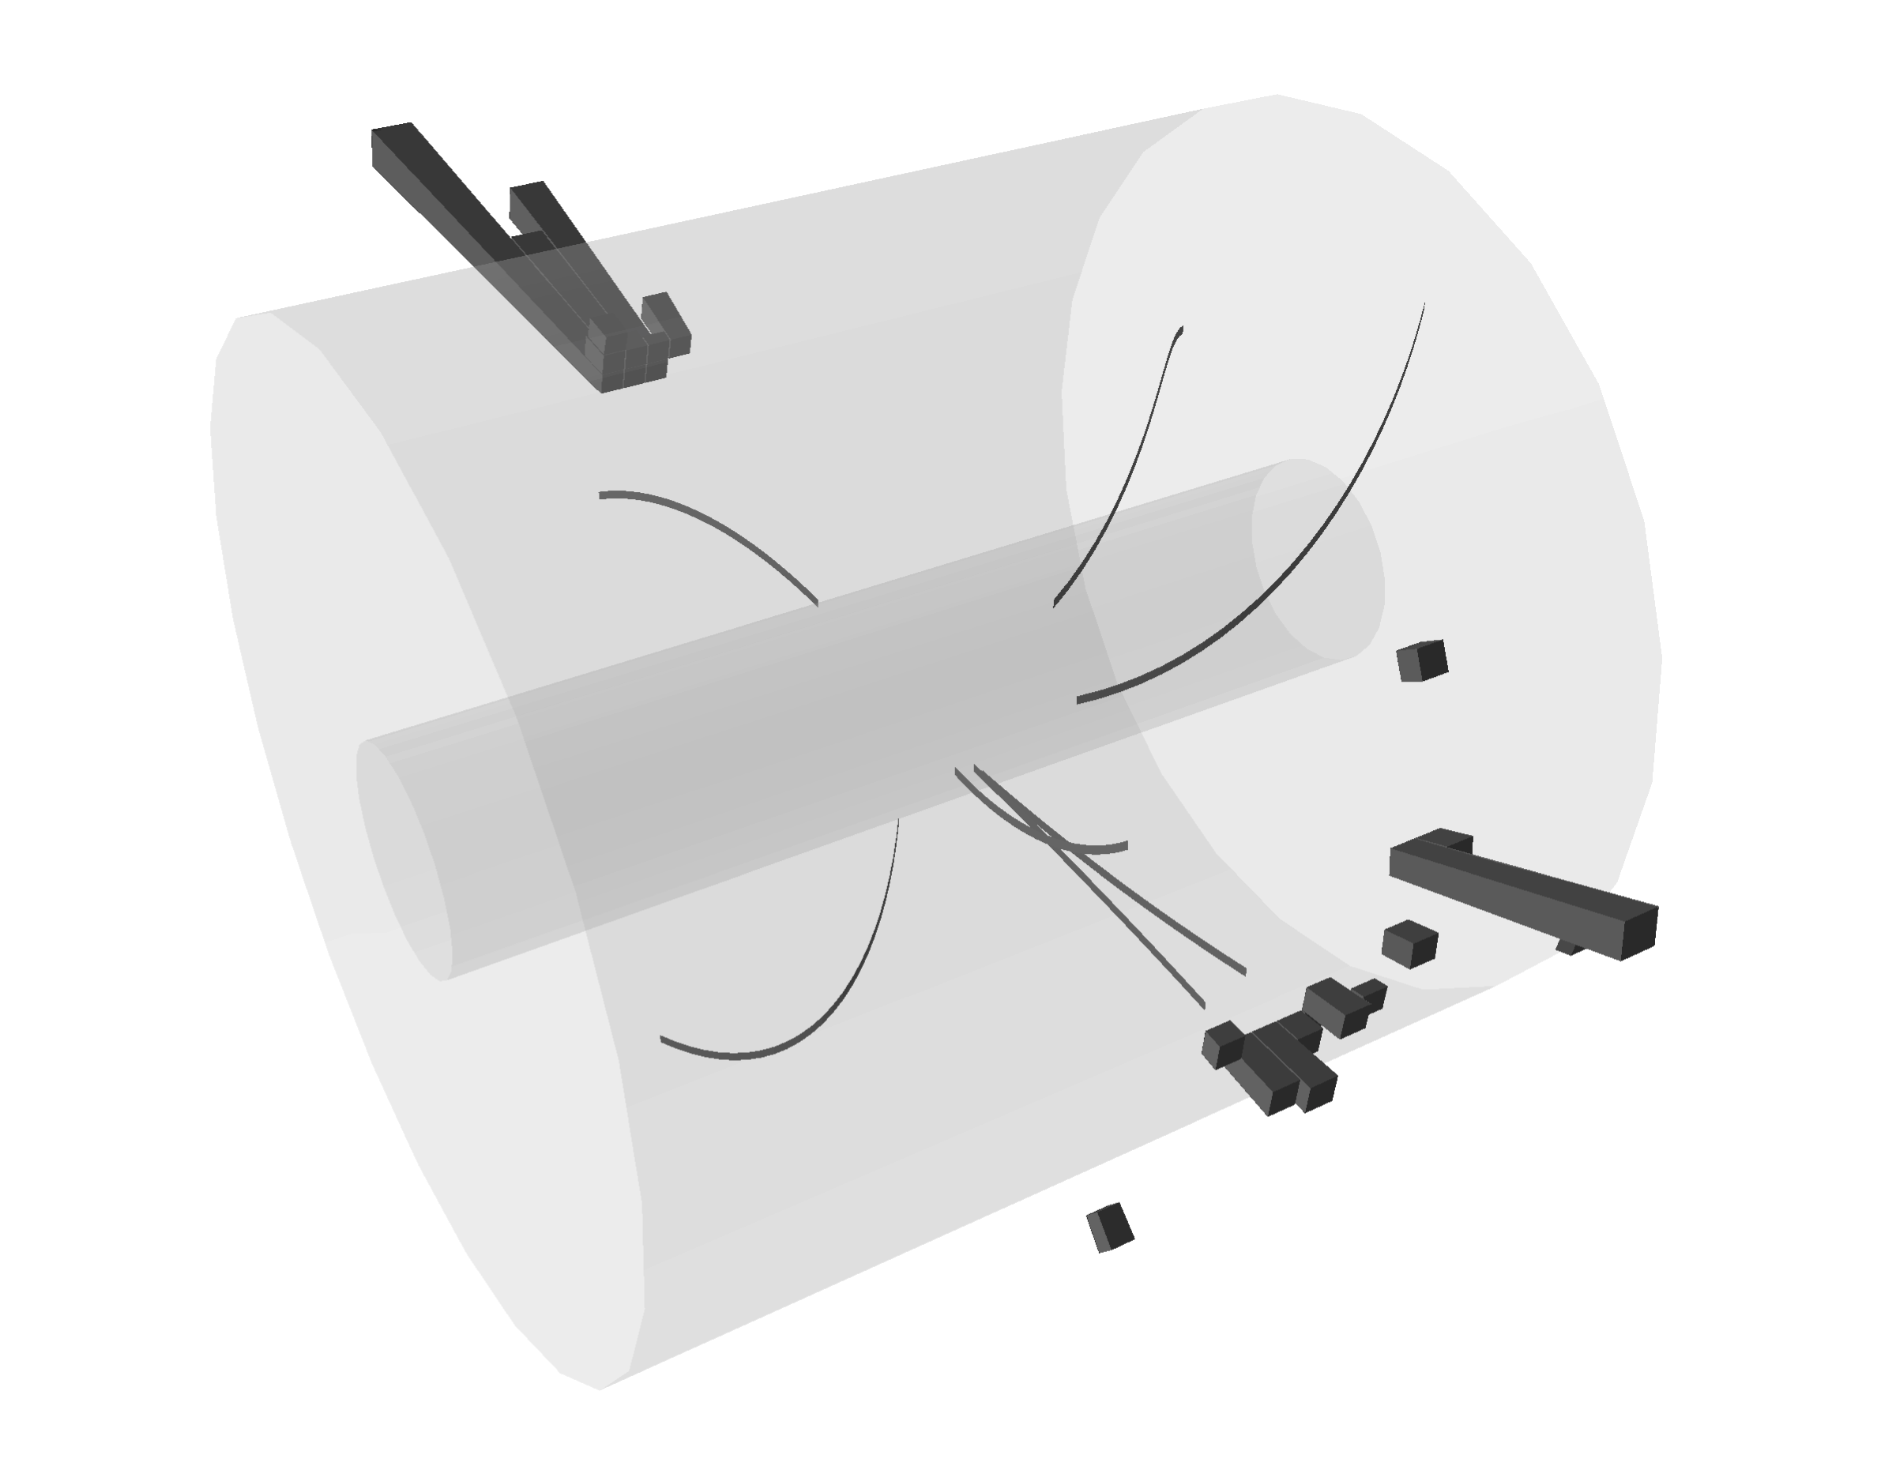
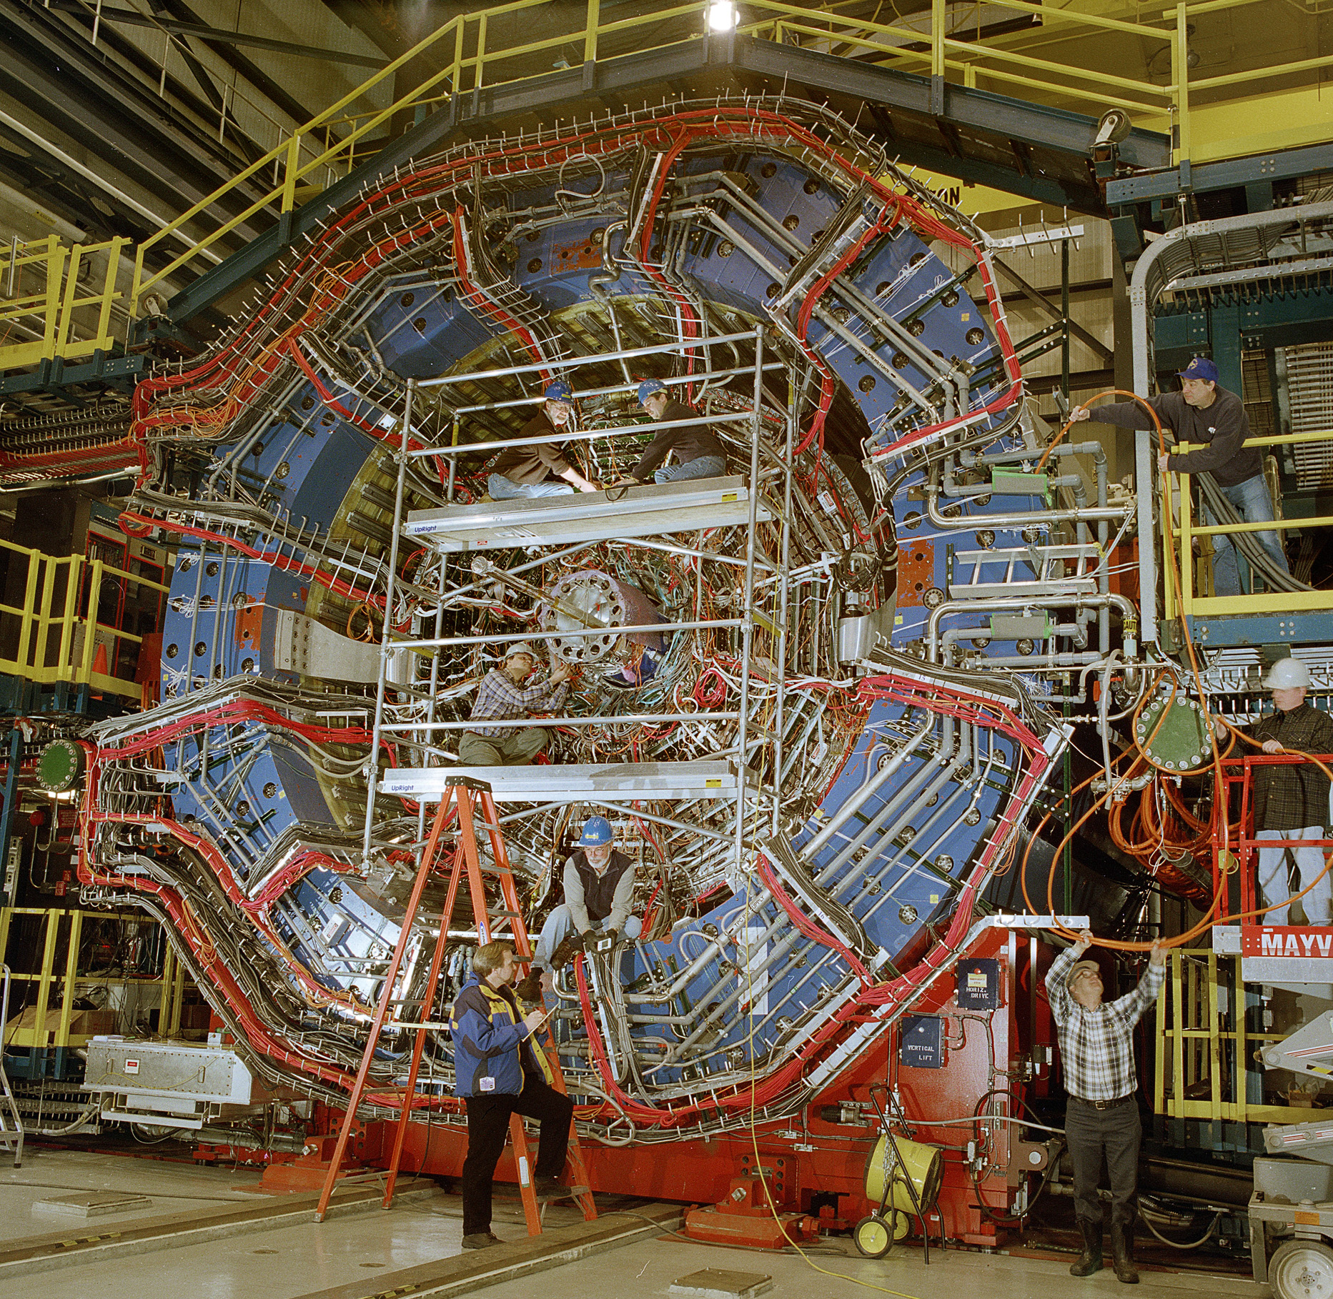
Realistic Example: Jets at STAR
STAR “Di-jet” event at “detector-level”
STAR detector in reality!
…In reality…
Strong interaction from quarks and gluons (partons)
Outgoing parton “hadronizes,” i.e. converts into spray of particles (“jet”)
Particles from the jet interact with STAR detector
STAR detector records information we can reconstruct, e.g. as electromagnetic energy or charged-particle momenta
But what we record with our detector is not reality!
Detectors are not perfect!
Energy and momenta will be “smeared” by finite resolution
Our detector may be more efficient for some processes over others (“bias”)
Need a way to unfold all of this to get back to reality

Slide 13
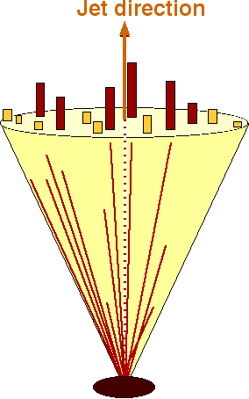
Realistic Example: Jets at STAR
Data jets MC jets
Monte Carlo Technique
Simulate collision: randomly generate events according to probabilities from theory
Simulate detector:
  Create computer model of detector, e.g. geometry, etc.
  Model response of detector to information from collision
  Smear detector-level information according to known resolution using, e.g. Gaussian distribution
Run same data analysis code over simulation!
Detector
GEANT
π⁺
e⁺
π⁰
π⁻
Particle
e⁻
Κ⁰
PYTHIA
Parton

Slide 14
Realistic Example: Jets at STAR
Proof of the pudding…
MUST see good agreement between simulation and data!
Data-M.C. comparison can be used to tune various parameters, e.g. detector resolution, non-calculable physical parameters, etc.
One clever trick:
Some backgrounds are difficult to simulate, e.g. “pile-up”
Don’t simulate them at all!
“Embed” M.C. into real data, e.g. zero-bias events that contain real pile-up

Slide 15
Realistic Example: Jets at STAR
Comparing “reconstructed” events to “generated” events can give a robust estimation of corrections, systematic uncertainties, and information for improving physics sensitivity

Slide 16
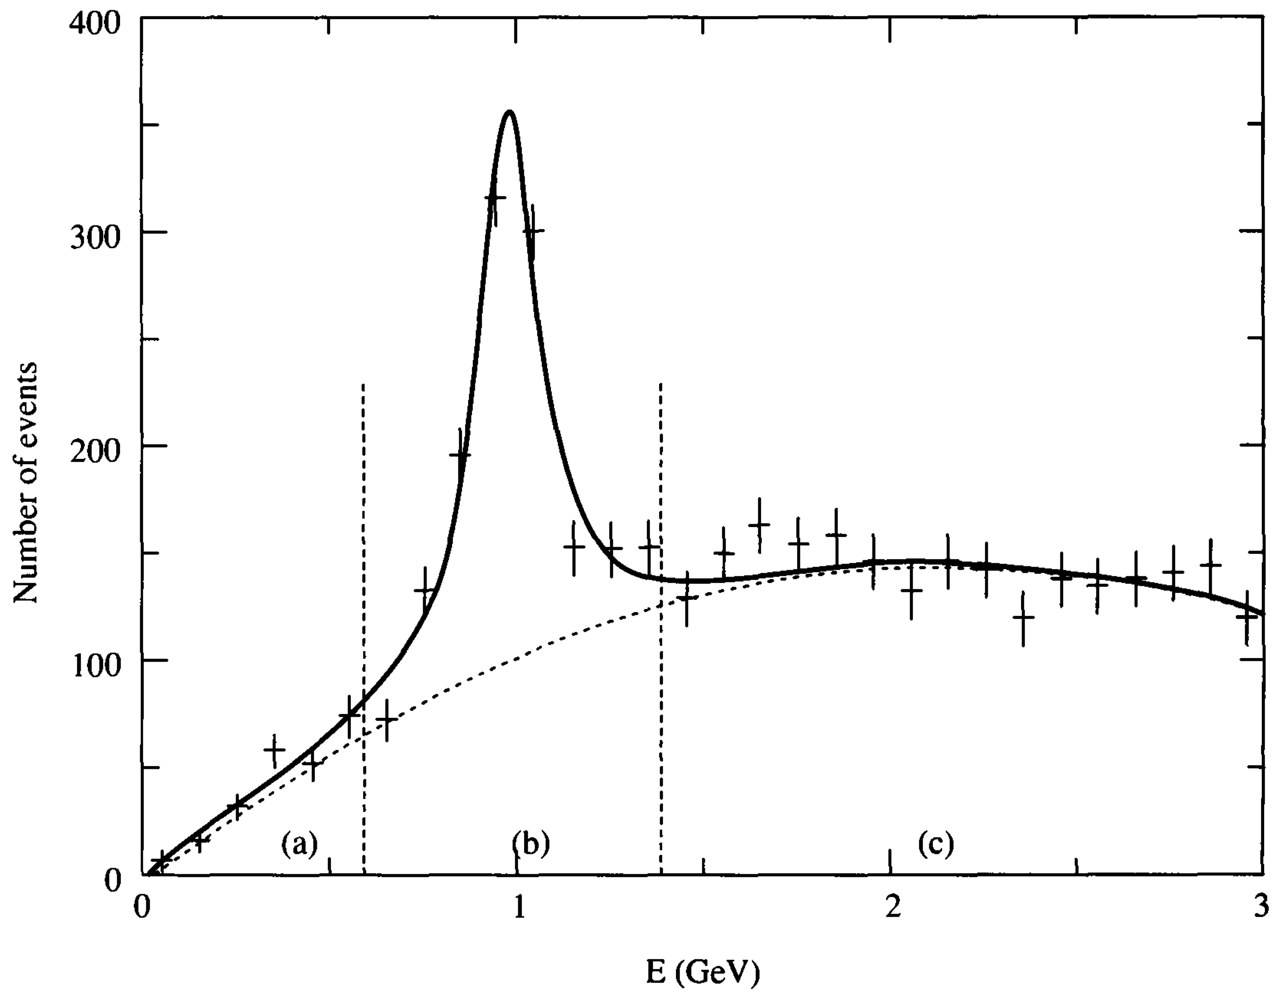
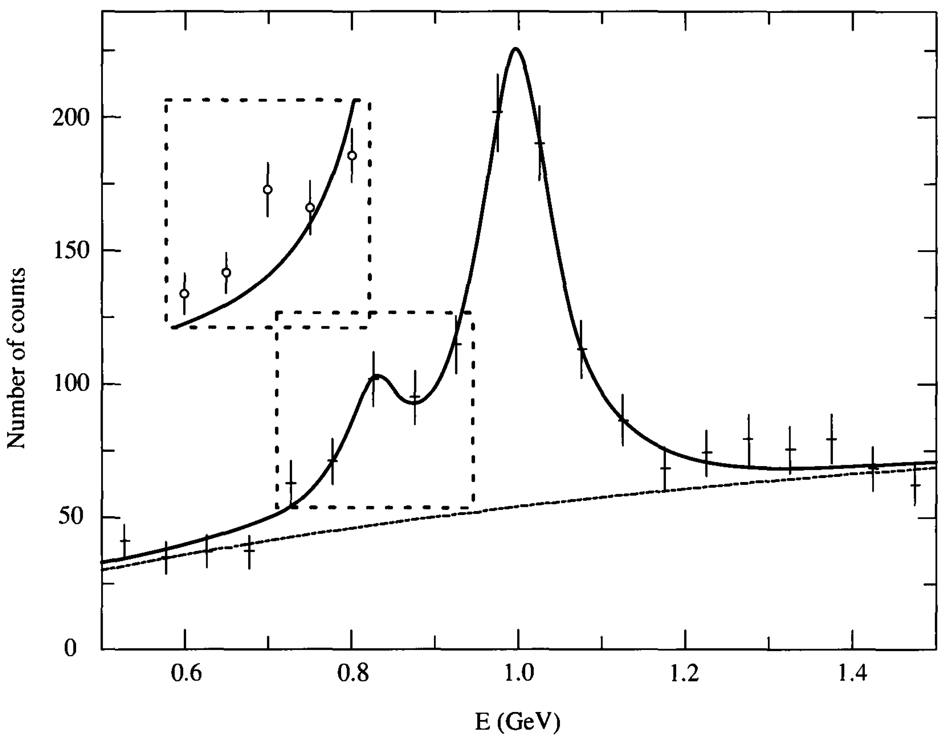



Monte Carlo Challenges
$$P_{χ^{2}}=4.4\%$$
$$P_{χ^{2}}=7.9\%$$
$$P_{χ^{2}}=29.4\%$$
Suppose we dig a bit deeper in an analysis and find a surprise!
Can Monte Carlo be used to test the likelihood of the new fit?

Slide 17
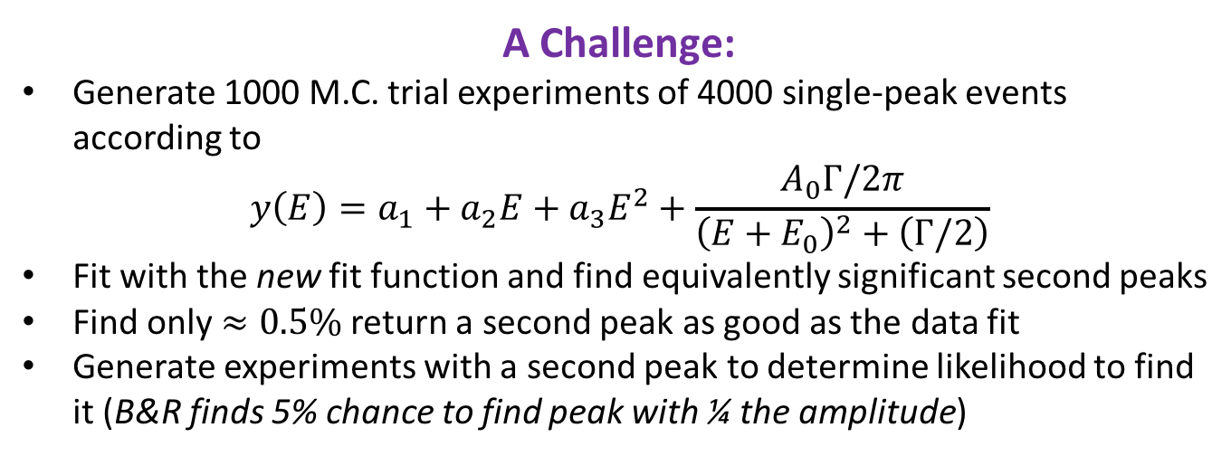
Monte Carlo Challenges
$$P_{χ^{2}}=4.4\%$$
$$P_{χ^{2}}=7.9\%$$
$$P_{χ^{2}}=29.4\%$$
A Challenge:
Generate 1000 M.C. trial experiments of 4000 single-peak events according to
$$y\left(E\right)=a_{1}+a_{2}E+a_{3}E^{2}+\frac{A_{0}Γ/2π}{{\left(E+E_{0}\right)}^{2}+\left(Γ/2\right)}$$
Fit with the new fit function and find equivalently significant second peaks
Find only $≈0.5\%$ return a second peak as good as the data fit
Generate experiments with a second peak to determine likelihood to find it (B&R finds 5% chance to find peak with ¼ the amplitude)

