Slide 1
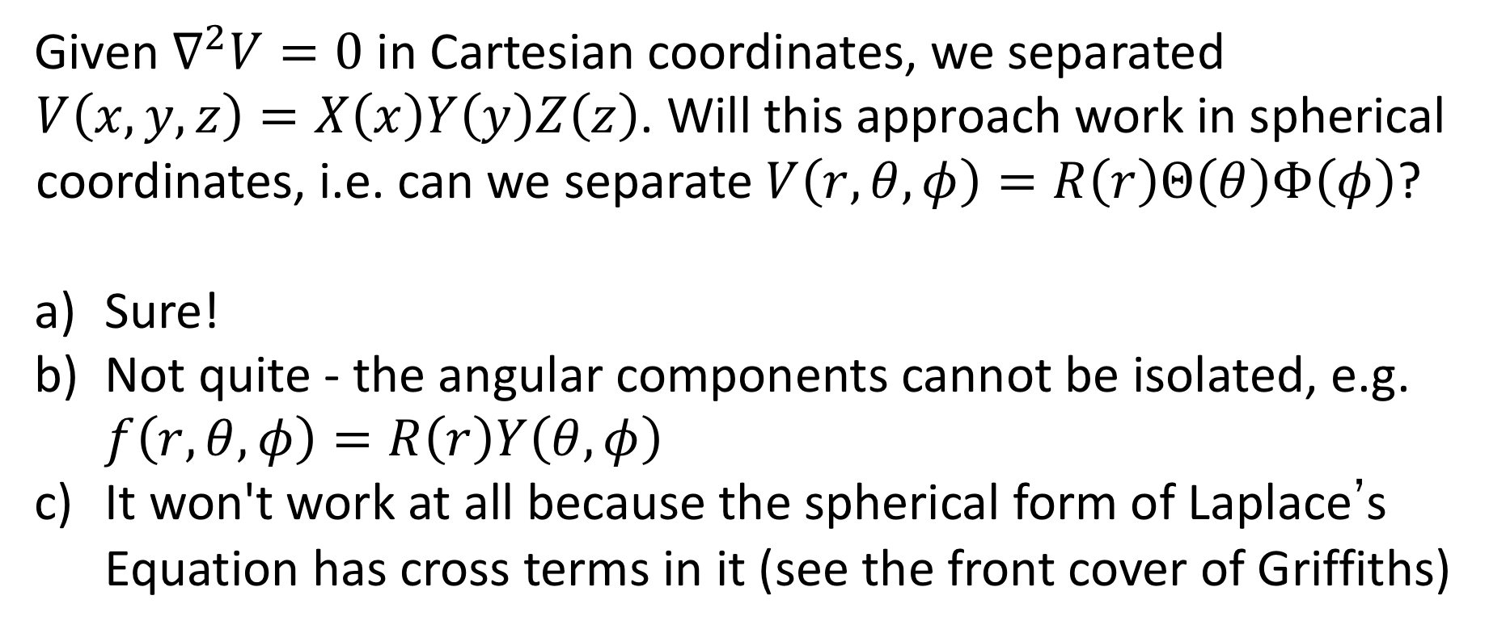
Concept Question
Given $∇^{2}V=0$ in Cartesian coordinates, we separated $V\left(x,y,z\right)=X\left(x\right)Y\left(y\right)Z\left(z\right)$. Will this approach work in spherical coordinates, i.e. can we separate $V\left(r,θ,φ\right)=R\left(r\right)Θ\left(θ\right)Φ\left(φ\right)$?
Sure!
Not quite - the angular components cannot be isolated, e.g. $f\left(r,θ,φ\right)=R\left(r\right)Y\left(θ,φ\right)$
It won't work at all because the spherical form of Laplace’s Equation has cross terms in it (see the front cover of Griffiths)
Notes:
1

Slide 2


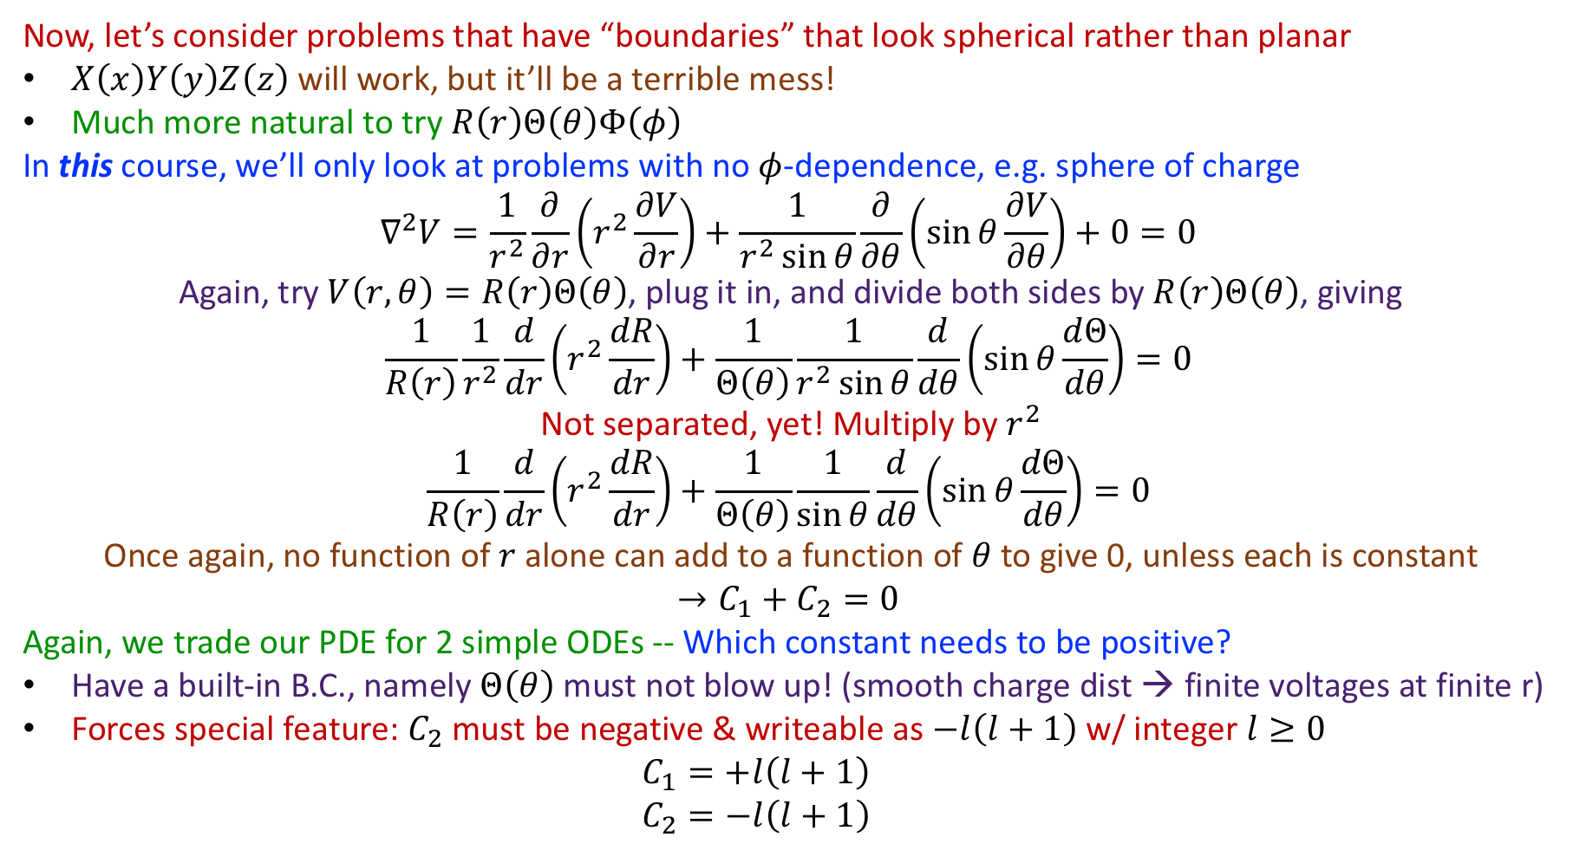












Separation of Variables
      Now, let’s consider problems that have “boundaries” that look spherical rather than planar
      $X\left(x\right)Y\left(y\right)Z\left(z\right)$ will work, but it’ll be a terrible mess!
      Much more natural to try $R\left(r\right)Θ\left(θ\right)Φ\left(φ\right)$
      In this course, we’ll only look at problems with no $φ$-dependence, e.g. sphere of charge
      $$∇^{2}V=\frac{1}{r^{2}}\frac{∂}{∂r}\left(r^{2}\frac{∂V}{∂r}\right)+\frac{1}{r^{2}\sin{θ}}\frac{∂}{∂θ}\left(\sin{θ}\frac{∂V}{∂θ}\right)+0=0$$
      Again, try $V\left(r,θ\right)=R\left(r\right)Θ\left(θ\right)$, plug it in, and divide both sides by $R\left(r\right)Θ\left(θ\right)$, giving
      $$\frac{1}{R\left(r\right)}\frac{1}{r^{2}}\frac{d}{dr}\left(r^{2}\frac{dR}{dr}\right)+\frac{1}{Θ\left(θ\right)}\frac{1}{r^{2}\sin{θ}}\frac{d}{dθ}\left(\sin{θ}\frac{dΘ}{dθ}\right)=0$$
      Not separated, yet! Multiply by $r^{2}$
      $$\frac{1}{R\left(r\right)}\frac{d}{dr}\left(r^{2}\frac{dR}{dr}\right)+\frac{1}{Θ\left(θ\right)}\frac{1}{\sin{θ}}\frac{d}{dθ}\left(\sin{θ}\frac{dΘ}{dθ}\right)=0$$
      Once again, no function of $r$ alone can add to a function of $θ$ to give 0, unless each is constant
      $$→C_{1}+C_{2}=0$$
      Again, we trade our PDE for 2 simple ODEs -- Which constant needs to be positive?
      Have a built-in B.C., namely $Θ\left(θ\right)$ must not blow up! (smooth charge dist → finite voltages at finite r)
      Forces special feature: $C_{2}$ must be negative & writeable as $−l\left(l+1\right)$ w/ integer $l≥0$
        $$C_{1}=+l\left(l+1\right)$$
        $$C_{2}=−l\left(l+1\right)$$
$$z$$
$$+$$
$$+$$
$$+$$
$$y$$
$$+$$
$$+$$
$$+$$
$$x$$
$$−$$
$$−$$
$$−$$
$$−$$
$$−$$
$$−$$
$$−$$

Slide 3

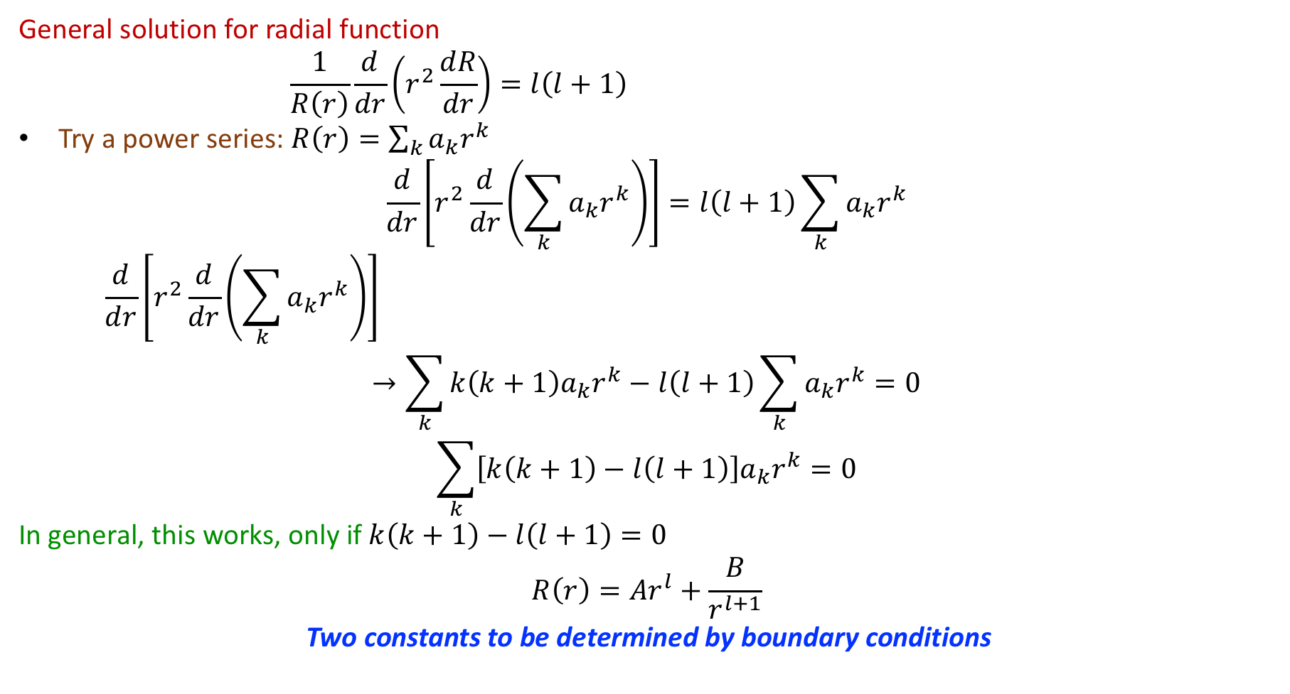
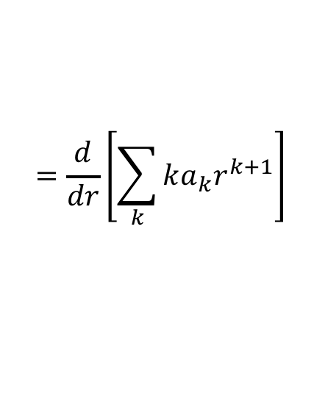

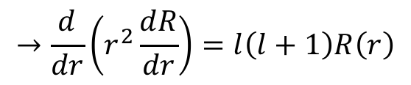

Separation of Variables
      General solution for radial function
      $$\frac{1}{R\left(r\right)}\frac{d}{dr}\left(r^{2}\frac{dR}{dr}\right)=l\left(l+1\right)$$
      Try a power series: $R\left(r\right)=\sum_{k}{a_{k}r^{k}}$
      $$\frac{d}{dr}\left[r^{2}\frac{d}{dr}\left(\sum_{k}{a_{k}r^{k}}\right)\right]=l\left(l+1\right)\sum_{k}{a_{k}r^{k}}$$
      $$\frac{d}{dr}\left[r^{2}\frac{d}{dr}\left(\sum_{k}{a_{k}r^{k}}\right)\right]$$
      $$→\sum_{k}{k\left(k+1\right)a_{k}r^{k}}−l\left(l+1\right)\sum_{k}{a_{k}r^{k}}=0$$
      $$\sum_{k}{\left[k\left(k+1\right)−l\left(l+1\right)\right]a_{k}r^{k}}=0$$
      In general, this works, only if $k\left(k+1\right)−l\left(l+1\right)=0$
      $$R\left(r\right)=Ar^{l}+\frac{B}{r^{l+1}}$$
      Two constants to be determined by boundary conditions
$$z$$
$$→\frac{d}{dr}\left(r^{2}\frac{dR}{dr}\right)=l\left(l+1\right)R\left(r\right)$$
$$+$$
$$+$$
$$+$$
$$+$$
$$y$$
$$+$$
$$+$$
$$x$$
$$−$$
$$−$$
$$−$$
$$−$$
$$−$$
$$−$$
$$−$$
$$=\frac{d}{dr}\left[r^{2}\sum_{k}{ka_{k}r^{k−1}}\right]$$
$$=\frac{d}{dr}\left[\sum_{k}{ka_{k}r^{k+1}}\right]$$
$$=\sum_{k}{k\left(k+1\right)a_{k}r^{k}}$$
→ $k=l$ or $k=−\left(l+1\right)$!

Slide 4
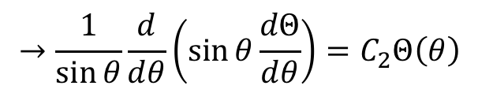
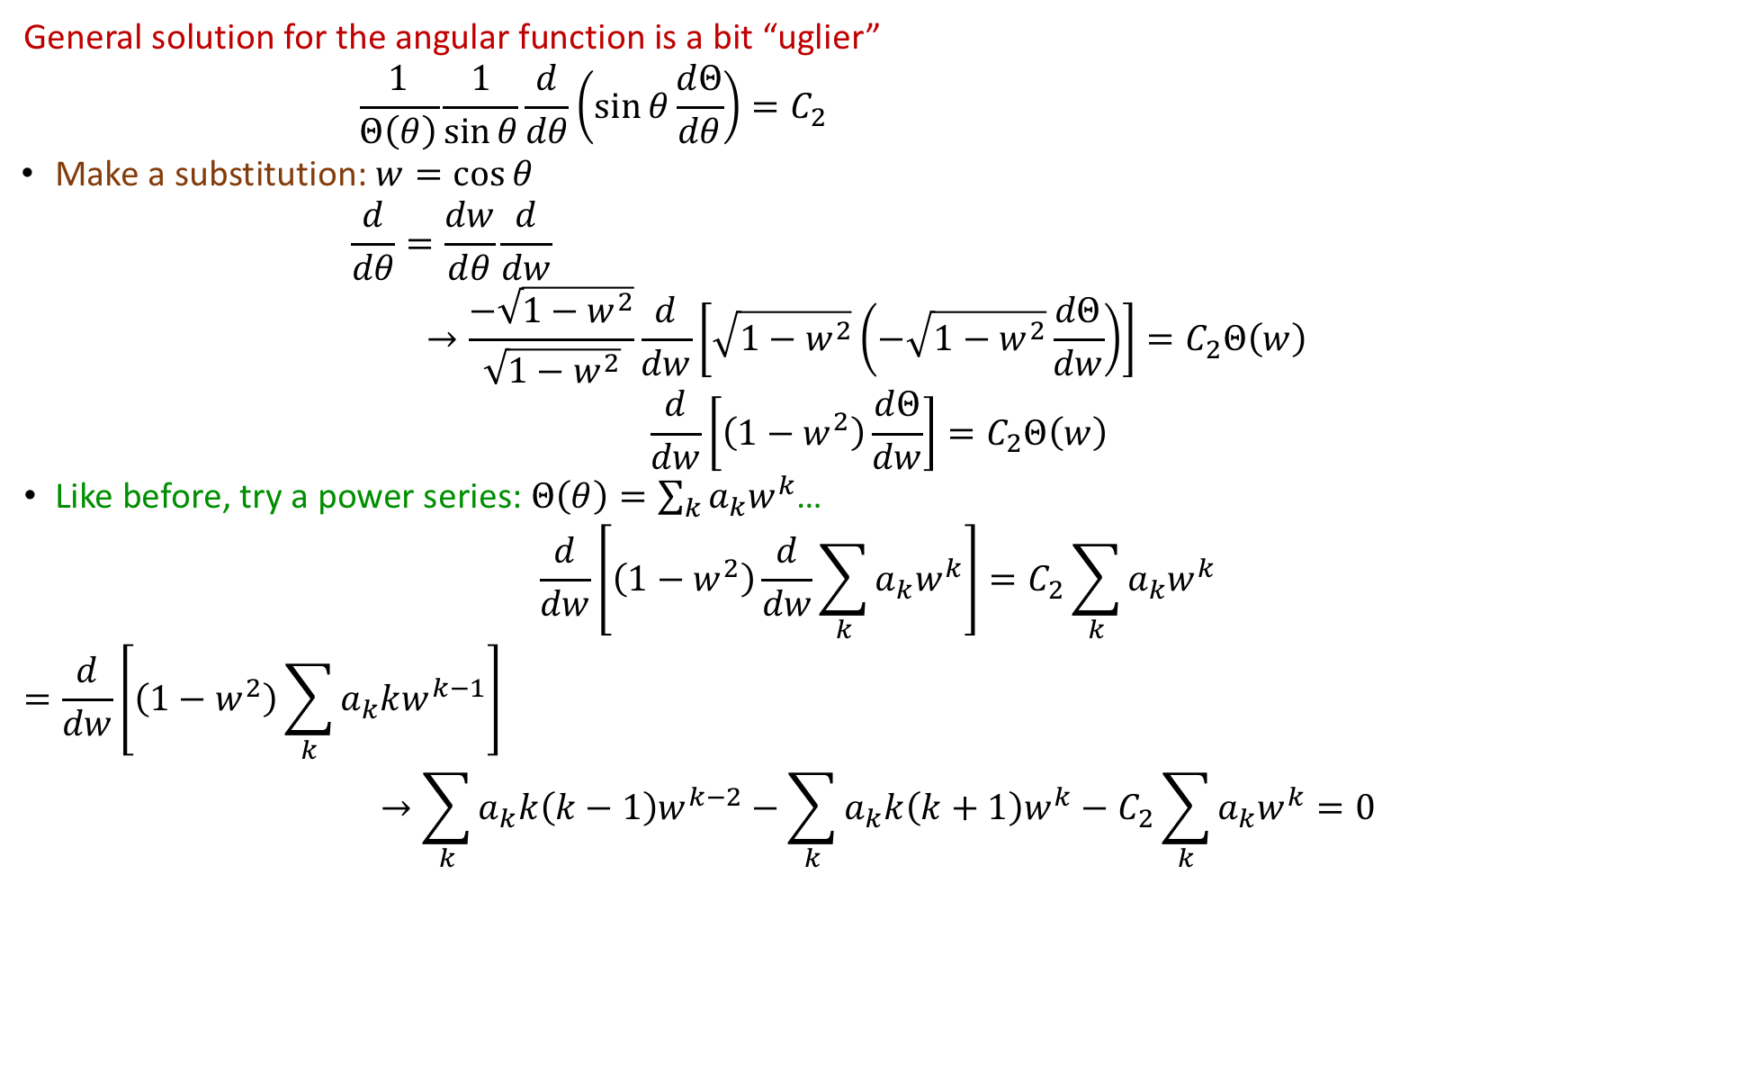
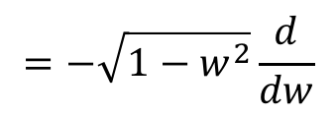
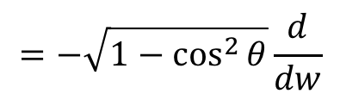
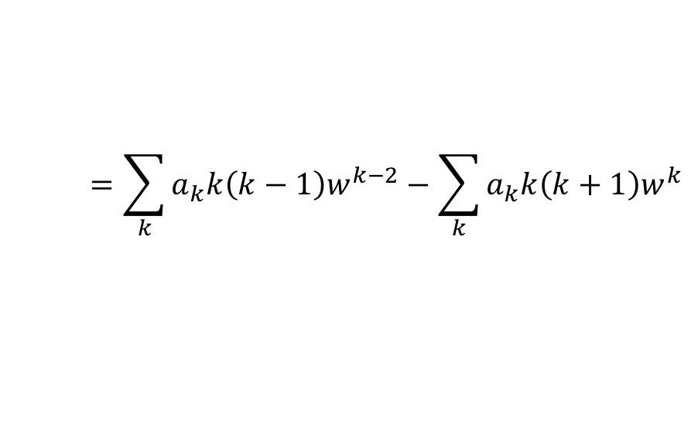
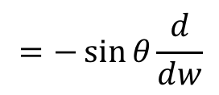
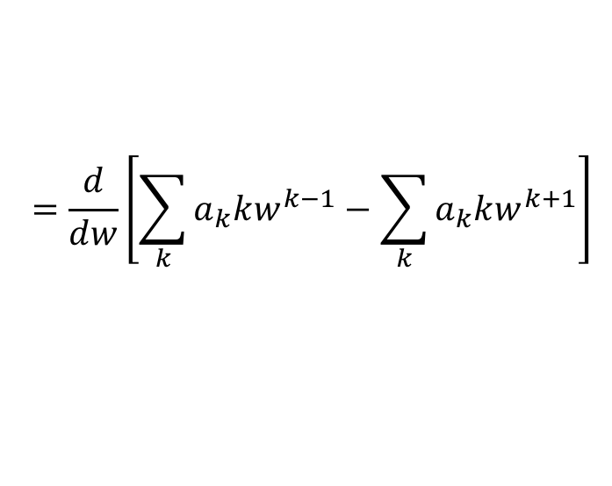
Separation of Variables
      General solution for the angular function is a bit “uglier”
      $$\frac{1}{Θ\left(θ\right)}\frac{1}{\sin{θ}}\frac{d}{dθ}\left(\sin{θ}\frac{dΘ}{dθ}\right)=C_{2}$$
Make a substitution: $w=\cos{θ}$
$$\frac{d}{dθ}=\frac{dw}{dθ}\frac{d}{dw}$$
$$→\frac{−\sqrt{1−w^{2}}}{\sqrt{1−w^{2}}}\frac{d}{dw}\left[\sqrt{1−w^{2}}\left(−\sqrt{1−w^{2}}\frac{dΘ}{dw}\right)\right]=C_{2}Θ\left(w\right)$$
$$\frac{d}{dw}\left[\left(1−w^{2}\right)\frac{dΘ}{dw}\right]=C_{2}Θ\left(w\right)$$
      Like before, try a power series: $Θ\left(θ\right)=\sum_{k}{a_{k}w^{k}}$…
      $$\frac{d}{dw}\left[\left(1−w^{2}\right)\frac{d}{dw}\sum_{k}{a_{k}w^{k}}\right]=C_{2}\sum_{k}{a_{k}w^{k}}$$
      $$=\frac{d}{dw}\left[\left(1−w^{2}\right)\sum_{k}{a_{k}kw^{k−1}}\right]$$
      $$→\sum_{k}{a_{k}k\left(k−1\right)w^{k−2}}−\sum_{k}{a_{k}k\left(k+1\right)w^{k}}−C_{2}\sum_{k}{a_{k}w^{k}}=0$$
$$z$$
$$→\frac{1}{\sin{θ}}\frac{d}{dθ}\left(\sin{θ}\frac{dΘ}{dθ}\right)=C_{2}Θ\left(θ\right)$$
$$+$$
$$+$$
$$+$$
$$+$$
$$y$$
$$+$$
$$+$$
$$x$$
$$=−\sin{θ}\frac{d}{dw}$$
$$=−\sqrt{1−\cos^{2}{θ}}\frac{d}{dw}$$
$$=−\sqrt{1−w^{2}}\frac{d}{dw}$$
$$−$$
$$−$$
$$−$$
$$−$$
$$−$$
$$−$$
$$−$$
$$=\frac{d}{dw}\left[\sum_{k}{a_{k}kw^{k−1}}−\sum_{k}{a_{k}kw^{k+1}}\right]$$
$$=\sum_{k}{a_{k}k\left(k−1\right)w^{k−2}}−\sum_{k}{a_{k}k\left(k+1\right)w^{k}}$$

Slide 5
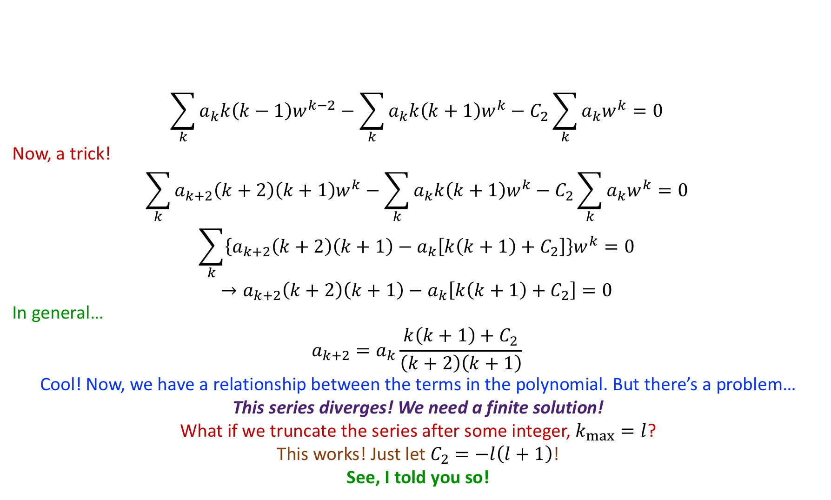
Separation of Variables
$$z$$
      $$\sum_{k}{a_{k}k\left(k−1\right)w^{k−2}}−\sum_{k}{a_{k}k\left(k+1\right)w^{k}}−C_{2}\sum_{k}{a_{k}w^{k}}=0$$
      Now, a trick!
      $$\sum_{k}{a_{k+2}\left(k+2\right)\left(k+1\right)w^{k}}−\sum_{k}{a_{k}k\left(k+1\right)w^{k}}−C_{2}\sum_{k}{a_{k}w^{k}}=0$$
      $$\sum_{k}{\left\{a_{k+2}\left(k+2\right)\left(k+1\right)−a_{k}\left[k\left(k+1\right)+C_{2}\right]\right\}w^{k}}=0$$
      $$→a_{k+2}\left(k+2\right)\left(k+1\right)−a_{k}\left[k\left(k+1\right)+C_{2}\right]=0$$
      In general…
      $$a_{k+2}=a_{k}\frac{k\left(k+1\right)+C_{2}}{\left(k+2\right)\left(k+1\right)}$$
      Cool! Now, we have a relationship between the terms in the polynomial. But there’s a problem…
      This series diverges! We need a finite solution!
      What if we truncate the series after some integer, $k_{max}=l$?
      This works! Just let $C_{2}=−l\left(l+1\right)$!
      See, I told you so!
$$+$$
$$+$$
$$+$$
$$y$$
$$+$$
$$+$$
$$+$$
$$x$$
$$−$$
$$−$$
$$−$$
$$−$$
$$−$$
$$−$$
$$−$$

Slide 6
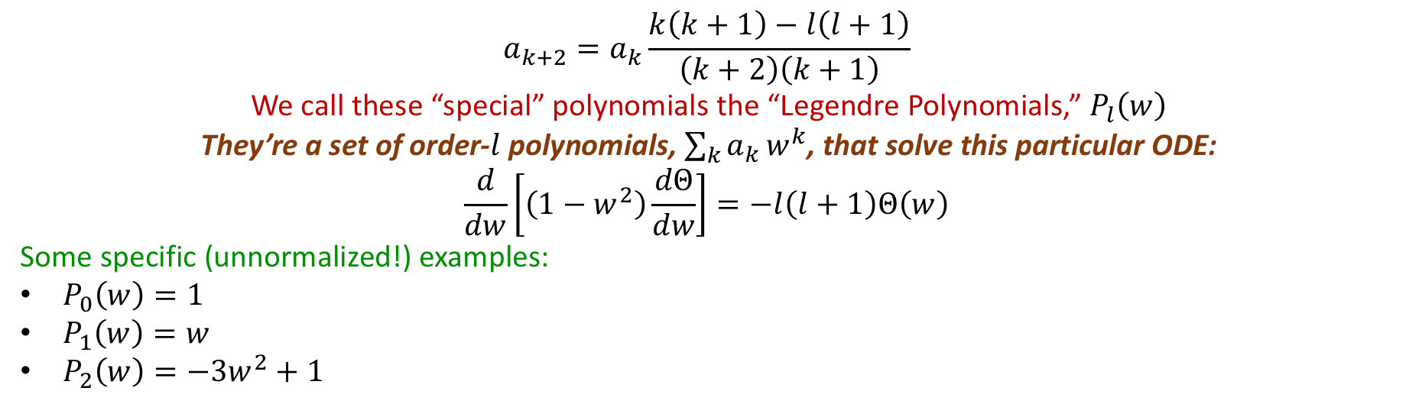
Separation of Variables
$$z$$
      $$a_{k+2}=a_{k}\frac{k\left(k+1\right)−l\left(l+1\right)}{\left(k+2\right)\left(k+1\right)}$$
      We call these “special” polynomials the “Legendre Polynomials,” $P_{l}\left(w\right)$
      They’re a set of order-$l$ polynomials, $\sum_{k}{a_{k}}w^{k}$, that solve this particular ODE:
      $$\frac{d}{dw}\left[\left(1−w^{2}\right)\frac{dΘ}{dw}\right]=−l\left(l+1\right)Θ\left(w\right)$$
      Some specific (unnormalized!) examples:
      $P_{0}\left(w\right)=1$
      $P_{1}\left(w\right)=w$
      $P_{2}\left(w\right)=−3w^{2}+1$
$$+$$
$$+$$
$$+$$
$$y$$
$$+$$
$$+$$
$$+$$
$$x$$
$$−$$
$$−$$
$$−$$
$$−$$
$$−$$
$$−$$
$$−$$

Slide 7
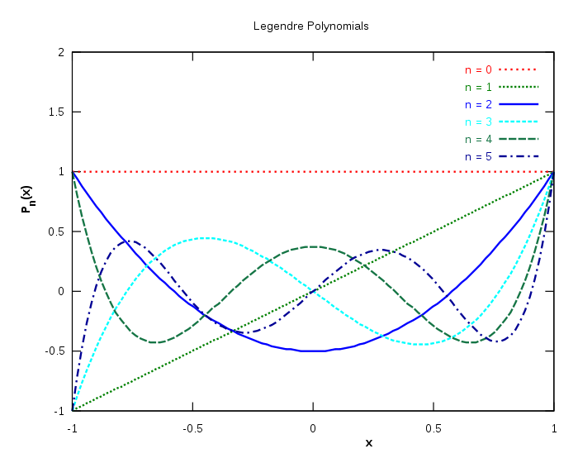
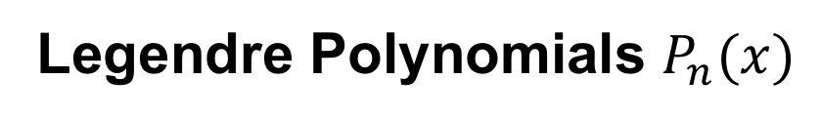
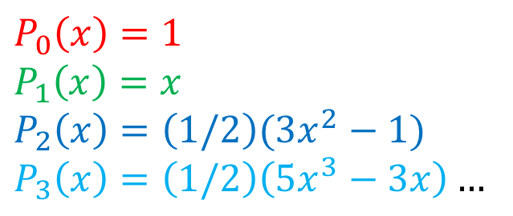
Separation of Variables
Legendre Polynomials $P_{n}(x)$
$$P_{0}\left(x\right)=1$$
$$P_{1}\left(x\right)=x$$
$$P_{2}\left(x\right)=\left(1/2\right)(3x^{2}−1)$$
$$P_{3}\left(x\right)=\left(1/2\right)\left(5x^{3}−3x\right)…$$

Slide 8
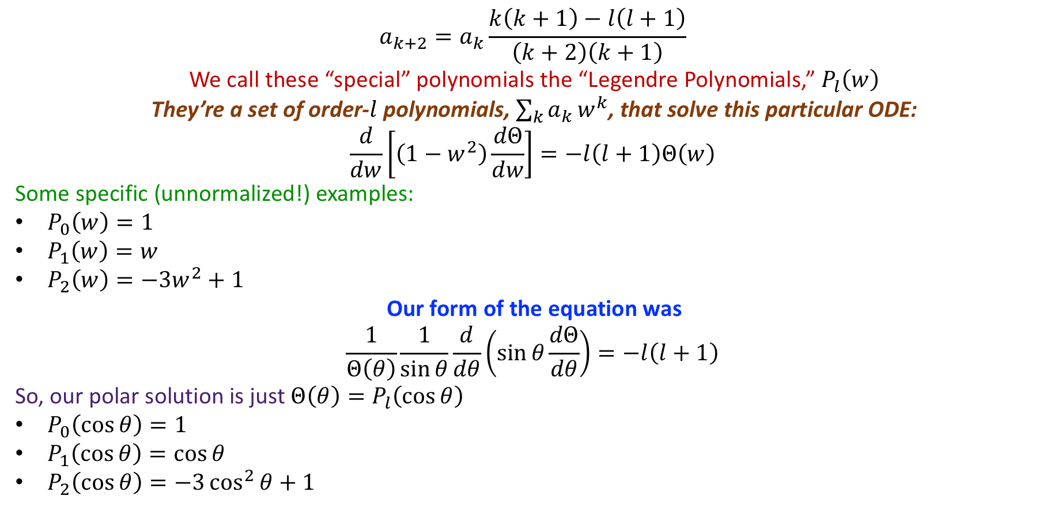
Separation of Variables
$$z$$
      $$a_{k+2}=a_{k}\frac{k\left(k+1\right)−l\left(l+1\right)}{\left(k+2\right)\left(k+1\right)}$$
      We call these “special” polynomials the “Legendre Polynomials,” $P_{l}\left(w\right)$
      They’re a set of order-$l$ polynomials, $\sum_{k}{a_{k}}w^{k}$, that solve this particular ODE:
      $$\frac{d}{dw}\left[\left(1−w^{2}\right)\frac{dΘ}{dw}\right]=−l\left(l+1\right)Θ\left(w\right)$$
      Some specific (unnormalized!) examples:
      $P_{0}\left(w\right)=1$
      $P_{1}\left(w\right)=w$
      $P_{2}\left(w\right)=−3w^{2}+1$
      Our form of the equation was
      $$\frac{1}{Θ\left(θ\right)}\frac{1}{\sin{θ}}\frac{d}{dθ}\left(\sin{θ}\frac{dΘ}{dθ}\right)=−l\left(l+1\right)$$
      So, our polar solution is just $Θ\left(θ\right)=P_{l}\left(\cos{θ}\right)$
      $P_{0}\left(\cos{θ}\right)=1$
      $P_{1}\left(\cos{θ}\right)=\cos{θ}$
      $P_{2}\left(\cos{θ}\right)=−3\cos^{2}{θ}+1$
$$+$$
$$+$$
$$+$$
$$y$$
$$+$$
$$+$$
$$+$$
$$x$$
$$−$$
$$−$$
$$−$$
$$−$$
$$−$$
$$−$$
$$−$$

Slide 9
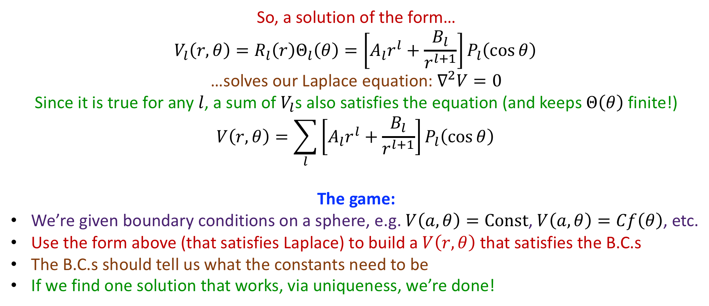

Separation of Variables
$$z$$
$$+$$
$$+$$
      So, a solution of the form…
      $$V_{l}\left(r,θ\right)=R_{l}\left(r\right)Θ_{l}\left(θ\right)=\left[A_{l}r^{l}+\frac{B_{l}}{r^{l+1}}\right]P_{l}\left(\cos{θ}\right)$$
      …solves our Laplace equation: $∇^{2}V=0$
      Since it is true for any $l$, a sum of $V_{l}$s also satisfies the equation (and keeps $Θ\left(θ\right)$ finite!)
      $$V\left(r,θ\right)=\sum_{l}{\left[A_{l}r^{l}+\frac{B_{l}}{r^{l+1}}\right]P_{l}\left(\cos{θ}\right)}$$
      The game:
      We’re given boundary conditions on a sphere, e.g. $V\left(a,θ\right)=Const$, $V\left(a,θ\right)=Cf\left(θ\right)$, etc.
      Use the form above (that satisfies Laplace) to build a $V\left(r,θ\right)$ that satisfies the B.C.s
      The B.C.s should tell us what the constants need to be
      If we find one solution that works, via uniqueness, we’re done!
$$+$$
$$+$$
$$y$$
$$+$$
$$+$$
$$x$$
$$−$$
$$−$$
$$−$$
$$−$$
$$−$$
$$−$$
$$−$$

Slide 10
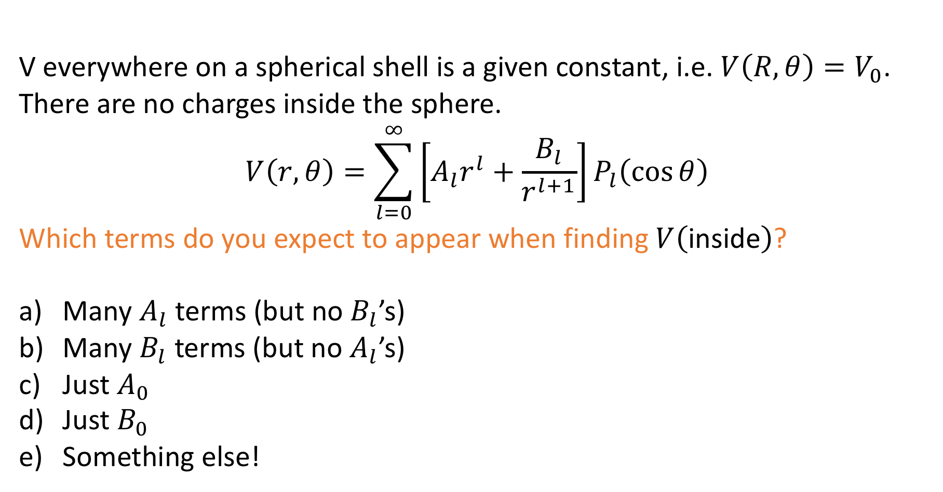
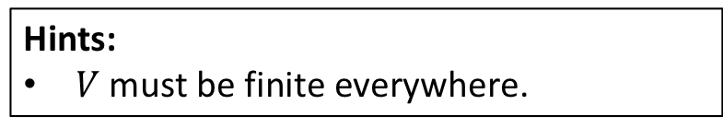
Concept Question
V everywhere on a spherical shell is a given constant, i.e. $V\left(R,θ\right)=V_{0}$. There are no charges inside the sphere.
$$V\left(r,θ\right)=\sum_{l=0}^{∞}{\left[A_{l}r^{l}+\frac{B_{l}}{r^{l+1}}\right]P_{l}\left(\cos{θ}\right)}$$
Which terms do you expect to appear when finding $V\left(\text{inside}\right)$?
Many $A_{l}$ terms (but no $B_{l}$’s)
Many $B_{l}$ terms (but no $A_{l}$’s)
Just $A_{0}$
Just $B_{0}$
Something else!
Hints:
$V$ must be finite everywhere.

Slide 11
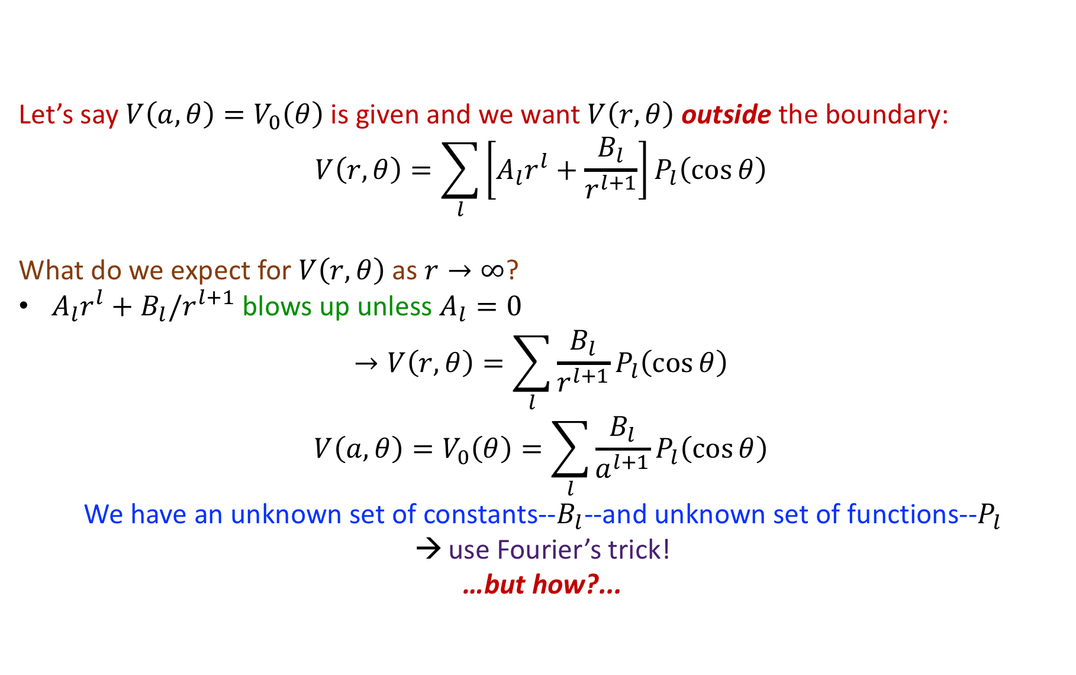

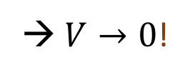


Separation of Variables
      Let’s say $V\left(a,θ\right)=V_{0}\left(θ\right)$ is given and we want $V\left(r,θ\right)$ outside the boundary:
      $$V\left(r,θ\right)=\sum_{l}{\left[A_{l}r^{l}+\frac{B_{l}}{r^{l+1}}\right]P_{l}\left(\cos{θ}\right)}$$
      What do we expect for $V\left(r,θ\right)$ as $r→∞$?
      $A_{l}r^{l}+B_{l}/r^{l+1}$ blows up unless $A_{l}=0$
      $$→V\left(r,θ\right)=\sum_{l}{\frac{B_{l}}{r^{l+1}}P_{l}\left(\cos{θ}\right)}$$
      $$V\left(a,θ\right)=V_{0}\left(θ\right)=\sum_{l}{\frac{B_{l}}{a^{l+1}}P_{l}\left(\cos{θ}\right)}$$
      We have an unknown set of constants--$B_{l}$--and unknown set of functions--$P_{l}$
      use Fourier’s trick!
      …but how?...
$$z$$
$$V_{0}\left(θ\right)$$
$$y$$
$$a$$
$$x$$
→ $V→0$!

Slide 12




Separation of Variables
$$z$$
$$V_{0}\left(θ\right)$$
      It turns out (can be proven—and you will, at some point—but let’s just accept it, for now)
      $$\int_{−1}^{1}{P_{l}\left(x\right)P_{l^{′}}\left(x\right)dx}=\frac{2}{2l+1}δ_{ll^{′}}$$
$$y$$
$$a$$
$$x$$

Slide 13
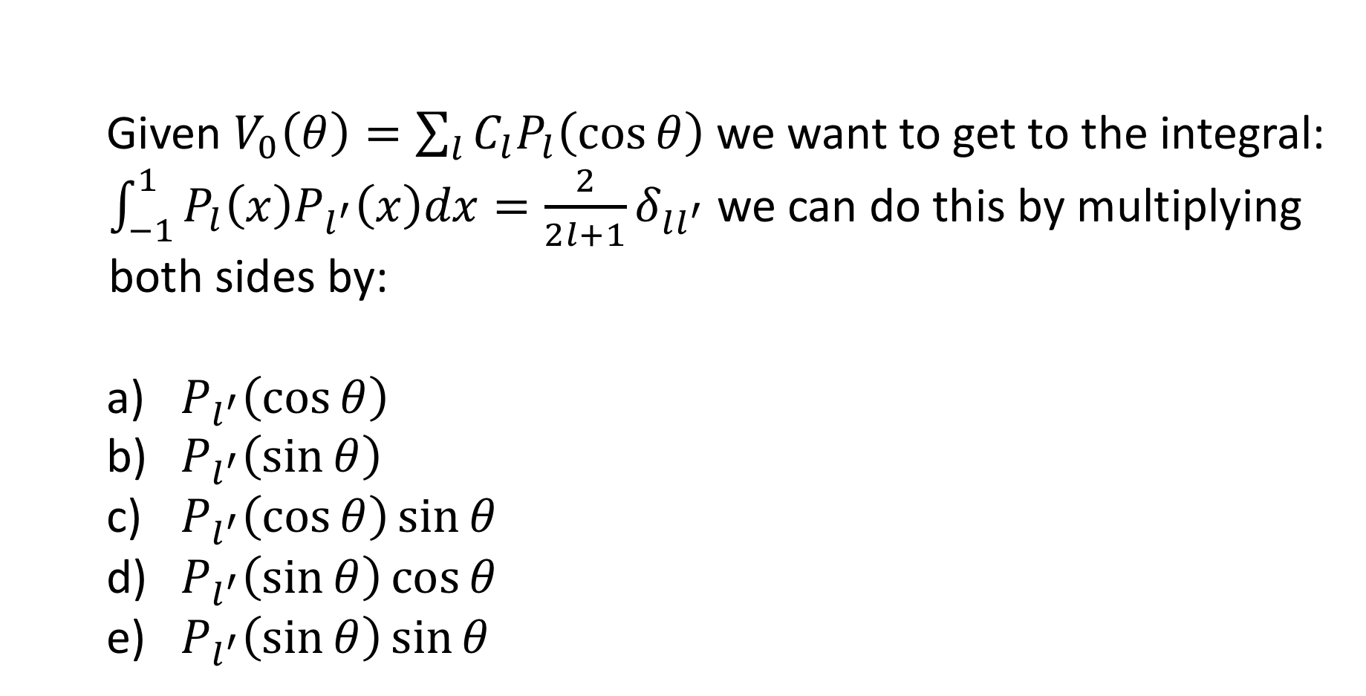
Concept Question
Given $V_{0}\left(θ\right)=\sum_{l}{C_{l}P_{l}\left(\cos{θ}\right)}$ we want to get to the integral: $\int_{−1}^{1}{P_{l}\left(x\right)P_{l^{′}}\left(x\right)dx}=\frac{2}{2l+1}δ_{ll^{′}}$ we can do this by multiplying both sides by:
$P_{l^{′}}\left(\cos{θ}\right)$
$P_{l^{′}}\left(\sin{θ}\right)$
$P_{l^{′}}\left(\cos{θ}\right)\sin{θ}$
$P_{l^{′}}\left(\sin{θ}\right)\cos{θ}$
$P_{l^{′}}\left(\sin{θ}\right)\sin{θ}$
Notes:
13

Slide 14

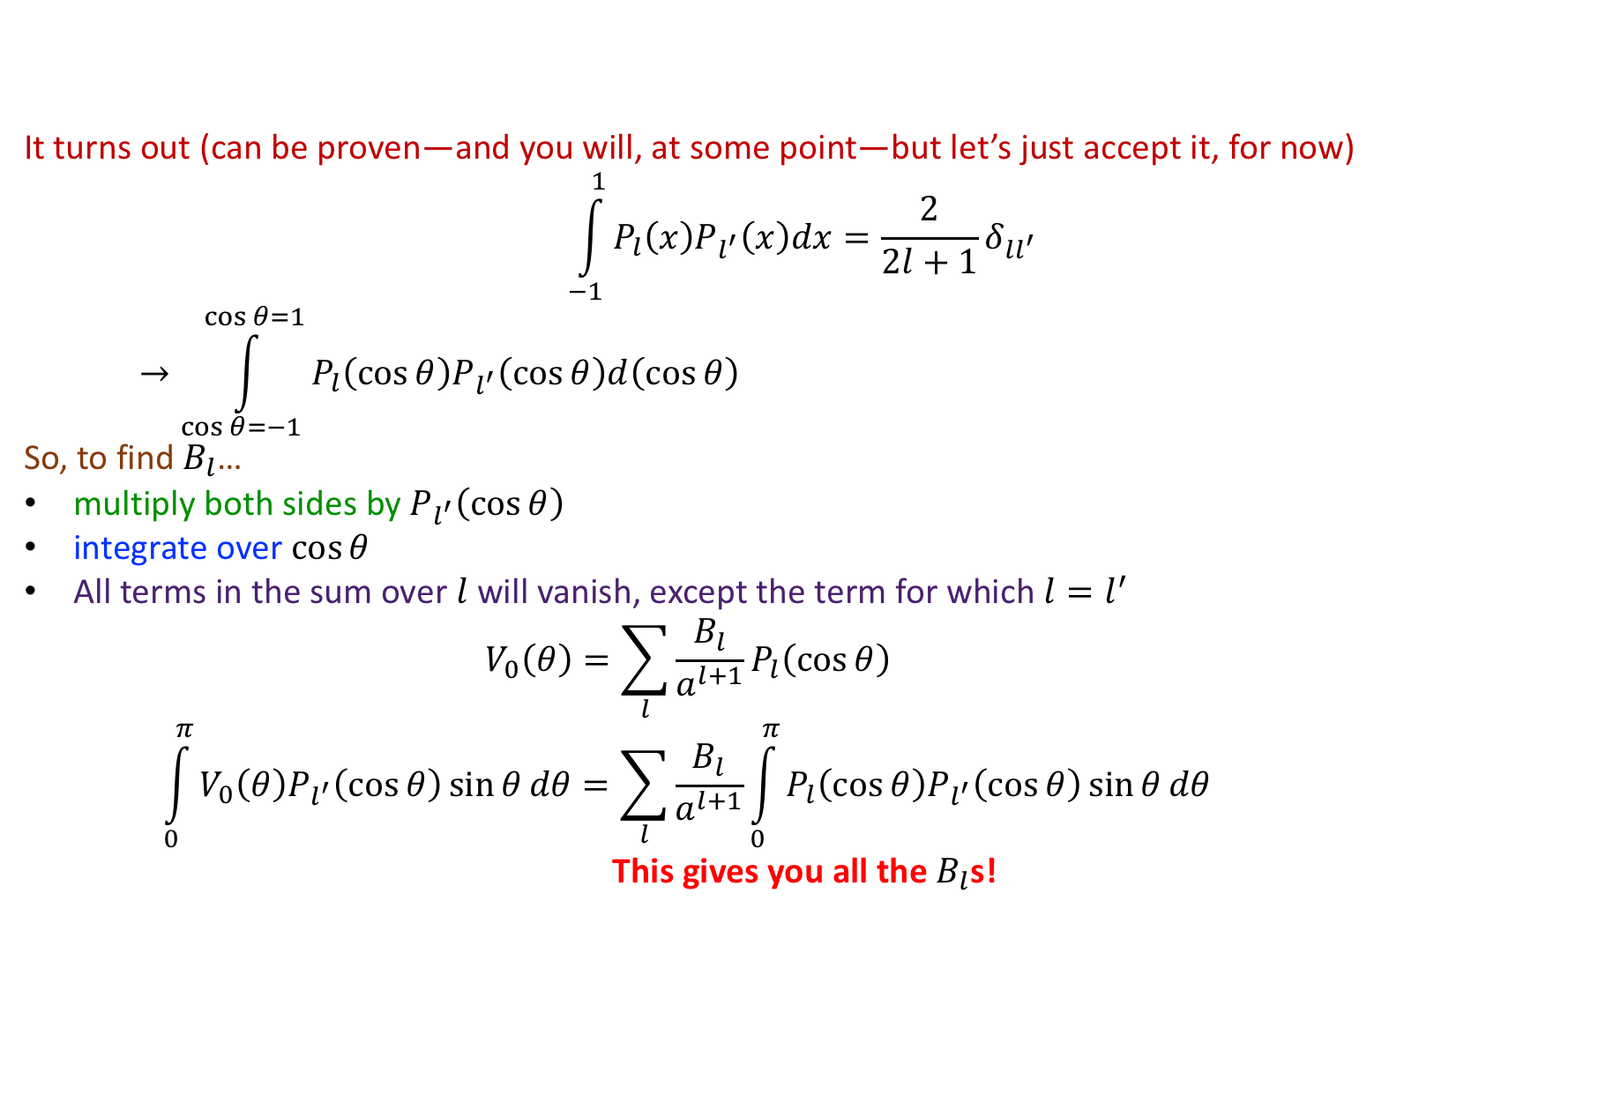
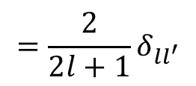
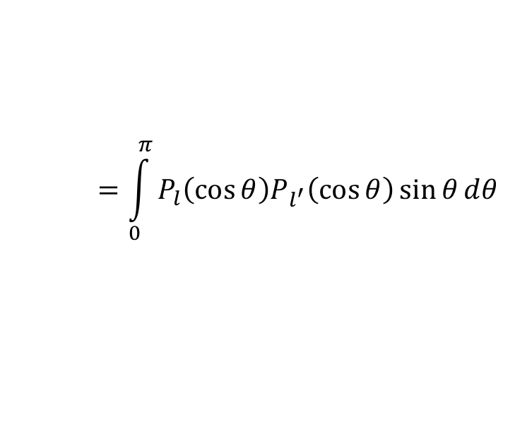
Separation of Variables
$$z$$
$$V_{0}\left(θ\right)$$
      It turns out (can be proven—and you will, at some point—but let’s just accept it, for now)
      $$\int_{−1}^{1}{P_{l}\left(x\right)P_{l^{′}}\left(x\right)dx}=\frac{2}{2l+1}δ_{ll^{′}}$$
      $$→\int_{\cos{θ}=−1}^{\cos{θ}=1}{P_{l}\left(\cos{θ}\right)P_{l^{′}}\left(\cos{θ}\right)d\left(\cos{θ}\right)}$$
      So, to find $B_{l}$…
      multiply both sides by $P_{l^{′}}\left(\cos{θ}\right)$
      integrate over $\cos{θ}$
      All terms in the sum over $l$ will vanish, except the term for which $l=l^{′}$
      $$V_{0}\left(θ\right)=\sum_{l}{\frac{B_{l}}{a^{l+1}}P_{l}\left(\cos{θ}\right)}$$
      $$\int_{0}^{π}{V_{0}\left(θ\right)P_{l^{′}}\left(\cos{θ}\right)\sin{θ}dθ}=\sum_{l}{\frac{B_{l}}{a^{l+1}}\int_{0}^{π}{P_{l}\left(\cos{θ}\right)P_{l^{′}}\left(\cos{θ}\right)\sin{θ}dθ}}$$
      This gives you all the $B_{l}$s!
$$y$$
$$a$$
$$x$$
$$=\int_{0}^{π}{P_{l}\left(\cos{θ}\right)P_{l^{′}}\left(\cos{θ}\right)\sin{θ}dθ}$$
$$=\frac{2}{2l+1}δ_{ll^{′}}$$
$$=\frac{B_{l^{′}}}{a^{l^{′}+1}}\frac{2}{2l+1}$$

Slide 15
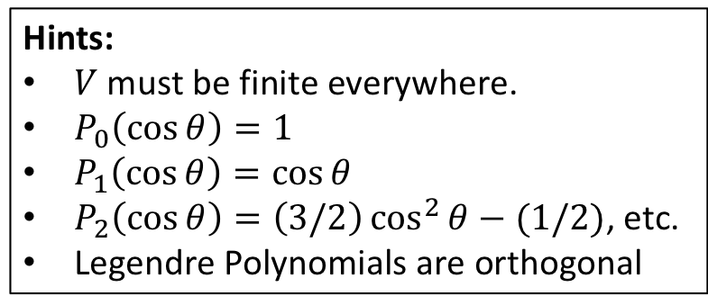
Concept Question
V everywhere on a spherical shell is a given constant, i.e. $V\left(R,θ\right)=V_{0}$. There are no charges inside the sphere.
$$V\left(r,θ\right)=\sum_{l=0}^{∞}{\left[A_{l}r^{l}+\frac{B_{l}}{r^{l+1}}\right]P_{l}\left(\cos{θ}\right)}$$
Which terms do you expect to appear when finding $V\left(\text{inside}\right)$?
Many $A_{l}$ terms (but no $B_{l}$’s)
Many $B_{l}$ terms (but no $A_{l}$’s)
Just $A_{0}$
Just $B_{0}$
Something else!
Hints:
$V$ must be finite everywhere.
$P_{0}\left(\cos{θ}\right)=1$
$P_{1}\left(\cos{θ}\right)=\cos{θ}$
$P_{2}\left(\cos{θ}\right)=\left(3/2\right)\cos^{2}{θ}−(1/2)$, etc.
Legendre Polynomials are orthogonal

Slide 16

Concept Question
V everywhere on a spherical shell is a given constant, i.e. $V\left(R,θ\right)=V_{0}$. There are no charges inside the sphere.
$$V\left(r,θ\right)=\sum_{l=0}^{∞}{\left[A_{l}r^{l}+\frac{B_{l}}{r^{l+1}}\right]P_{l}\left(\cos{θ}\right)}$$
Which terms do you expect to appear when finding $V\left(\text{out}\text{side}\right)$?
Many $A_{l}$ terms (but no $B_{l}$’s)
Many $B_{l}$ terms (but no $A_{l}$’s)
Just $A_{0}$
Just $B_{0}$
Something else!

Slide 17
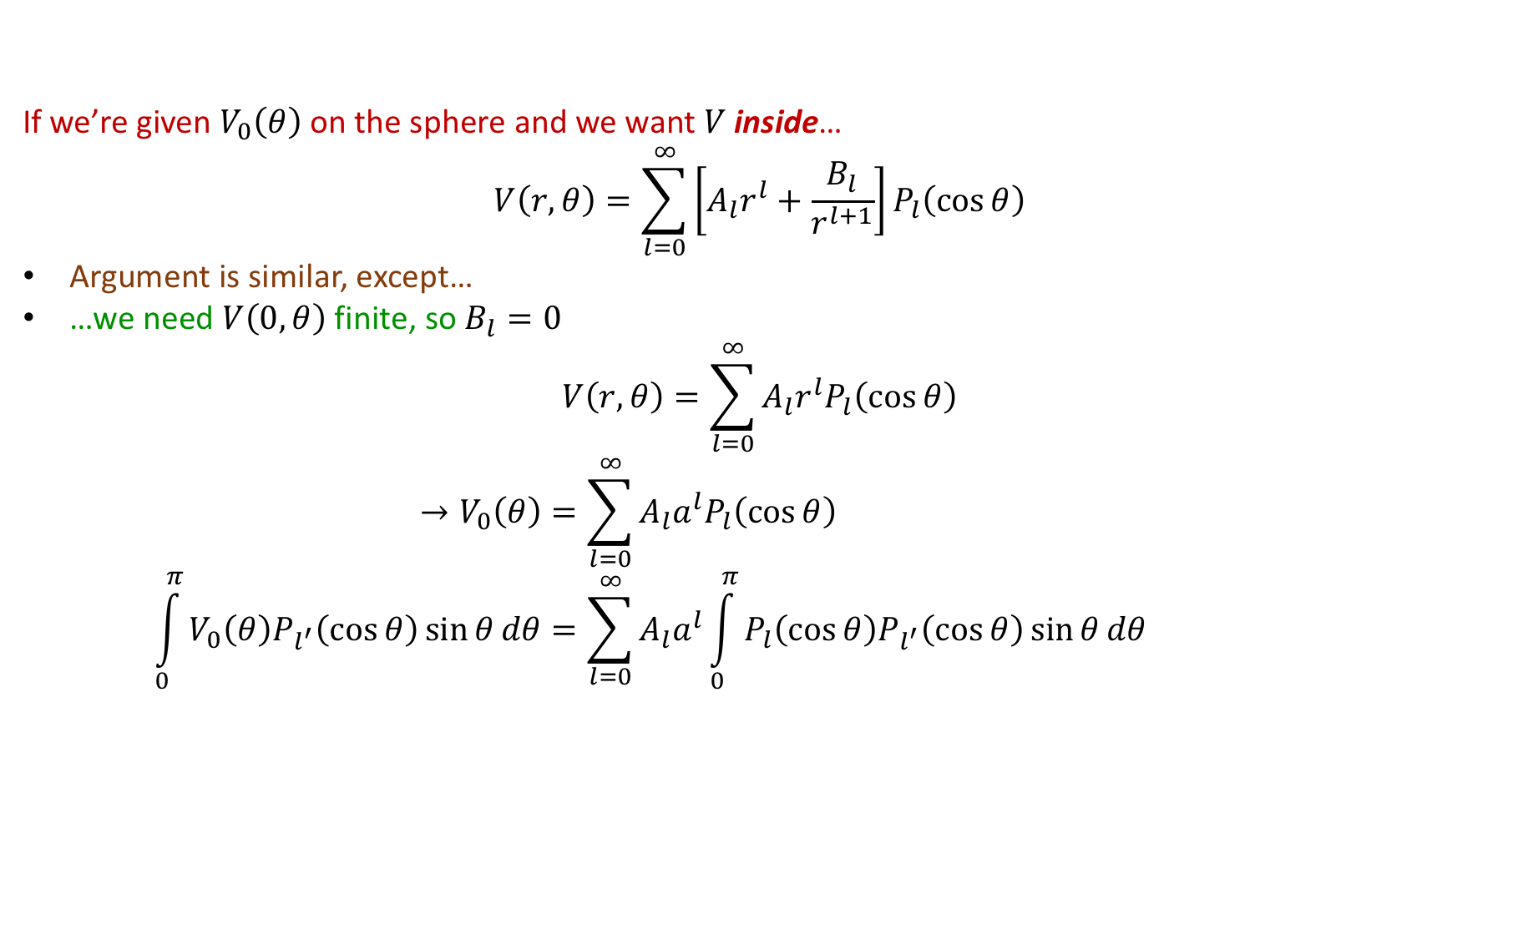
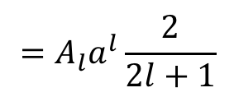
Separation of Variables
$$z$$
$$V_{0}\left(θ\right)$$
      If we’re given $V_{0}\left(θ\right)$ on the sphere and we want $V$ inside…
      $$V\left(r,θ\right)=\sum_{l=0}^{∞}{\left[A_{l}r^{l}+\frac{B_{l}}{r^{l+1}}\right]P_{l}\left(\cos{θ}\right)}$$
      Argument is similar, except…
      …we need $V\left(0,θ\right)$ finite, so $B_{l}=0$
      $$V\left(r,θ\right)=\sum_{l=0}^{∞}{A_{l}r^{l}P_{l}\left(\cos{θ}\right)}$$
      $$→V_{0}\left(θ\right)=\sum_{l=0}^{∞}{A_{l}a^{l}P_{l}\left(\cos{θ}\right)}$$
      $$\int_{0}^{π}{V_{0}\left(θ\right)P_{l^{′}}\left(\cos{θ}\right)\sin{θ}dθ}=\sum_{l=0}^{∞}{A_{l}a^{l}\int_{0}^{π}{P_{l}\left(\cos{θ}\right)P_{l^{′}}\left(\cos{θ}\right)\sin{θ}dθ}}$$
$$y$$
$$a$$
$$x$$
$$=A_{l}a^{l}\frac{2}{2l+1}$$

Slide 18
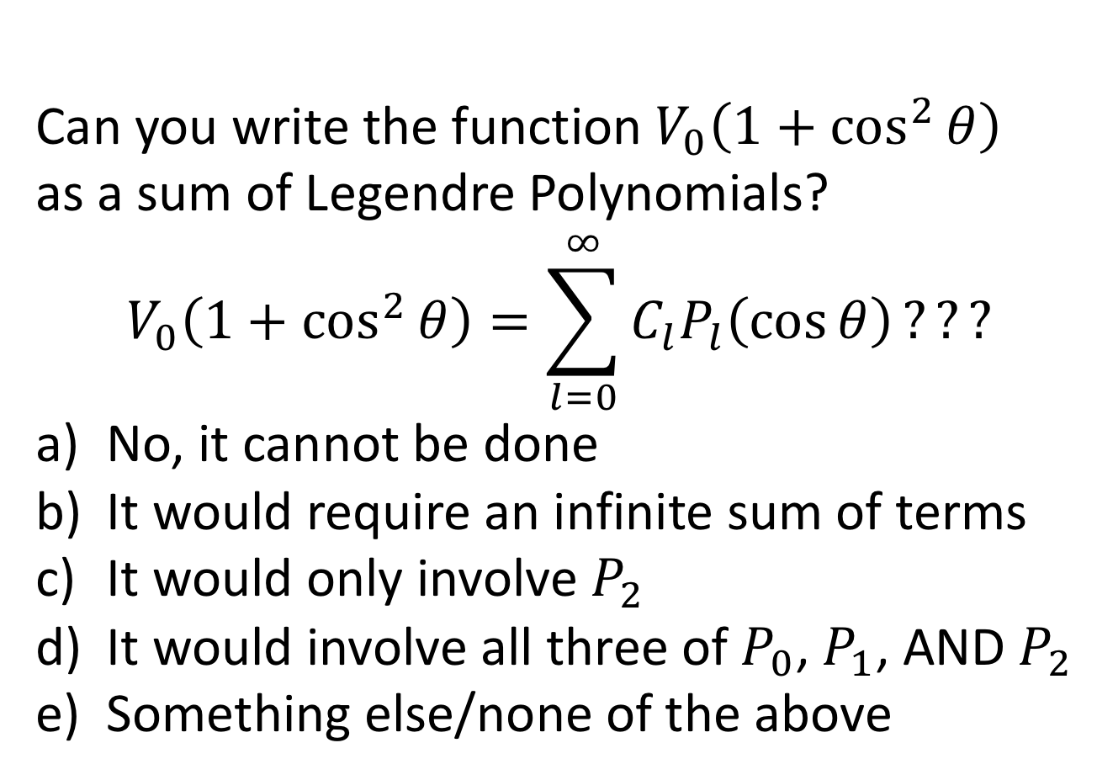
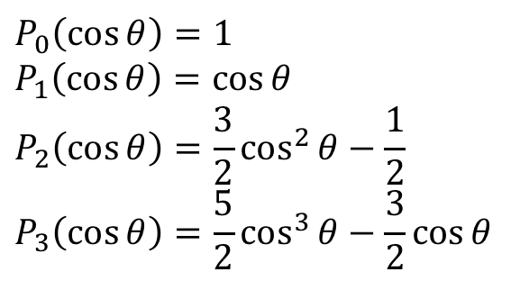
Concept Question
Can you write the function $V_{0}\left(1+\cos^{2}{θ}\right)$
as a sum of Legendre Polynomials?
$$V_{0}\left(1+\cos^{2}{θ}\right)=\sum_{l=0}^{∞}{C_{l}P_{l}\left(\cos{θ}\right)}???$$
No, it cannot be done
It would require an infinite sum of terms
It would only involve $P_{2}$
It would involve all three of $P_{0}$, $P_{1}$, AND $P_{2}$
Something else/none of the above
$$P_{0}\left(\cos{θ}\right)=1$$
$$P_{1}\left(\cos{θ}\right)=\cos{θ}$$
$$P_{2}\left(\cos{θ}\right)=\frac{3}{2}\cos^{2}{θ}−\frac{1}{2}$$
$$P_{3}\left(\cos{θ}\right)=\frac{5}{2}\cos^{3}{θ}−\frac{3}{2}\cos{θ}$$

Slide 19
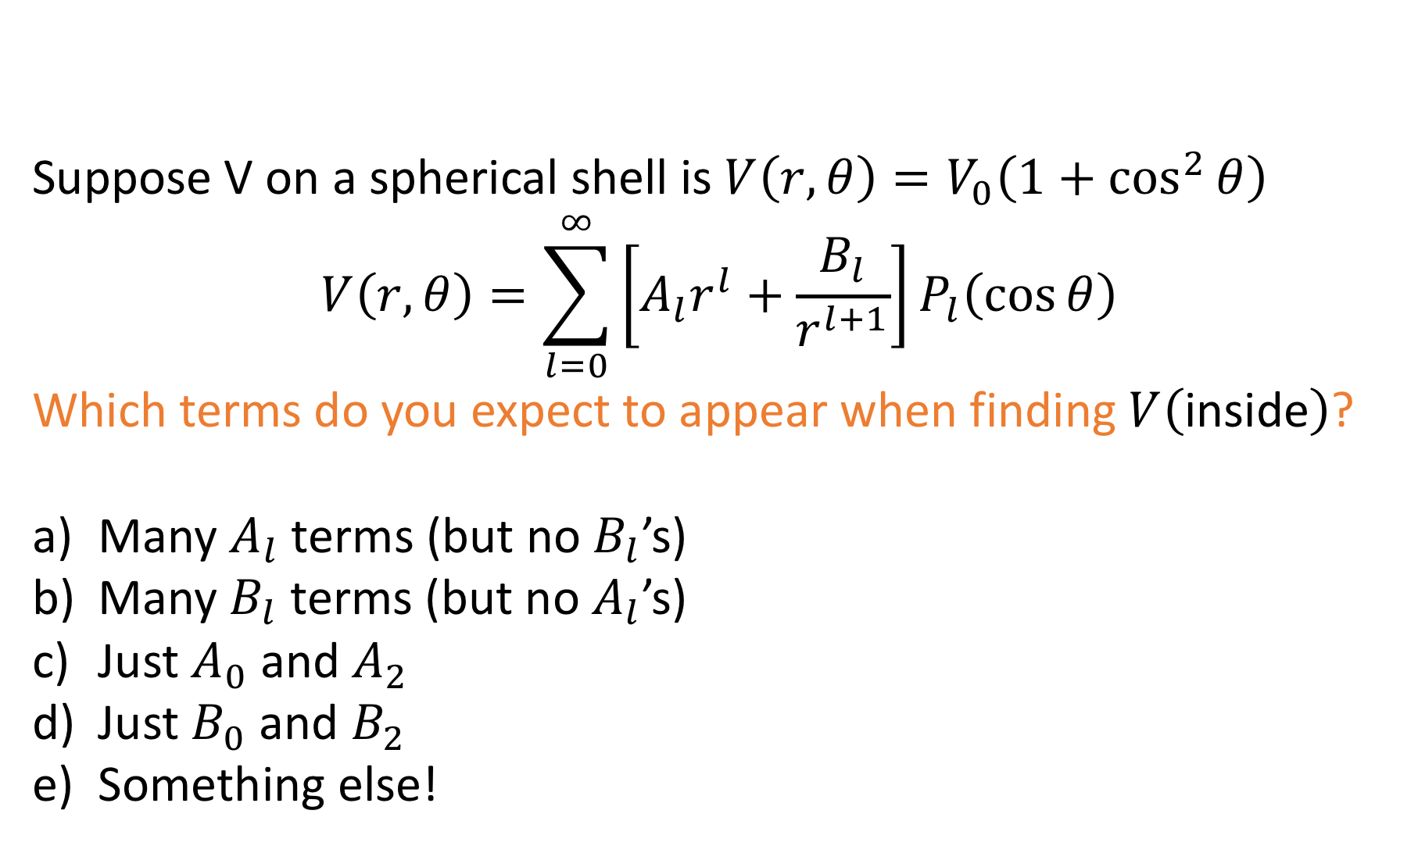
Concept Question
Suppose V on a spherical shell is $V\left(r,θ\right)=V_{0}\left(1+\cos^{2}{θ}\right)$
$$V\left(r,θ\right)=\sum_{l=0}^{∞}{\left[A_{l}r^{l}+\frac{B_{l}}{r^{l+1}}\right]P_{l}\left(\cos{θ}\right)}$$
Which terms do you expect to appear when finding $V\left(\text{in}\text{side}\right)$?
Many $A_{l}$ terms (but no $B_{l}$’s)
Many $B_{l}$ terms (but no $A_{l}$’s)
Just $A_{0}$ and $A_{2}$
Just $B_{0}$ and $B_{2}$
Something else!

Slide 20
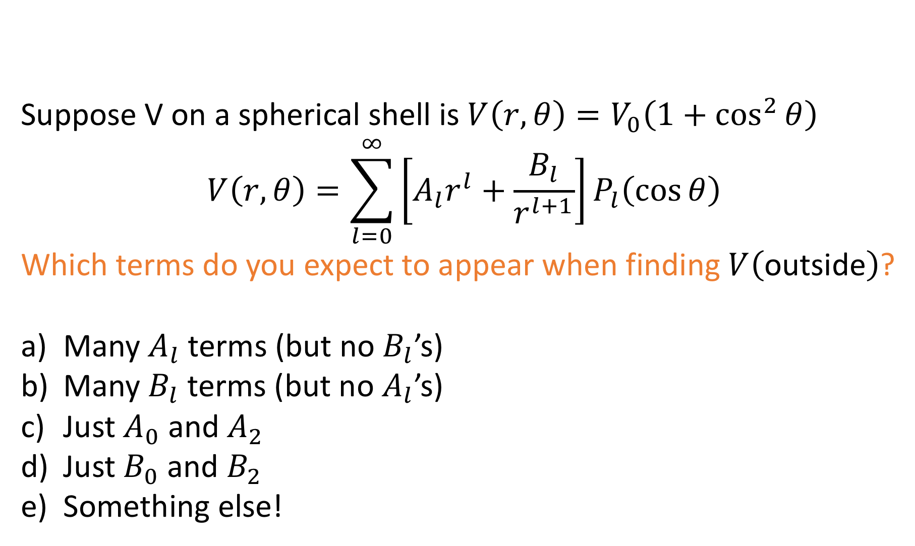
Concept Question
Suppose V on a spherical shell is $V\left(r,θ\right)=V_{0}\left(1+\cos^{2}{θ}\right)$
$$V\left(r,θ\right)=\sum_{l=0}^{∞}{\left[A_{l}r^{l}+\frac{B_{l}}{r^{l+1}}\right]P_{l}\left(\cos{θ}\right)}$$
Which terms do you expect to appear when finding $V\left(\text{out}\text{side}\right)$?
Many $A_{l}$ terms (but no $B_{l}$’s)
Many $B_{l}$ terms (but no $A_{l}$’s)
Just $A_{0}$ and $A_{2}$
Just $B_{0}$ and $B_{2}$
Something else!

Slide 21
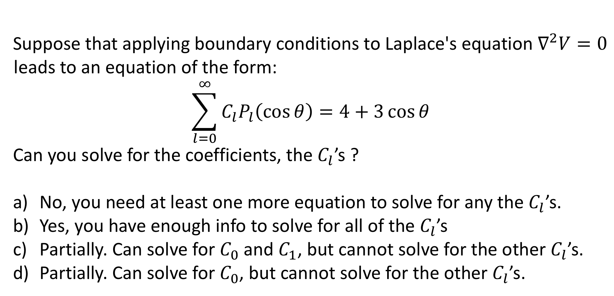

Concept Question
Suppose that applying boundary conditions to Laplace's equation $∇^{2}V=0$ leads to an equation of the form:
$$\sum_{l=0}^{∞}{C_{l}P_{l}\left(\cos{θ}\right)}=4+3\cos{θ}$$
Can you solve for the coefficients, the $C_{l}$’s ?
No, you need at least one more equation to solve for any the $C_{l}$’s.
Yes, you have enough info to solve for all of the $C_{l}$’s
Partially. Can solve for $C_{0}$ and $C_{1}$, but cannot solve for the other $C_{l}$’s.
Partially. Can solve for $C_{0}$, but cannot solve for the other $C_{l}$’s.
$$\left(x≡\cos{θ}\right)$$
$$P_{0}\left(x\right)=1$$
$$P_{1}\left(x\right)=x$$
$$P_{2}\left(x\right)=\left(3x^{2}−1\right)/2$$
Notes:
21

Slide 22
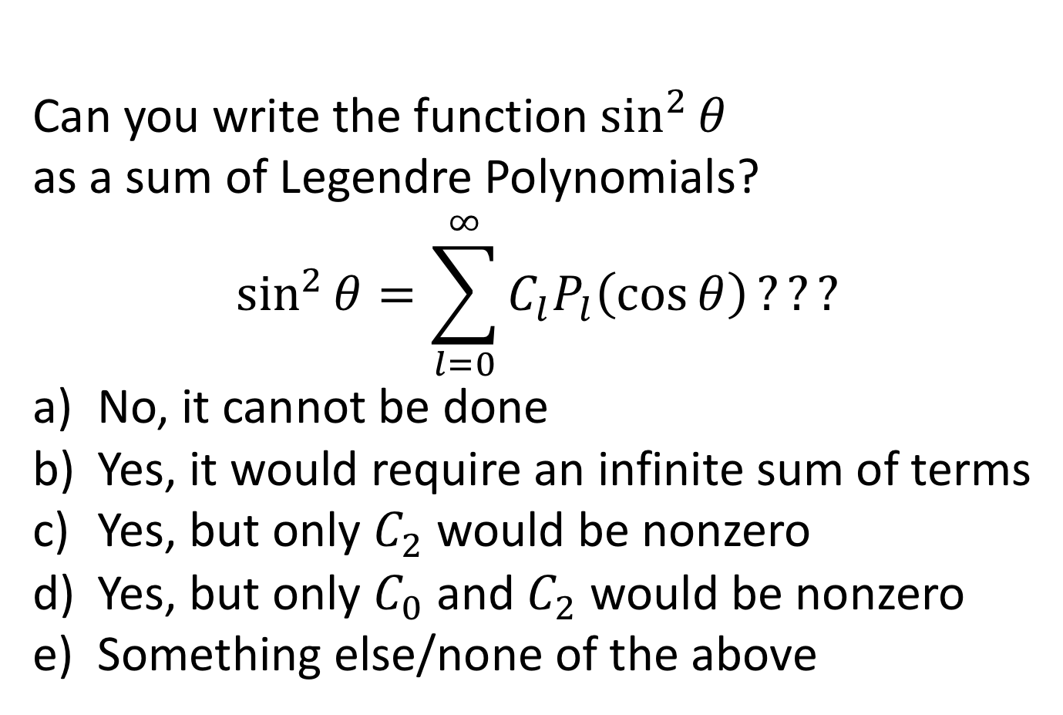
Concept Question
Can you write the function $\sin^{2}{θ}$
as a sum of Legendre Polynomials?
$$\sin^{2}{θ}=\sum_{l=0}^{∞}{C_{l}P_{l}\left(\cos{θ}\right)}???$$
No, it cannot be done
Yes, it would require an infinite sum of terms
Yes, but only $C_{2}$ would be nonzero
Yes, but only $C_{0}$ and $C_{2}$ would be nonzero
Something else/none of the above
$$P_{0}\left(\cos{θ}\right)=1$$
$$P_{1}\left(\cos{θ}\right)=\cos{θ}$$
$$P_{2}\left(\cos{θ}\right)=\frac{3}{2}\cos^{2}{θ}−\frac{1}{2}$$
$$P_{3}\left(\cos{θ}\right)=\frac{5}{2}\cos^{3}{θ}−\frac{3}{2}\cos{θ}$$

Slide 23
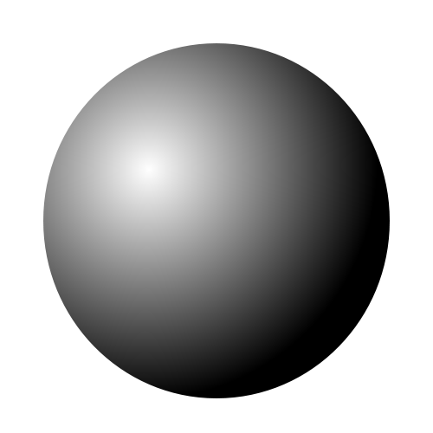

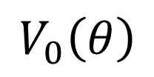
Concept Question
How many boundary conditions (on the potential $V$) do you use to find $V$ inside the spherical plastic shell?
1
2
3
4
It depends on $V_{0}\left(θ\right)$
Does the previous answer change at all if you’re asked for $V$ outside the sphere?
$$V_{0}\left(θ\right)$$
Notes:
23

Slide 24

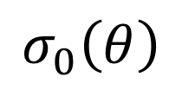
Concept Question
How many boundary conditions (on the potential $V$) do you use to find $V$ inside the spherical plastic shell?
1
2
3
4
Other/depends on $σ_{0}\left(θ\right)$
Does the previous answer change at all if you’re asked for $V$ outside the sphere?
$$σ_{0}\left(θ\right)$$
Notes:
24

