Slide 1
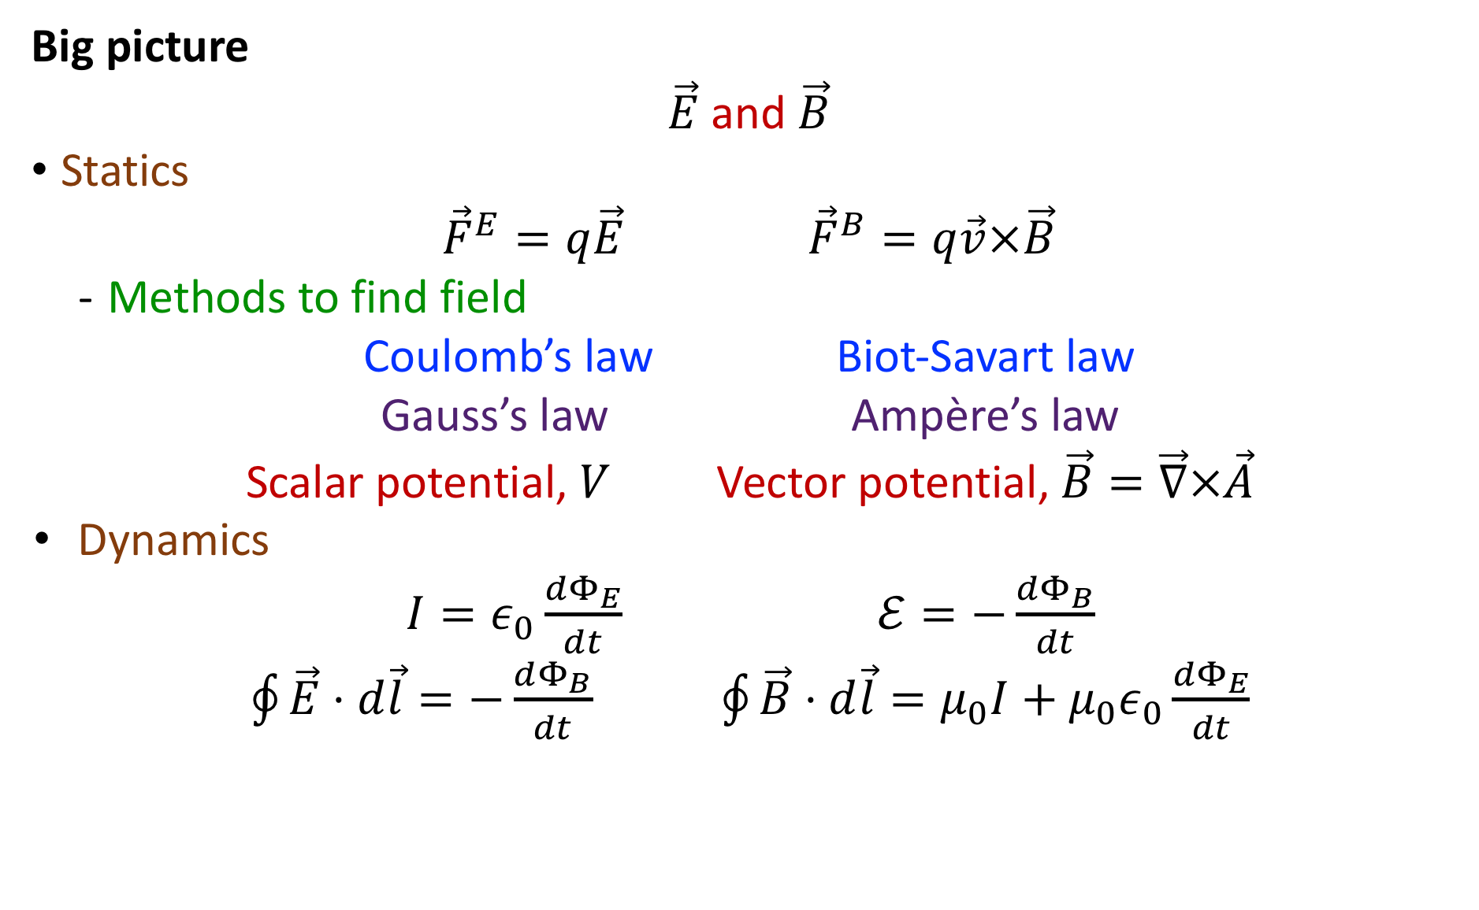
Highlights: Section 29.1-29.4
Big picture
$\vec{E}$ and $\vec{B}$
Statics
${\vec{F}}^{E}=q\vec{E}$ ${\vec{F}}^{B}=q\vec{v}×\vec{B}$
  Methods to find field
Coulomb’s law Biot-Savart law
Gauss’s law Ampère’s law
Scalar potential, $V$ Vector potential, $\vec{B}=\vec{∇}×\vec{A}$
Dynamics
$I=ε_{0}\frac{dΦ_{E}}{dt}$ $ℰ=−\frac{dΦ_{B}}{dt}$
$\oint{\vec{E}⋅d\vec{l}}=−\frac{dΦ_{B}}{dt}$ $\oint{\vec{B}⋅d\vec{l}}=μ_{0}I+μ_{0}ε_{0}\frac{dΦ_{E}}{dt}$

Slide 2
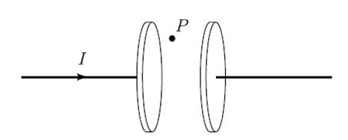
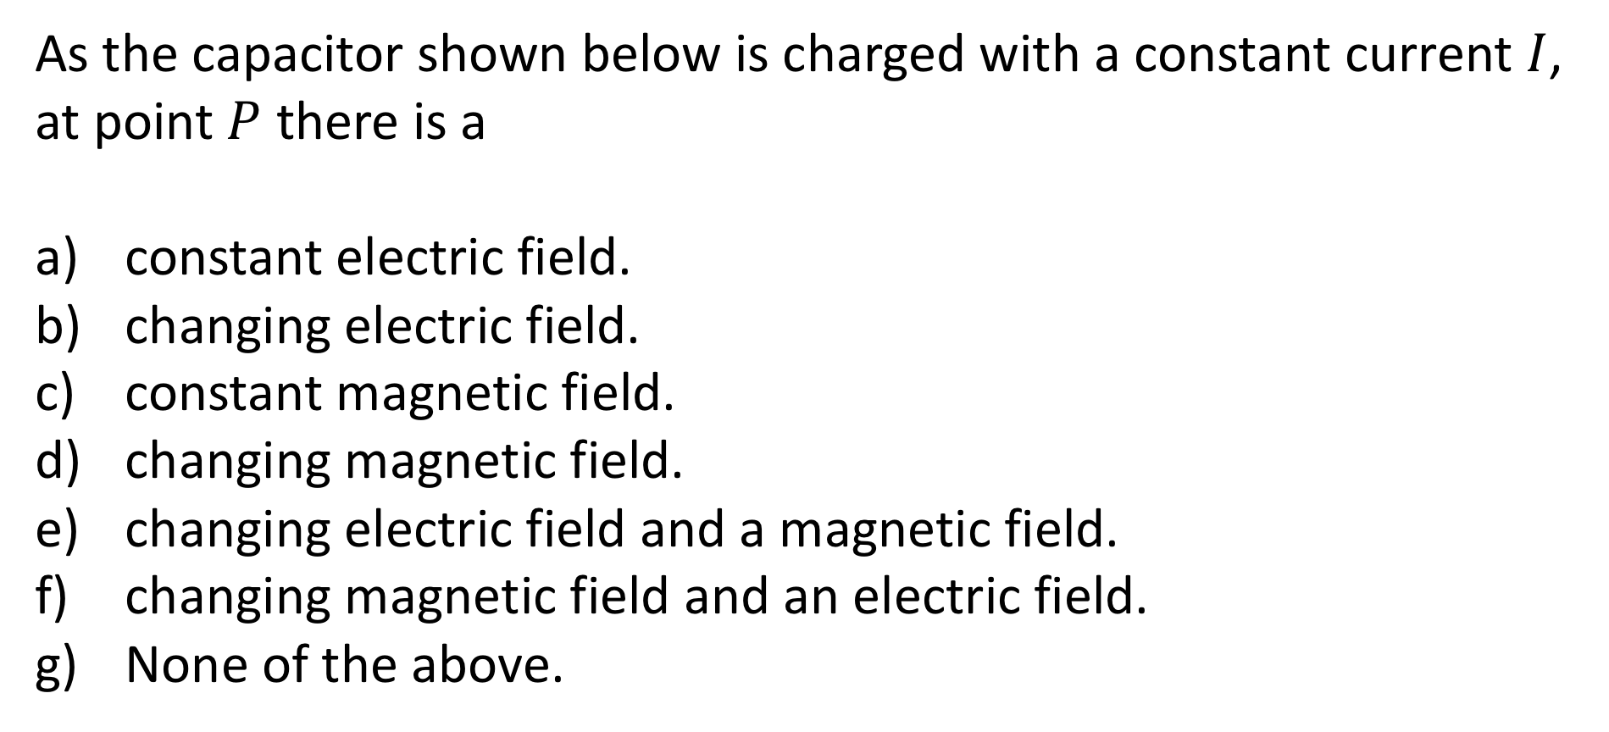
Section 30.1: Clicker Question 1
As the capacitor shown below is charged with a constant current $I$, at point $P$ there is a
constant electric field.
changing electric field.
constant magnetic field.
changing magnetic field.
changing electric field and a magnetic field.
changing magnetic field and an electric field.
None of the above.

Slide 3
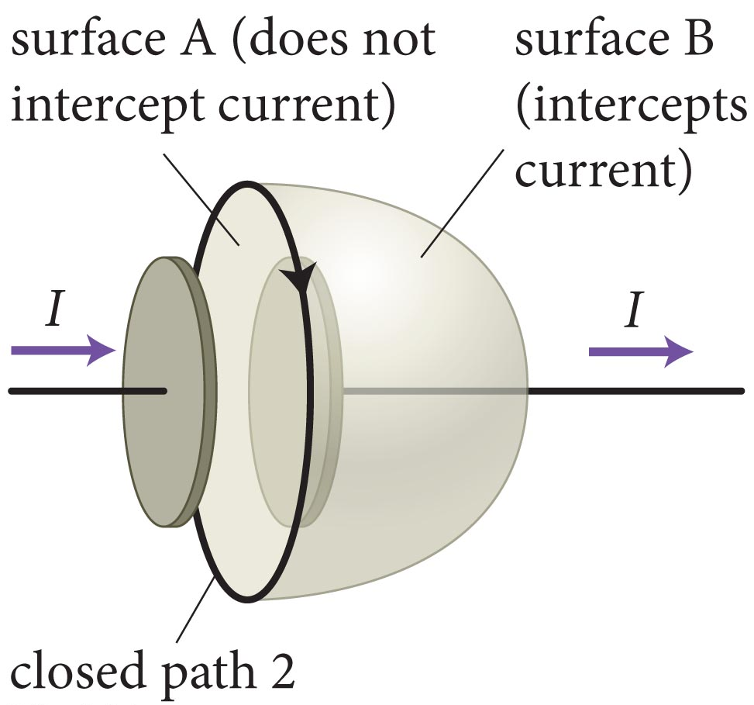
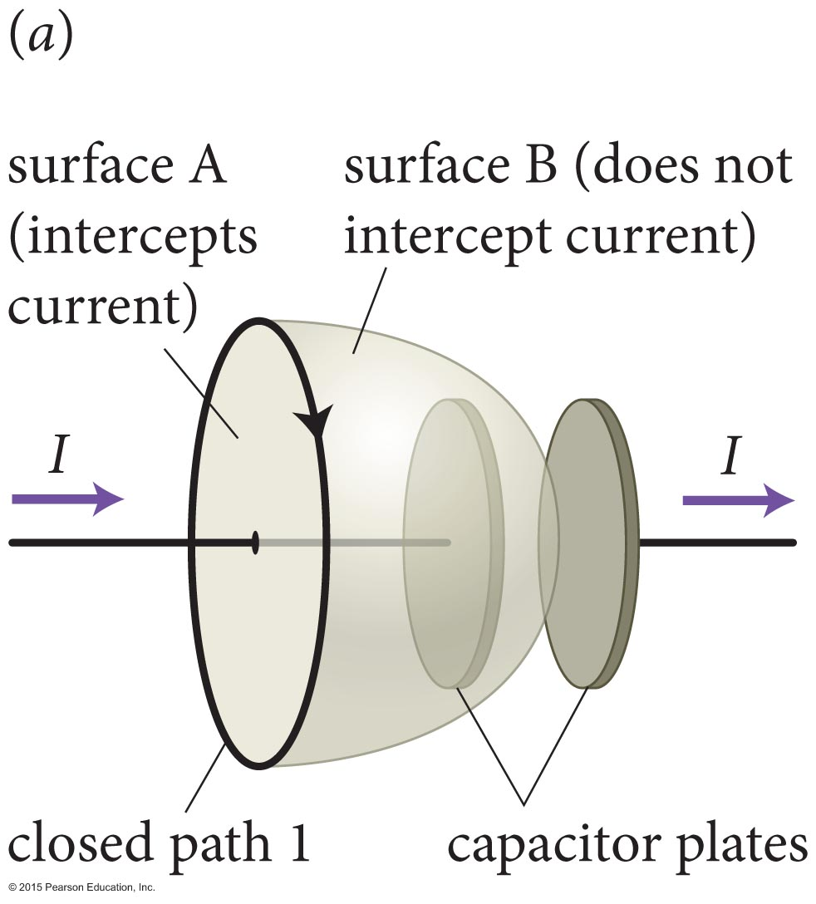
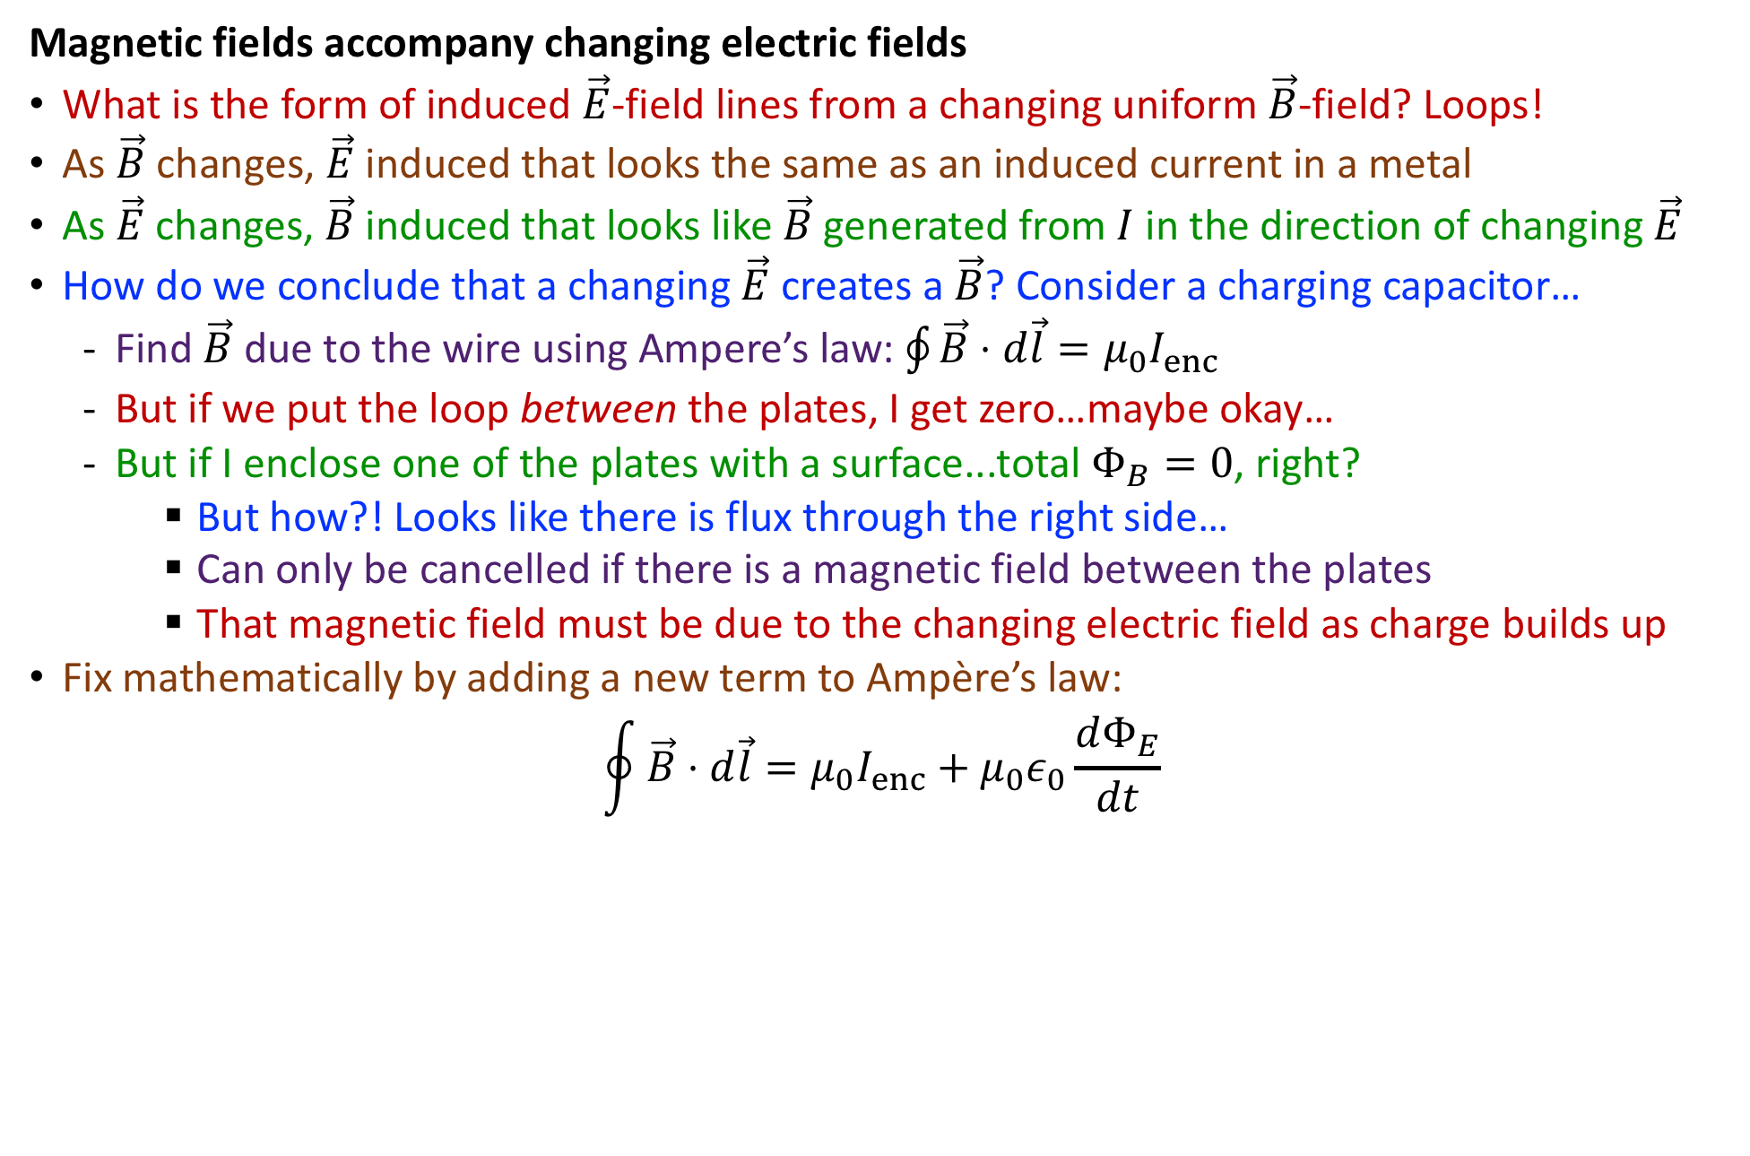
Highlights: Section 30.1-30.3
Magnetic fields accompany changing electric fields
What is the form of induced $\vec{E}$-field lines from a changing uniform $\vec{B}$-field? Loops!
As $\vec{B}$ changes, $\vec{E}$ induced that looks the same as an induced current in a metal
As $\vec{E}$ changes, $\vec{B}$ induced that looks like $\vec{B}$ generated from $I$ in the direction of changing $\vec{E}$
How do we conclude that a changing $\vec{E}$ creates a $\vec{B}$? Consider a charging capacitor…
  Find $\vec{B}$ due to the wire using Ampere’s law: $\oint{\vec{B}⋅d\vec{l}}=μ_{0}I_{enc}$
  But if we put the loop between the plates, I get zero…maybe okay…
  But if I enclose one of the plates with a surface...total $Φ_{B}=0$, right?
    But how?! Looks like there is flux through the right side…
    Can only be cancelled if there is a magnetic field between the plates
    That magnetic field must be due to the changing electric field as charge builds up
Fix mathematically by adding a new term to Ampère’s law:
$$\oint{\vec{B}⋅d\vec{l}}=μ_{0}I_{enc}+μ_{0}ε_{0}\frac{dΦ_{E}}{dt}$$

Slide 4
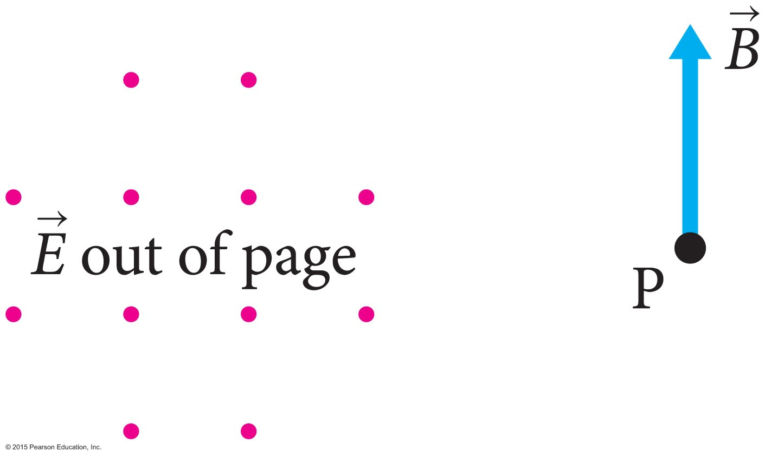
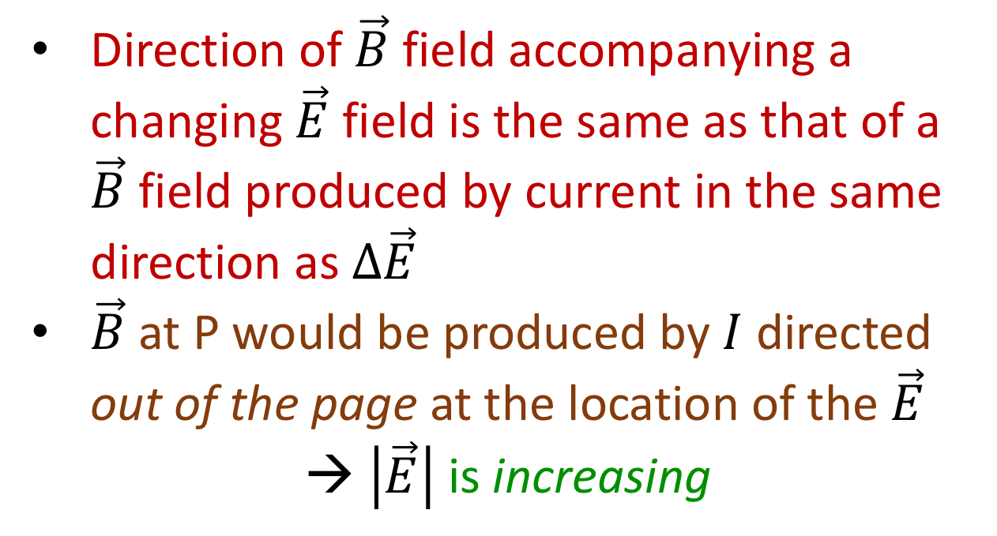
Example Problem: QP 30.1
The magnitude of the electric field of the figure is changing with time. As a result of this change, there is an upward-pointing magnetic field at position P. Is the electric field magnitude increasing or decreasing?
Direction of $\vec{B}$ field accompanying a changing $\vec{E}$ field is the same as that of a $\vec{B}$ field produced by current in the same direction as $Δ\vec{E}$
$\vec{B}$ at P would be produced by $I$ directed out of the page at the location of the $\vec{E}$
→ $\left|\vec{E}\right|$ is increasing

Slide 5
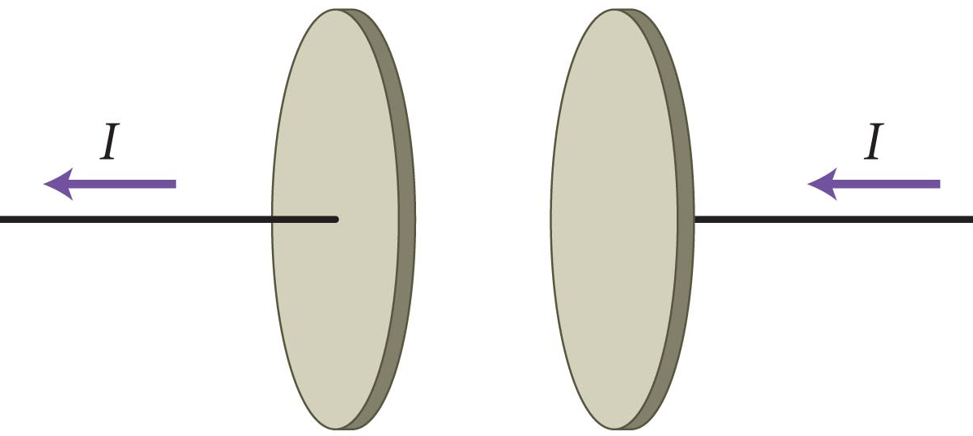
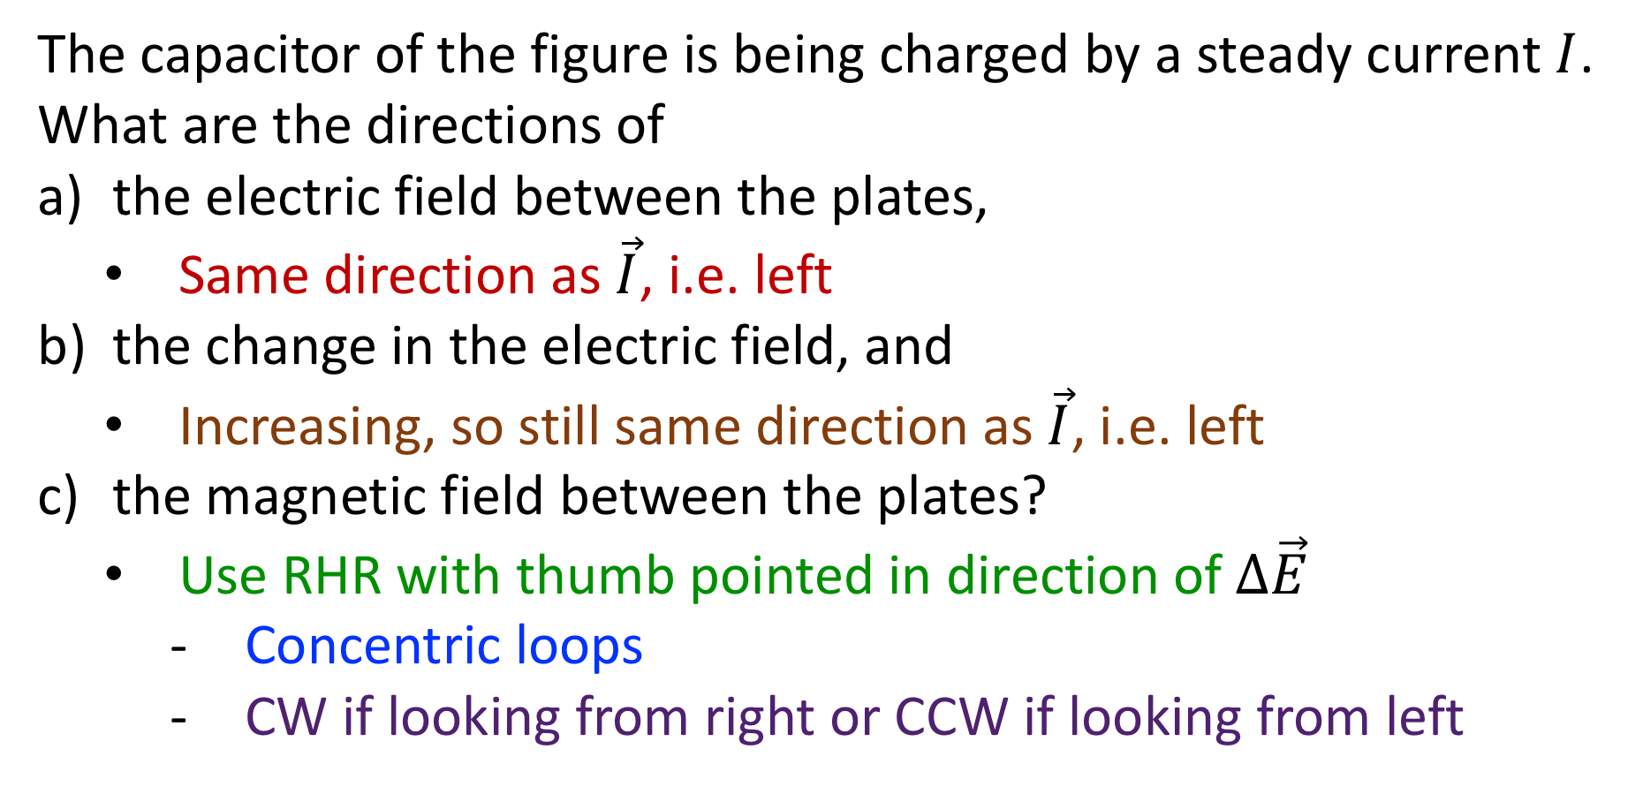
Example Problem: QP 30.5
The capacitor of the figure is being charged by a steady current $I$. What are the directions of
the electric field between the plates,
  Same direction as $\vec{I}$, i.e. left
the change in the electric field, and
  Increasing, so still same direction as $\vec{I}$, i.e. left
the magnetic field between the plates?
  Use RHR with thumb pointed in direction of $Δ\vec{E}$
    Concentric loops
    CW if looking from right or CCW if looking from left

Slide 6
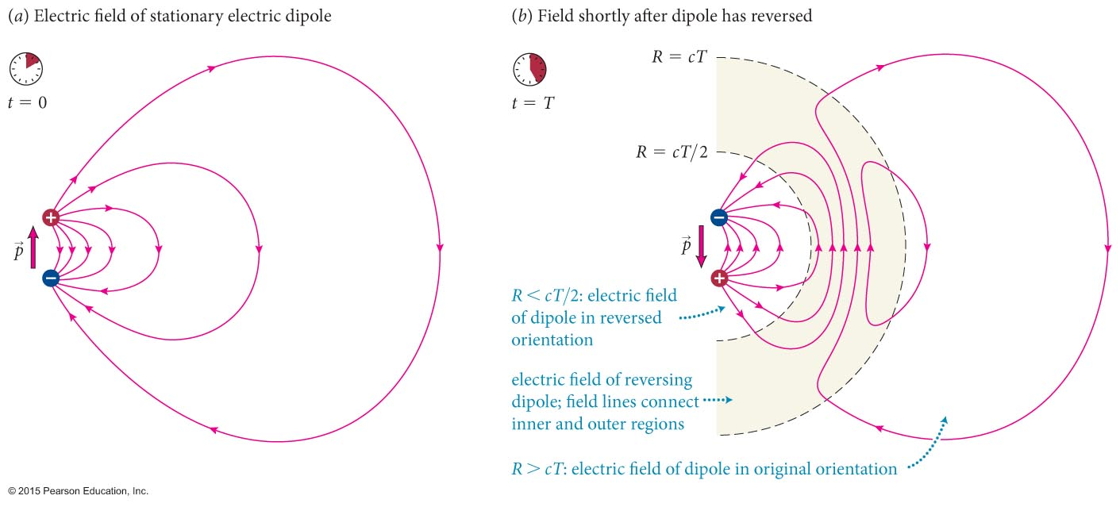
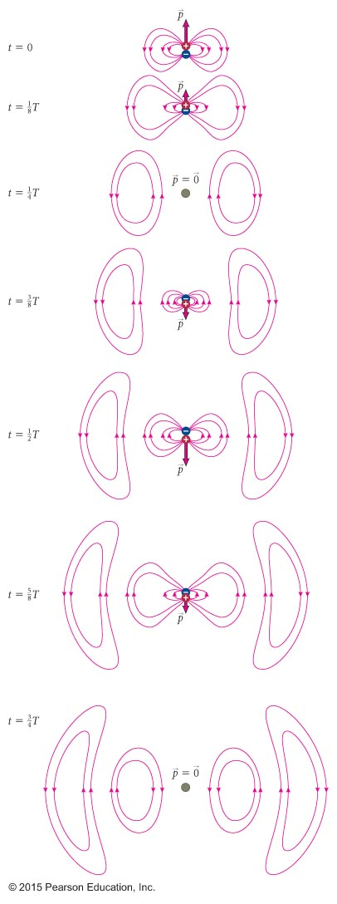
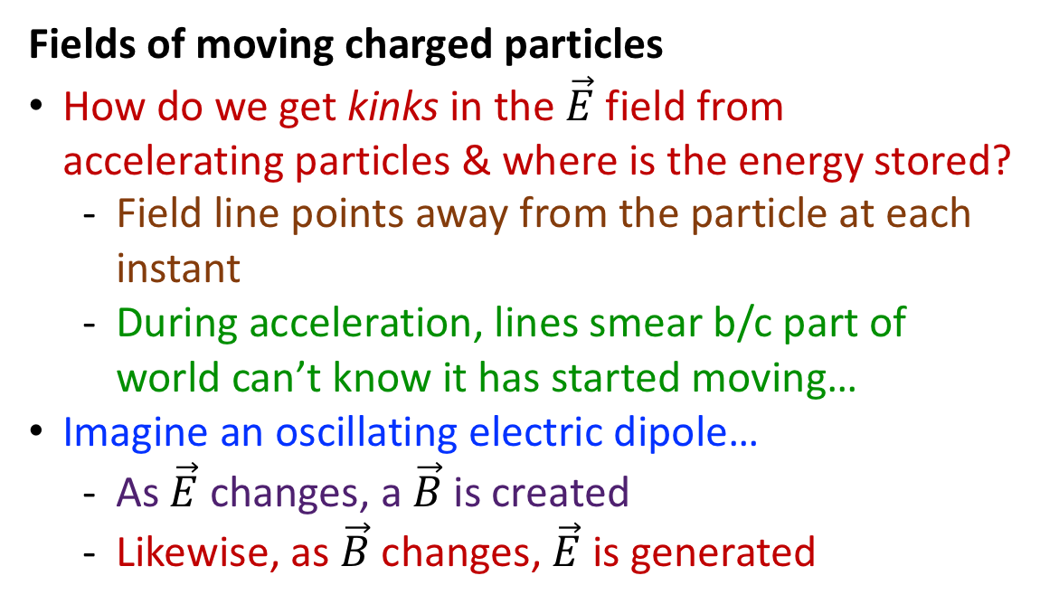
Highlights: Section 30.1-30.3
Fields of moving charged particles
How do we get kinks in the $\vec{E}$ field from accelerating particles & where is the energy stored?
  Field line points away from the particle at each instant
  During acceleration, lines smear b/c part of world can’t know it has started moving…
Imagine an oscillating electric dipole…
  As $\vec{E}$ changes, a $\vec{B}$ is created
  Likewise, as $\vec{B}$ changes, $\vec{E}$ is generated

Slide 7
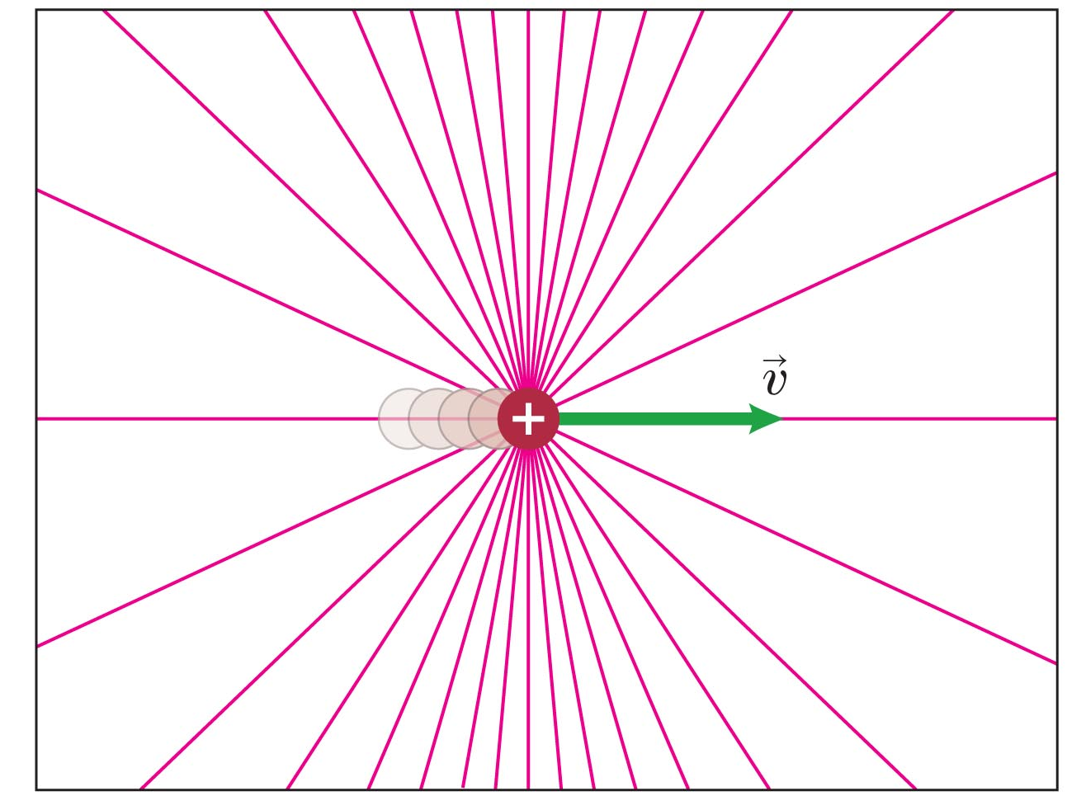
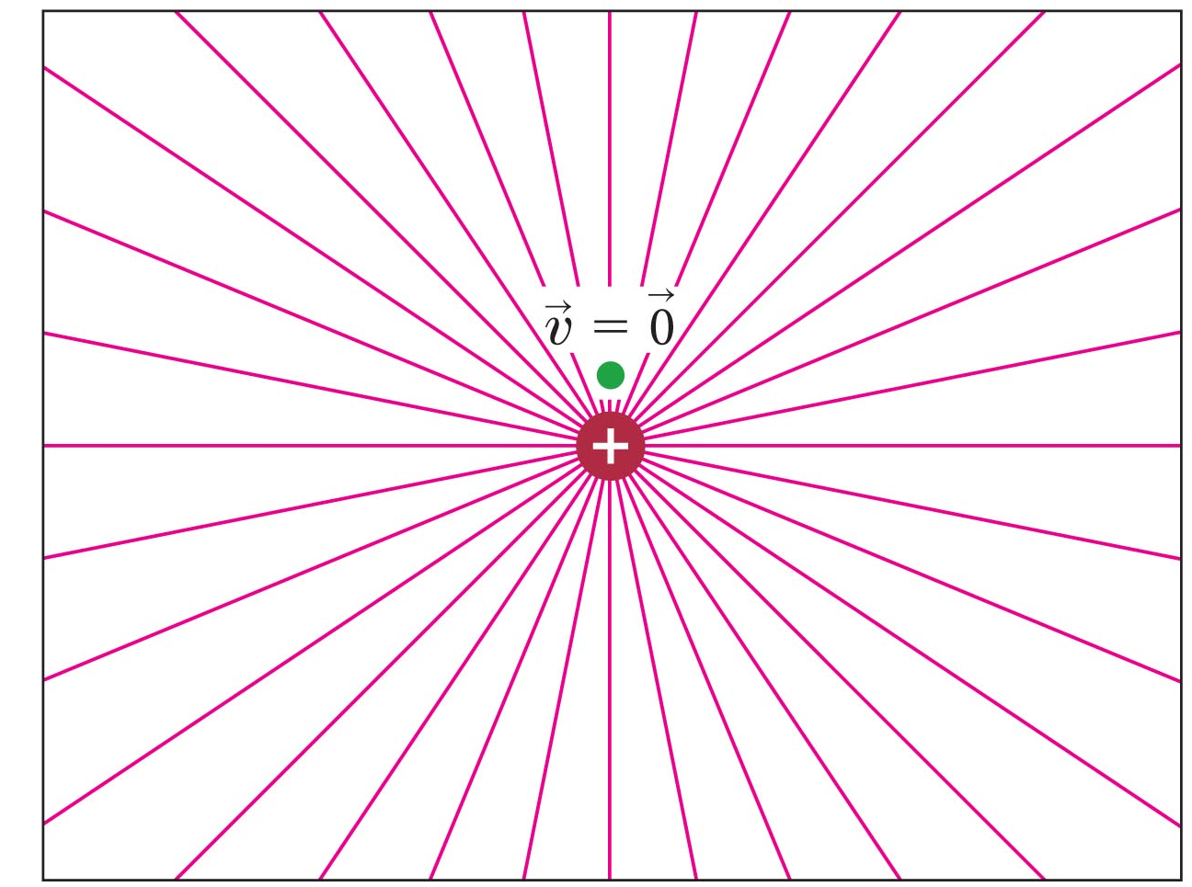
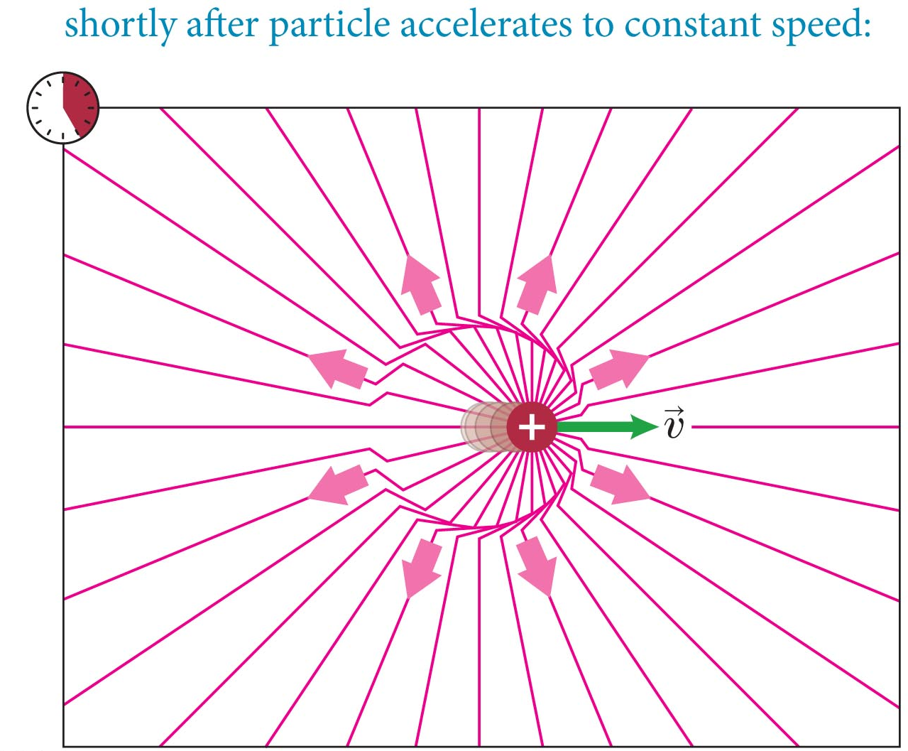
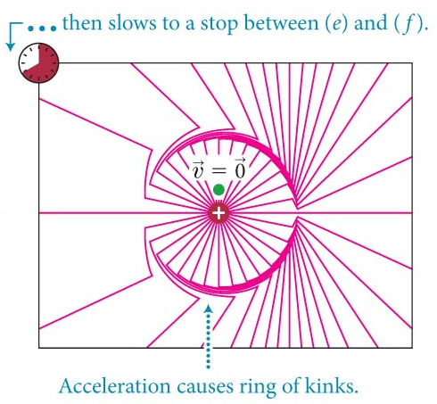
Example Problem: QP 30.7
Are the radiating electric field lines around a charged particle straight lines when the particle
is stationary,
  Yes! This is chapter 23…
moves at constant velocity,
  Yes! Still straight lines…
accelerates?
  Nope!

Slide 8
Example Problem: QP 30.9
Would a charged particle moving at a high speed in a circle create kinks in its electric field?
A particle moving in a circle is accelerating
  Specifically, toward the center of the circle
This should create kinks in its electric field

Slide 9
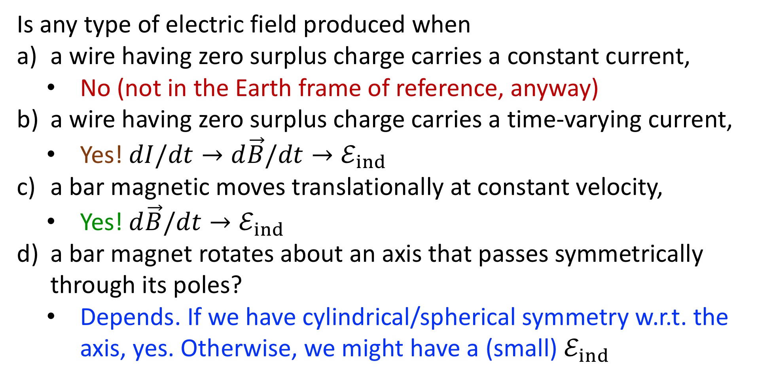
Example Problem: QP 30.11
Is any type of electric field produced when
a wire having zero surplus charge carries a constant current,
  No (not in the Earth frame of reference, anyway)
a wire having zero surplus charge carries a time-varying current,
  Yes! $dI/dt→d\vec{B}/dt→ℰ_{ind}$
a bar magnetic moves translationally at constant velocity,
  Yes! $d\vec{B}/dt→ℰ_{ind}$
a bar magnet rotates about an axis that passes symmetrically through its poles?
  Depends. If we have cylindrical/spherical symmetry w.r.t. the axis, yes. Otherwise, we might have a (small) $ℰ_{ind}$

Slide 10
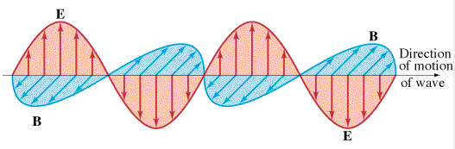
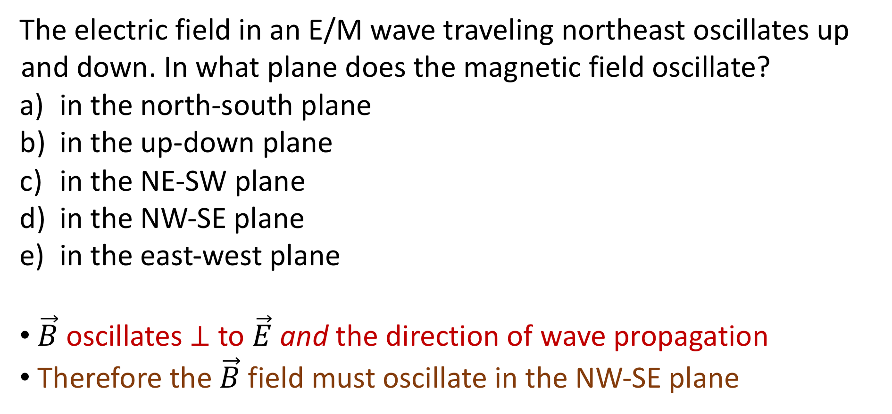
Concept Question: Oscillations
The electric field in an E/M wave traveling northeast oscillates up and down. In what plane does the magnetic field oscillate?
in the north-south plane
in the up-down plane
in the NE-SW plane
in the NW-SE plane
in the east-west plane
$\vec{B}$ oscillates $⊥$ to $\vec{E}$ and the direction of wave propagation
Therefore the $\vec{B}$ field must oscillate in the NW-SE plane

Slide 11
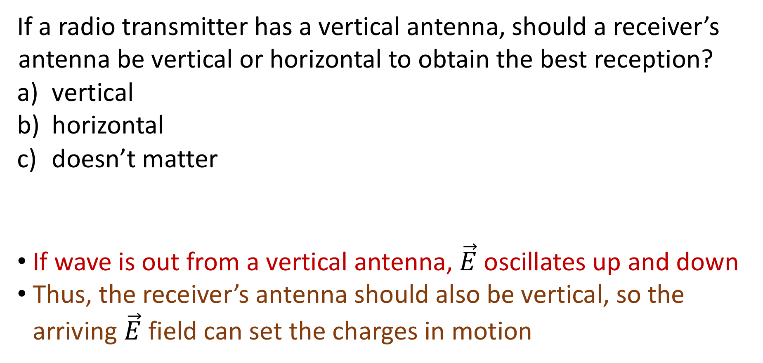
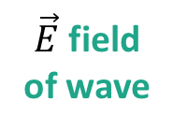

Concept Question: Radio Antennas
If a radio transmitter has a vertical antenna, should a receiver’s antenna be vertical or horizontal to obtain the best reception?
vertical
horizontal
doesn’t matter
If wave is out from a vertical antenna, $\vec{E}$ oscillates up and down
Thus, the receiver’s antenna should also be vertical, so the arriving $\vec{E}$ field can set the charges in motion
$\vec{E}$ field
of wave
$\vec{E}$ field
of wave

Slide 12
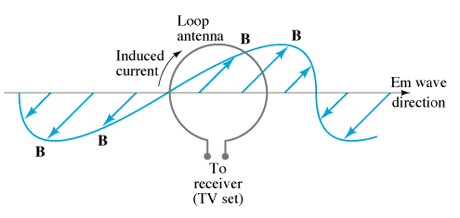
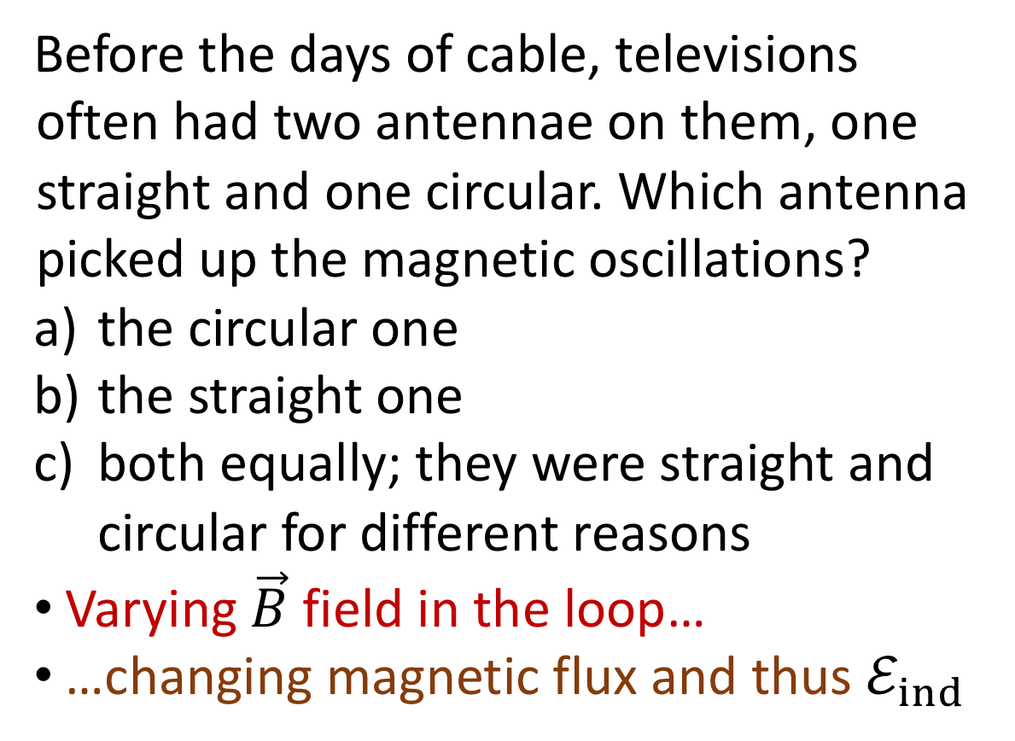
Concept Question: TV Antennas
Before the days of cable, televisions often had two antennae on them, one straight and one circular. Which antenna picked up the magnetic oscillations?
the circular one
the straight one
both equally; they were straight and circular for different reasons
Varying $\vec{B}$ field in the loop…
…changing magnetic flux and thus $ℰ_{ind}$
Follow-up: Is this antenna better for low or high frequency waves?

Slide 13
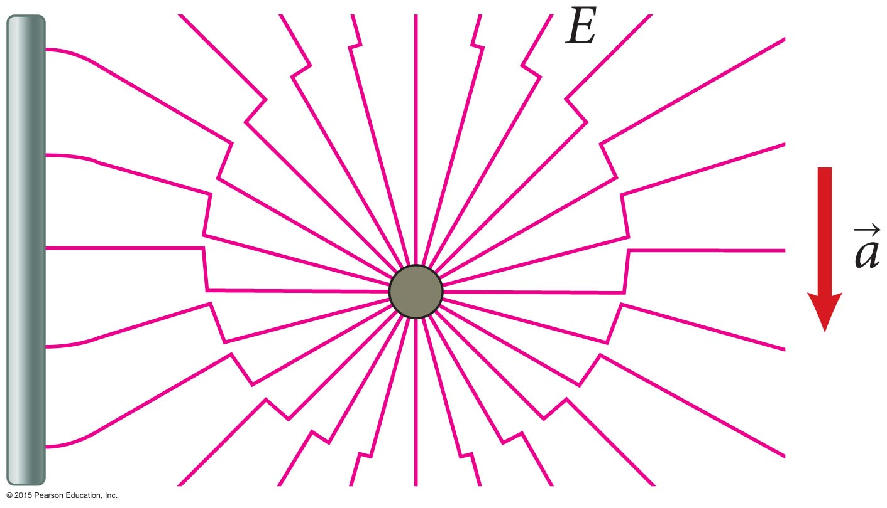
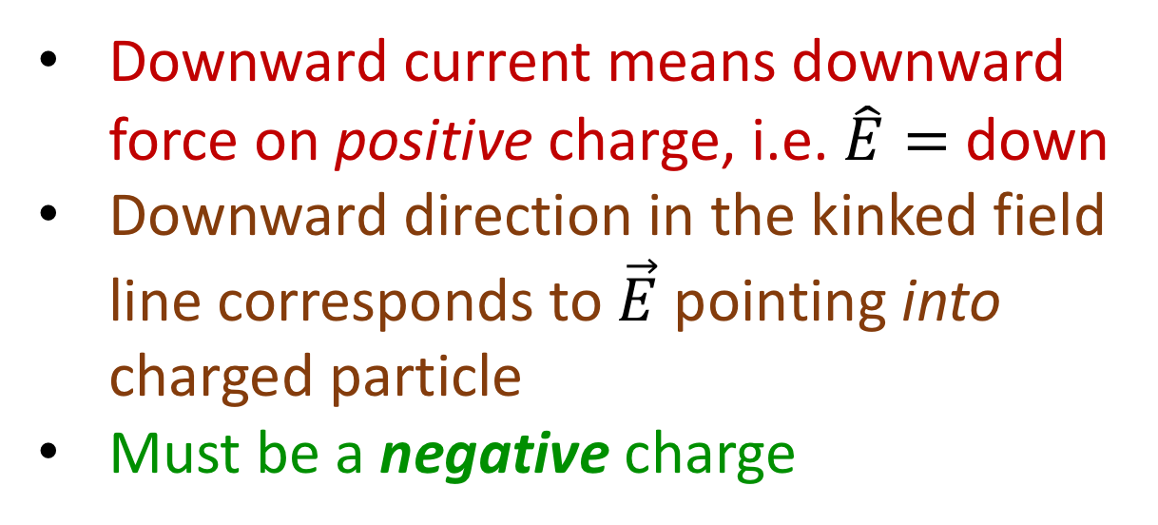
Example Problem: QP 30.21
In the figure, a charged particle has been suddenly accelerated downward, producing the electric field line pattern shown. When the kinks in the field lines reach the metal rod at the left, they produce a downward current in the rod. Is the particle that has been accelerated positively or negatively charged?
Downward current means downward force on positive charge, i.e. $\hat{E}=$ down
Downward direction in the kinked field line corresponds to $\vec{E}$ pointing into charged particle
Must be a negative charge

Slide 14
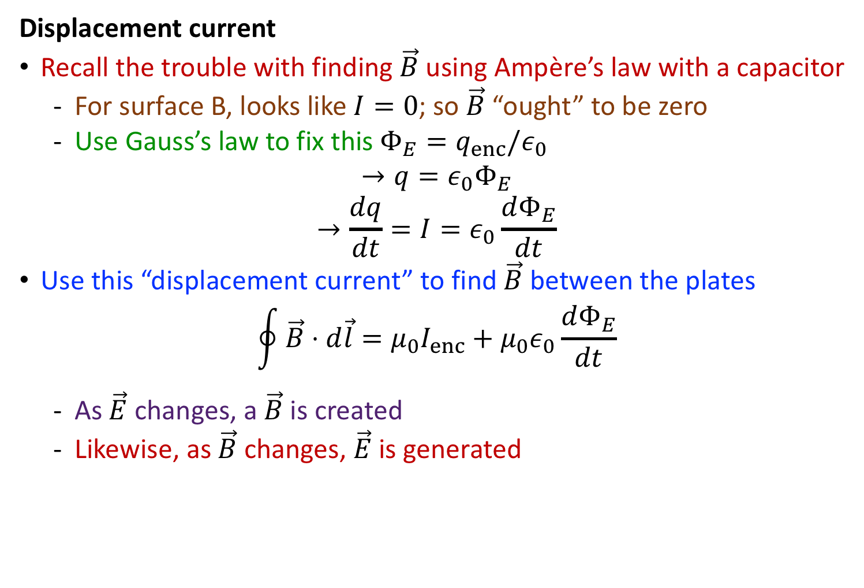
Highlights: Section 30.4-30.7
Displacement current
Recall the trouble with finding $\vec{B}$ using Ampère’s law with a capacitor
  For surface B, looks like $I=0$; so $\vec{B}$ “ought” to be zero
  Use Gauss’s law to fix this $Φ_{E}=q_{enc}/ε_{0}$
$$→q=ε_{0}Φ_{E}$$
$$→\frac{dq}{dt}=I=ε_{0}\frac{dΦ_{E}}{dt}$$
Use this “displacement current” to find $\vec{B}$ between the plates
$$\oint{\vec{B}⋅d\vec{l}}=μ_{0}I_{enc}+μ_{0}ε_{0}\frac{dΦ_{E}}{dt}$$
  As $\vec{E}$ changes, a $\vec{B}$ is created
  Likewise, as $\vec{B}$ changes, $\vec{E}$ is generated

Slide 15
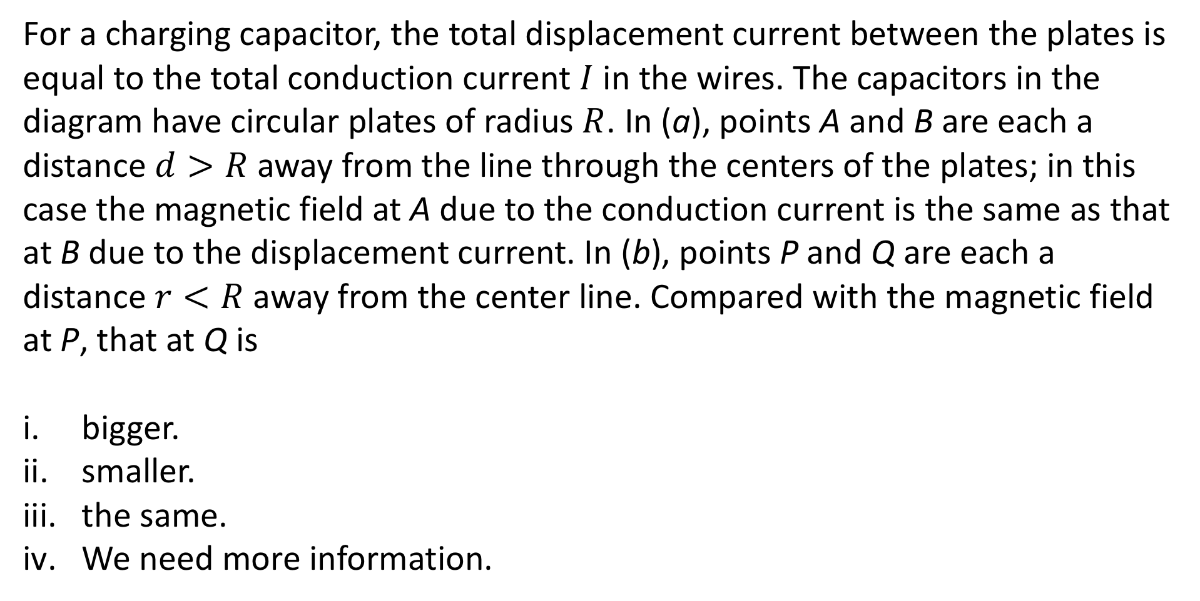
Section 30.4: Clicker Question 4
For a charging capacitor, the total displacement current between the plates is equal to the total conduction current $I$ in the wires. The capacitors in the diagram have circular plates of radius $R$. In (a), points A and B are each a distance $d>R$ away from the line through the centers of the plates; in this case the magnetic field at A due to the conduction current is the same as that at B due to the displacement current. In (b), points P and Q are each a distance $r<R$ away from the center line. Compared with the magnetic field at P, that at Q is
bigger.
smaller.
the same.
We need more information.

Slide 16
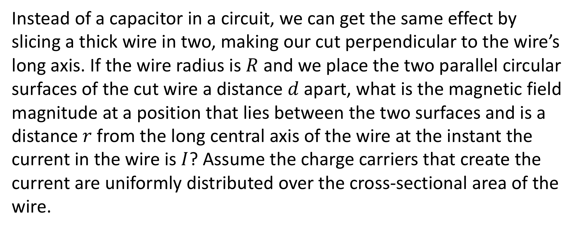
Example Problem: QP 30.25 alt
Instead of a capacitor in a circuit, we can get the same effect by slicing a thick wire in two, making our cut perpendicular to the wire’s long axis. If the wire radius is $R$ and we place the two parallel circular surfaces of the cut wire a distance $d$ apart, what is the magnetic field magnitude at a position that lies between the two surfaces and is a distance $r$ from the long central axis of the wire at the instant the current in the wire is $I$? Assume the charge carriers that create the current are uniformly distributed over the cross-sectional area of the wire.

Slide 17

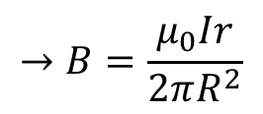
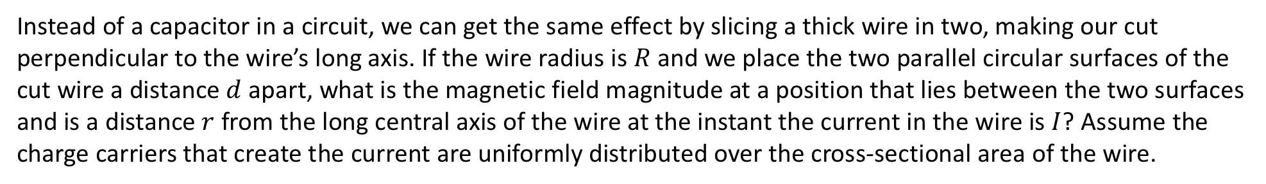



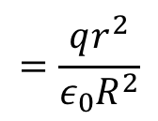


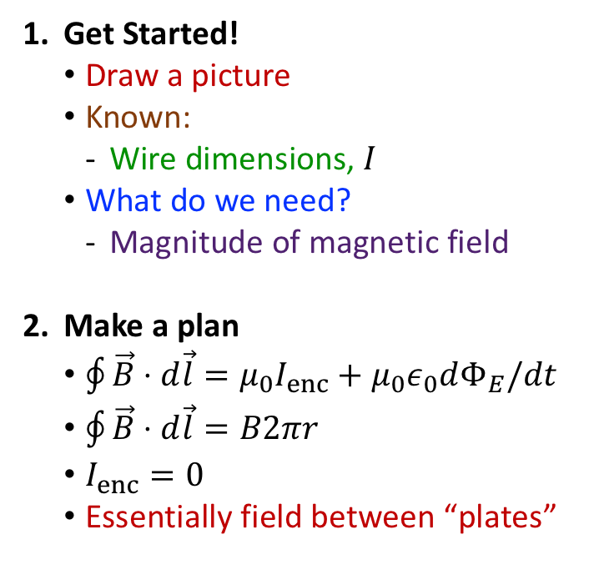


Example Problem: QP 30.25 alt
Instead of a capacitor in a circuit, we can get the same effect by slicing a thick wire in two, making our cut perpendicular to the wire’s long axis. If the wire radius is $R$ and we place the two parallel circular surfaces of the cut wire a distance $d$ apart, what is the magnetic field magnitude at a position that lies between the two surfaces and is a distance $r$ from the long central axis of the wire at the instant the current in the wire is $I$? Assume the charge carriers that create the current are uniformly distributed over the cross-sectional area of the wire.
Get Started!
  Draw a picture
  Known:
    Wire dimensions, $I$
  What do we need?
    Magnitude of magnetic field
Make a plan
  $\oint{\vec{B}⋅d\vec{l}}=μ_{0}I_{enc}+μ_{0}ε_{0}dΦ_{E}/dt$
  $\oint{\vec{B}⋅d\vec{l}}=B2πr$
  $I_{enc}=0$
  Essentially field between “plates”
Execute!
$$E=\frac{σ}{ε_{0}}$$
$$Φ_{E}=\int{\vec{E}⋅d\vec{A}}$$
$$\frac{dΦ_{E}}{dt}=\frac{r^{2}}{ε_{0}R^{2}}\frac{dq}{dt}$$
$$B2πr=μ_{0}ε_{0}\frac{Ir^{2}}{ε_{0}R^{2}}$$
Evaluate:
Try a different surface that intersects the wire and $I_{disp}=0$
$I_{enc}=Iπr^{2}/πR^{2}$
$$=\frac{q}{ε_{0}πR^{2}}$$
$$\vec{I}$$
$$=\frac{qπr^{2}}{ε_{0}πR^{2}}$$
$$=\frac{qr^{2}}{ε_{0}R^{2}}$$
$$=Eπr^{2}$$
$$\vec{E}$$
$$=\frac{Ir^{2}}{ε_{0}R^{2}}$$
$$→B=\frac{μ_{0}Ir}{2πR^{2}}$$
$$→B=μ_{0}Ir/2πR^{2}$$

Slide 18

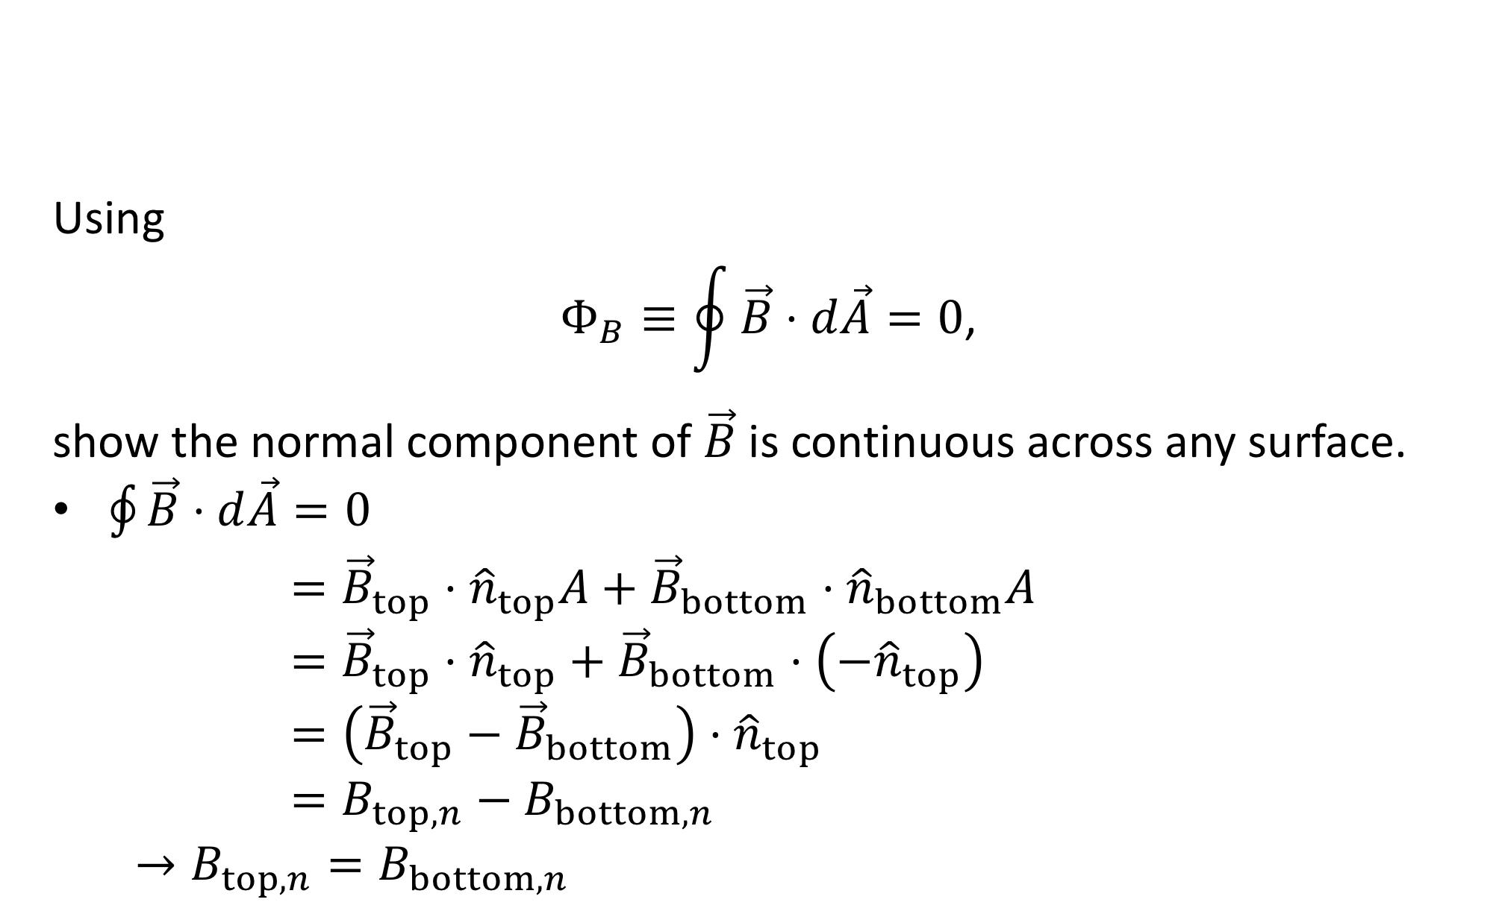




Example Problem: QP 30.33
Using
$$Φ_{B}≡\oint{\vec{B}⋅d\vec{A}}=0\text{,}$$
show the normal component of $\vec{B}$ is continuous across any surface.
$\oint{\vec{B}⋅d\vec{A}}=0$
$$={\vec{B}}_{top}⋅{\hat{n}}_{top}A+{\vec{B}}_{bottom}⋅{\hat{n}}_{bottom}A$$
$$={\vec{B}}_{top}⋅{\hat{n}}_{top}+{\vec{B}}_{bottom}⋅\left(−{\hat{n}}_{top}\right)$$
$$=\left({\vec{B}}_{top}−{\vec{B}}_{bottom}\right)⋅{\hat{n}}_{top}$$
$$=B_{top,n}−B_{bottom,n}$$
$$→B_{top,n}=B_{bottom,n}$$
$$d{\vec{A}}_{top}$$
$$A→0$$
$$h→0$$
$$d{\vec{A}}_{side}$$
$$d{\vec{A}}_{bottom}$$

Slide 19
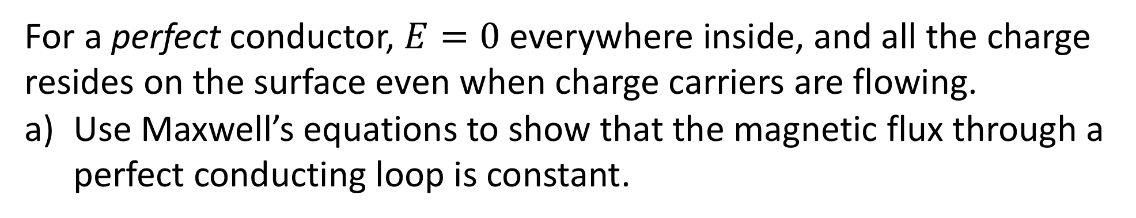
Example Problem: QP 30.35 alt
For a perfect conductor, $E=0$ everywhere inside, and all the charge resides on the surface even when charge carriers are flowing.
Use Maxwell’s equations to show that the magnetic flux through a perfect conducting loop is constant.

Slide 20
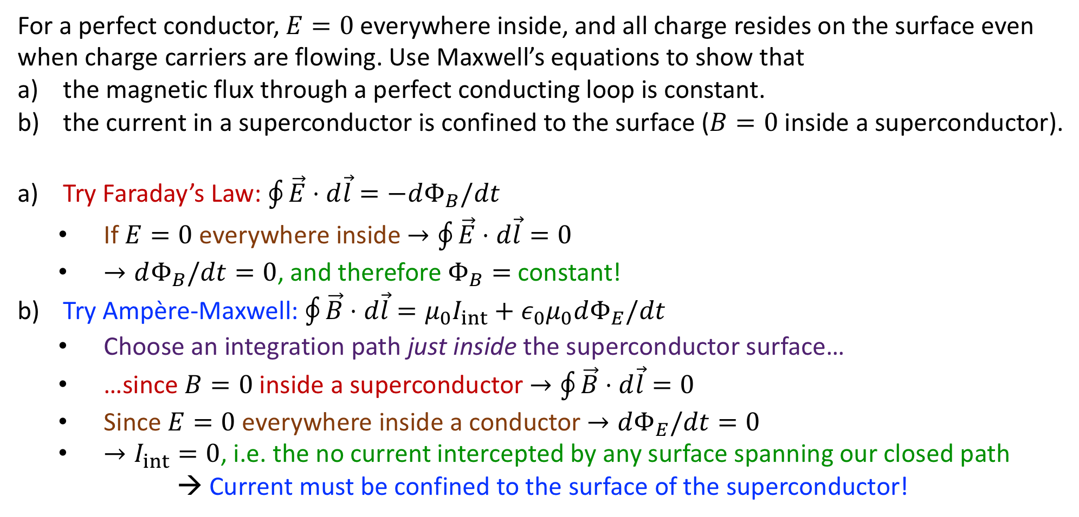
Example Problem: QP 30.35
For a perfect conductor, $E=0$ everywhere inside, and all charge resides on the surface even when charge carriers are flowing. Use Maxwell’s equations to show that
the magnetic flux through a perfect conducting loop is constant.
the current in a superconductor is confined to the surface ($B=0$ inside a superconductor).
Try Faraday’s Law: $\oint{\vec{E}⋅d\vec{l}}=−dΦ_{B}/dt$
  If $E=0$ everywhere inside $→\oint{\vec{E}⋅d\vec{l}}=0$
  $→dΦ_{B}/dt=0$, and therefore $Φ_{B}=$ constant!
Try Ampère-Maxwell: $\oint{\vec{B}⋅d\vec{l}}=μ_{0}I_{int}+ε_{0}μ_{0}dΦ_{E}/dt$
  Choose an integration path just inside the superconductor surface…
  …since $B=0$ inside a superconductor $→\oint{\vec{B}⋅d\vec{l}}=0$
  Since $E=0$ everywhere inside a conductor $→dΦ_{E}/dt=0$
  $→I_{int}=0$, i.e. the no current intercepted by any surface spanning our closed path
→ Current must be confined to the surface of the superconductor!

Slide 21
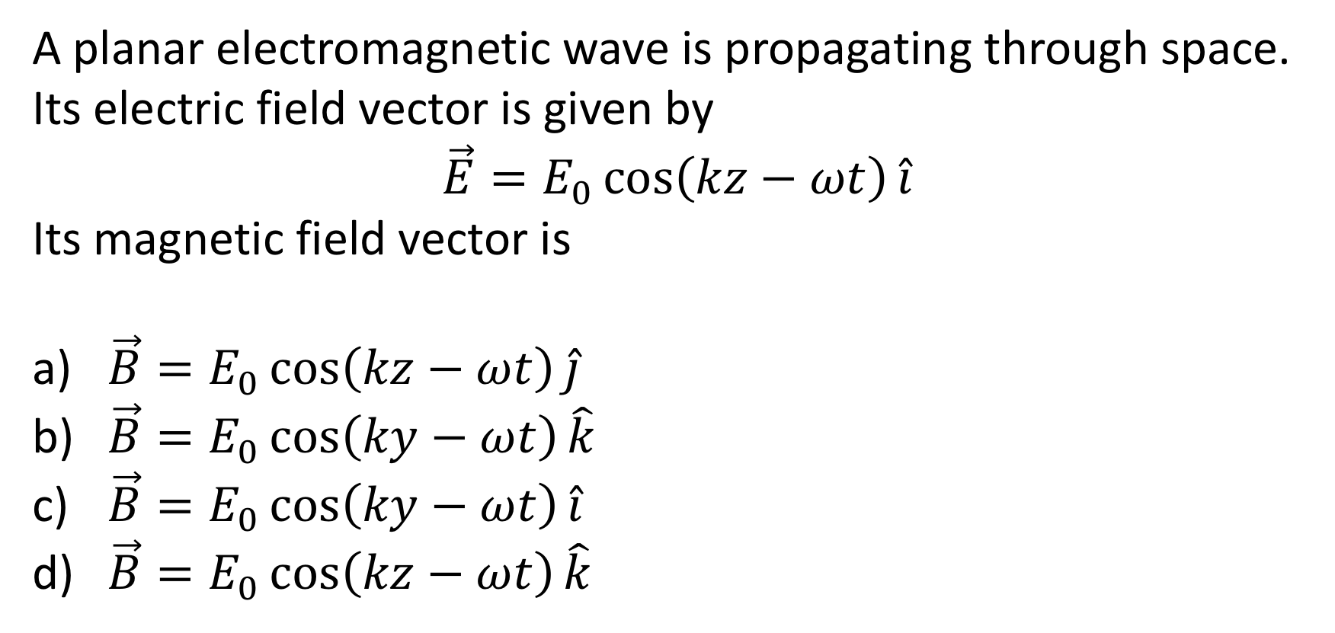
Section 30.6: Clicker Question 5
A planar electromagnetic wave is propagating through space. Its electric field vector is given by
$$\vec{E}=E_{0}\cos\left(kz−ωt\right)\hat{i}$$
Its magnetic field vector is
$\vec{B}=E_{0}\cos\left(kz−ωt\right)\hat{j}$
$\vec{B}=E_{0}\cos\left(ky−ωt\right)\hat{k}$
$\vec{B}=E_{0}\cos\left(ky−ωt\right)\hat{i}$
$\vec{B}=E_{0}\cos\left(kz−ωt\right)\hat{k}$

Slide 22
Electromagnetic Waves
Crab Nebula (visible wavelength)

Slide 23
Electromagnetic Waves
Crab Nebula (x-ray)

Slide 24
Concept Question: Superman
Since Superman is from the planet Krypton, his eyes are sensitive to the entire electromagnetic spectrum. Does that mean he can use X-ray vision to see that Lois Lane is being kidnapped in the other room?
yes, no problem
nope, he can’t
need more information
X-ray vision means that Superman’s eyes can receive X-rays…
…but not send them!
What would have to happen for him to see Lois being kidnapped?

Slide 25
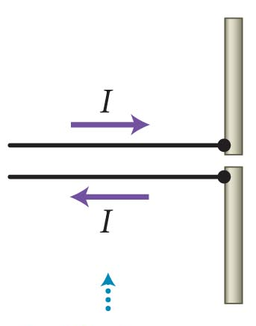
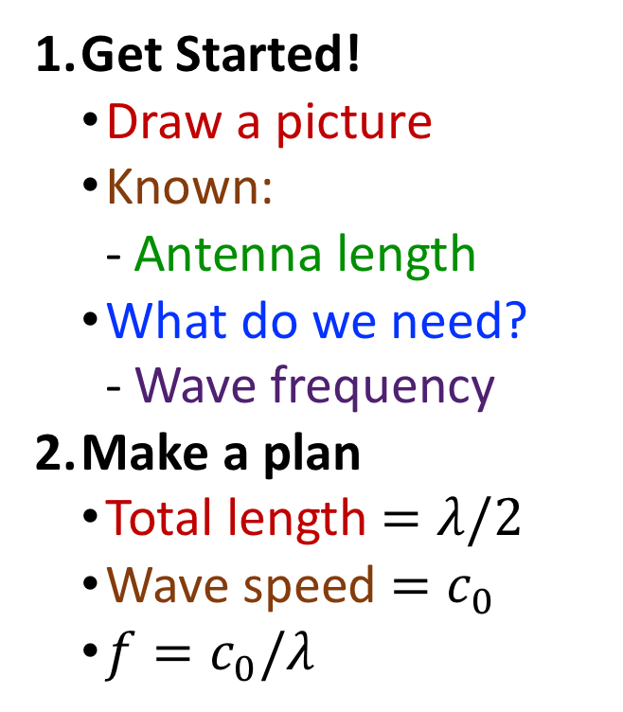
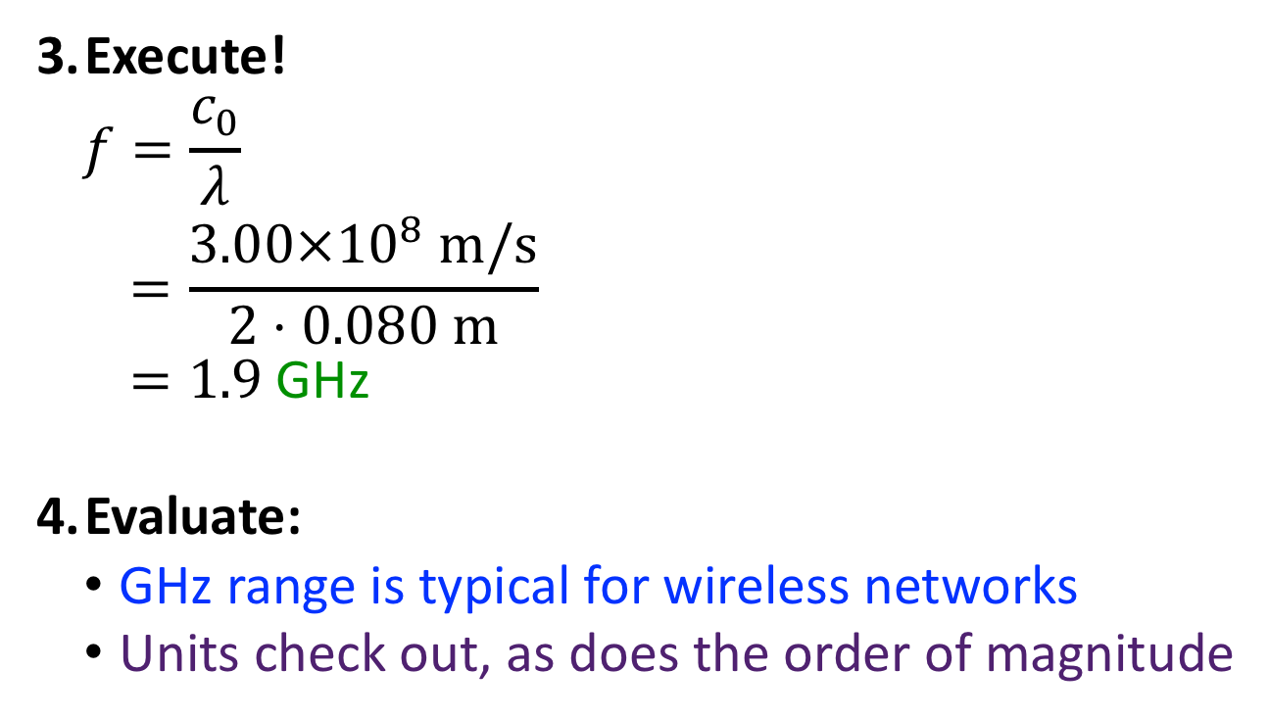
Example Problem: QP 30.41
The antenna of a WiFi access point has a length of about 80 mm. What does this say about the likely frequency of the wireless network?
Get Started!
  Draw a picture
  Known:
    Antenna length
  What do we need?
    Wave frequency
Make a plan
  Total length $=λ/2$
  Wave speed $=c_{0}$
  $f=c_{0}/λ$
Execute!
$$f=\frac{c_{0}}{λ}$$
$$=\frac{3.00×{10}^{8} m/s}{2⋅0.080 m}$$
$=1.9$ GHz
Evaluate:
GHz range is typical for wireless networks
Units check out, as does the order of magnitude

Slide 26
Example Problem: QP 30.43
Using electromagnetic waves, you generally cannot resolve any structures that are smaller than the wavelength you are using. CD, DVD, and Blu-ray players use small “pits” that encode the 0s and 1s of the digital information stored on them—the smaller the pits, the more information you can store. A DVD can store 4.7 GB, and a Blu-ray can store 25 GB. If a DVD player typically uses lasers that emit red light in the wavelength range from 640 nm to 660 nm, what do you expect the wavelength and color of a Blu-ray laser to be?

Slide 27

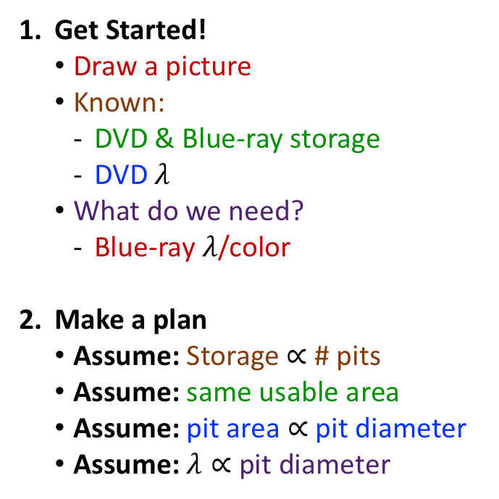



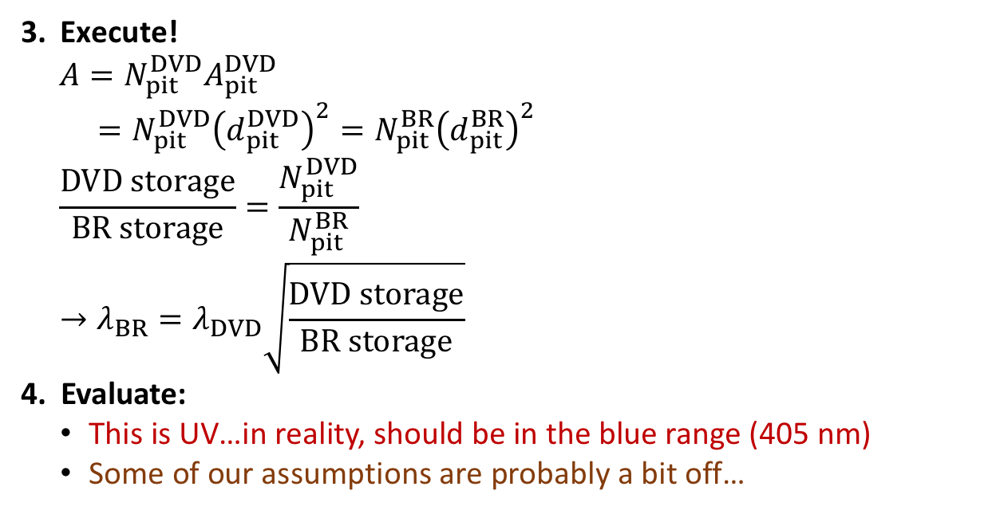

Example Problem: QP 30.43
Using electromagnetic waves, you generally cannot resolve any structures that are smaller than the wavelength you are using. CD, DVD, and Blu-ray players use small “pits” that encode the 0s and 1s of the digital information stored on them—the smaller the pits, the more information you can store. A DVD can store 4.7 GB, and a Blu-ray can store 25 GB. If a DVD player typically uses lasers that emit red light in the wavelength range from 640 nm to 660 nm, what do you expect the wavelength and color of a Blu-ray laser to be?
Get Started!
  Draw a picture
  Known:
    DVD & Blue-ray storage
    DVD $λ$
  What do we need?
    Blue-ray $λ$/color
Make a plan
  Assume: Storage $∝$ # pits
  Assume: same usable area
  Assume: pit area $∝$ pit diameter
  Assume: $λ∝$ pit diameter
Execute!
$$A=N_{pit}^{DVD}A_{pit}^{DVD}$$
$$=N_{pit}^{DVD}{\left(d_{pit}^{DVD}\right)}^{2}=N_{pit}^{BR}{\left(d_{pit}^{BR}\right)}^{2}$$
$$\frac{DVD storage}{BR storage}=\frac{N_{pit}^{DVD}}{N_{pit}^{BR}}$$
$$→λ_{BR}=λ_{DVD}\sqrt{\frac{DVD storage}{BR storage}}$$
Evaluate:
This is UV…in reality, should be in the blue range (405 nm)
Some of our assumptions are probably a bit off…
$$=N_{pit}^{BR}A_{pit}^{BR}$$
$$={\left(\frac{d_{pit}^{BR}}{d_{pit}^{DVD}}\right)}^{2}$$
$$={\left(\frac{λ_{BR}}{λ_{DVD}}\right)}^{2}$$
$$=\left(640 nm\right)\sqrt{\frac{4.7 GB}{25 GB}}$$
$$=277 nm$$

Slide 28




Example Problem: QP 30.46
If the electric field in an electromagnetic wave 100 mm from a radio-emitting antenna has a maximum magnitude of $6.0×{10}^{5}$ V/m, what is the maximum magnetic field magnitude 500 m from the antenna?
Get Started!
  Draw a picture
  Known:
    $E_{max}$ at $r=100$ mm
  What do we need?
    $B_{max}$ at $r=500$ m
Make a plan
  $E=c_{0}B$
  Treat like a point source:
    Energy spread over wavefront
    Energy $∝E^{2}∝1/r^{2}$
    $E∝1/r$
Execute!
Field at 500 m
$$E\left(r_{2}\right)=E\left(r_{1}\right)\frac{r_{1}}{r_{2}}$$
$$=\left(6.0×{10}^{5} V/m\right)\frac{0.100 m}{500 m}$$
$=120$ V/m
$$B=E/c_{0}$$
$$=\left(120 V/m\right)/\left(3.00×{10}^{8} m/s\right)$$
$=4.0×{10}^{−7}$ T
Evaluate:
$B\left(100 mm\right)=\left(4.0×{10}^{−7} T\right)\left(500 m/0.100 m\right)=0.0020$ T
$E\left(100 mm\right)=\left(3.00×{10}^{8} m/s\right)\left(0.0020 T\right)=6.0×{10}^{5}$ V/m

Slide 29

Section 30.7: Clicker Question 6
At a fixed point, P, the electric and magnetic field vectors in an electromagnetic wave oscillate at angular frequency $ω$. At what angular frequency does the Poynting vector oscillate at that point?
$2ω$
$ω$
$ω/2$
$4ω$

Slide 30






Example Problem: QP 30.56
A laser beam has a radius of 1.5 mm. How powerful does the laser have to be for the maximum magnitude of the magnetic field in the beam to be 5.0 $μ$T?
Get Started!
  Draw a picture
  Known:
    Beam radius & $B_{max}$
  What do we need?
    Power
Make a plan
  ${\vec{S}}_{max}={\vec{E}}_{max}×{\vec{B}}_{max}/μ_{0}$
    $E=c_{0}B$
    $P=S⋅A$
    $A=πr^{2}$
Execute!
$$S_{max}=\frac{E_{max}B_{max}}{μ_{0}}$$
$$P_{max}=S_{max}⋅A=\frac{c_{0}B_{max}^{2}}{μ_{0}}πr^{2}$$
$$=\frac{\left(3.00×{10}^{8} m/s\right){\left(5.0×{10}^{−6} T\right)}^{2}}{4π×{10}^{−7} Tm/A}π{\left(0.0015 m\right)}^{2}$$
$=0.042$ W
Evaluate:
Check the units!
Check the order of magnitude
$$r$$
$$=\frac{c_{0}B_{max}^{2}}{μ_{0}}$$
$$=\frac{c_{0}B_{max}^{2}}{μ_{0}}πr^{2}$$

Slide 31

Example Problem: QP 30.57
Sunlight on Earth has an intensity of about $S=1.0$ kW/${\text{m}}^{2}$. How much power can be harvested from a solar energy panel that is 2.0 m long and 1.6 m wide if the sunlight comes in at an angle of $θ=20°$ with respect to the surface normal vector of the panel and the panel is 20% efficient?

Slide 32





Example Problem: QP 30.57
Sunlight on Earth has an intensity of about $S=1.0$ kW/${\text{m}}^{2}$. How much power can be harvested from a solar energy panel that is 2.0 m long and 1.6 m wide if the sunlight comes in at an angle of $θ=20°$ with respect to the normal vector of the panel and the panel is 20% efficient?
Get Started!
  Draw a picture
  Known:
    $S$, $l$, $w$, $θ$, efficiency
  What do we need?
    Power
Make a plan
  $P=\int{\vec{S}⋅d\vec{A}}$
    If uniform across surface
    $P=\vec{S}⋅\vec{A}=SA\cos{θ}$
  Multiply by efficiency
Execute!
$$P=εSA\cos{θ}$$
$$=\left(0.20\right)\left(1.0×{10}^{3} W/m^{2}\right)\left(2.0 m⋅1.6 m\right)\cos{20°}$$
$=601$ W
Evaluate:
Check the order of magnitude
$$\hat{A}$$
$$θ$$

Slide 33

Concept Question: Polarization
If unpolarized light is incident from the left, in which case will some light get through?
only case 1
only case 2
only case 3
cases 1 and 3
all three cases
1
2
Cases 1 & 3: light blocked by adjacent horizontal and vertical polarizers
Case 2: $45°$ polarizer allows some light through last vertical polarizer
3

Slide 34


Example Problem: QP 30.63
A polarizing filter is a plastic sheet that allows only certain components of the electric field in an electromagnetic wave to pass through, and a wave that has passed through such a filter is said to be polarized. After a wave has passed through the filter shown in the figure, for instance, the wave’s electric field contains only the vertical components of all the electric field vectors present before the wave passed through. Because the horizontal components have been blocked, the wave has lost half of its initial intensity. If this polarized wave then passes through the filter of the figure, where the filter-polarizing direction is at an angle $θ$ to the direction of the vertically polarized wave, the wave loses more of its intensity. If the polarized wave has an intensity $S_{before}=200$ $W/m^{2}$ before passing through the filter of the figure and $θ=20.0°$, what is the intensity after the wave passes through?

Slide 35



Example Problem: QP 30.63
After a wave has passed through the filter shown in the figure, for instance, the wave’s electric field contains only the vertical components of all the electric field vectors present before the wave passed through. Because the horizontal components have been blocked, the wave has lost half its initial intensity. If this polarized wave passes through the filter of the figure, where the filter-polarizing direction is at an angle $θ$ to the direction of the vertically polarized wave, the wave loses more of its intensity. If the polarized wave has an intensity $S_{before}=200$ $W/m^{2}$ before passing through the filter of the figure and $θ=20.0°$, what is the intensity after the wave passes through?
Get Started!
  Draw a picture (given)
  Known:
    $S_{before}$, $θ$
  What do we need?
    $S_{after}$
Make a plan
  After: $E_{after}=E_{before}\cos{θ}$
  $S=EB/μ_{0}$
    $E=c_{0}B$
    $→S=E^{2}/c_{0}μ_{0}$
Execute!
$$S_{after}=\frac{E_{after}^{2}}{c_{0}μ_{0}}$$
$$=\frac{E_{before}^{2}\cos^{2}{θ}}{c_{0}μ_{0}}$$
$$=S_{before}\cos^{2}{θ}$$
$$=\left(200 W/m^{2}\right)\cos^{2}{20.0°}$$
$$=177 W/m^{2}$$
Evaluate:
Minimum transmission when $θ=90°$
Maximum transmission when $θ=0°$

