Slide 1
Chapter 14: Special Relativity
Notes:
The Persistence of Memory, Salvador Dalí, 1931

Slide 2


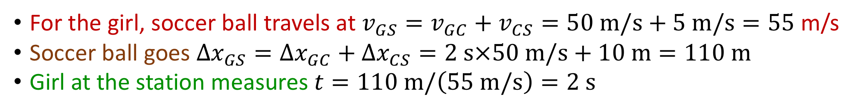

The Boxcar
A boxcar moves right at 50 m/s. A physics professor kicks a soccer ball at 5 m/s toward the front of the car. Since the boxcar is 10 m long, he measures the time it takes for the ball to reach the front wall to be t = 10 m / 5 m/s = 2 seconds. What time does the girl at the station measure?
2 s
more than 2 s
less than 2 s
10 m
5 m/s
50 m/s
For the girl, soccer ball travels at $v_{GS}=v_{GC}+v_{CS}=50 m/s+5 m/s=55$ m/s
Soccer ball goes $Δx_{GS}=Δx_{GC}+Δx_{CS}=2 s×50 m/s+10 m=110 m$
Girl at the station measures $t=110 m/\left(55 m/s\right)=2 s$

Slide 3



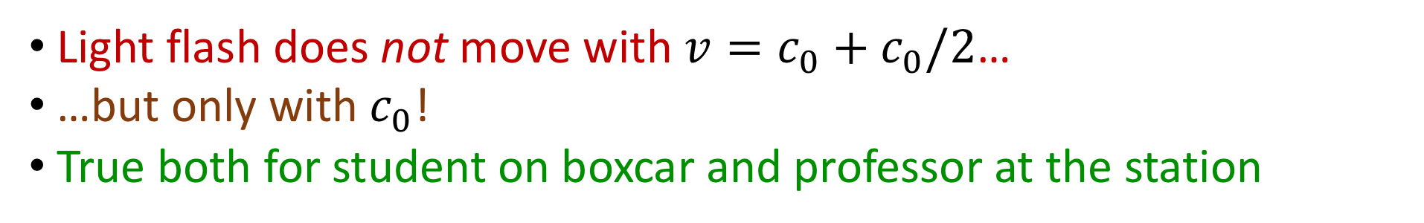
The Boxcar
A boxcar moves right at $v=c_{0}/2$. A physics student sends a light flash toward the front of the car and measures the light flash speed to be $c_{0}$. What speed will the physics professor at the station measure for the light flash?
$v=3c_{0}/2$
$v=c_{0}/2$
$v=c_{0}$
10 m
$$c_{0}/2$$
Light flash does not move with $v=c_{0}+c_{0}/2$…
…but only with $c_{0}$!
True both for student on boxcar and professor at the station

Slide 4
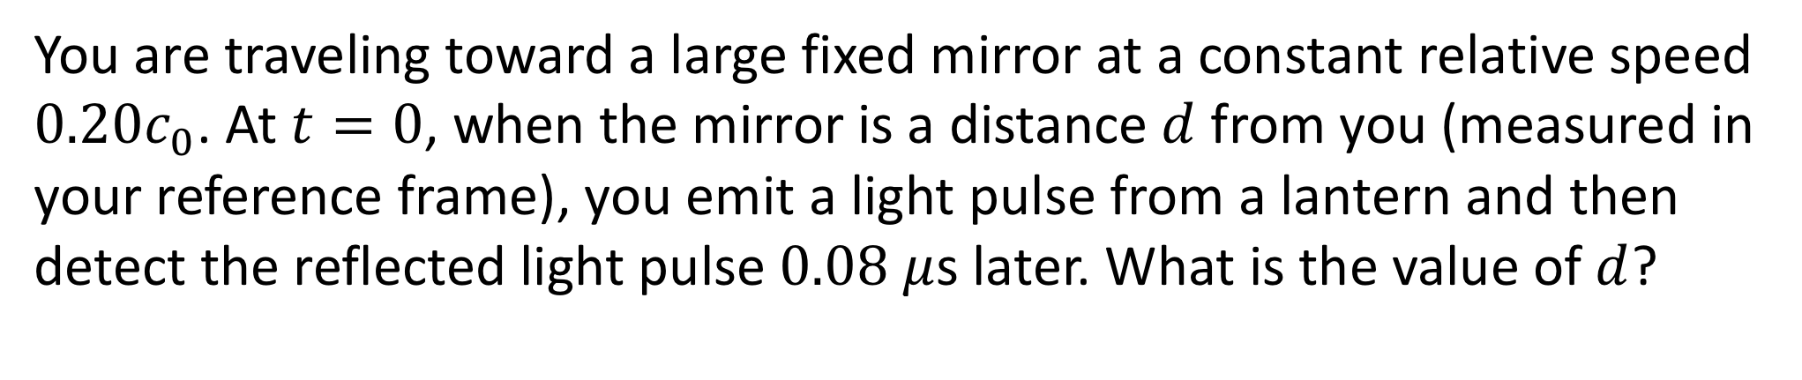
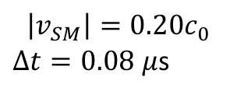

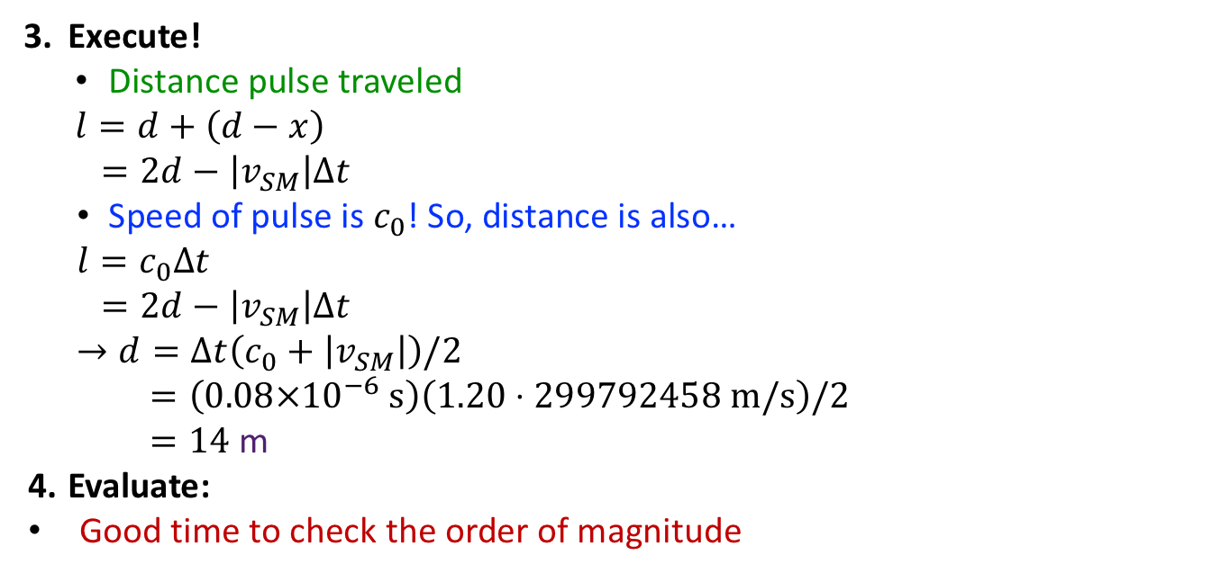
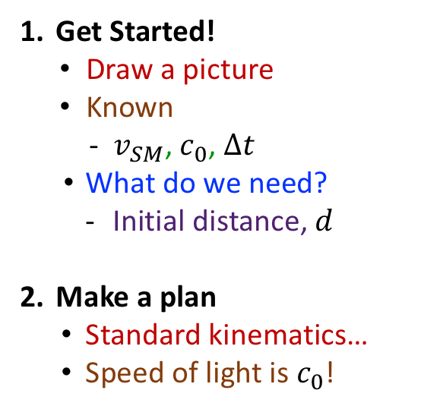
Example Problem: 14.9
You are traveling toward a large fixed mirror at a constant relative speed $0.20c_{0}$. At $t=0$, when the mirror is a distance $d$ from you (measured in your reference frame), you emit a light pulse from a lantern and then detect the reflected light pulse $0.08$ $μ$s later. What is the value of $d$?
Get Started!
  Draw a picture
  Known
    $v_{SM}$, $c_{0}$, $Δt$
  What do we need?
    Initial distance, $d$
Make a plan
  Standard kinematics…
  Speed of light is $c_{0}$!
Execute!
Distance pulse traveled
$$l=d+\left(d−x\right)$$
$$=2d−\left|v_{SM}\right|Δt$$
Speed of pulse is $c_{0}$! So, distance is also…
$$l=c_{0}Δt$$
$$=2d−\left|v_{SM}\right|Δt$$
$$→d=Δt\left(c_{0}+\left|v_{SM}\right|\right)/2$$
$$=\left(0.08×{10}^{−6} s\right)\left(1.20⋅299792458 m/s\right)/2$$
$=14$ m
Evaluate:
Good time to check the order of magnitude
$$d$$
$$\left|v_{SM}\right|=0.20c_{0}$$
$Δt=0.08$ $μ$s

Slide 5
Section 14.3: Clicker Question 3
Clock A is moving relative to identical clock B. To an observer at rest relative to B, how does the rate at which A runs compare with the rate at which B runs?
Both clocks “run” the same.
Clock A runs slow compared to clock B.
Clock B runs slow compared to clock A.

Slide 6

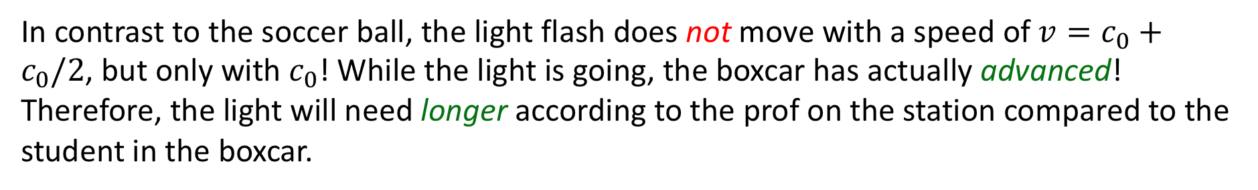
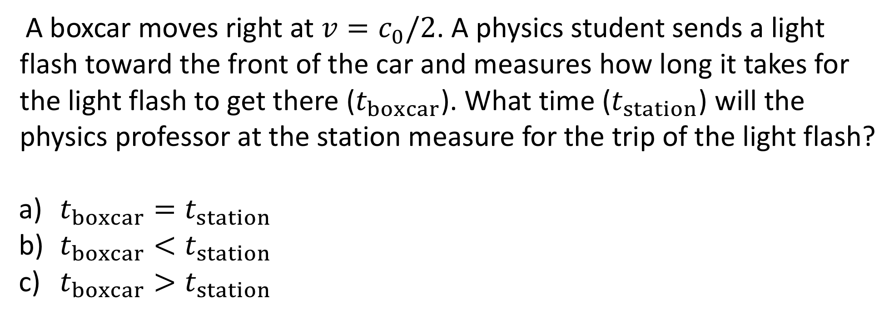
The Boxcar
A boxcar moves right at $v=c_{0}/2$. A physics student sends a light flash toward the front of the car and measures how long it takes for the light flash to get there ($t_{boxcar}$). What time ($t_{station}$) will the physics professor at the station measure for the trip of the light flash?
$t_{boxcar}=t_{station}$
$t_{boxcar}<t_{station}$
$t_{boxcar}>t_{station}$
10 m
$$c_{0}/2$$
In contrast to the soccer ball, the light flash does not move with a speed of $v=c_{0}+c_{0}/2$, but only with $c_{0}$! While the light is going, the boxcar has actually advanced! Therefore, the light will need longer according to the prof on the station compared to the student in the boxcar.

Slide 7
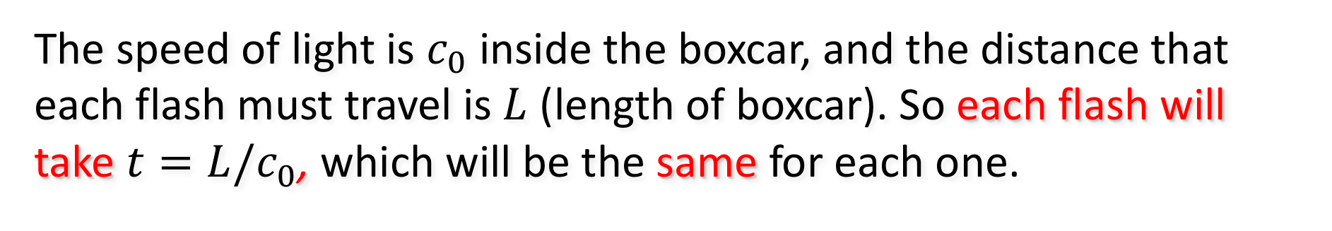

The Boxcar
A boxcar moves right at a very high speed. A green flash of light moves from left to right, and a blue flash from right to left. For someone with sophisticated measuring equipment in the boxcar, which flash takes longer to go from one end to the other?
the blue flash
the green flash
both the same
$$\vec{v}$$
Simultaneous
The speed of light is $c_{0}$ inside the boxcar, and the distance that each flash must travel is $L$ (length of boxcar). So each flash will take $t=L/c_{0}$, which will be the same for each one.

Slide 8
The Boxcar
A boxcar moves right at a very high speed. A green flash of light moves from left to right, and a blue flash from right to left. According to an observer on the ground, which flash takes longer to go from one end to the other?
the blue flash
the green flash
both the same
$$\vec{v}$$
Simultaneous
The ground observer still sees the light moving at speed c. But while the light is going, the boxcar has actually advanced. The back wall is moving toward the blue flash, and the front wall is moving away from the green flash. Thus, the green flash has a longer distance to travel and takes a longer time.

Slide 9
Concept Question
An astronaut moves away from Earth at close to the speed of light. How would an observer on Earth measure the astronaut’s pulse rate?
It would be faster
It would be slower
It wouldn’t change
No pulse - the astronaut died a long time ago!
The astronaut’s pulse would function like a clock. Since time moves slower in a moving reference frame, the observer on Earth would measure a slower pulse.

Slide 10
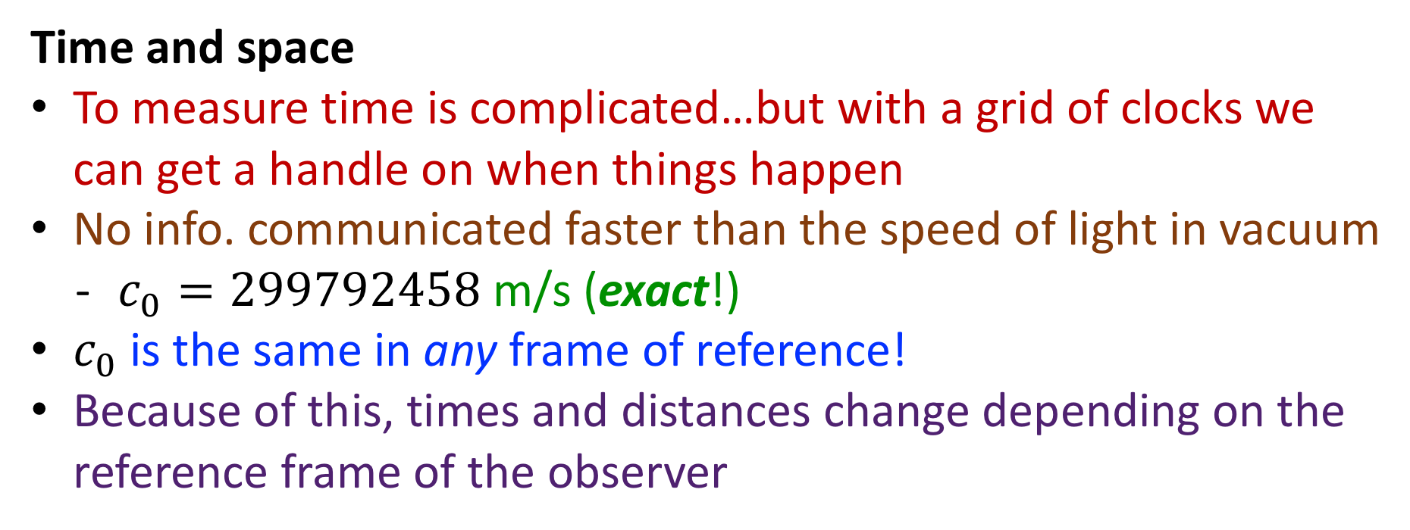
Highlights: Section 14.1-14.4
Time and space
To measure time is complicated…but with a grid of clocks we can get a handle on when things happen
No info. communicated faster than the speed of light in vacuum
  $c_{0}=299792458$ m/s (exact!)
$c_{0}$is the same in any frame of reference!
Because of this, times and distances change depending on the reference frame of the observer

Slide 11
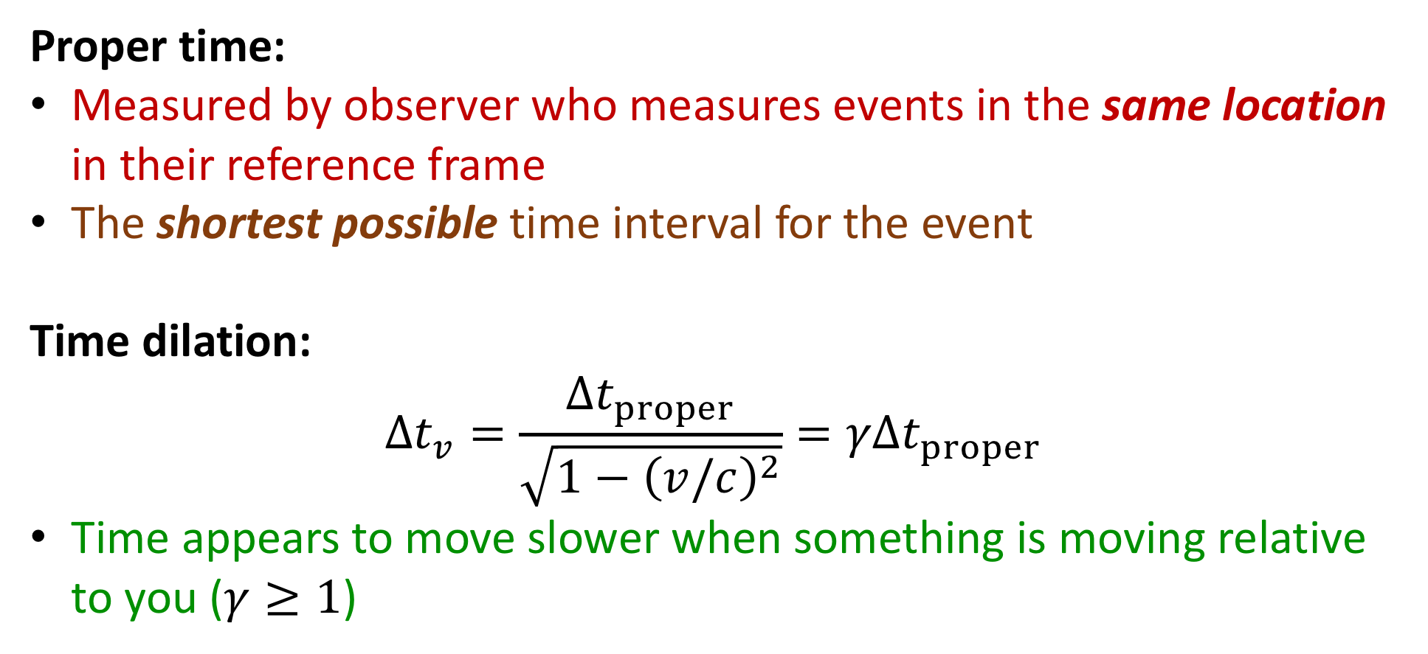
Highlights: Section 14.1-14.4
Proper time:
Measured by observer who measures events in the same location in their reference frame
The shortest possible time interval for the event
Time dilation:
$$Δt_{v}=\frac{Δt_{proper}}{\sqrt{1−{\left(v/c\right)}^{2}}}=γΔt_{proper}$$
Time appears to move slower when something is moving relative to you ($γ≥1$)

Slide 12
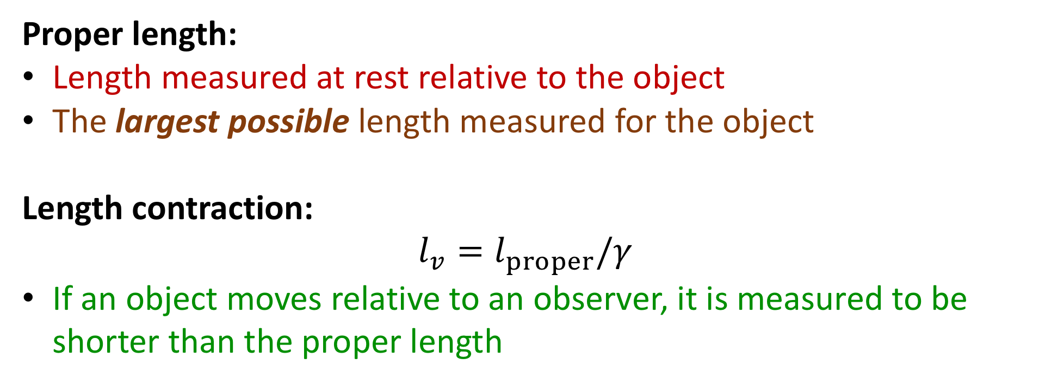
Highlights: Section 14.1-14.4
Proper length:
Length measured at rest relative to the object
The largest possible length measured for the object
Length contraction:
$$l_{v}=l_{proper}/γ$$
If an object moves relative to an observer, it is measured to be shorter than the proper length

Slide 13
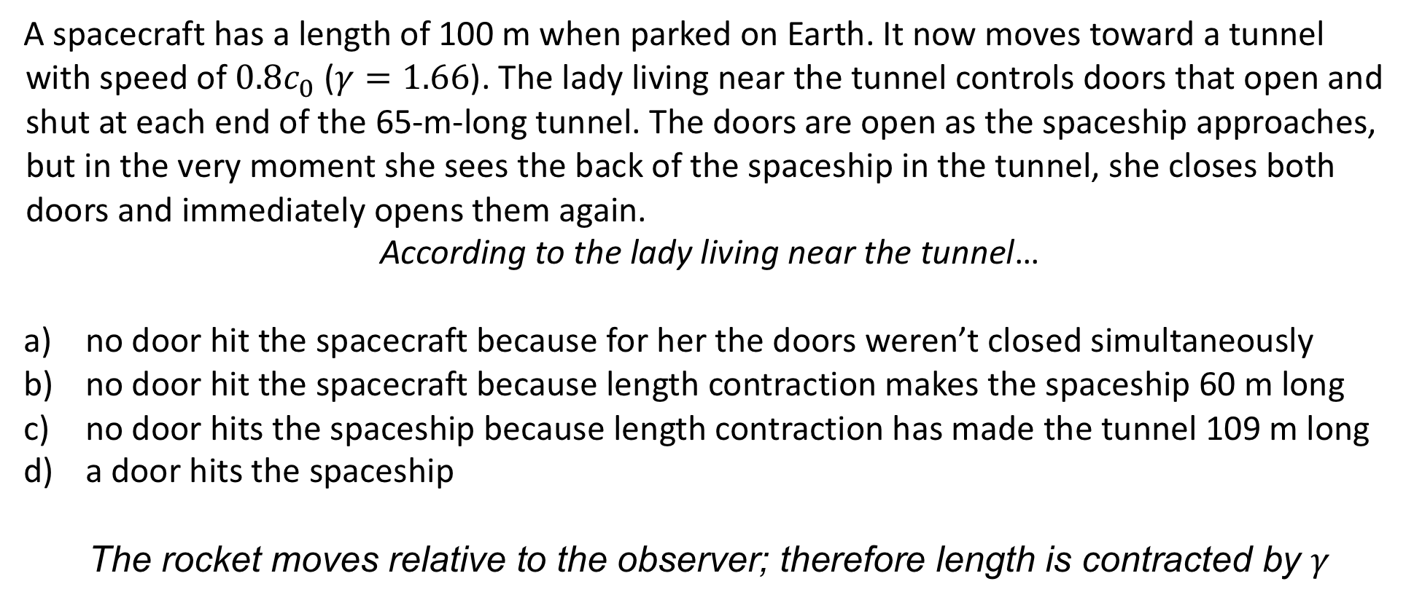
The Tunnel
A spacecraft has a length of 100 m when parked on Earth. It now moves toward a tunnel with speed of $0.8c_{0}$ ($γ=1.66$). The lady living near the tunnel controls doors that open and shut at each end of the 65-m-long tunnel. The doors are open as the spaceship approaches, but in the very moment she sees the back of the spaceship in the tunnel, she closes both doors and immediately opens them again.
According to the lady living near the tunnel…
no door hit the spacecraft because for her the doors weren’t closed simultaneously
no door hit the spacecraft because length contraction makes the spaceship 60 m long
no door hits the spaceship because length contraction has made the tunnel 109 m long
a door hits the spaceship
The rocket moves relative to the observer; therefore length is contracted by $γ$

Slide 14
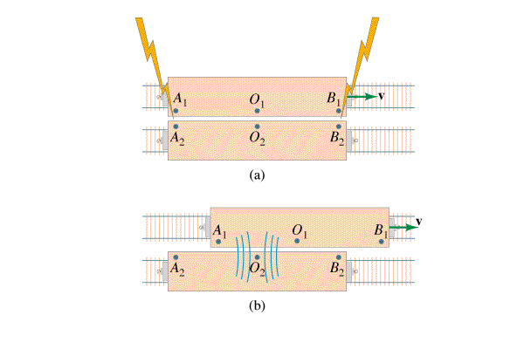
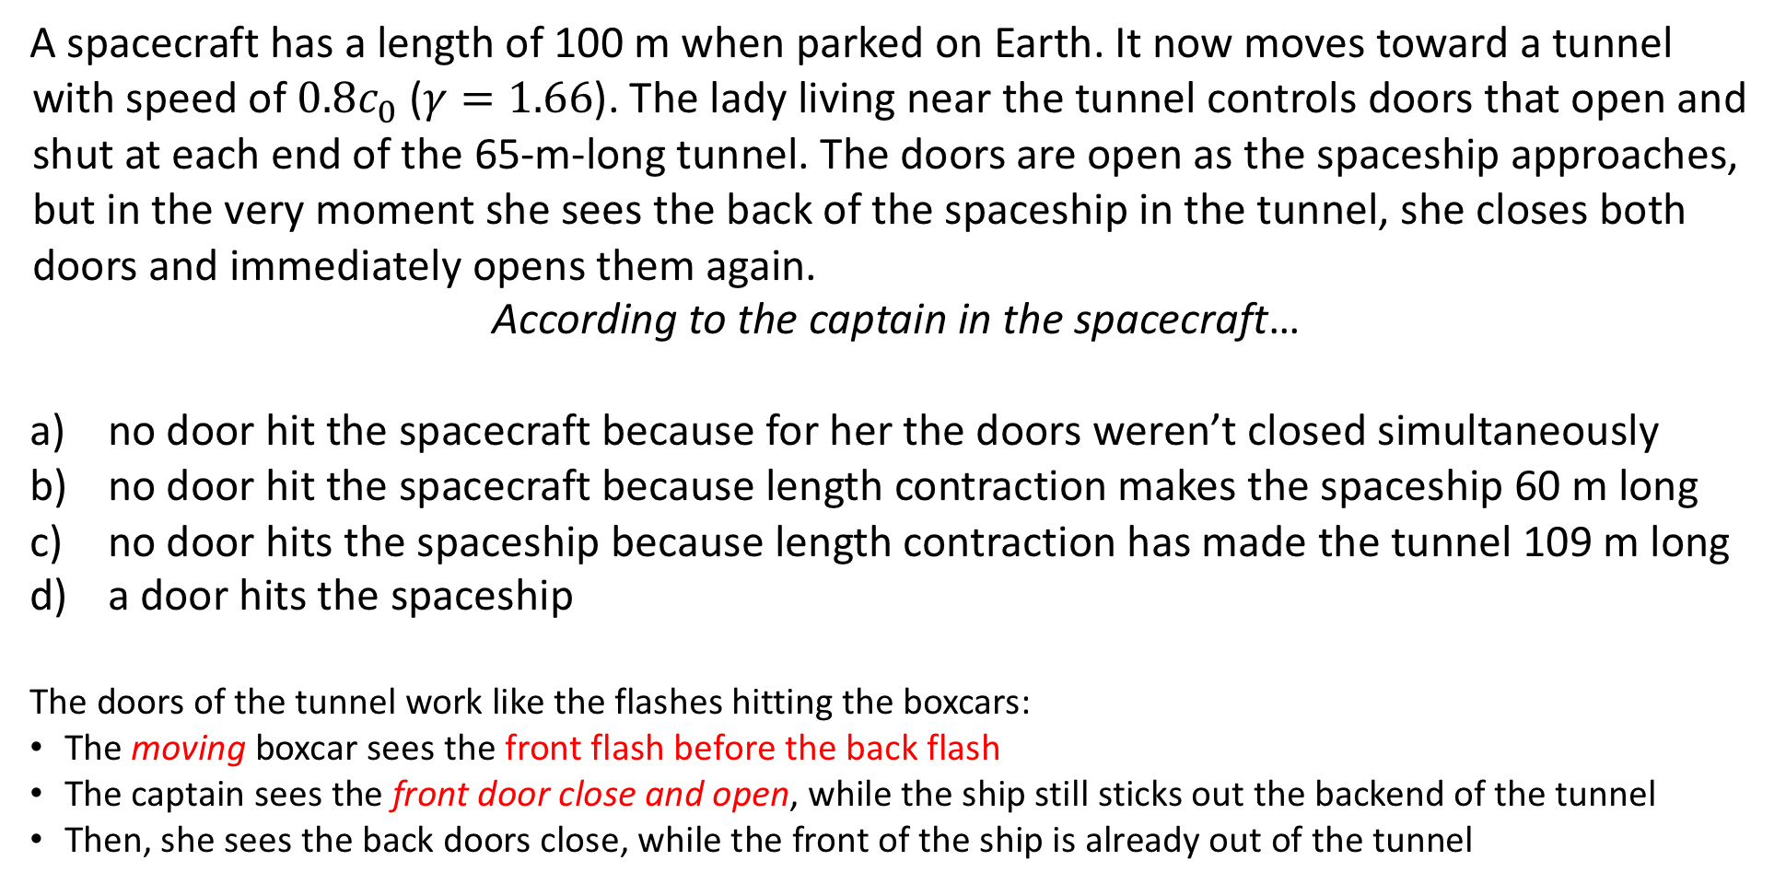
The Tunnel
A spacecraft has a length of 100 m when parked on Earth. It now moves toward a tunnel with speed of $0.8c_{0}$ ($γ=1.66$). The lady living near the tunnel controls doors that open and shut at each end of the 65-m-long tunnel. The doors are open as the spaceship approaches, but in the very moment she sees the back of the spaceship in the tunnel, she closes both doors and immediately opens them again.
According to the captain in the spacecraft…
no door hit the spacecraft because for her the doors weren’t closed simultaneously
no door hit the spacecraft because length contraction makes the spaceship 60 m long
no door hits the spaceship because length contraction has made the tunnel 109 m long
a door hits the spaceship
The doors of the tunnel work like the flashes hitting the boxcars:
The moving boxcar sees the front flash before the back flash
The captain sees the front door close and open, while the ship still sticks out the backend of the tunnel
Then, she sees the back doors close, while the front of the ship is already out of the tunnel

Slide 15
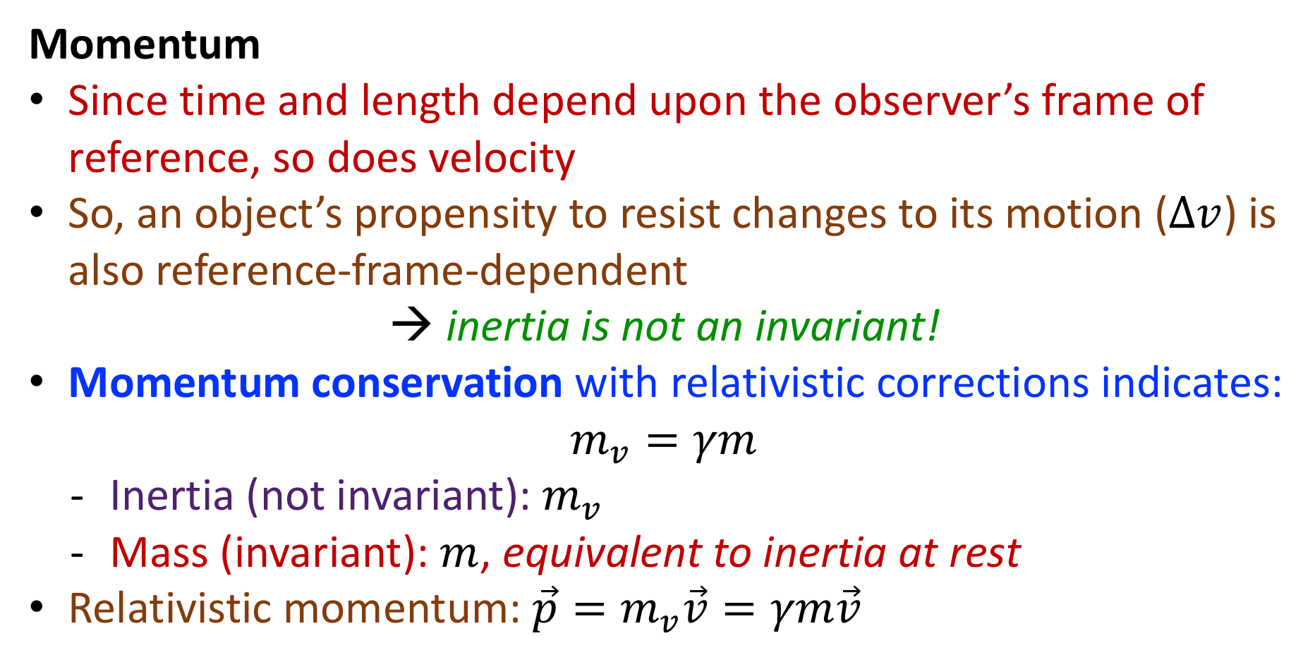
Highlights: Section 14.1-14.4
Momentum
Since time and length depend upon the observer’s frame of reference, so does velocity
So, an object’s propensity to resist changes to its motion ($Δv$) is also reference-frame-dependent
→ inertia is not an invariant!
Momentum conservation with relativistic corrections indicates:
$$m_{v}=γm$$
  Inertia (not invariant): $m_{v}$
  Mass (invariant): $m$, equivalent to inertia at rest
Relativistic momentum: $\vec{p}=m_{v}\vec{v}=γm\vec{v}$

Slide 16
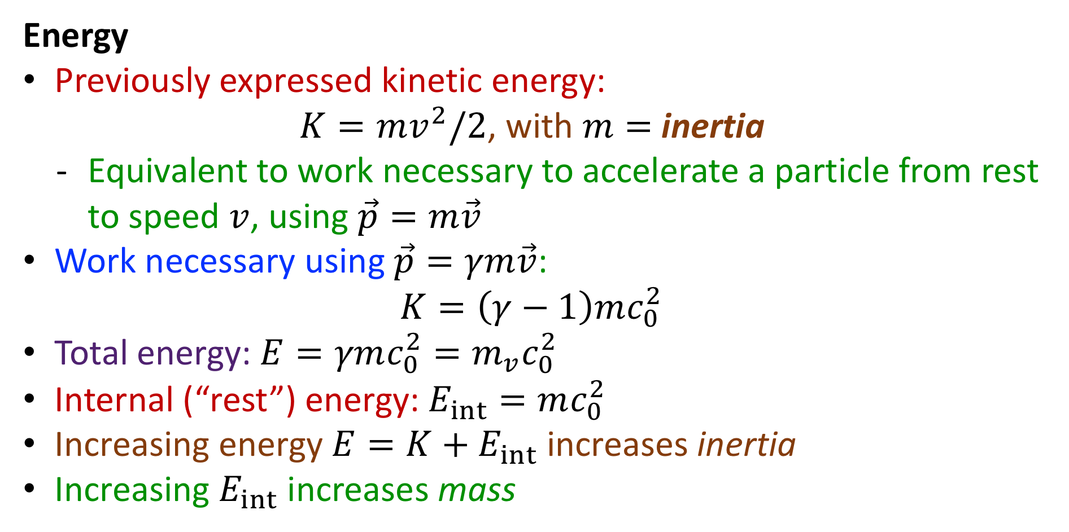
Highlights: Section 14.1-14.4
Energy
Previously expressed kinetic energy:
$K=mv^{2}/2$, with $m=$ inertia
  Equivalent to work necessary to accelerate a particle from rest to speed $v$, using $\vec{p}=m\vec{v}$
Work necessary using $\vec{p}=γm\vec{v}$:
$$K=\left(γ−1\right)mc_{0}^{2}$$
Total energy: $E=γmc_{0}^{2}=m_{v}c_{0}^{2}$
Internal (“rest”) energy: $E_{int}=mc_{0}^{2}$
Increasing energy $E=K+E_{int}$ increases inertia
Increasing $E_{int}$ increases mass

Slide 17
Section 14.4: Clicker Question 4
Which of the following variables depend on the reference frame of the person measuring them? Answer all that apply.
Inertia
Mass
Kinetic energy
Internal energy

Slide 18
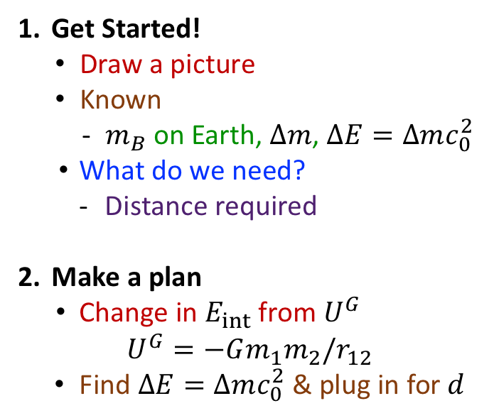
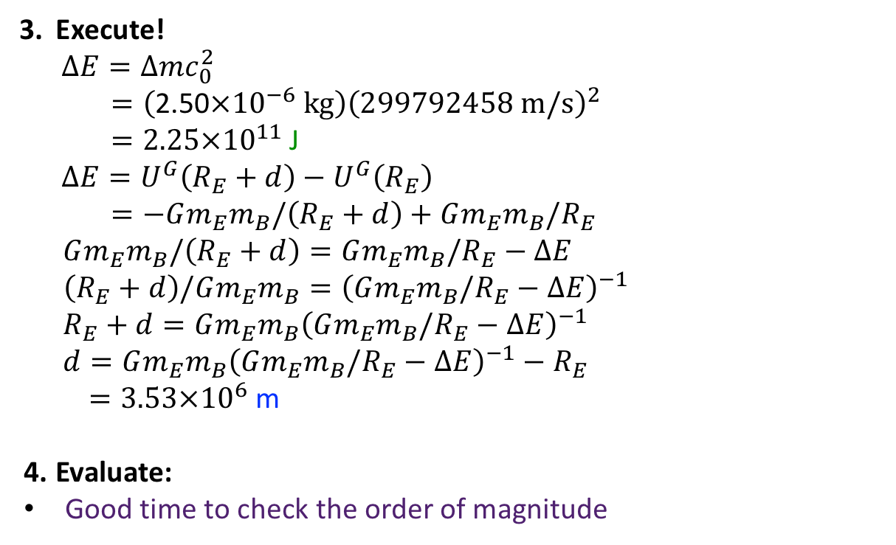
Example Problem: 14.25
How far above Earth’s surface must a 10,000-kg boulder be moved to increase the mass of the Earth-boulder system by 2.50 mg?
Get Started!
  Draw a picture
  Known
    $m_{B}$ on Earth, $Δm$, $ΔE=Δmc_{0}^{2}$
  What do we need?
    Distance required
Make a plan
  Change in $E_{int}$ from $U^{G}$
$$U^{G}=−Gm_{1}m_{2}/r_{12}$$
Find $ΔE=Δmc_{0}^{2}$ & plug in for $d$
Execute!
$$ΔE=Δmc_{0}^{2}$$
$$=\left(\text{2.50}×{10}^{−6} kg\right){\left(299792458 m/s\right)}^{2}$$
$=2.25×{10}^{11}$ J
$$ΔE=U^{G}\left(R_{E}+d\right)−U^{G}\left(R_{E}\right)$$
$$=−Gm_{E}m_{B}/\left(R_{E}+d\right)+Gm_{E}m_{B}/R_{E}$$
$$Gm_{E}m_{B}/\left(R_{E}+d\right)=Gm_{E}m_{B}/R_{E}−ΔE$$
$$\left(R_{E}+d\right)/Gm_{E}m_{B}={\left(Gm_{E}m_{B}/R_{E}−ΔE\right)}^{−1}$$
$$R_{E}+d=Gm_{E}m_{B}{\left(Gm_{E}m_{B}/R_{E}−ΔE\right)}^{−1}$$
$$d=Gm_{E}m_{B}{\left(Gm_{E}m_{B}/R_{E}−ΔE\right)}^{−1}−R_{E}$$
$=3.53×{10}^{6}$ m
Evaluate:
Good time to check the order of magnitude

Slide 19
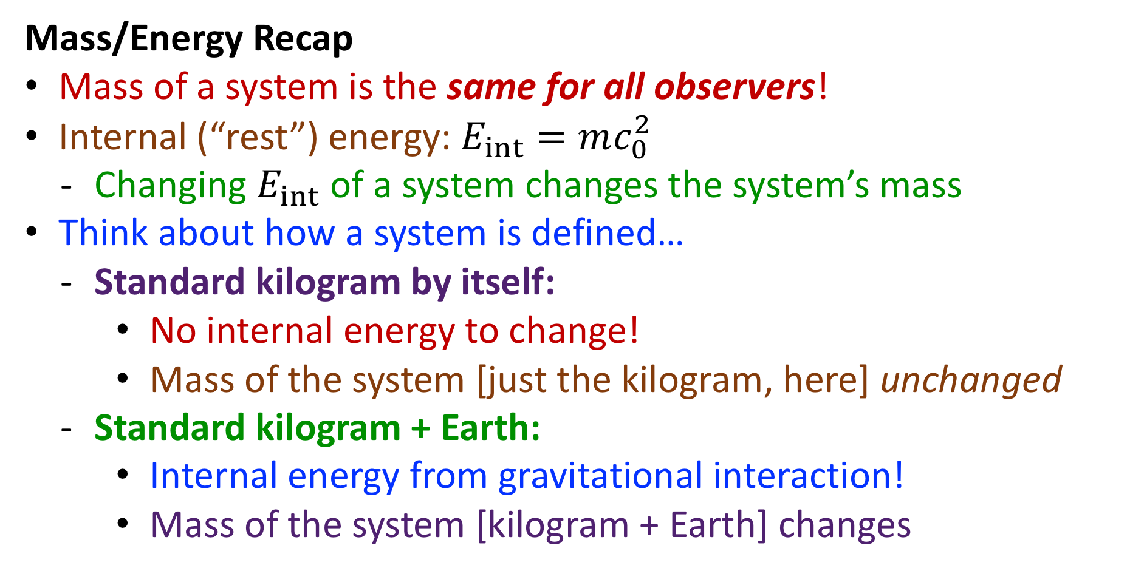
Highlights: Section 14.1-14.4
Mass/Energy Recap
Mass of a system is the same for all observers!
Internal (“rest”) energy: $E_{int}=mc_{0}^{2}$
  Changing $E_{int}$ of a system changes the system’s mass
Think about how a system is defined…
  Standard kilogram by itself:
    No internal energy to change!
    Mass of the system [just the kilogram, here] unchanged
  Standard kilogram + Earth:
    Internal energy from gravitational interaction!
    Mass of the system [kilogram + Earth] changes

Slide 20
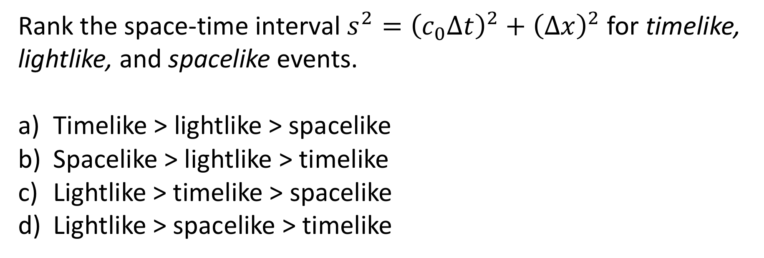
Section 14.5: Clicker Question 5
Rank the space-time interval $s^{2}={\left(c_{0}Δt\right)}^{2}+{\left(Δx\right)}^{2}$ for timelike, lightlike, and spacelike events.
Timelike > lightlike > spacelike
Spacelike > lightlike > timelike
Lightlike > timelike > spacelike
Lightlike > spacelike > timelike

Slide 21
Example Problem: 14.32
Planets A and B are 10 light years apart in the reference frame of planet A (one light year is the distance light travels in one year). A deep-space probe is launched from A, and 5 y later (in reference frame A) a similar probe is launched from B. Does a reference frame exist in which these two events
are simultaneous and
occur at the same positions?
Compute, if possible, the proper time interval between the events?
How do your answers to parts a)-c) change if the planets are (in reference frame A) 5 light years apart and the time interval between launch from A and launch from B is 10 y?

Slide 22

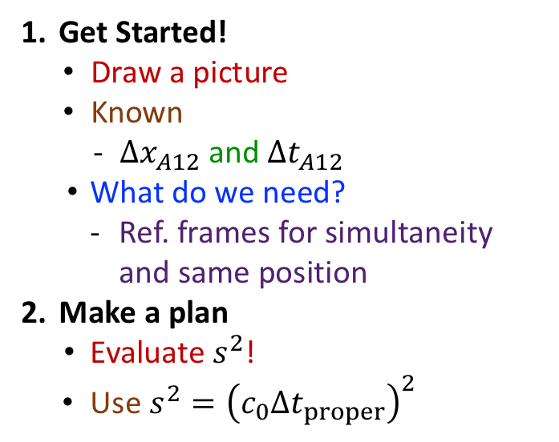



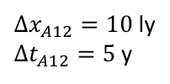

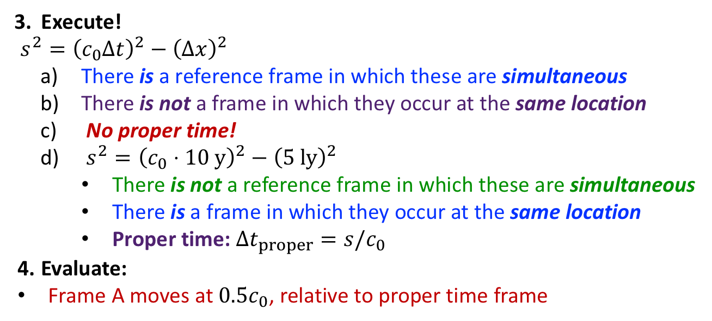

Example Problem: 14.32
Planets A and B are 10 light years apart in the reference frame of planet A (one light year is the distance light travels in one year). A deep-space probe is launched from A, and 5 y later (in reference frame A) a similar probe is launched from B. Does a reference frame exist in which these two events
are simultaneous and
occur at the same positions?
Compute, if possible, the proper time interval between the events?
How do answers to a)-c) change if planets are (in frame A) 5 ly apart and interval between launches is 10 y?
${Δx}_{A12}=10$ ly
${Δt}_{A12}=5$ y
Get Started!
  Draw a picture
  Known
    ${Δx}_{A12}$ and ${Δt}_{A12}$
  What do we need?
    Ref. frames for simultaneity and same position
Make a plan
  Evaluate $s^{2}$!
Use $s^{2}={\left(c_{0}Δt_{proper}\right)}^{2}$
Execute!
$s^{2}={\left(c_{0}Δt\right)}^{2}−{\left(Δx\right)}^{2}$
  There is a reference frame in which these are simultaneous
  There is not a frame in which they occur at the same location
  No proper time!
  $s^{2}={\left(c_{0}⋅10 y\right)}^{2}−{\left(5 ly\right)}^{2}$
    There is not a reference frame in which these are simultaneous
    There is a frame in which they occur at the same location
    Proper time: $Δt_{proper}=s/c_{0}$
Evaluate:
Frame A moves at ${0.5c}_{0}$, relative to proper time frame
$$={\left(c_{0}⋅5 y\right)}^{2}−{\left(10 ly\right)}^{2}$$
$$=−75 {ly}^{2}$$
-- “space-like”
$$=+75 {ly}^{2}$$
-- “time-like”
$$=\sqrt{75 {ly}^{2}}/c_{0}$$
$=8.7$ y
→ ${Δx}_{A12}=5$ ly

Slide 23
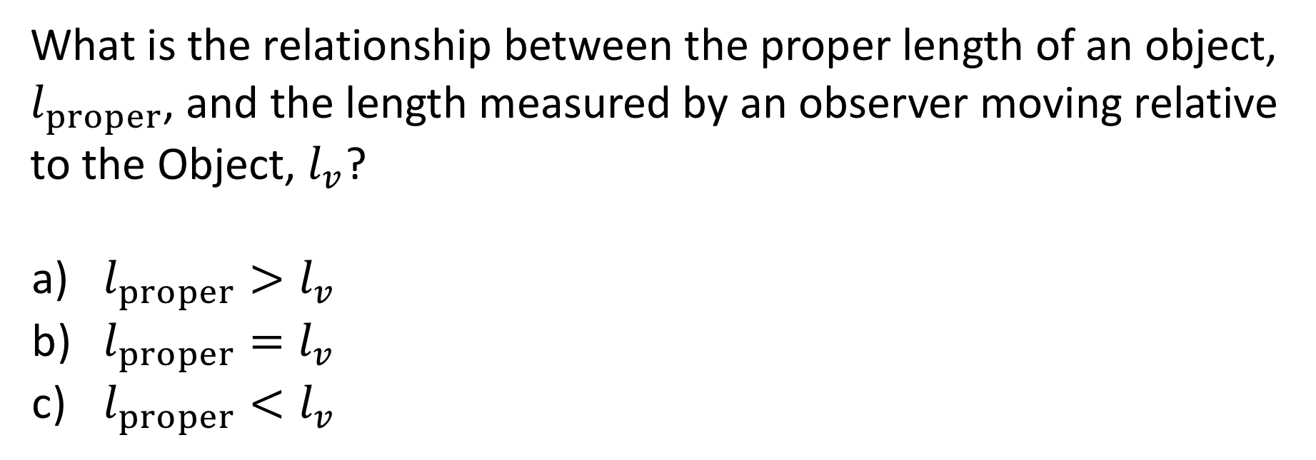
Section 14.6: Clicker Question 6
What is the relationship between the proper length of an object, $l_{proper}$, and the length measured by an observer moving relative to the Object, $l_{v}$?
$l_{proper}>l_{v}$
$l_{proper}=l_{v}$
$l_{proper}<l_{v}$

Slide 24
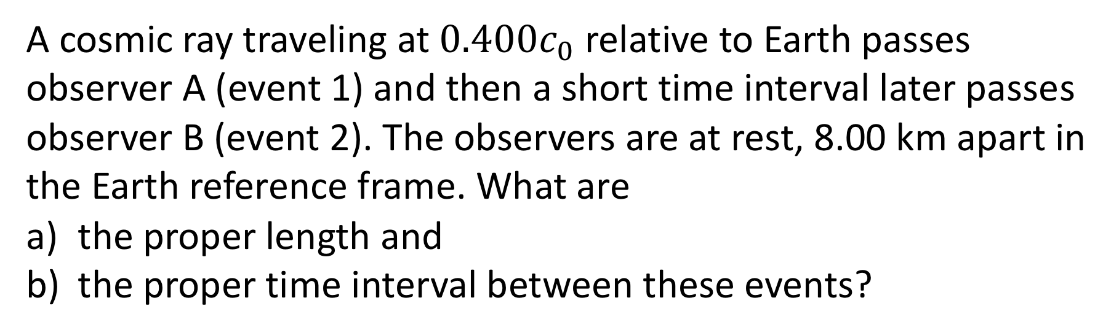
Example Problem: 14.35
A cosmic ray traveling at $0.400c_{0}$ relative to Earth passes observer A (event 1) and then a short time interval later passes observer B (event 2). The observers are at rest, 8.00 km apart in the Earth reference frame. What are
the proper length and
the proper time interval between these events?

Slide 25
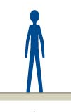

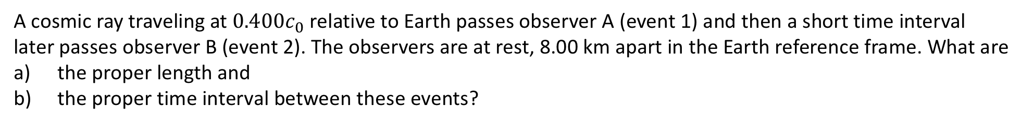

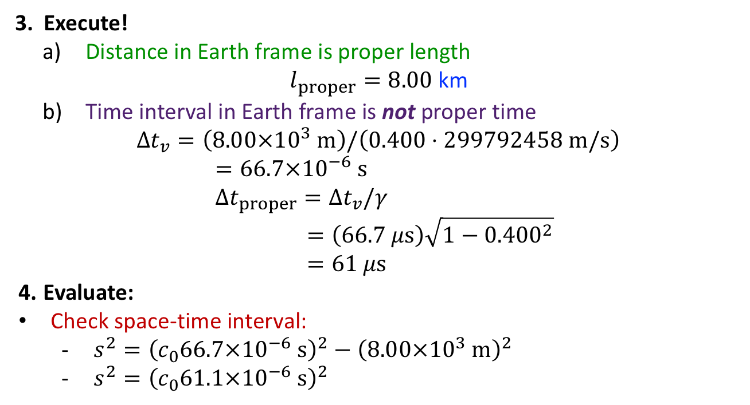

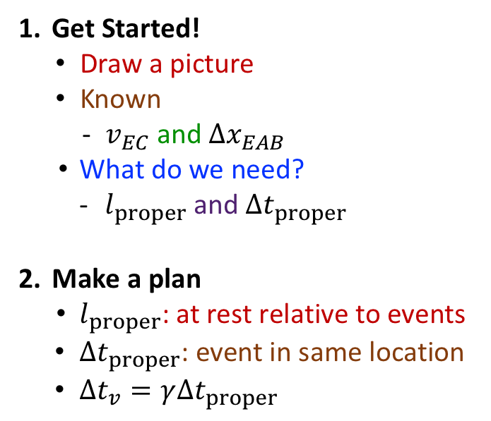

Example Problem: 14.35
A cosmic ray traveling at $0.400c_{0}$ relative to Earth passes observer A (event 1) and then a short time interval later passes observer B (event 2). The observers are at rest, 8.00 km apart in the Earth reference frame. What are
the proper length and
the proper time interval between these events?
$$v_{EC}$$
Get Started!
  Draw a picture
  Known
    $v_{EC}$ and ${Δx}_{EAB}$
  What do we need?
    $l_{proper}$ and ${Δt}_{proper}$
Make a plan
  $l_{proper}$: at rest relative to events
${Δt}_{proper}$: event in same location
${Δt}_{v}=γ{Δt}_{proper}$
Execute!
  Distance in Earth frame is proper length
  $l_{proper}=8.00$ km
  Time interval in Earth frame is not proper time
$${Δt}_{v}=\left(8.00×{10}^{3} m\right)/\left(0.400⋅299792458 m/s\right)$$
$$=66.7×{10}^{−6} s$$
$${Δt}_{proper}={Δt}_{v}/γ$$
$$=\left(66.7 μs\right)\sqrt{1−{0.400}^{2}}$$
$$=61 μs$$
Evaluate:
Check space-time interval:
  $s^{2}={\left(c_{0}66.7×{10}^{−6} s\right)}^{2}−{\left(8.00×{10}^{3} m\right)}^{2}$
  $s^{2}={\left(c_{0}61.1×{10}^{−6} s\right)}^{2}$
$${Δx}_{EAB}$$
A
B
$$=3.36×{10}^{8} m^{2}$$
$$=3.36×{10}^{8} m^{2}$$

Slide 26
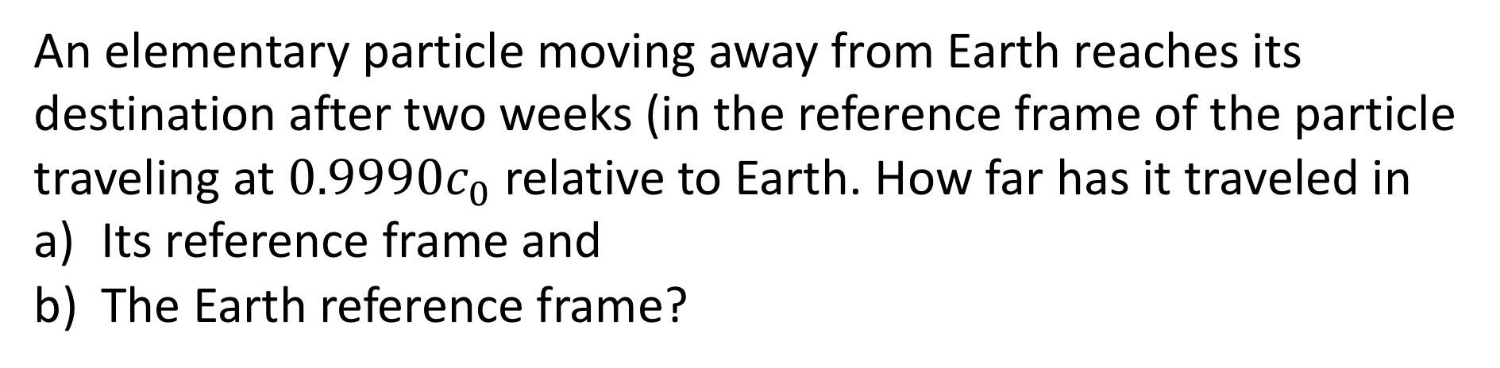
Example Problem: 14.41
An elementary particle moving away from Earth reaches its destination after two weeks (in the reference frame of the particle traveling at $0.9990c_{0}$ relative to Earth. How far has it traveled in
Its reference frame and
The Earth reference frame?

Slide 27

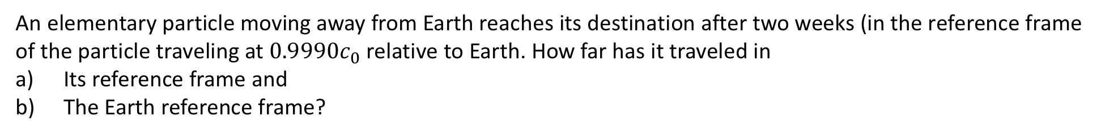


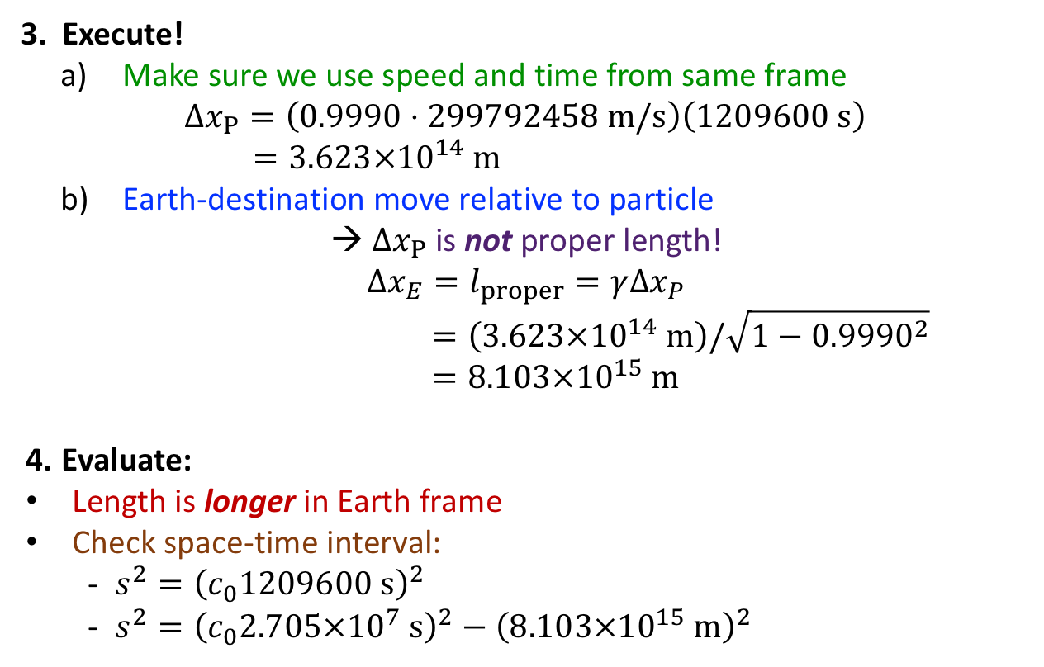
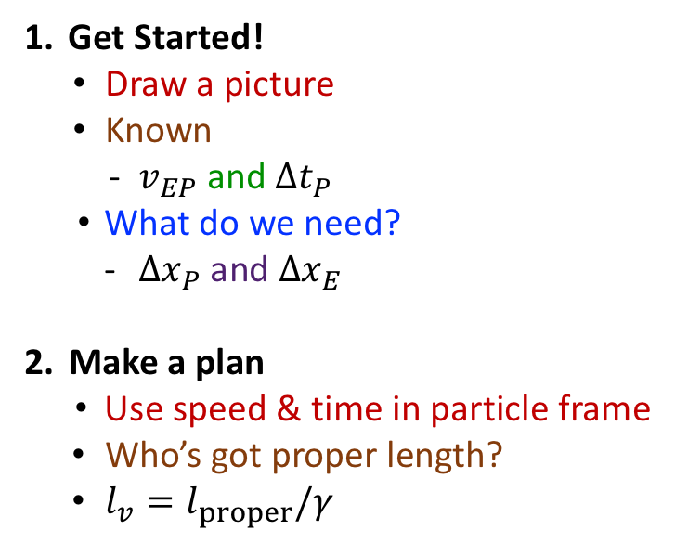

Example Problem: 14.41
An elementary particle moving away from Earth reaches its destination after two weeks (in the reference frame of the particle traveling at $0.9990c_{0}$ relative to Earth. How far has it traveled in
Its reference frame and
The Earth reference frame?
$$v_{EP}=0.9990c_{0}$$
Execute!
  Make sure we use speed and time from same frame
  $${Δx}_{P}=\left(0.9990⋅299792458 m/s\right)\left(1209600 s\right)$$
  $$=3.623×{10}^{14} m$$
  Earth-destination move relative to particle
→ ${Δx}_{P}$ is not proper length!
$${Δx}_{E}=l_{proper}=γ{Δx}_{P}$$
$$=\left(3.623×{10}^{14} m\right)/\sqrt{1−{0.9990}^{2}}$$
$$=8.103×{10}^{15} m$$
Evaluate:
Length is longer in Earth frame
Check space-time interval:
  $s^{2}={\left(c_{0}1209600 s\right)}^{2}$
  $s^{2}={\left(c_{0}2.705×{10}^{7} s\right)}^{2}−{\left(8.103×{10}^{15} m\right)}^{2}$
${Δt}_{P}=2$ wk
Get Started!
  Draw a picture
  Known
    $v_{EP}$ and ${Δt}_{P}$
  What do we need?
    ${Δx}_{P}$ and ${Δx}_{E}$
Make a plan
  Use speed & time in particle frame
Who’s got proper length?
$l_{v}=l_{proper}/γ$
$$=1.315×{10}^{29} m^{2}$$
$$=1.315×{10}^{26} m^{2}$$

Slide 28
Section 14.7: Clicker Question 7
Does the momentum of an isolated system remain constant when one or more components travel at a relativistic speed?
Yes
No
Need more information to say

Slide 29
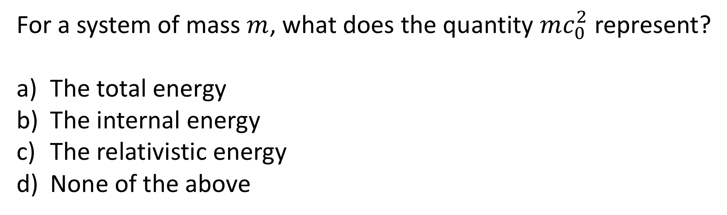
Section 14.8: Clicker Question 8
For a system of mass $m$, what does the quantity $mc_{0}^{2}$ represent?
The total energy
The internal energy
The relativistic energy
None of the above

Slide 30
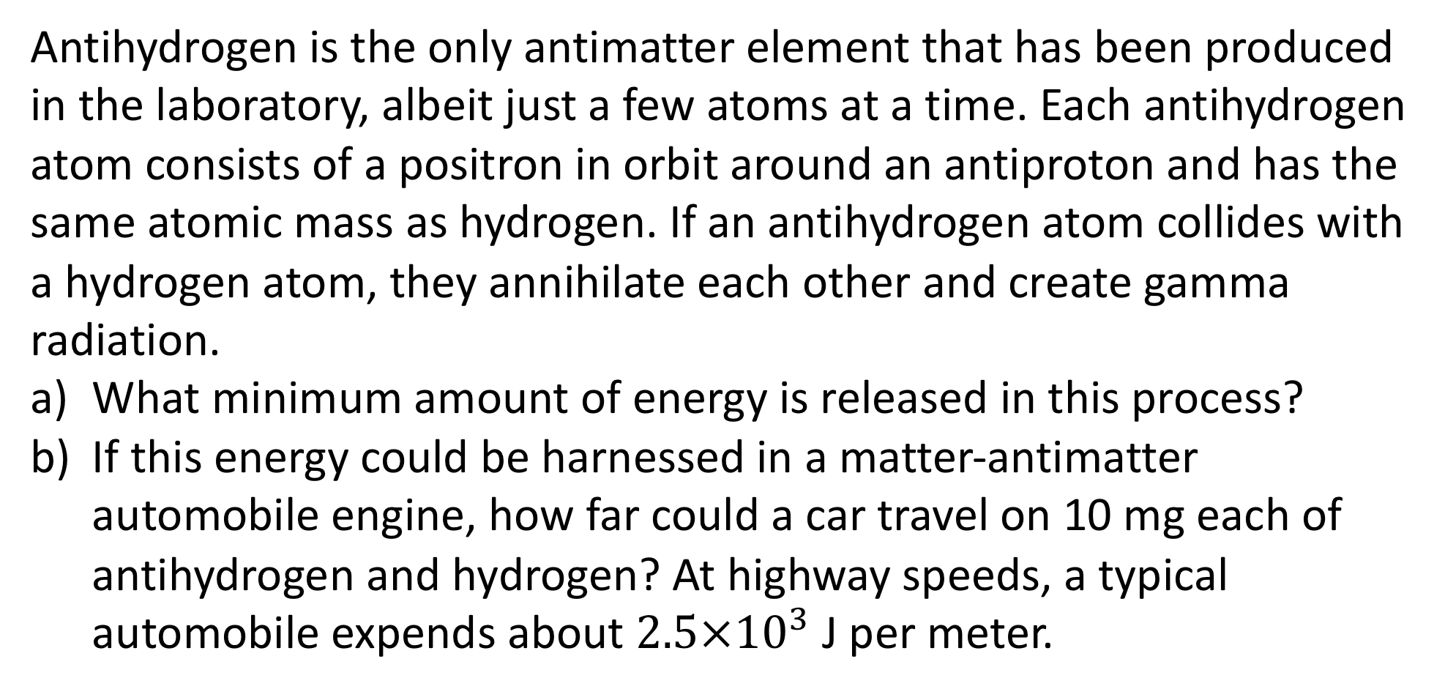
Example Problem: 14.69
Antihydrogen is the only antimatter element that has been produced in the laboratory, albeit just a few atoms at a time. Each antihydrogen atom consists of a positron in orbit around an antiproton and has the same atomic mass as hydrogen. If an antihydrogen atom collides with a hydrogen atom, they annihilate each other and create gamma radiation.
What minimum amount of energy is released in this process?
If this energy could be harnessed in a matter-antimatter automobile engine, how far could a car travel on 10 mg each of antihydrogen and hydrogen? At highway speeds, a typical automobile expends about $2.5×{10}^{3}$ J per meter.

Slide 31
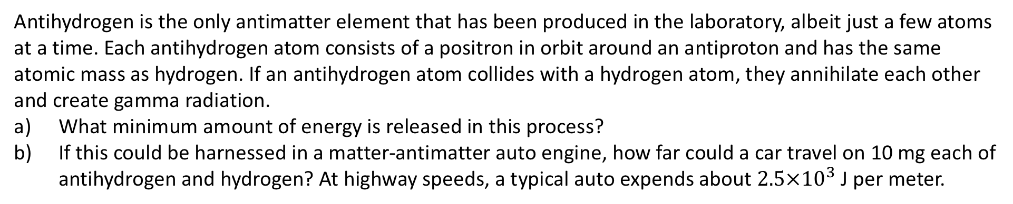
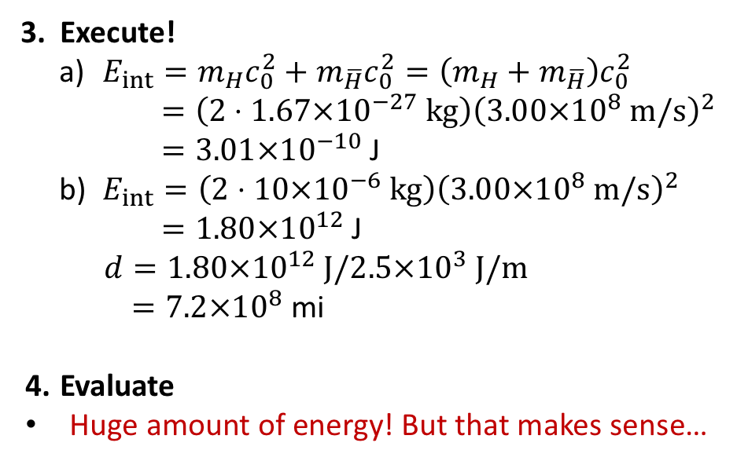
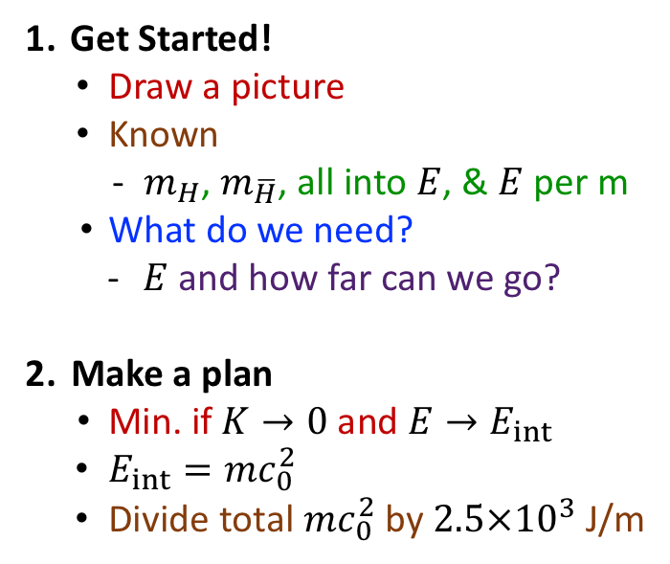
Example Problem: 14.69
Antihydrogen is the only antimatter element that has been produced in the laboratory, albeit just a few atoms at a time. Each antihydrogen atom consists of a positron in orbit around an antiproton and has the same atomic mass as hydrogen. If an antihydrogen atom collides with a hydrogen atom, they annihilate each other and create gamma radiation.
What minimum amount of energy is released in this process?
If this could be harnessed in a matter-antimatter auto engine, how far could a car travel on 10 mg each of antihydrogen and hydrogen? At highway speeds, a typical auto expends about $2.5×{10}^{3}$ J per meter.
Get Started!
  Draw a picture
  Known
    $m_{H}$, $m_{\overline{H}}$, all into $E$, & $E$ per m
  What do we need?
    $E$ and how far can we go?
Make a plan
  Min. if $K→0$ and $E→E_{int}$
$E_{int}=mc_{0}^{2}$
Divide total $mc_{0}^{2}$ by $2.5×{10}^{3}$ J/m
Execute!
  $E_{int}=m_{H}c_{0}^{2}+m_{\overline{H}}c_{0}^{2}=\left(m_{H}+m_{\overline{H}}\right)c_{0}^{2}$
  $$=\left(2⋅1.67×{10}^{−27} kg\right){\left(3.00×{10}^{8} m/s\right)}^{2}$$
  $=3.01×{10}^{−10}$ J
  $E_{int}=\left(2⋅10×{10}^{−6} kg\right){\left(3.00×{10}^{8} m/s\right)}^{2}$
$=1.80×{10}^{12}$ J
$$d=1.80×{10}^{12} J/2.5×{10}^{3} J/m$$
$=7.2×{10}^{8}$ mi
Evaluate
Huge amount of energy! But that makes sense…

Slide 32
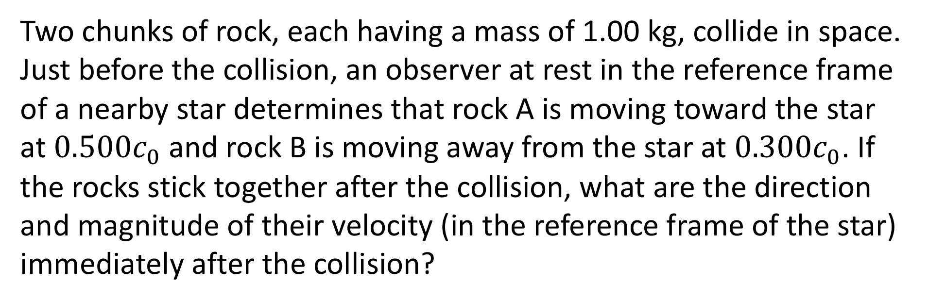
Example Problem: 14.58
Two chunks of rock, each having a mass of 1.00 kg, collide in space. Just before the collision, an observer at rest in the reference frame of a nearby star determines that rock A is moving toward the star at $0.500c_{0}$ and rock B is moving away from the star at $0.300c_{0}$. If the rocks stick together after the collision, what are the direction and magnitude of their velocity (in the reference frame of the star) immediately after the collision?

Slide 33

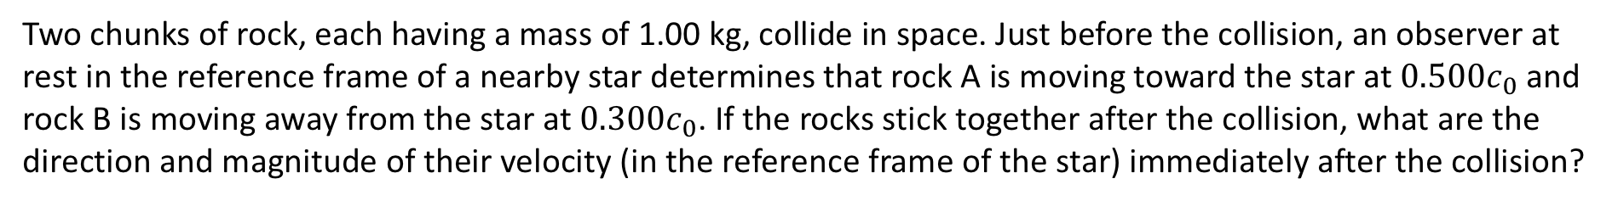


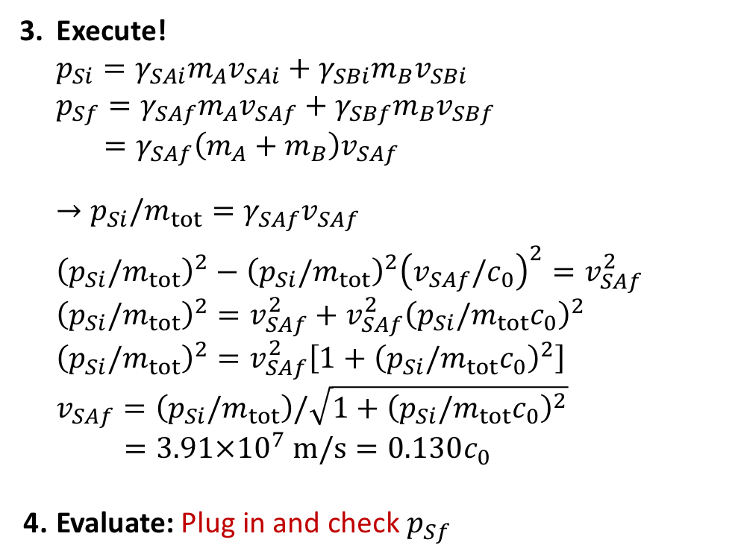
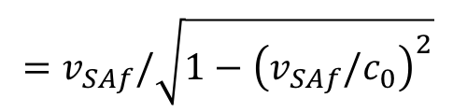
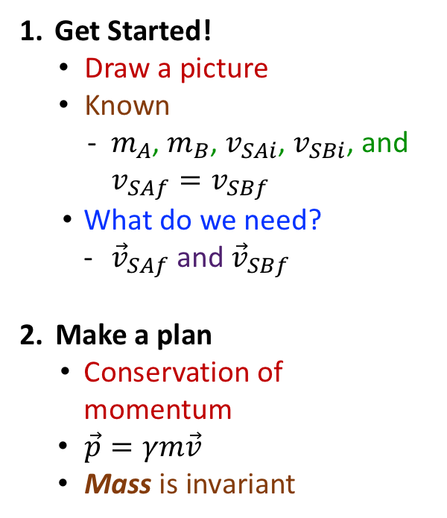

Example Problem: 14.58
Two chunks of rock, each having a mass of 1.00 kg, collide in space. Just before the collision, an observer at rest in the reference frame of a nearby star determines that rock A is moving toward the star at $0.500c_{0}$ and rock B is moving away from the star at $0.300c_{0}$. If the rocks stick together after the collision, what are the direction and magnitude of their velocity (in the reference frame of the star) immediately after the collision?
Get Started!
  Draw a picture
  Known
    $m_{A}$, $m_{B}$, $v_{SAi}$, $v_{SBi}$, and $v_{SAf}=v_{SBf}$
  What do we need?
    ${\vec{v}}_{SAf}$ and ${\vec{v}}_{SBf}$
Make a plan
  Conservation of momentum
$\vec{p}=γm\vec{v}$
Mass is invariant
Execute!
  $$p_{Si}=γ_{SAi}m_{A}v_{SAi}+γ_{SBi}m_{B}v_{SBi}$$
  $$p_{Sf}=γ_{SAf}m_{A}v_{SAf}+γ_{SBf}m_{B}v_{SBf}$$
  $$=γ_{SAf}\left(m_{A}+m_{B}\right)v_{SAf}$$
  $$→p_{Si}/m_{tot}=γ_{SAf}v_{SAf}=v_{SAf}/\sqrt{1−{\left(v_{SAf}/c_{0}\right)}^{2}}$$
  $${\left(p_{Si}/m_{tot}\right)}^{2}−{\left(p_{Si}/m_{tot}\right)}^{2}{\left(v_{SAf}/c_{0}\right)}^{2}=v_{SAf}^{2}$$
  $${\left(p_{Si}/m_{tot}\right)}^{2}=v_{SAf}^{2}+v_{SAf}^{2}{\left(p_{Si}/m_{tot}c_{0}\right)}^{2}$$
  $${\left(p_{Si}/m_{tot}\right)}^{2}=v_{SAf}^{2}\left[1+{\left(p_{Si}/m_{tot}c_{0}\right)}^{2}\right]$$
  $$v_{SAf}=\left(p_{Si}/m_{tot}\right)/\sqrt{1+{\left(p_{Si}/m_{tot}c_{0}\right)}^{2}}$$
  $$=3.91×{10}^{7} m/s=0.130c_{0}$$
Evaluate: Plug in and check $p_{Sf}$
$$v_{SAi}=+0.500c_{0}$$
$$v_{SBi}=−0.300c_{0}$$
$$=γ_{SAf}m_{tot}v_{SAf}$$
$$v_{SAf}=v_{SBf}$$
$$=v_{SAf}/\sqrt{1−{\left(v_{SAf}/c_{0}\right)}^{2}}$$

