Slide 1
Reflection and Refraction of Light

Slide 2
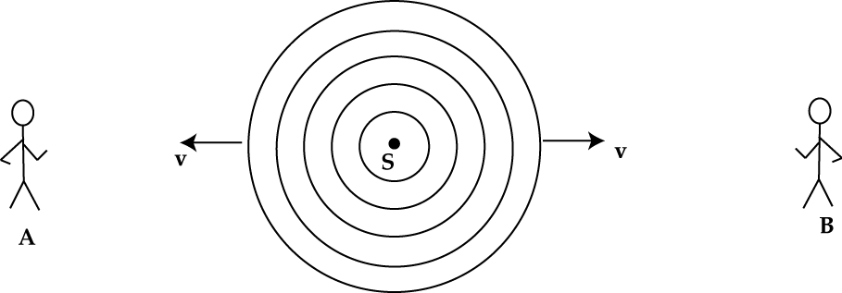
Wavefronts and Rays
Wavefronts
Rays

Slide 3
Wavefronts and Rays
This is a 6-foot copperhead.
True or false?
http://www.beaumontenterprise.com/news/article/Orange-County-man-finds-large-copperhead-snake-1619584.php#photo-1175225

Slide 4
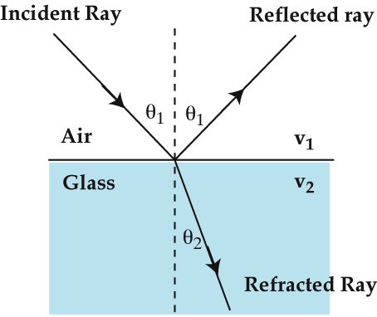
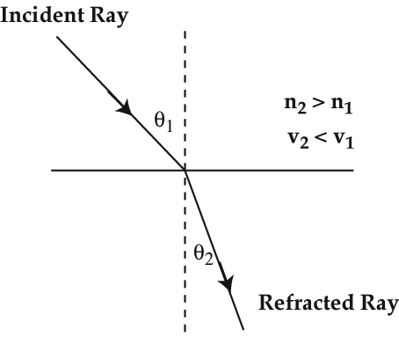
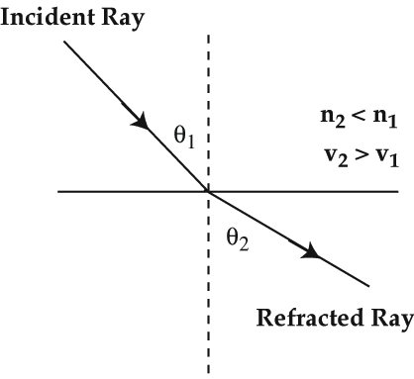

Reflection and Refraction of Light
Law of Reflection
$$θ_{i}=θ_{r}=θ_{1}$$
Refractive Index
Snell’s Law
n₂ > n₁
v₂ < v₁
n₂ < n₁
v₂ > v₁

Slide 5
Question 22.1 Reflection
a) the Moon is very large
b) atmospheric conditions are just right
c) the ocean is calm
d) the ocean is wavy
e) motion of the Moon
When watching the Moon over the ocean, you often see a long streak of light on the surface of the water. This occurs because:

Slide 6
Question 22.2b Refraction II
Parallel light rays cross interfaces from medium 1 into medium 2 and then into medium 3. What can we say about the relative sizes of the index of refraction of these media?
a) n₁ > n₂ > n₃
b) n₃ > n₂ > n₁
c) n₂ > n₃ > n₁
d) n₁ > n₃ > n₂
e) none of the above
1
2
3

Slide 7
Question 22.3a Gone Fishin’ I
To shoot a fish with a gun, should you aim directly at the image, slightly above, or slightly below?
a) aim directly at the image
b) aim slightly above
c) aim slightly below

Slide 8
Question 22.3b Gone Fishin’ II
To shoot a fish with a laser gun, should you aim directly at the image, slightly above, or slightly below?
a) aim directly at the image
b) aim slightly above
c) aim slightly below

Slide 9
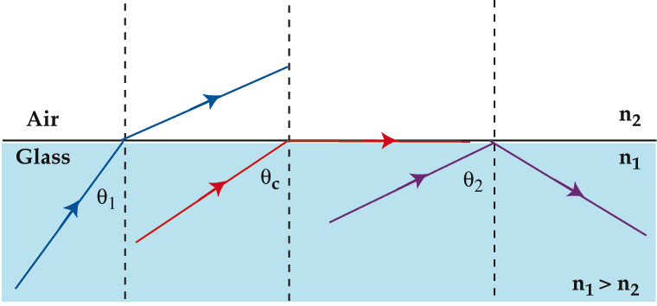
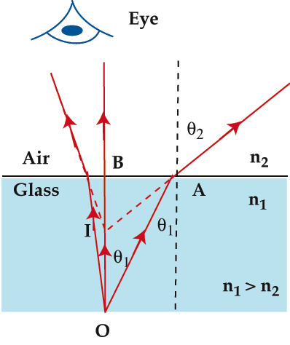
Total Internal Reflection
Critical Angle
Apparent Depth

Slide 10
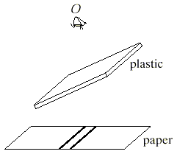
Question 22.4 Parallel Lines
a) shifted to the right
b) shifted to the left
c) spaced farther apart
d) spaced closer together
e) no change – same as before
An observer views two closely spaced lines through an angled piece of glass. To the observer, the lines appear:

Slide 11
Example Problem
A 5 cm thick rectangular block of glass is made of material with a refractive index of 1.5.
If light is incident on this block at an angle of 40º (with respect to the surface), find the angle of refraction inside the block
When this ray of light leaves the block, what is the angle between the ray and the surface of the block?
If light, starting from inside the block is incident on the surface, at what minimum angle would the light be totally reflected inside the block?
Now this block is kept on a piece of paper which has a patch of ink on it. When viewed from above, find the location of the image of the patch of ink.

Slide 12
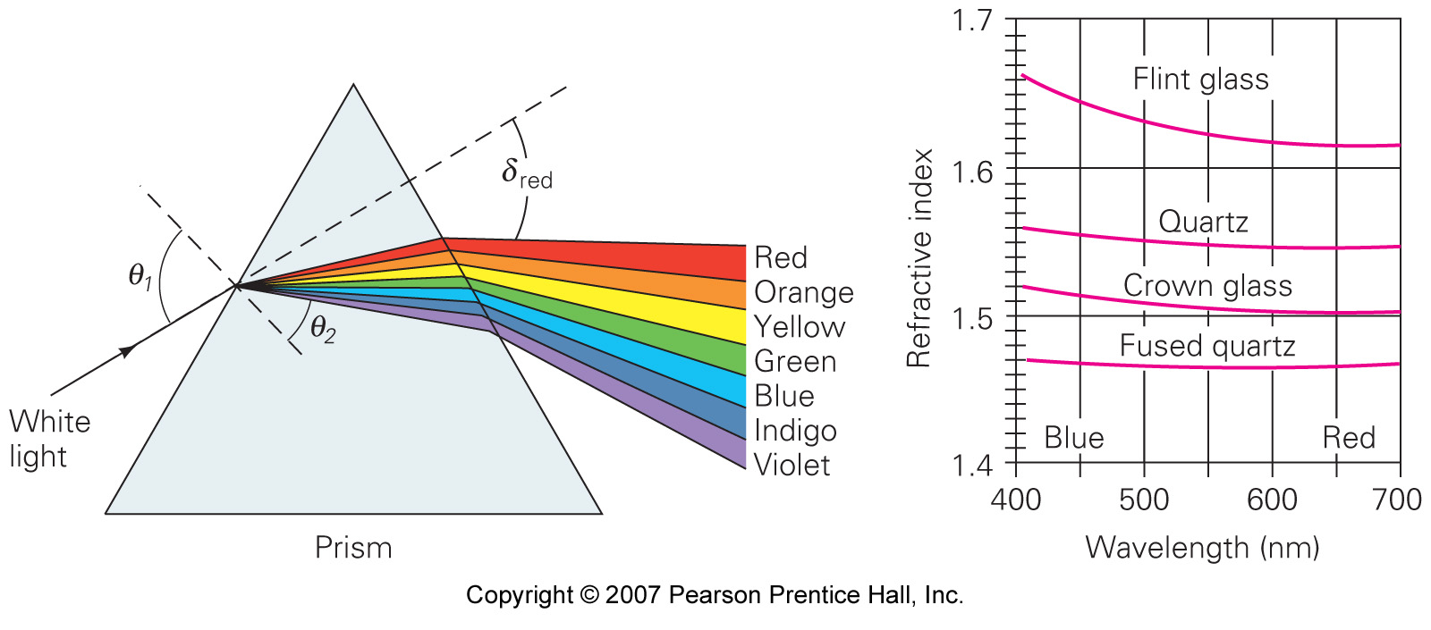
Dispersion
Dispersion occurs because the index of refraction depends slightly on wavelength (speed of light in medium is wavelength-dependent)
© 2010 Pearson Education, Inc.

Slide 13

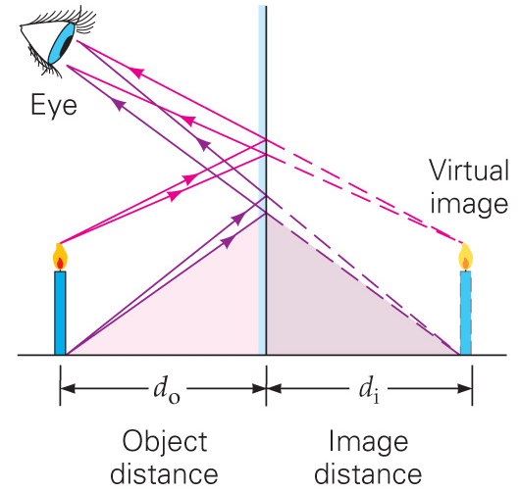


Plane Mirrors
The image formed by a plane mirror
Upright
Identical in size to the object
As far behind the mirror as the object is in front of it.
$$s$$
$$s^{′}$$
© 2010 Pearson Education, Inc.

Slide 14
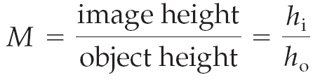
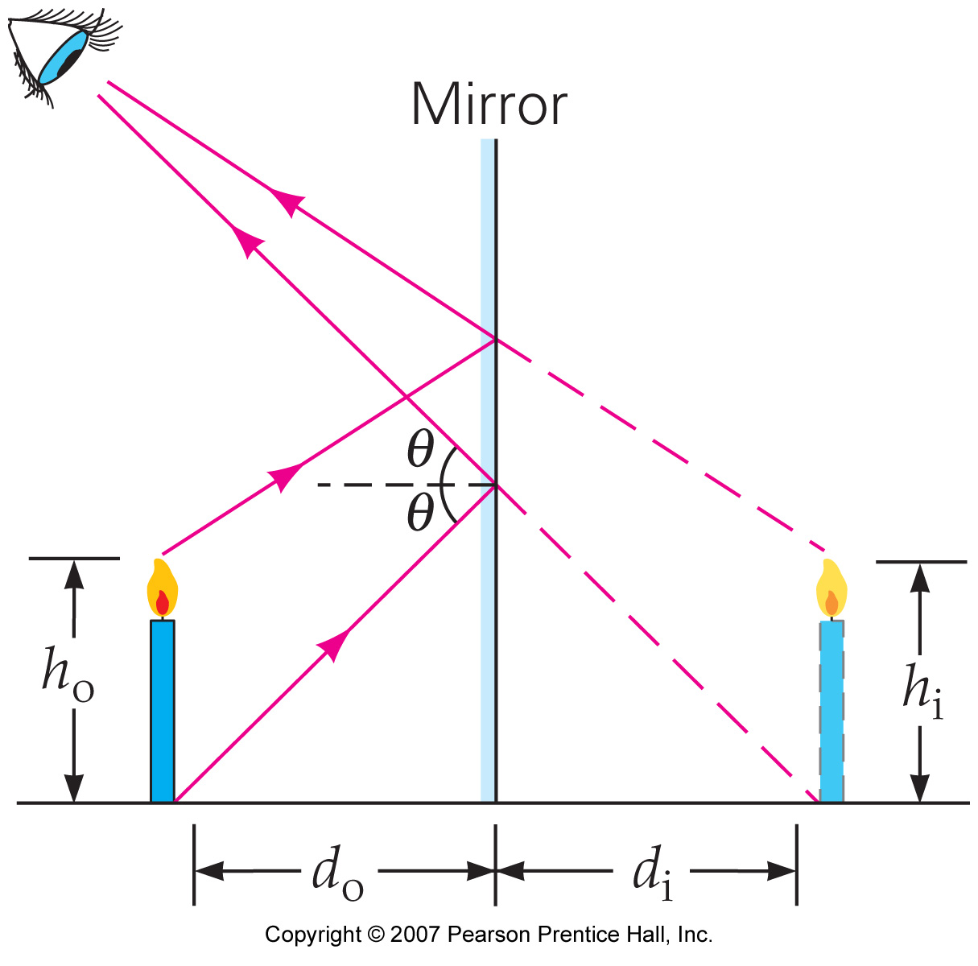





Plane Mirrors
The magnification is given by
$$\frac{h^{′}}{h}$$
For a plane mirror, M = +1.
$$h$$
$$h^{′}$$
$$s$$
$$s^{′}$$
© 2010 Pearson Education, Inc.

Slide 15
Example Problem
When you stand between two plane mirrors on opposite walls in a dance studio, you observe
  One image
  Two images
  Multiple images
If you stand 2.9 m from the mirror on the north wall and 6.4 m from the mirror on the south wall, what are the image distances for the first two images in the north mirror?
What are the image distances for the first two images in the south mirror?

Slide 16
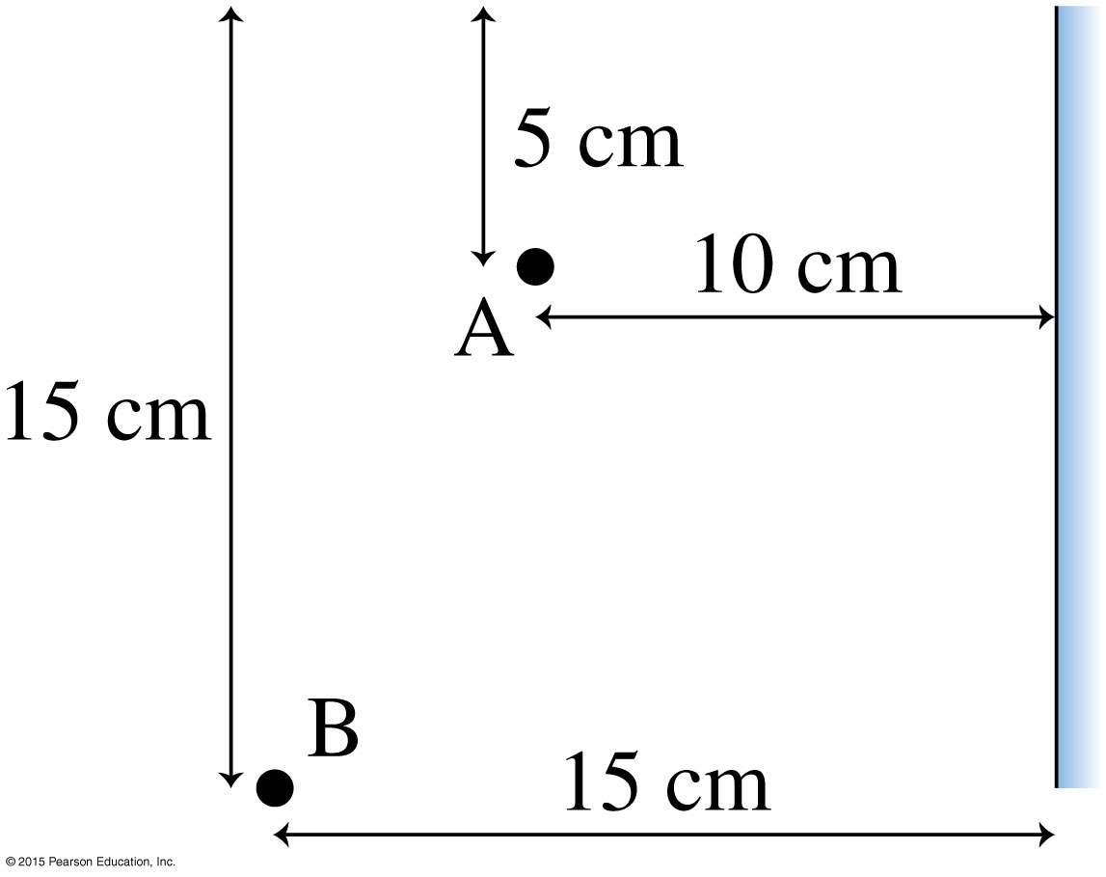
Exercise 18.6
A light ray leaves point A, reflects from the mirror, and reaches point B. How far below the top edge does the ray strike the mirror?
10 cm

Slide 17
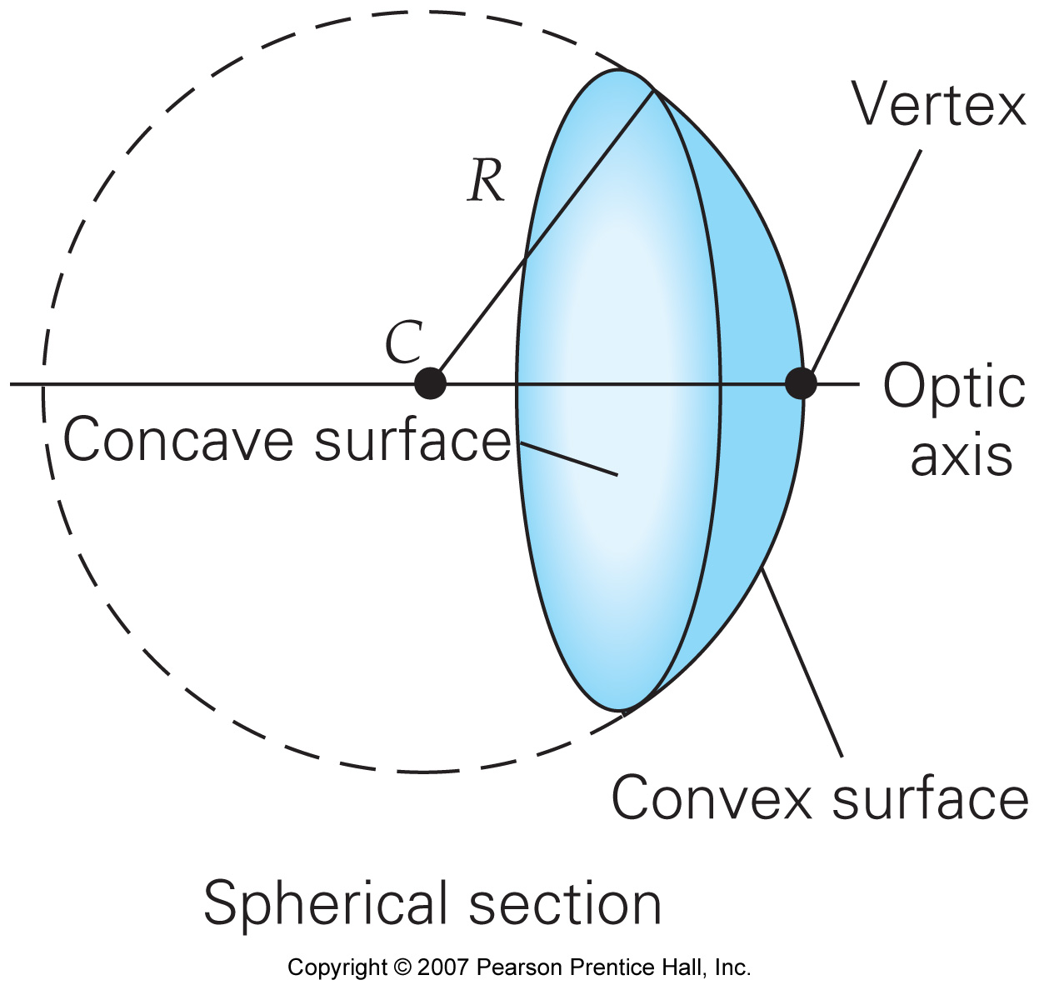
Spherical Mirrors
A spherical mirror is a section of a sphere.
It may be concave or convex.
© 2010 Pearson Education, Inc.

Slide 18
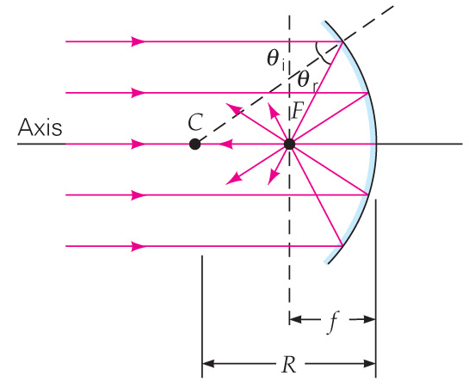
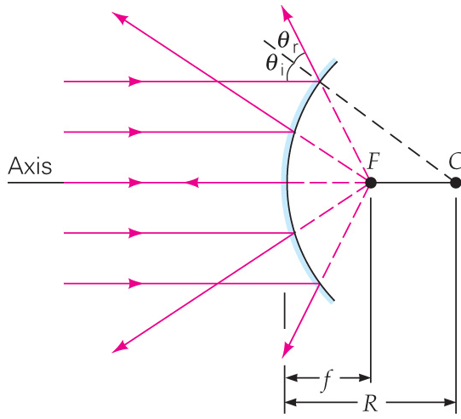
Spherical Mirrors
Concave Mirror:
focuses incoming parallel rays at the focal point.
Convex mirror:
bends incoming parallel rays outward, as though from a focal point behind the mirror.
© 2010 Pearson Education, Inc.

Slide 19
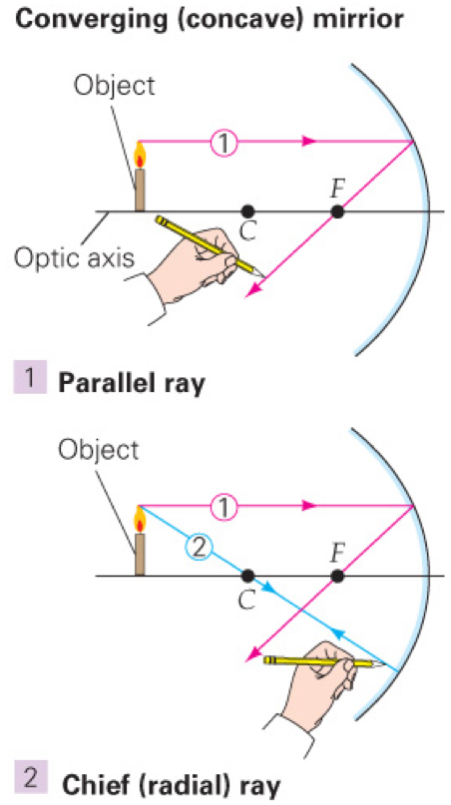
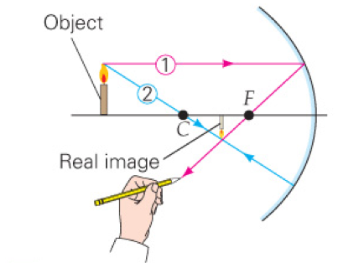
Spherical Mirrors
Images formed by spherical mirrors may be found by using the parallel, chief, and focal rays.
Object
Object
Object
1) Parallel ray
2) Chief (radial) ray
3) Locating image
© 2010 Pearson Education, Inc.

Slide 20










Spherical Mirrors
For a concave mirror, the type of image formed depends on the position of the object.
$$s=2f$$
$$s=f$$
$$s>2f$$
$$s<f$$
$$2f<s<f$$
$$s$$
$$s^{′}$$
$$2f>s>f$$
© 2010 Pearson Education, Inc.

Slide 21
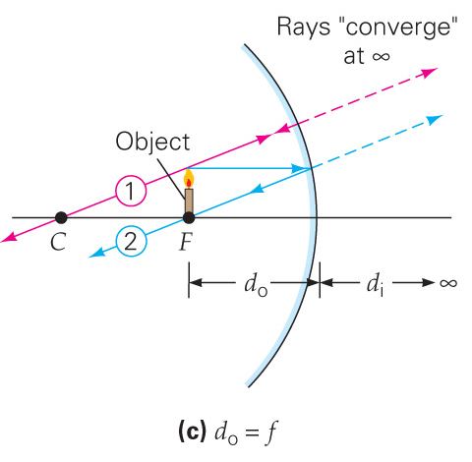
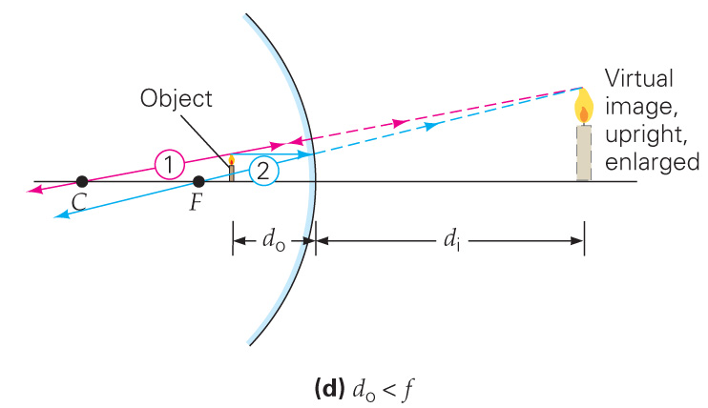




Spherical Mirrors
If the object is at the focal point, there is no image.
$$s$$
$$s^{′}$$
$$s=f$$
$$s$$
$$s^{′}$$
© 2010 Pearson Education, Inc.
$$s<f$$

Slide 22
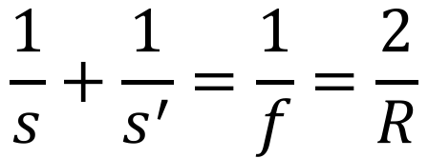
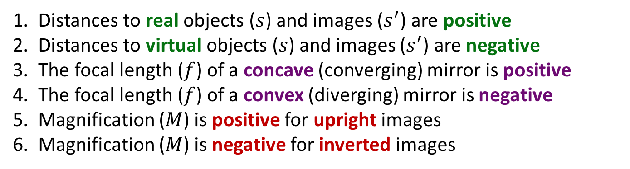
Spherical Mirrors
Spherical-mirror equation (valid for any object position):
$$\frac{1}{s}+\frac{1}{s^{′}}=\frac{1}{f}=\frac{2}{R}$$
Sign Convention
Distances to real objects ($s$) and images ($s^{′}$) are positive
Distances to virtual objects ($s$) and images ($s^{′}$) are negative
The focal length ($f$) of a concave (converging) mirror is positive
The focal length ($f$) of a convex (diverging) mirror is negative
Magnification ($M$) is positive for upright images
Magnification ($M$) is negative for inverted images
© 2010 Pearson Education, Inc.

Slide 23
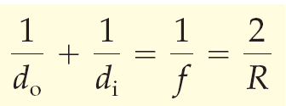
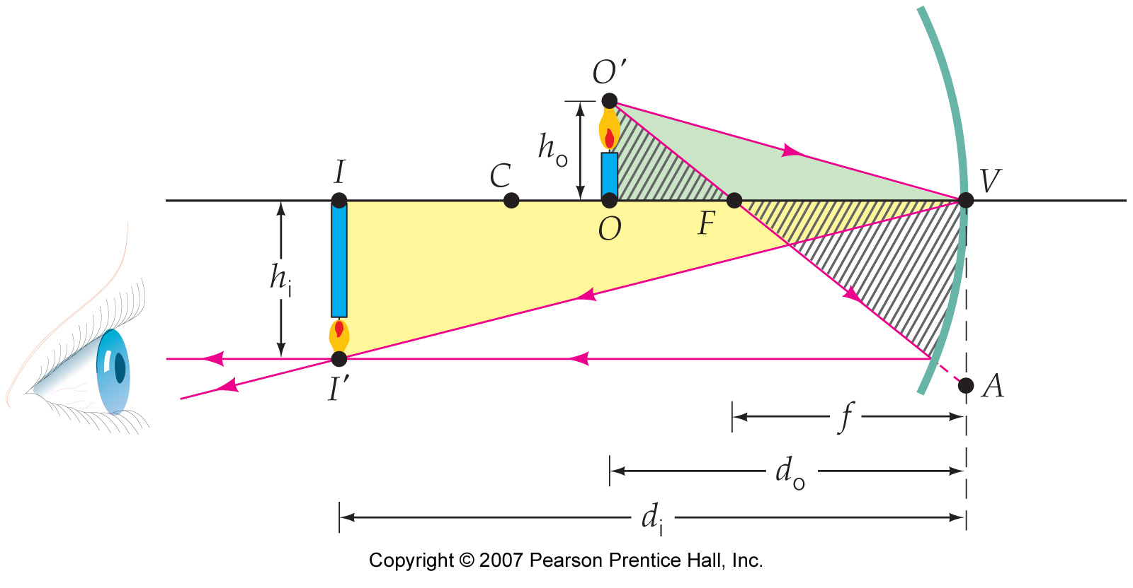


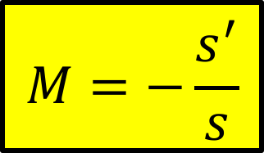


Spherical Mirrors
$$M=−\frac{s^{′}}{s}$$
The magnification is given by
$$\frac{1}{s}+\frac{1}{s^{′}}=\frac{1}{f}=\frac{2}{R}$$
$$h$$
$$h^{′}$$
$$s$$
$$s^{′}$$
© 2010 Pearson Education, Inc.

Slide 24
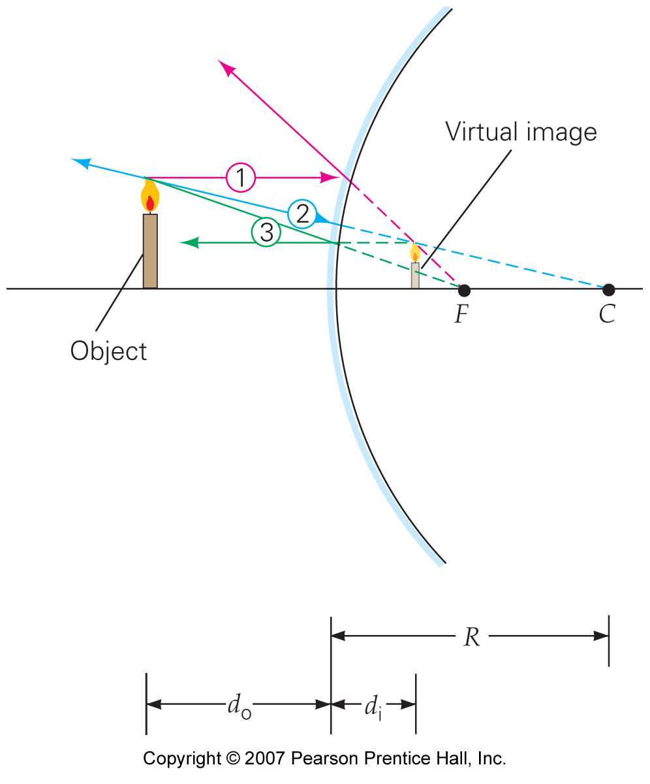

Spherical Mirrors
For a convex mirror the process is similar, but the image will always be virtual.
$$s$$
$$s^{′}$$
© 2010 Pearson Education, Inc.

Slide 25
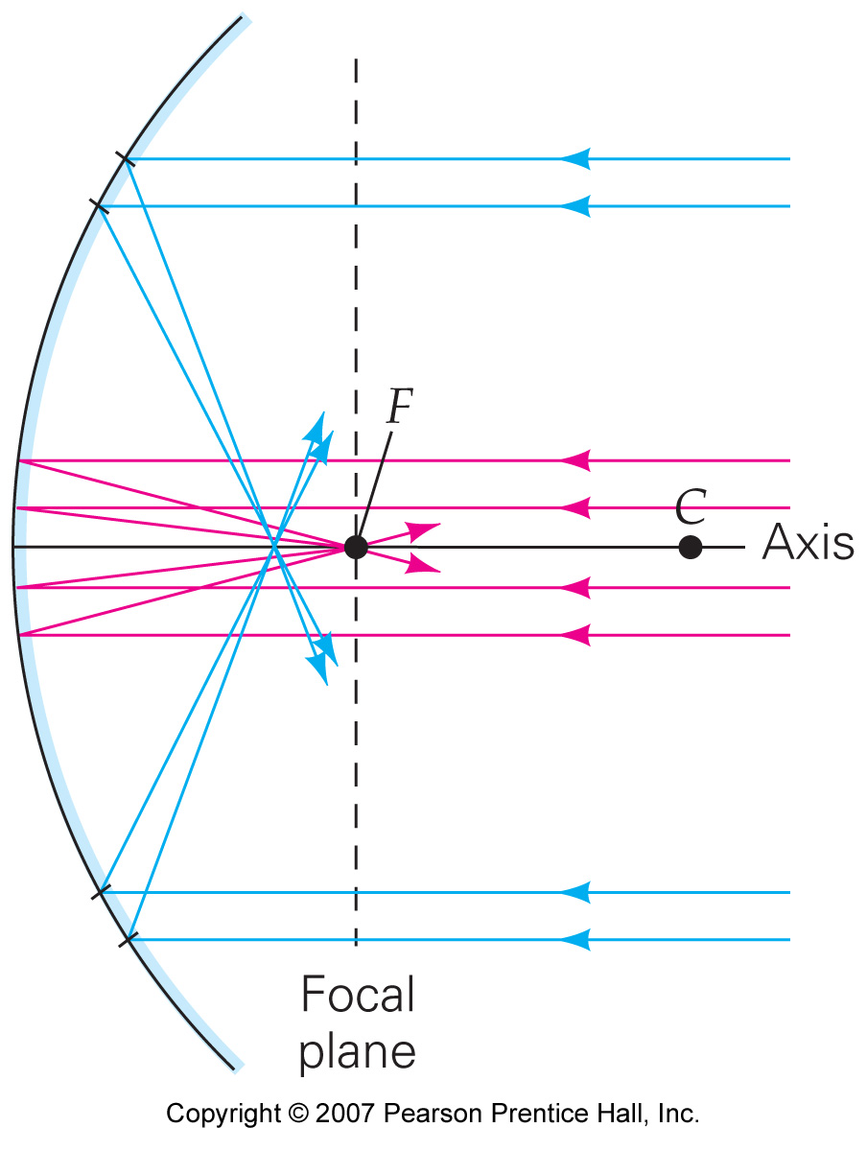
Spherical Mirrors
Spherical aberration occurs because rays far from the mirror axis do not go through the focal point.
© 2010 Pearson Education, Inc.

Slide 26
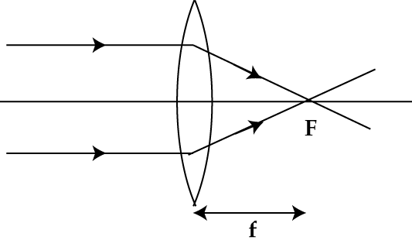
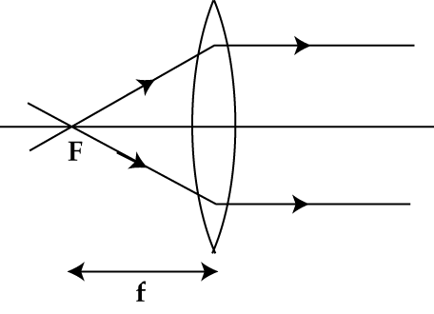
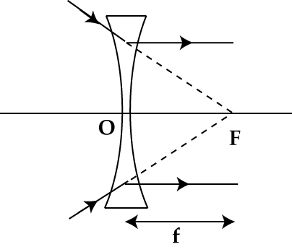
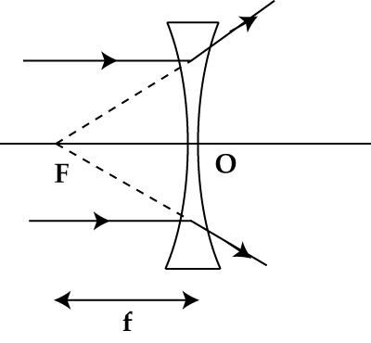
Thin Lenses
Converging Lenses
Diverging Lenses
Object →
The point in which the rays meet before refraction.
Image →
The point in which the rays meet after refraction.
Real and Virtual Objects/Images

Slide 27
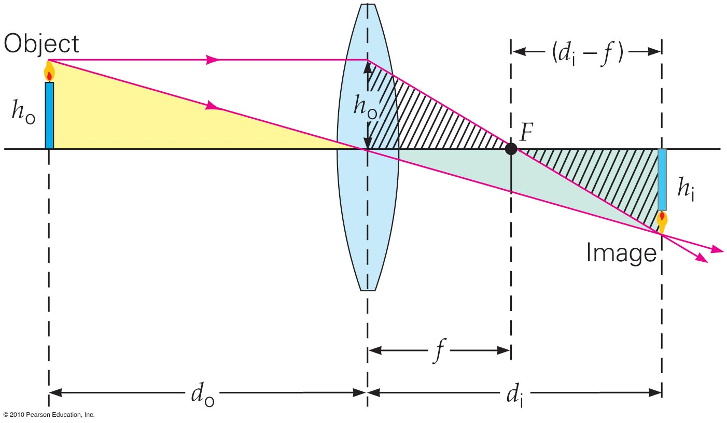
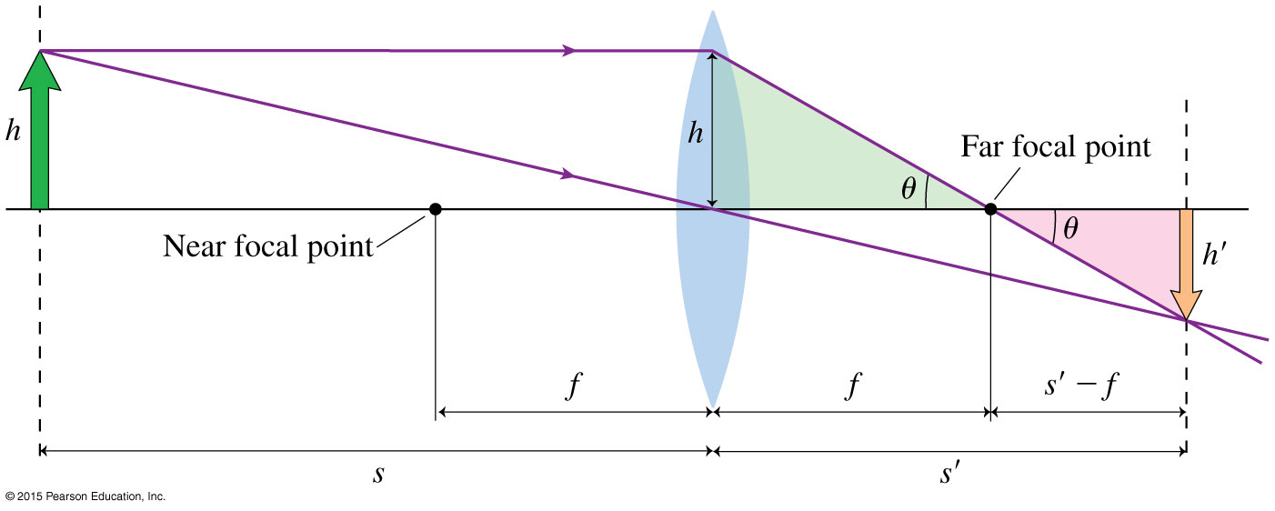
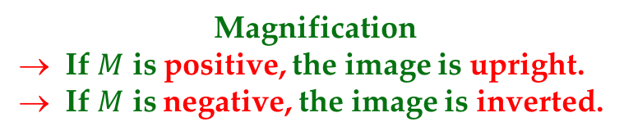
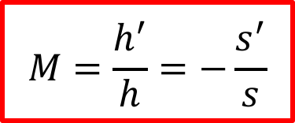
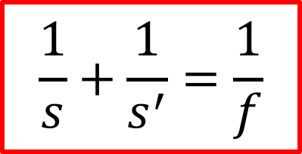
Thin Lens Formula
$$\frac{1}{s}+\frac{1}{s^{′}}=\frac{1}{f}$$
Sign Convention
All distances are measured from the center of the lens
Distances to real objects and real images are positive
Distances to virtual objects and virtual images are negative
The focal length of a converging lens is positive
The focal length of a diverging lens is negative
Magnification
If $M$ is positive, the image is upright.
If $M$ is negative, the image is inverted.
$$M=\frac{h^{′}}{h}=−\frac{s^{′}}{s}$$

Slide 28
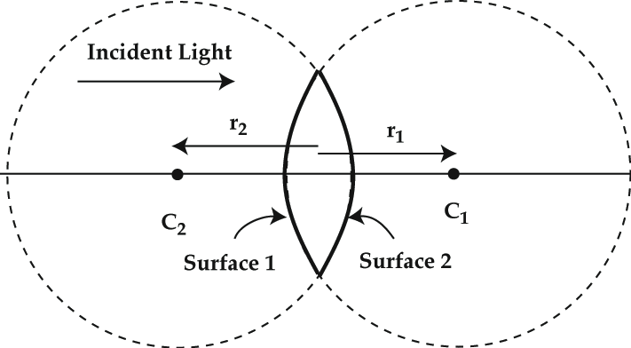
Lens Maker’s Formula
Sign Convention
→ If the center of the curved surface is in the same direction of the incident ray:
the sign of r is positive
→ If the center of the curved surface is in the direction opposite to that of the incident ray
the sign of r is negative
Example: A converging lens is made of glass of refractive index 1.5 and has surfaces with radii of curvature 20 cm and 30 cm respectively. What is the focal length of the lens?

Slide 29
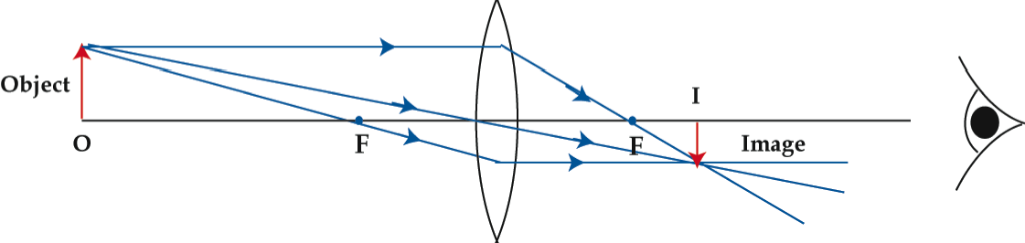
Ray Diagrams
Converging Lens → Object outside 2f

Slide 30
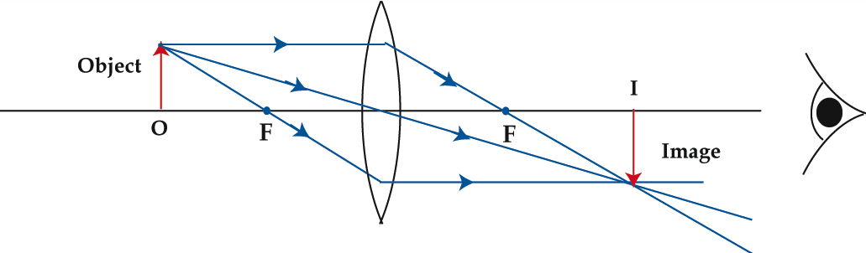
Ray Diagrams
Converging Lens → Object at 2f

Slide 31
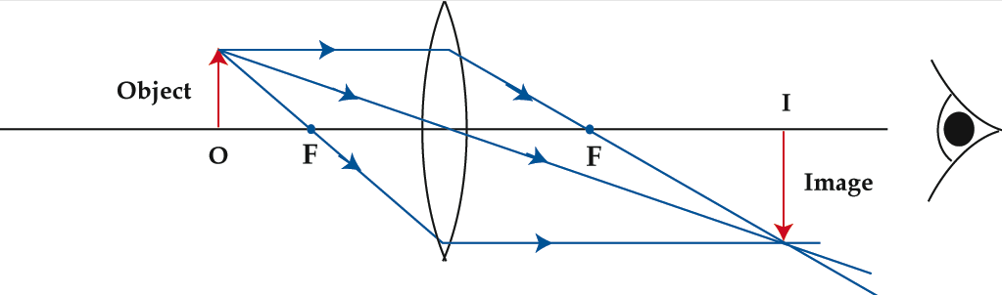
Ray Diagrams
Converging Lens → Object between f and 2f

Slide 32
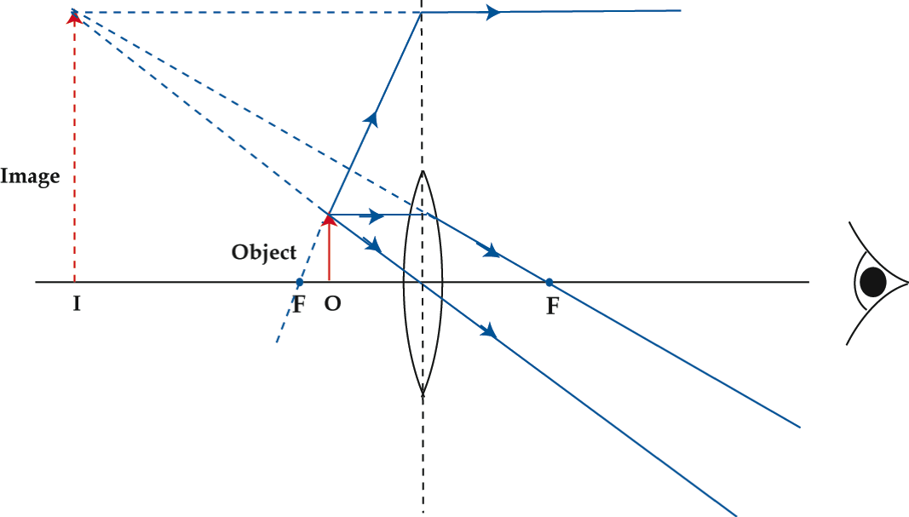
Ray Diagrams
Converging Lens → Object between the lens and f

Slide 33
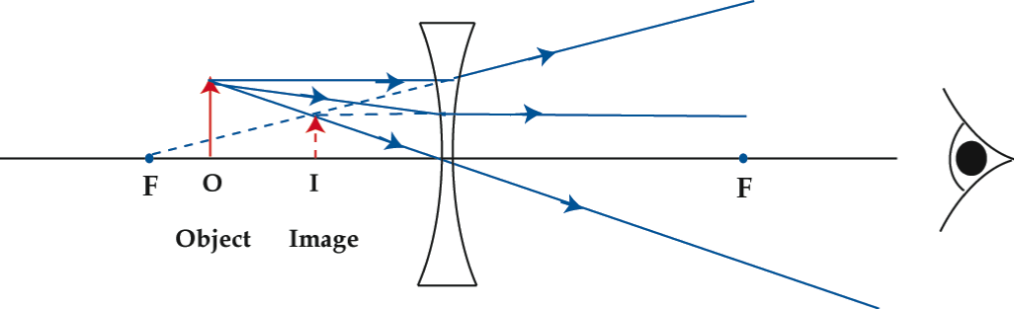
Ray Diagrams
Diverging Lens → Object between the lens and f

Slide 34
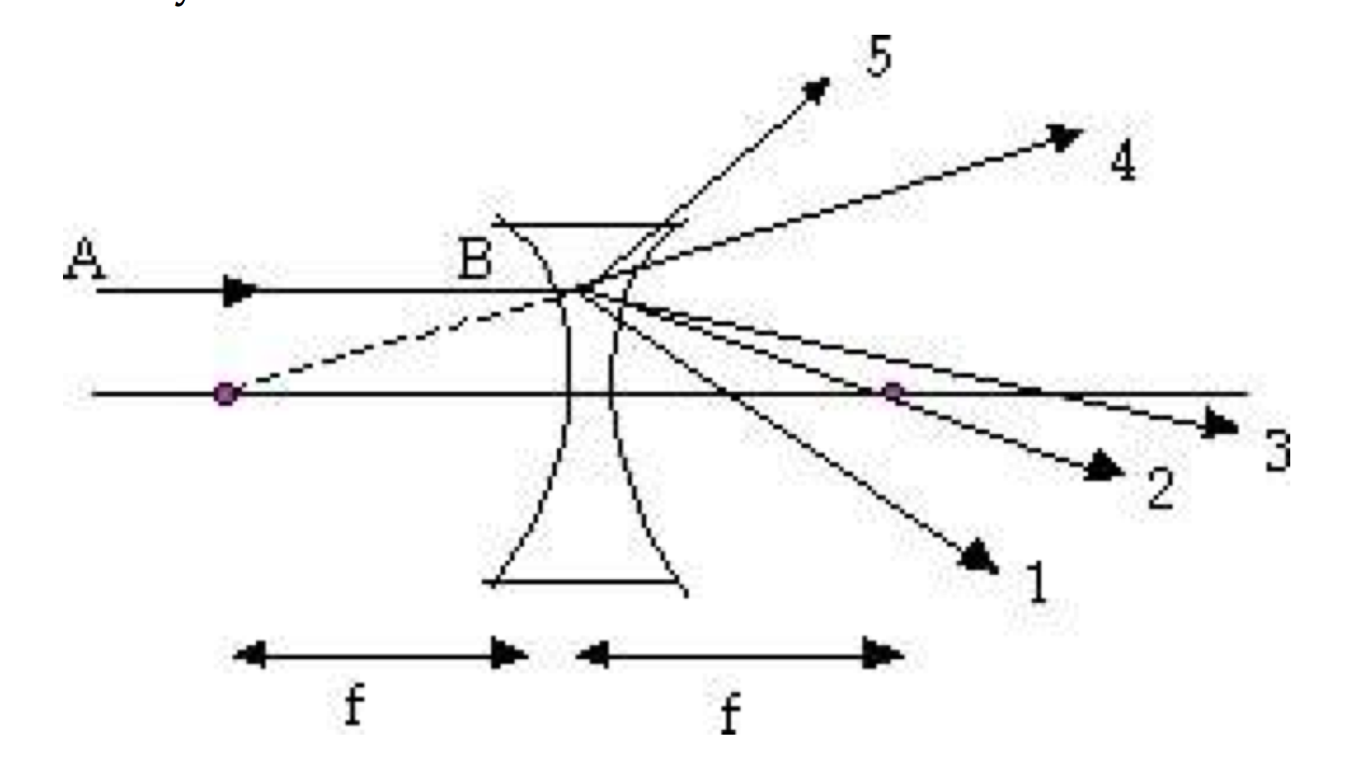
Concept Check
Question 1:
A ray AB, parallel to the central axis, is incident on a lens of focal length f as shown in the figure. Which of the lines shown best represents the direction of the ray after refraction?
Answer:
1
2
3
4
5

Slide 35
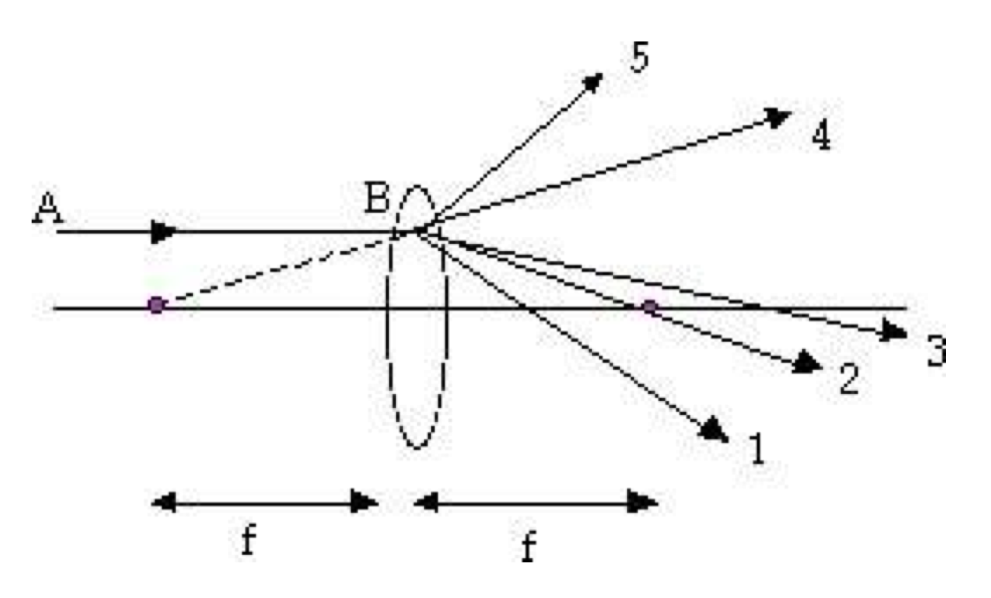
Concept Check
Question 2:
A ray AB, parallel to the central axis, is incident on a lens of focal length f as shown in the figure. Which of the lines shown best represents the direction of the ray after refraction?
Answer:
1
2
3
4
5

Slide 36
Concept Check
Question 3:
A converging lens has a focal length f. The only way to get a magnification of –1 is to
Answer:
place a real object at the focal point.
place a real object at a distance 2f from the lens.
place a virtual object at a distance 2f from the lens.
Magnifications for a converging lens can never be negative.
None of these are correct.

Slide 37
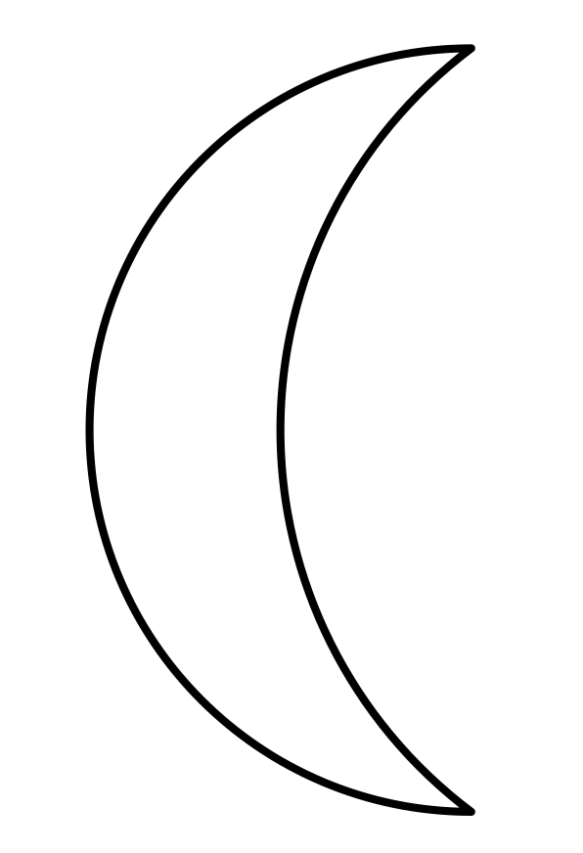
Concept Check
Question 4:
The lens shown below has two surfaces with radii of curvature 15 and 20 cm. It is made of a material with index of refraction 1.65. Its focal length is:
Answer:
92 cm
-92 cm
13 cm
-13 cm
0.011 cm

Slide 38
Concept Check
Question 5:
When an object is placed 10 cm from a lens, it produces a real image 30 cm from the lens. If the object is moved to a distance 5 cm from the lens, the image it produces is:
Answer:
real, upright, and enlarged
virtual, upright, and enlarged
real, inverted, and reduced
virtual, inverted, and reduced
real, inverted, and enlarged

Slide 39
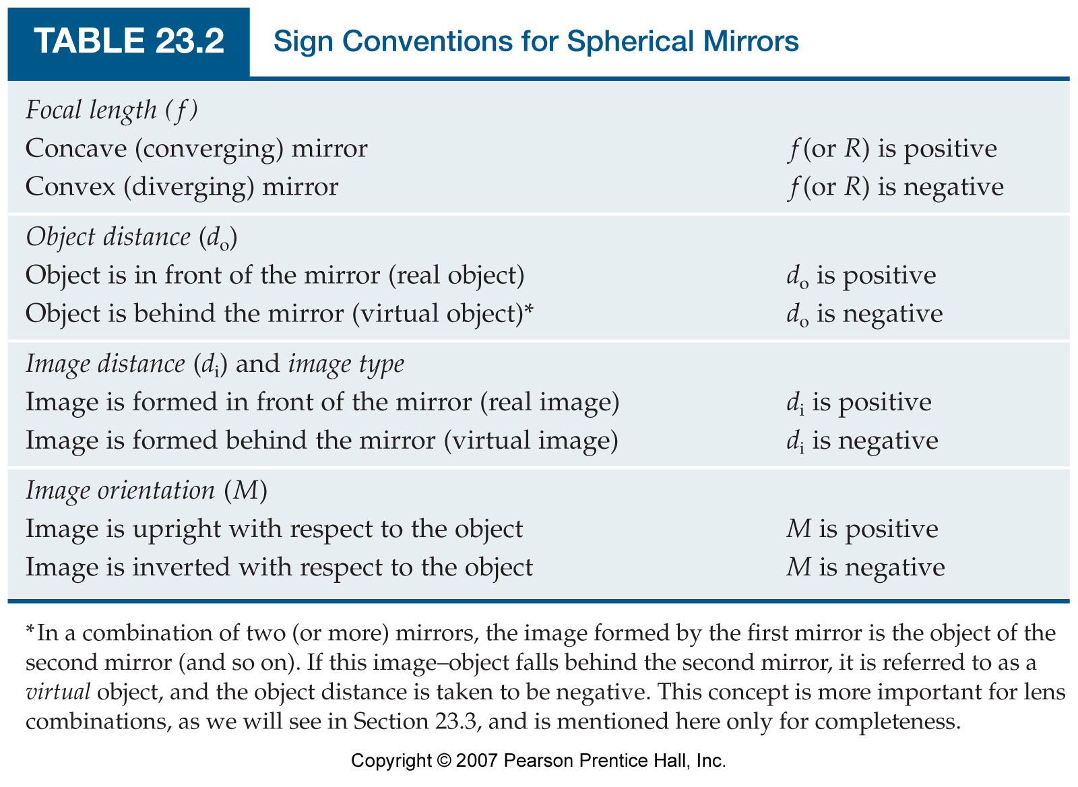
Spherical Mirrors
© 2010 Pearson Education, Inc.

Slide 40

Example Problem
A converging lens of focal length 30 cm and a diverging lens of focal length 20 cm have a common central axis. Their separation is 20 cm. An object of height 2 cm is placed 50 cm in front of the converging lens on their common axis.
Find the location of the final image due to the combination of the two lenses
Is the final image real or virtual?
Is the final image upright or inverted?
Find the height of the final image.

