Slide 1
PHYS 4320
Angular Momentum and Co.

Slide 2
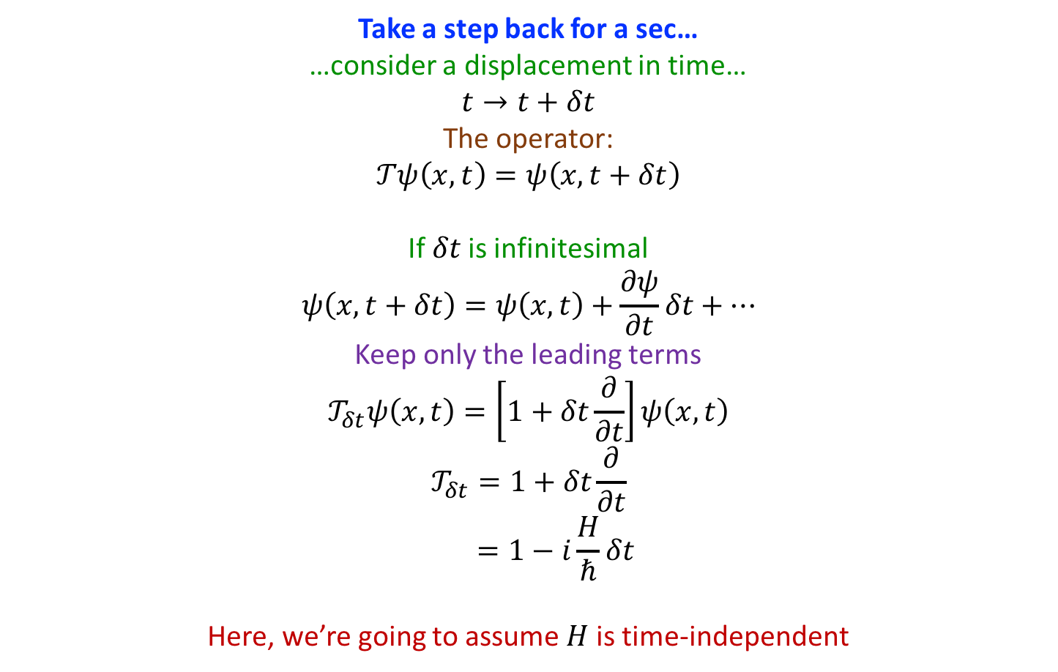
Angular Momentum: Translations
Take a step back for a sec…
…consider a displacement in time…
$$t→t+δt$$
The operator:
$$𝒯ψ\left(x,t\right)=ψ\left(x,t+δt\right)$$
If $δt$ is infinitesimal
$$ψ\left(x,t+δt\right)=ψ\left(x,t\right)+\frac{∂ψ}{∂t}δt+…$$
Keep only the leading terms
$$𝒯_{δt}ψ\left(x,t\right)=\left[1+δt\frac{∂}{∂t}\right]ψ\left(x,t\right)$$
$$𝒯_{δt}=1+δt\frac{∂}{∂t}$$
$$=1−i\frac{H}{ℏ}δt$$
Here, we’re going to assume $H$ is time-independent

Slide 3
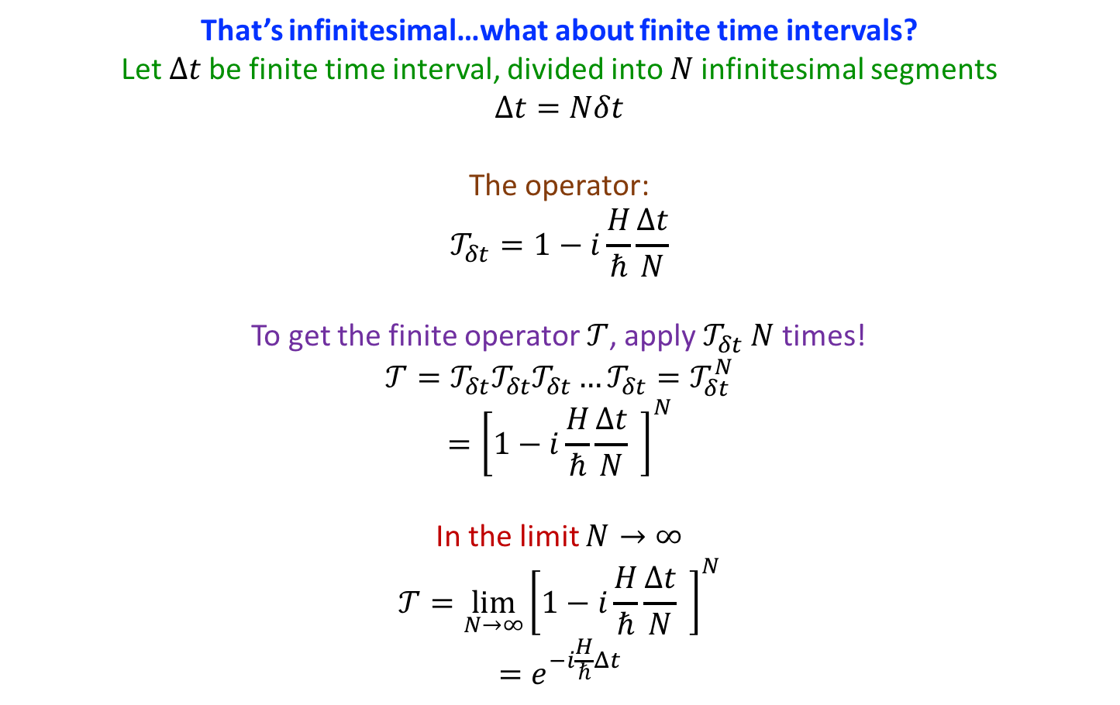
Angular Momentum: Translations
That’s infinitesimal…what about finite time intervals?
Let $Δt$ be finite time interval, divided into $N$ infinitesimal segments
$$Δt=Nδt$$
The operator:
$$𝒯_{δt}=1−i\frac{H}{ℏ}\frac{Δt}{N}$$
To get the finite operator $𝒯$, apply $𝒯_{δt}$ $N$ times!
$$𝒯=𝒯_{δt}𝒯_{δt}𝒯_{δt}…𝒯_{δt}=𝒯_{δt}^{N}$$
$$={\left[1−i\frac{H}{ℏ}\frac{Δt}{N} \right]}^{N}$$
In the limit $N→∞$
$$𝒯=\lim_{N→∞}{{\left[1−i\frac{H}{ℏ}\frac{Δt}{N} \right]}^{N}}$$
$$=e^{−i\frac{H}{ℏ}Δt}$$

Slide 4
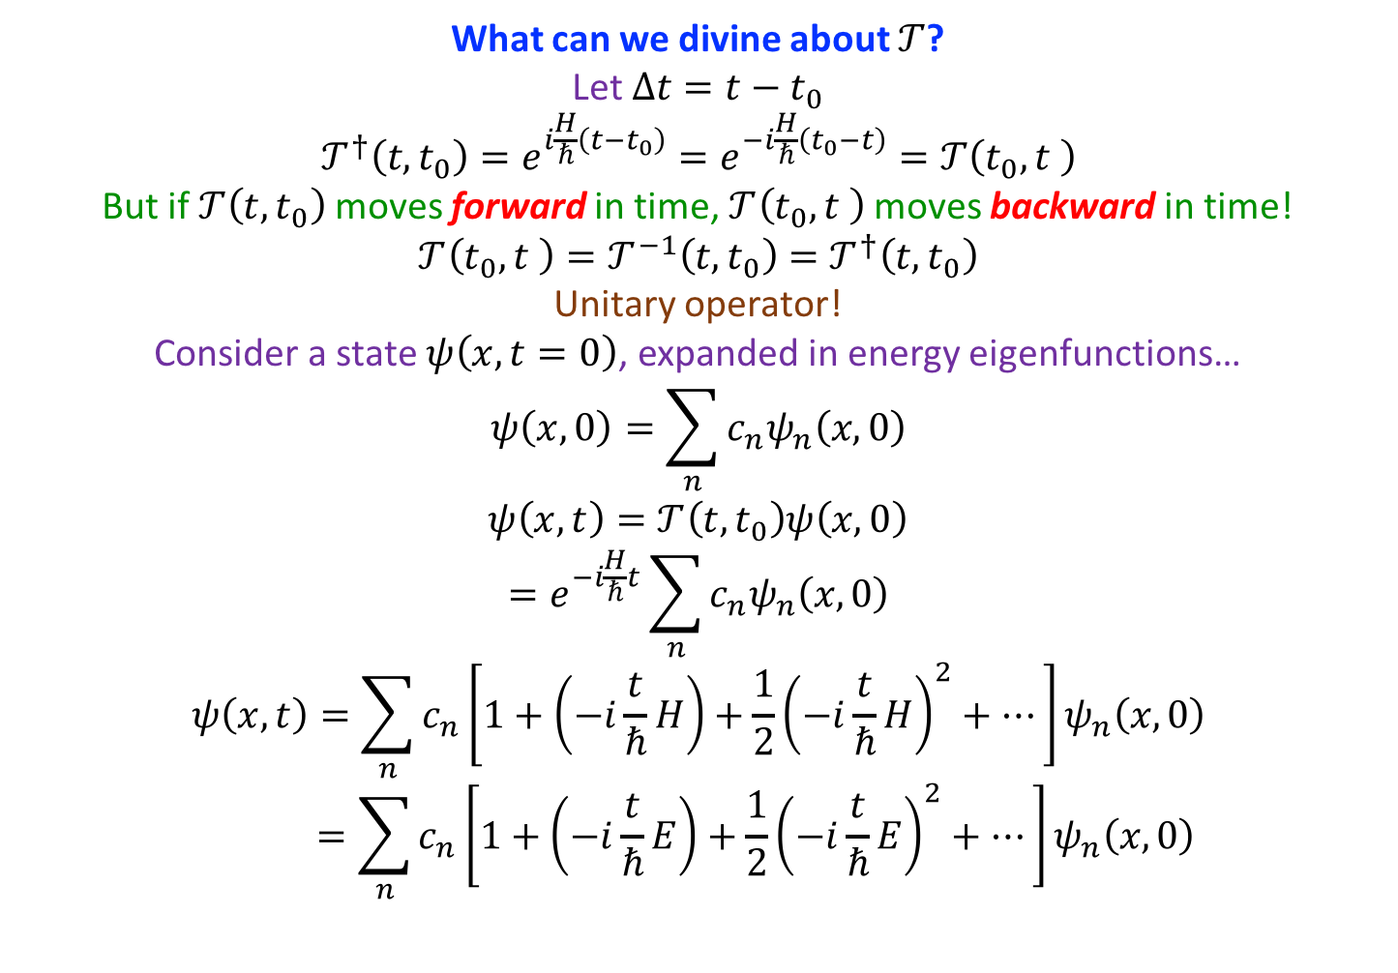
Angular Momentum: Translations
What can we divine about $𝒯$?
Let $Δt=t−t_{0}$
$$𝒯^{†}\left(t,t_{0}\right)=e^{i\frac{H}{ℏ}\left(t−t_{0}\right)}=e^{−i\frac{H}{ℏ}\left(t_{0}−t\right)}=𝒯\left(t_{0},t \right)$$
But if $𝒯\left(t,t_{0}\right)$ moves forward in time, $𝒯\left(t_{0},t \right)$ moves backward in time!
$$𝒯\left(t_{0},t \right)=𝒯^{−1}\left(t,t_{0}\right)=𝒯^{†}\left(t,t_{0}\right)$$
Unitary operator!
Consider a state $ψ\left(x,t=0\right)$, expanded in energy eigenfunctions…
$$ψ\left(x, 0\right)=\sum_{n}{c_{n}ψ_{n}\left(x,0\right)}$$
$$ψ\left(x,t\right)=𝒯\left(t,t_{0}\right)ψ\left(x,0\right)$$
$$=e^{−i\frac{H}{ℏ}t}\sum_{n}{c_{n}ψ_{n}\left(x,0\right)}$$
$$ψ\left(x,t\right)=\sum_{n}{c_{n}\left[1+\left(−i\frac{t}{ℏ}H\right)+\frac{1}{2}{\left(−i\frac{t}{ℏ}H\right)}^{2}+…\right]ψ_{n}\left(x,0\right)}$$
$$=\sum_{n}{c_{n}\left[1+\left(−i\frac{t}{ℏ}E\right)+\frac{1}{2}{\left(−i\frac{t}{ℏ}E\right)}^{2}+…\right]ψ_{n}\left(x,0\right)}$$

Slide 5
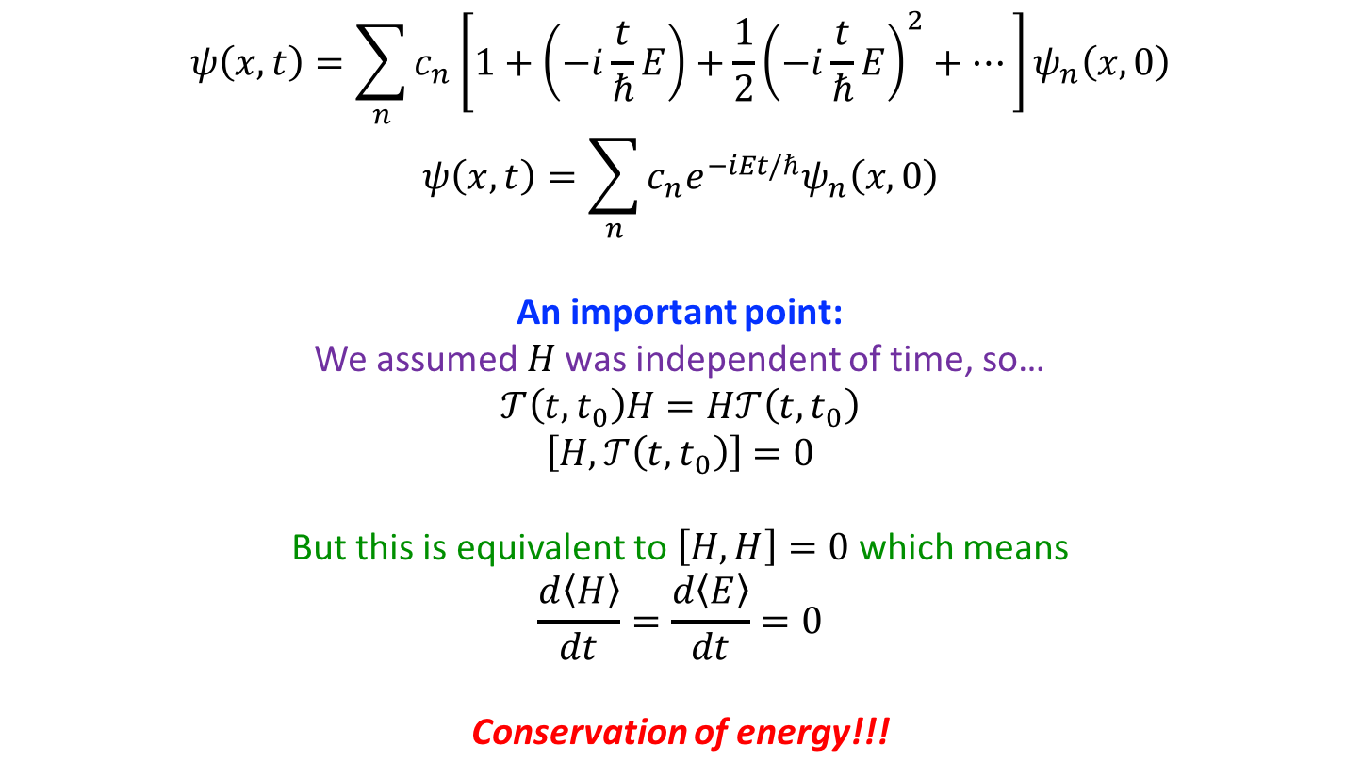
Angular Momentum: Translations
$$ψ\left(x,t\right)=\sum_{n}{c_{n}\left[1+\left(−i\frac{t}{ℏ}E\right)+\frac{1}{2}{\left(−i\frac{t}{ℏ}E\right)}^{2}+…\right]ψ_{n}\left(x,0\right)}$$
$$ψ\left(x,t\right)=\sum_{n}{c_{n}e^{−iEt/ℏ}ψ_{n}\left(x,0\right)}$$
An important point:
We assumed $H$ was independent of time, so…
$$𝒯\left(t,t_{0}\right)H=H𝒯\left(t,t_{0}\right)$$
$$\left[H,𝒯\left(t,t_{0}\right)\right]=0$$
But this is equivalent to $\left[H,H\right]=0$ which means
$$\frac{d〈H〉}{dt}=\frac{d〈E〉}{dt}=0$$
Conservation of energy!!!

Slide 6
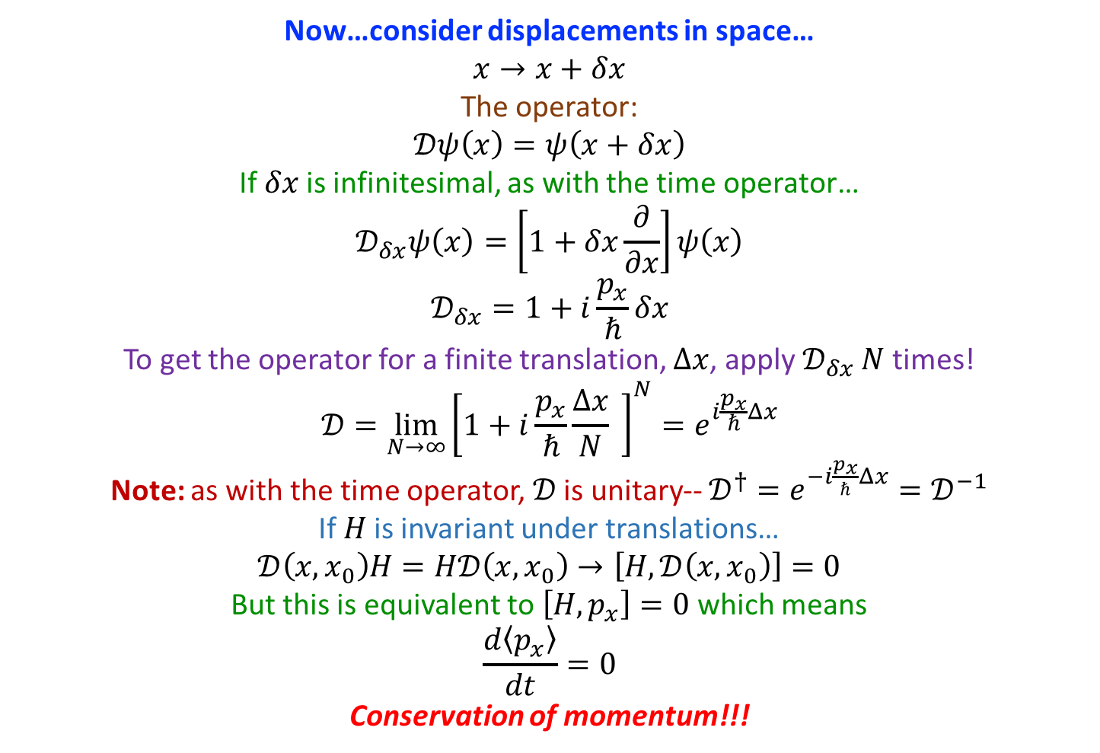
Angular Momentum: Translations
Now…consider displacements in space…
$$x→x+δx$$
The operator:
$$𝒟ψ\left(x\right)=ψ\left(x+δx\right)$$
If $δx$ is infinitesimal, as with the time operator…
$$𝒟_{δx}ψ\left(x\right)=\left[1+δx\frac{∂}{∂x}\right]ψ\left(x\right)$$
$$𝒟_{δx}=1+i\frac{p_{x}}{ℏ}δx$$
To get the operator for a finite translation, $Δx$, apply $𝒟_{δx}$ $N$times!
$$𝒟=\lim_{N→∞}{{\left[1+i\frac{p_{x}}{ℏ}\frac{Δx}{N} \right]}^{N}}=e^{i\frac{p_{x}}{ℏ}Δx}$$
Note: as with the time operator, $𝒟$ is unitary-- $𝒟^{†}=e^{−i\frac{p_{x}}{ℏ}Δx}=𝒟^{−1}$
If $H$ is invariant under translations…
$$𝒟\left(x,x_{0}\right)H=H𝒟\left(x,x_{0}\right)→\left[H,𝒟\left(x,x_{0}\right)\right]=0$$
But this is equivalent to $\left[H,p_{x}\right]=0$ which means
$$\frac{d〈p_{x}〉}{dt}=0$$
Conservation of momentum!!!

Slide 7
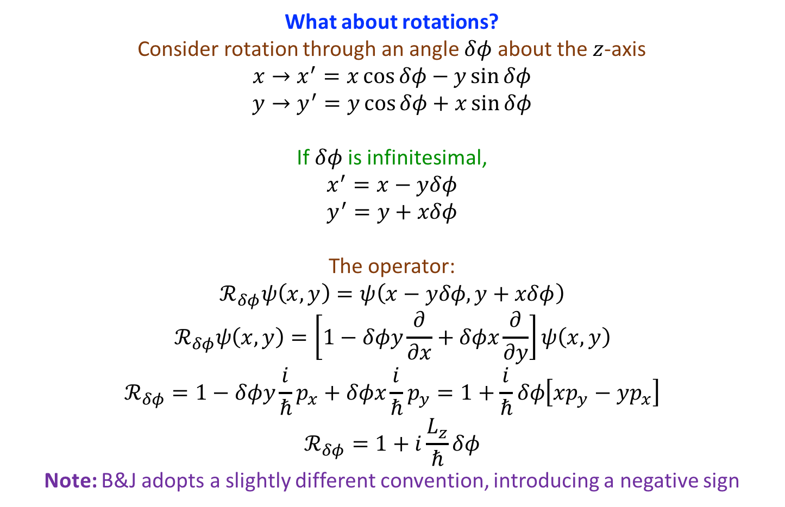
Angular Momentum: Rotations
What about rotations?
Consider rotation through an angle $δφ$ about the $z$-axis
$$x→x^{′}=x\cos{δφ}−y\sin{δφ}$$
$$y→y^{′}=y\cos{δφ}+x\sin{δφ}$$
If $δφ$ is infinitesimal,
$$x^{′}=x−yδφ$$
$$y^{′}=y+xδφ$$
The operator:
$$ℛ_{δφ}ψ\left(x,y\right)=ψ\left(x−yδφ,y+xδφ\right)$$
$$ℛ_{δφ}ψ\left(x,y\right)=\left[1−δφy\frac{∂}{∂x}+δφx\frac{∂}{∂y}\right]ψ\left(x,y\right)$$
$$ℛ_{δφ}=1−δφy\frac{i}{ℏ}p_{x}+δφx\frac{i}{ℏ}p_{y}=1+\frac{i}{ℏ}δφ\left[xp_{y}−yp_{x}\right]$$
$$ℛ_{δφ}=1+i\frac{L_{z}}{ℏ}δφ$$
Note: B&J adopts a slightly different convention, introducing a negative sign

Slide 8
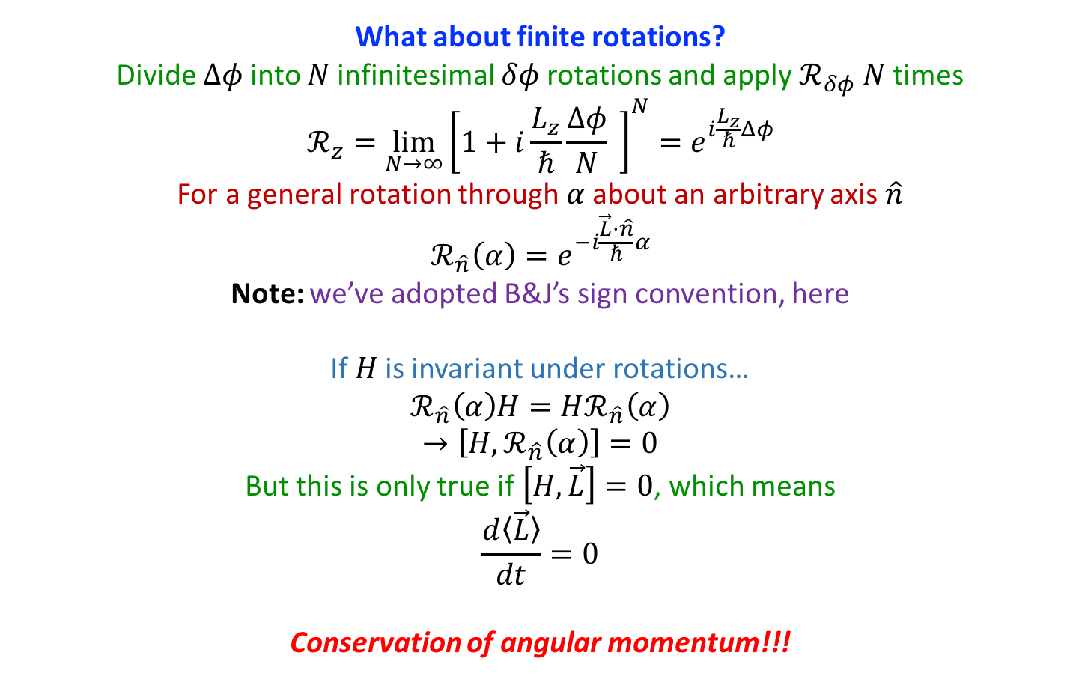
Angular Momentum: Rotations
What about finite rotations?
Divide $Δφ$ into $N$ infinitesimal $δφ$rotations and apply $ℛ_{δφ}$ $N$ times
$$ℛ_{z}=\lim_{N→∞}{{\left[1+i\frac{L_{z}}{ℏ}\frac{Δφ}{N} \right]}^{N}}=e^{i\frac{L_{z}}{ℏ}Δφ}$$
For a general rotation through $α$ about an arbitrary axis $\hat{n}$
$$ℛ_{\hat{n}}\left(α\right)=e^{−i\frac{\vec{L}⋅\hat{n}}{ℏ}α}$$
Note: we’ve adopted B&J’s sign convention, here
If $H$ is invariant under rotations…
$$ℛ_{\hat{n}}\left(α\right)H=Hℛ_{\hat{n}}\left(α\right)$$
$$→\left[H,ℛ_{\hat{n}}\left(α\right)\right]=0$$
But this is only true if $\left[H,\vec{L}\right]=0$, which means
$$\frac{d〈\vec{L}〉}{dt}=0$$
Conservation of angular momentum!!!

Slide 9
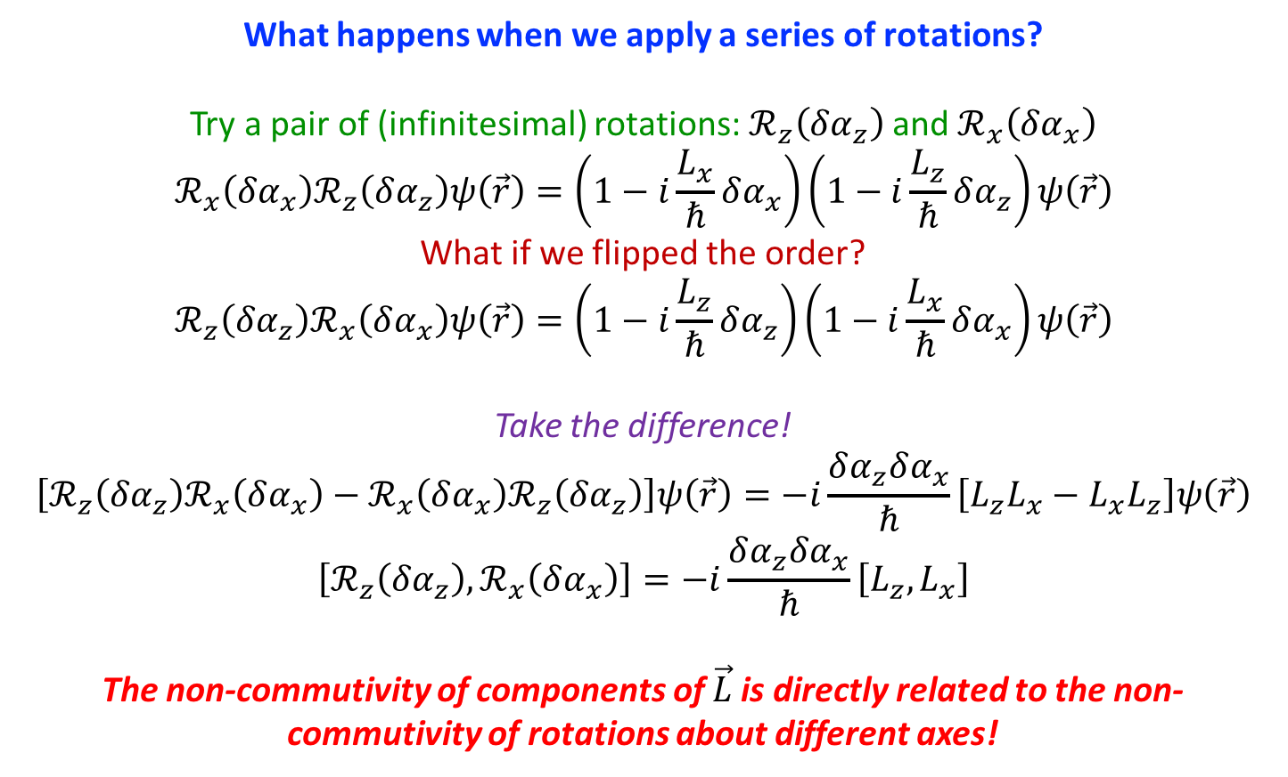
Angular Momentum: Rotations
What happens when we apply a series of rotations?
Try a pair of (infinitesimal) rotations: $ℛ_{z}\left(δα_{z}\right)$ and $ℛ_{x}\left(δα_{x}\right)$
$$ℛ_{x}\left(δα_{x}\right)ℛ_{z}\left(δα_{z}\right)ψ\left(\vec{r}\right)=\left(1−i\frac{L_{x}}{ℏ}δα_{x}\right)\left(1−i\frac{L_{z}}{ℏ}δα_{z}\right)ψ\left(\vec{r}\right)$$
What if we flipped the order?
$$ℛ_{z}\left(δα_{z}\right)ℛ_{x}\left(δα_{x}\right)ψ\left(\vec{r}\right)=\left(1−i\frac{L_{z}}{ℏ}δα_{z}\right)\left(1−i\frac{L_{x}}{ℏ}δα_{x}\right)ψ\left(\vec{r}\right)$$
Take the difference!
$$\left[ℛ_{z}\left(δα_{z}\right)ℛ_{x}\left(δα_{x}\right)−ℛ_{x}\left(δα_{x}\right)ℛ_{z}\left(δα_{z}\right)\right]ψ\left(\vec{r}\right)=−i\frac{δα_{z}δα_{x}}{ℏ}\left[L_{z}L_{x}−L_{x}L_{z}\right]ψ\left(\vec{r}\right)$$
$$\left[ℛ_{z}\left(δα_{z}\right),ℛ_{x}\left(δα_{x}\right)\right]=−i\frac{δα_{z}δα_{x}}{ℏ}\left[L_{z},L_{x}\right]$$
The non-commutivity of components of $\vec{L}$ is directly related to the non-commutivity of rotations about different axes!

Slide 10
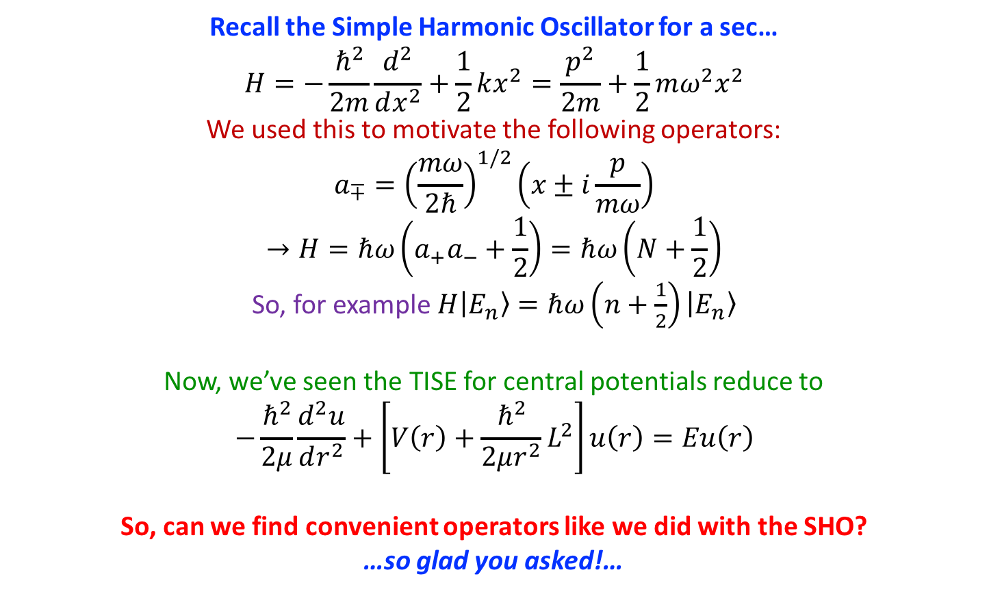
Angular Momentum: Linear Algebra
Recall the Simple Harmonic Oscillator for a sec…
$$H=−\frac{ℏ^{2}}{2m}\frac{d^{2}}{dx^{2}}+\frac{1}{2}kx^{2}=\frac{p^{2}}{2m}+\frac{1}{2}mω^{2}x^{2}$$
We used this to motivate the following operators:
$$a_{∓}={\left(\frac{mω}{2ℏ}\right)}^{1/2}\left(x±i\frac{p}{mω}\right)$$
$$→H=ℏω\left(a_{+}a_{−}+\frac{1}{2}\right)=ℏω\left(N+\frac{1}{2}\right)$$
So, for example $H|E_{n}〉=ℏω\left(n+\frac{1}{2}\right)|E_{n}〉$
Now, we’ve seen the TISE for central potentials reduce to
$$−\frac{ℏ^{2}}{2μ}\frac{d^{2}u}{dr^{2}}+\left[V\left(r\right)+\frac{ℏ^{2}}{2μr^{2}}L^{2}\right]u\left(r\right)=Eu\left(r\right)$$
So, can we find convenient operators like we did with the SHO?
…so glad you asked!…

Slide 11
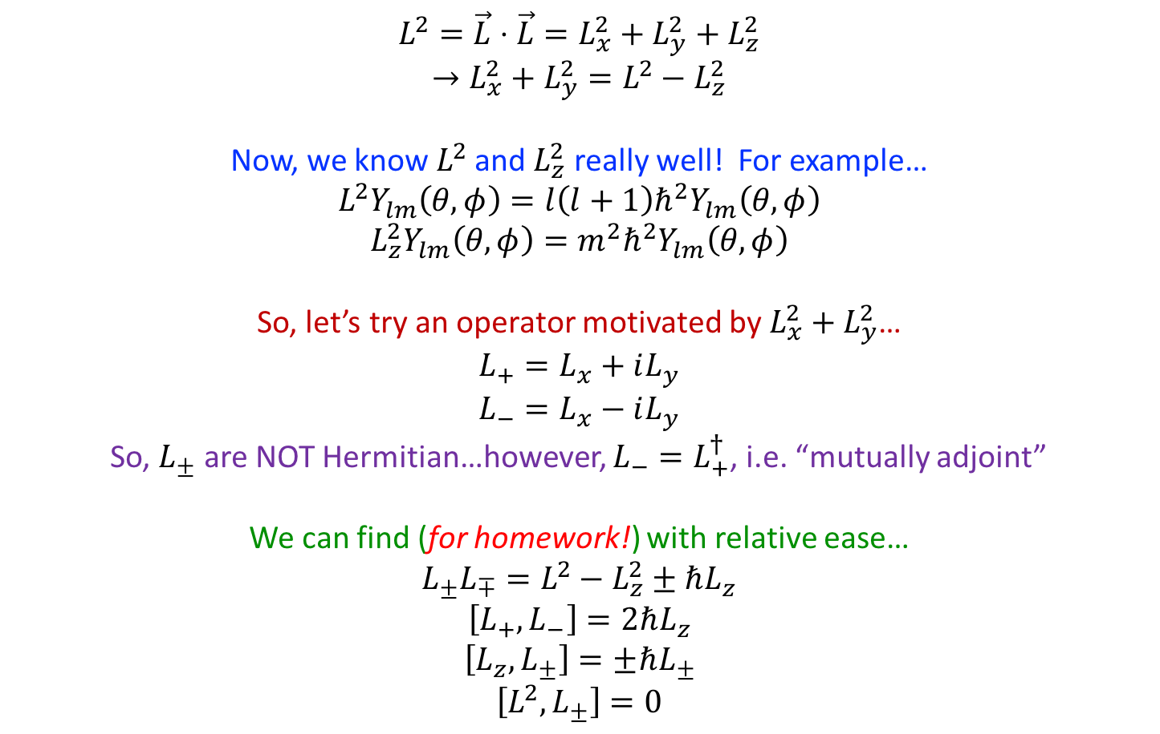
Angular Momentum: Linear Algebra
$$L^{2}=\vec{L}⋅\vec{L}=L_{x}^{2}+L_{y}^{2}+L_{z}^{2}$$
$$→L_{x}^{2}+L_{y}^{2}=L^{2}−L_{z}^{2}$$
Now, we know $L^{2}$ and $L_{z}^{2}$ really well! For example…
$$L^{2}Y_{lm}\left(θ,φ\right)=l\left(l+1\right)ℏ^{2}Y_{lm}\left(θ,φ\right)$$
$$L_{z}^{2}Y_{lm}\left(θ,φ\right)=m^{2}ℏ^{2}Y_{lm}\left(θ,φ\right)$$
So, let’s try an operator motivated by $L_{x}^{2}+L_{y}^{2}$…
$$L_{+}=L_{x}+iL_{y}$$
$$L_{−}=L_{x}−iL_{y}$$
So, $L_{±}$ are NOT Hermitian…however, $L_{−}=L_{+}^{†}$, i.e. “mutually adjoint”
We can find (for homework!) with relative ease…
$$L_{±}L_{∓}=L^{2}−L_{z}^{2}±ℏL_{z}$$
$$\left[L_{+},L_{−}\right]=2ℏL_{z}$$
$$\left[L_{z},L_{±}\right]=±ℏL_{±}$$
$$\left[L^{2},L_{±}\right]=0$$

Slide 12
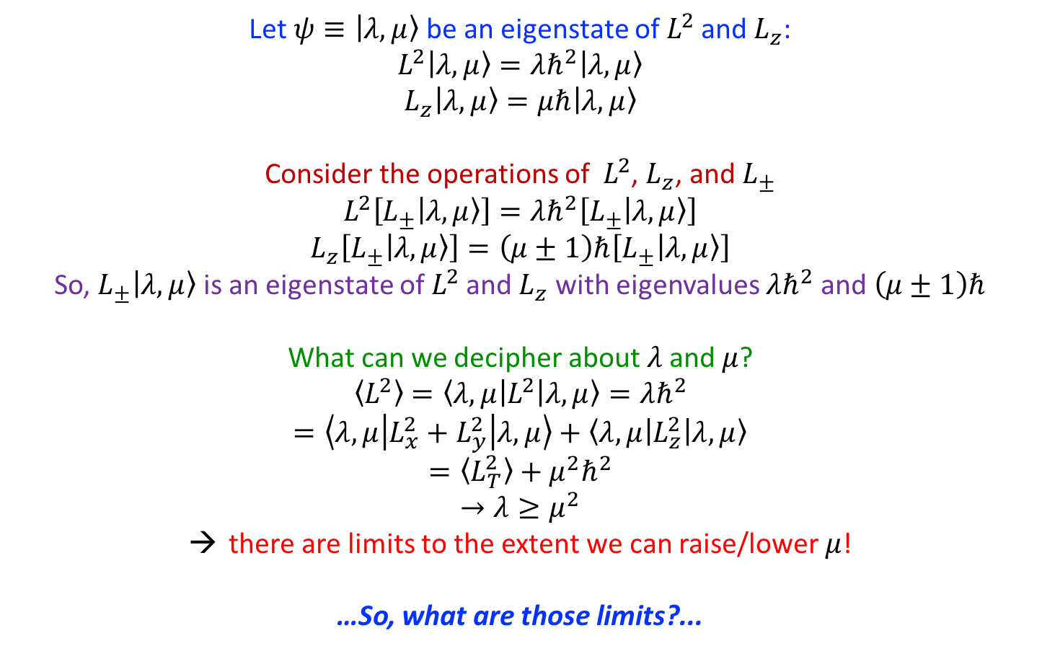
Angular Momentum: Linear Algebra
Let $ψ≡|λ,μ〉$ be an eigenstate of $L^{2}$ and $L_{z}$:
$$L^{2}|λ,μ〉=λℏ^{2}|λ,μ〉$$
$$L_{z}|λ,μ〉=μℏ|λ,μ〉$$
Consider the operations of $L^{2}$, $L_{z}$, and $L_{±}$
$$L^{2}\left[L_{±}|λ,μ〉\right]=λℏ^{2}\left[L_{±}|λ,μ〉\right]$$
$$L_{z}\left[L_{±}|λ,μ〉\right]=\left(μ±1\right)ℏ\left[L_{±}|λ,μ〉\right]$$
So, $L_{±}|λ,μ〉$ is an eigenstate of $L^{2}$ and $L_{z}$ with eigenvalues $λℏ^{2}$ and $\left(μ±1\right)ℏ$
What can we decipher about $λ$ and $μ$?
$$〈L^{2}〉=\left\langle λ,μ | L^{2} | λ,μ\right\rangle =λℏ^{2}$$
$$=\left\langle λ,μ | L_{x}^{2}+L_{y}^{2} | λ,μ\right\rangle +\left\langle λ,μ | L_{z}^{2} | λ,μ\right\rangle$$
$$=〈L_{T}^{2}〉+μ^{2}ℏ^{2}$$
$$→λ≥μ^{2}$$
there are limits to the extent we can raise/lower $μ$!
…So, what are those limits?...

Slide 13
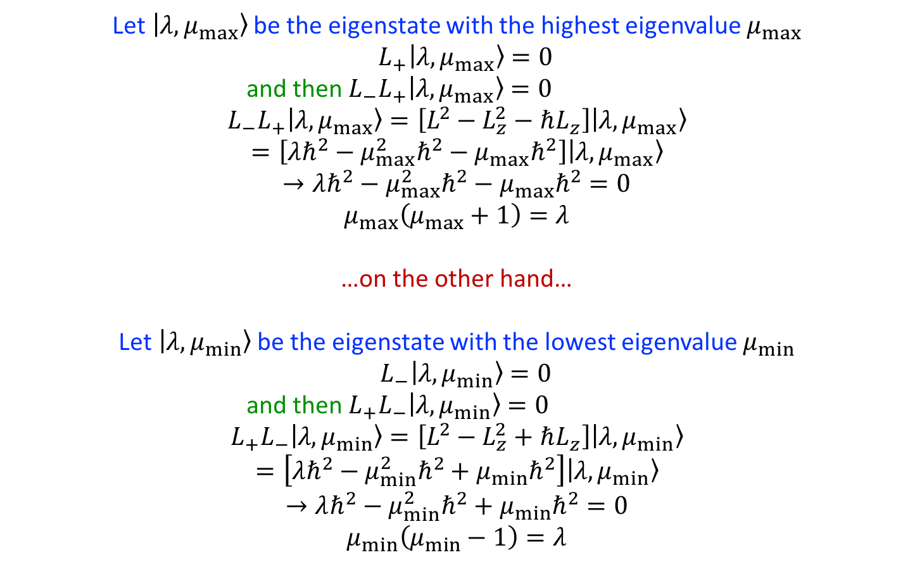
Angular Momentum: Linear Algebra
Let $|λ,μ_{max}〉$ be the eigenstate with the highest eigenvalue $μ_{max}$
$L_{+}|λ,μ_{max}〉=0$
          and then $L_{−}L_{+}|λ,μ_{max}〉=0$
$$L_{−}L_{+}|λ,μ_{max}〉=\left[L^{2}−L_{z}^{2}−ℏL_{z}\right]|λ,μ_{max}〉$$
$$=\left[λℏ^{2}−μ_{max}^{2}ℏ^{2}−μ_{max}ℏ^{2}\right]|λ,μ_{max}〉$$
$$→λℏ^{2}−μ_{max}^{2}ℏ^{2}−μ_{max}ℏ^{2}=0$$
$$μ_{max}\left(μ_{max}+1\right)=λ$$
…on the other hand…
Let $|λ,μ_{min}〉$ be the eigenstate with the lowest eigenvalue $μ_{min}$
$L_{−}|λ,μ_{min}〉=0$
          and then $L_{+}L_{−}|λ,μ_{min}〉=0$
$$L_{+}L_{−}|λ,μ_{min}〉=\left[L^{2}−L_{z}^{2}+ℏL_{z}\right]|λ,μ_{min}〉$$
$$=\left[λℏ^{2}−μ_{min}^{2}ℏ^{2}+μ_{min}ℏ^{2}\right]|λ,μ_{min}〉$$
$$→λℏ^{2}−μ_{min}^{2}ℏ^{2}+μ_{min}ℏ^{2}=0$$
$$μ_{min}\left(μ_{min}−1\right)=λ$$

Slide 14
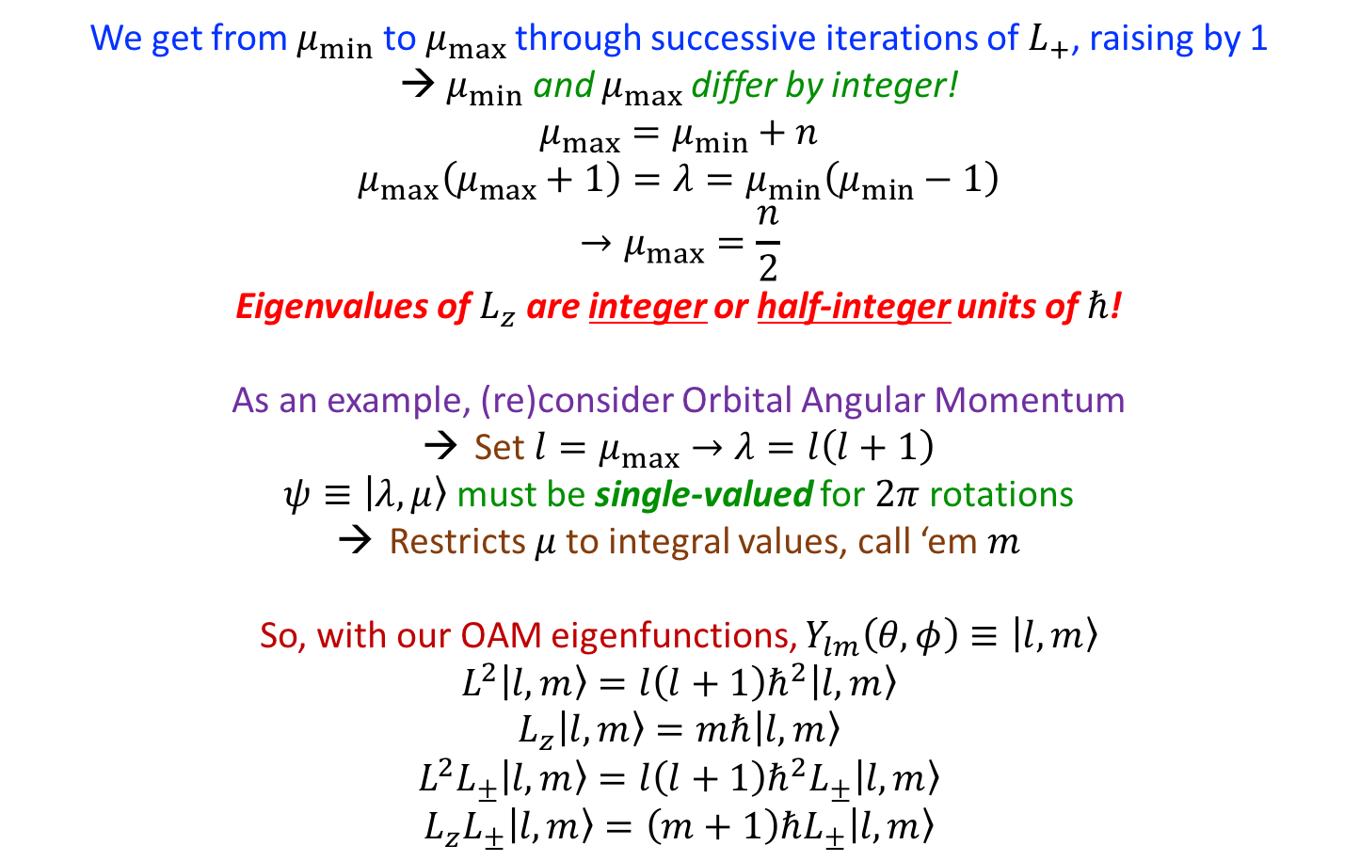
Angular Momentum: Linear Algebra
We get from $μ_{min}$ to $μ_{max}$ through successive iterations of $L_{+}$, raising by 1
→ $μ_{min}$ and $μ_{max}$ differ by integer!
$$μ_{max}=μ_{min}+n$$
$$μ_{max}\left(μ_{max}+1\right)=λ=μ_{min}\left(μ_{min}−1\right)$$
$$→μ_{max}=\frac{n}{2}$$
Eigenvalues of $L_{z}$ are integer or half-integer units of $ℏ$!
As an example, (re)consider Orbital Angular Momentum
Set $l=μ_{max}→λ=l\left(l+1\right)$
$ψ≡|λ,μ〉$ must be single-valued for $2π$ rotations
Restricts $μ$ to integral values, call ‘em $m$
So, with our OAM eigenfunctions, $Y_{lm}\left(θ,φ\right)≡|l,m〉$
$$L^{2}|l,m〉=l\left(l+1\right)ℏ^{2}|l,m〉$$
$$L_{z}|l,m〉=mℏ|l,m〉$$
$$L^{2}L_{±}|l,m〉=l\left(l+1\right)ℏ^{2}L_{±}|l,m〉$$
$$L_{z}L_{±}|l,m〉=\left(m+1\right)ℏL_{±}|l,m〉$$

Slide 15
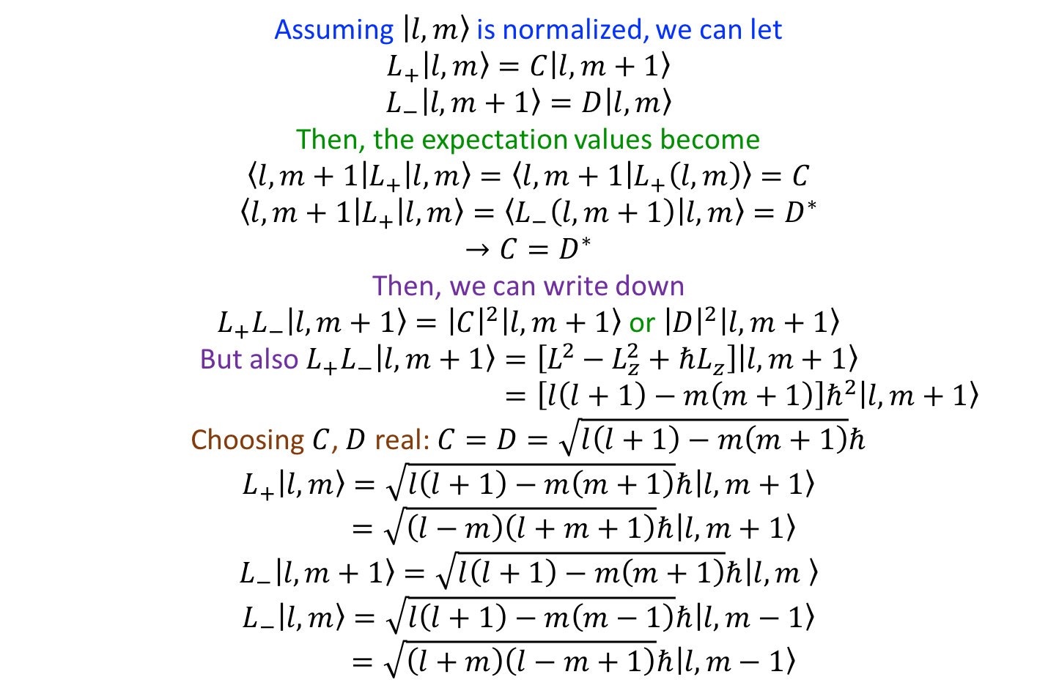
Angular Momentum: Linear Algebra
Assuming $|l,m〉$ is normalized, we can let
$$L_{+}|l,m〉=C|l,m+1〉$$
$$L_{−}|l,m+1〉=D|l,m〉$$
Then, the expectation values become
$$\left\langle l,m+1 | L_{+} | l,m\right\rangle =〈l,m+1 | L_{+}\left(l,m\right)〉=C$$
$$\left\langle l,m+1 | L_{+} | l,m\right\rangle =〈L_{−}\left(l,m+1\right) | l,m〉=D^{∗}$$
$$→C=D^{∗}$$
Then, we can write down
$L_{+}L_{−}|l,m+1〉={\left|C\right|}^{2}|l,m+1〉$ or ${\left|D\right|}^{2}|l,m+1〉$
But also $L_{+}L_{−}|l,m+1〉=\left[L^{2}−L_{z}^{2}+ℏL_{z}\right]|l,m+1〉$
$=\left[l\left(l+1\right)−m\left(m+1\right)\right]ℏ^{2}|l,m+1〉$
Choosing $C$, $D$ real: $C=D=\sqrt{l\left(l+1\right)−m\left(m+1\right)}ℏ$
$$L_{+}|l,m〉=\sqrt{l\left(l+1\right)−m\left(m+1\right)}ℏ|l,m+1〉$$
$=\sqrt{\left(l−m\right)\left(l+m+1\right)}ℏ|l,m+1〉$
$$L_{−}|l,m+1〉=\sqrt{l\left(l+1\right)−m\left(m+1\right)}ℏ|l,m 〉$$
$$L_{−}|l,m〉=\sqrt{l\left(l+1\right)−m\left(m−1\right)}ℏ|l,m−1〉$$
$=\sqrt{\left(l+m\right)\left(l−m+1\right)}ℏ|l,m−1〉$

Slide 16
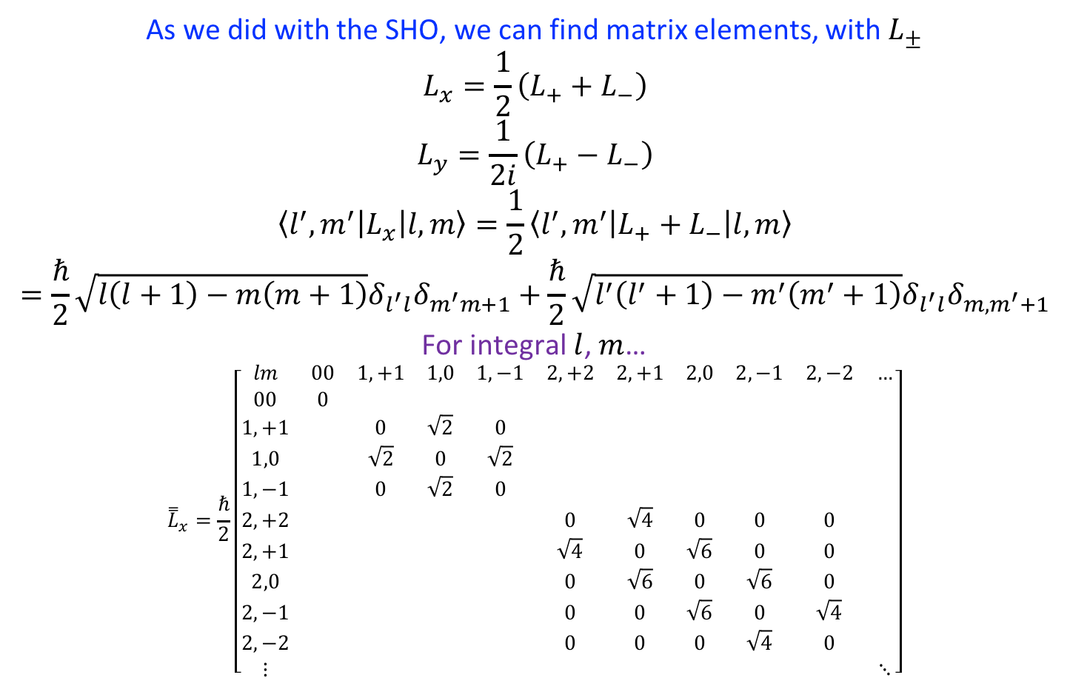
Angular Momentum: Linear Algebra
As we did with the SHO, we can find matrix elements, with $L_{±}$
$$L_{x}=\frac{1}{2}\left(L_{+}+L_{−}\right)$$
$$L_{y}=\frac{1}{2i}\left(L_{+}−L_{−}\right)$$
$$\left\langle l^{′},m^{′} | L_{x} | l,m\right\rangle =\frac{1}{2}\left\langle l^{′},m^{′} | L_{+}+L_{−} | l,m\right\rangle$$
$$=\frac{ℏ}{2}\sqrt{l\left(l+1\right)−m\left(m+1\right)}δ_{l^{′}l}δ_{m^{′}m+1}+\frac{ℏ}{2}\sqrt{l^{′}\left(l^{′}+1\right)−m^{′}\left(m^{′}+1\right)}δ_{l^{′}l}δ_{m,m^{′}+1}$$
For integral $l$, $m$…
$${\overset{̿}{L}}_{x}=\frac{ℏ}{2}\left[\begin{matrix}lm & 00 & 1,+1 & 1,0 & 1,−1 & 2,+2 & 2,+1 & 2,0 & 2,−1 & 2,−2 & … \\ 00 & 0 & & & & & & & & & \\ 1,+1 & & 0 & \sqrt{2} & 0 & & & & & & \\ 1,0 & & \sqrt{2} & 0 & \sqrt{2} & & & & & & \\ 1,−1 & & 0 & \sqrt{2} & 0 & & & & & & \\ 2,+2 & & & & & 0 & \sqrt{4} & 0 & 0 & 0 & \\ 2,+1 & & & & & \sqrt{4} & 0 & \sqrt{6} & 0 & 0 & \\ 2,0 & & & & & 0 & \sqrt{6} & 0 & \sqrt{6} & 0 & \\ 2,−1 & & & & & 0 & 0 & \sqrt{6} & 0 & \sqrt{4} & \\ 2,−2 & & & & & 0 & 0 & 0 & \sqrt{4} & 0 & \\ ⋮ & & & & & & & & & & ⋱\end{matrix}\right]$$

Slide 17

Angular Momentum: Linear Algebra
An example problem:
Find the eigenvectors/values of $L_{x}$ for $l=1$
$$\begin{matrix}λ & \\ +ℏ & {|ψ_{11}〉}_{x}=\frac{1}{2}\left[|1,1〉+\sqrt{2}|1,0〉+|1,−1〉\right] \\ 0 & {|ψ_{10}〉}_{x}=\frac{1}{\sqrt{2}}\left[|1,1〉−|1,−1〉\right] \\ −ℏ & {|ψ_{1−1}〉}_{x}=\frac{1}{2}\left[|1,1〉−\sqrt{2}|1,0〉+|1,−1〉\right]\end{matrix}$$

Slide 18
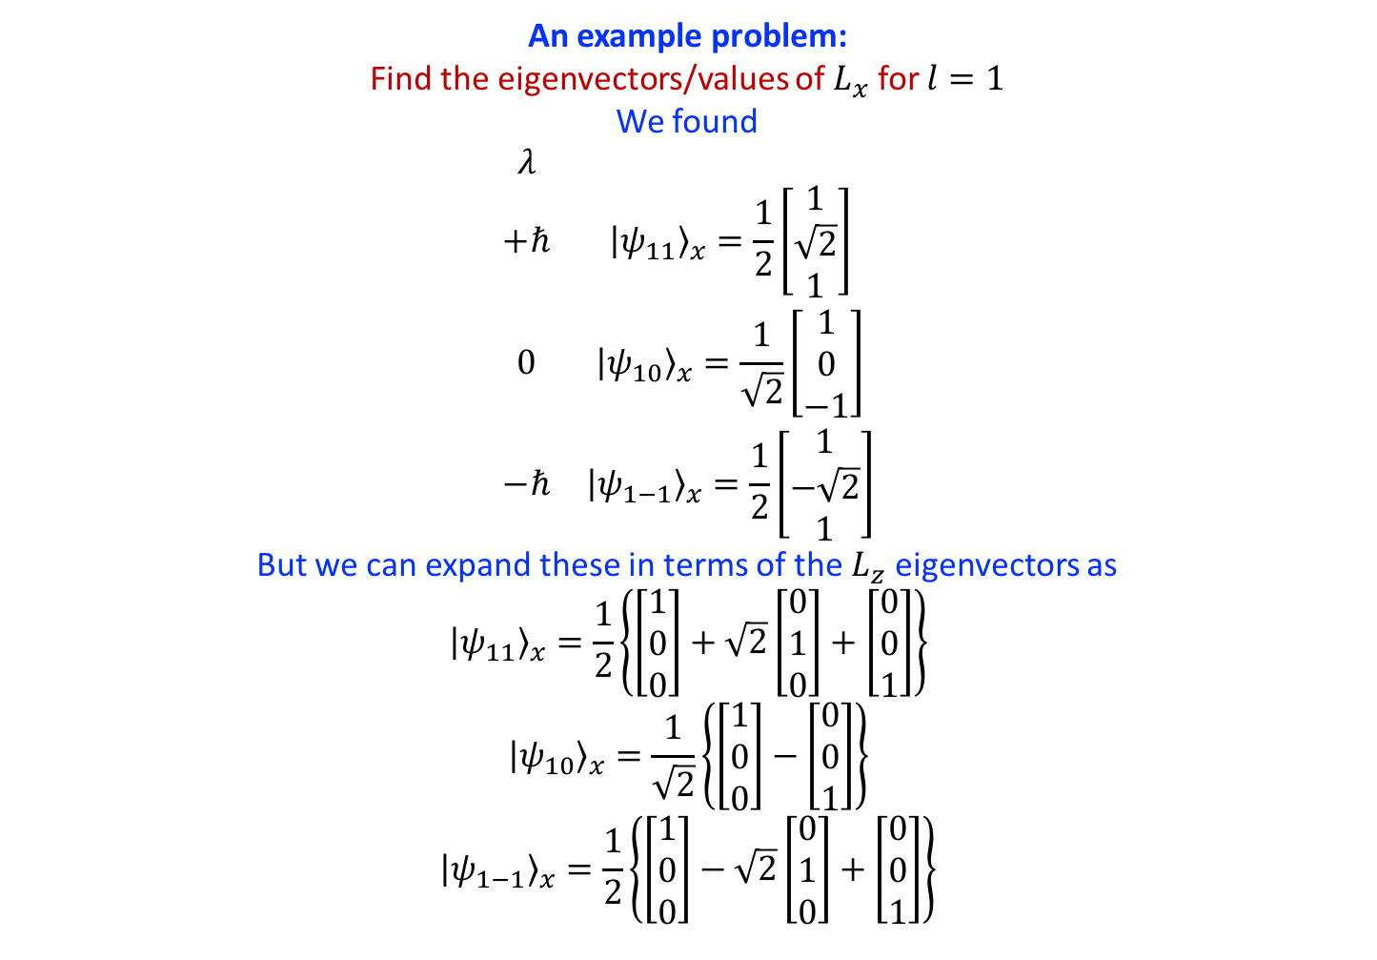
Angular Momentum: Linear Algebra
An example problem:
Find the eigenvectors/values of $L_{x}$ for $l=1$
We found
$$\begin{matrix}λ & \\ +ℏ & {|ψ_{11}〉}_{x}=\frac{1}{2}\left[\begin{matrix}1 \\ \sqrt{2} \\ 1\end{matrix}\right] \\ 0 & {|ψ_{10}〉}_{x}=\frac{1}{\sqrt{2}}\left[\begin{matrix}1 \\ 0 \\ −1\end{matrix}\right] \\ −ℏ & {|ψ_{1−1}〉}_{x}=\frac{1}{2}\left[\begin{matrix}1 \\ −\sqrt{2} \\ 1\end{matrix}\right]\end{matrix}$$
But we can expand these in terms of the $L_{z}$ eigenvectors as
$${|ψ_{11}〉}_{x}=\frac{1}{2}\left\{\left[\begin{matrix}1 \\ 0 \\ 0\end{matrix}\right]+\sqrt{2}\left[\begin{matrix}0 \\ 1 \\ 0\end{matrix}\right]+\left[\begin{matrix}0 \\ 0 \\ 1\end{matrix}\right]\right\}$$
$${|ψ_{10}〉}_{x}=\frac{1}{\sqrt{2}}\left\{\left[\begin{matrix}1 \\ 0 \\ 0\end{matrix}\right]−\left[\begin{matrix}0 \\ 0 \\ 1\end{matrix}\right]\right\}$$
$${|ψ_{1−1}〉}_{x}=\frac{1}{2}\left\{\left[\begin{matrix}1 \\ 0 \\ 0\end{matrix}\right]−\sqrt{2}\left[\begin{matrix}0 \\ 1 \\ 0\end{matrix}\right]+\left[\begin{matrix}0 \\ 0 \\ 1\end{matrix}\right]\right\}$$

Slide 19

Angular Momentum: Linear Algebra
An example problem:
Find the eigenvectors/values of $L_{x}$ for $l=1$
$$\begin{matrix}λ & \\ +ℏ & {|ψ_{11}〉}_{x}=\frac{1}{2}\left[|1,1〉+\sqrt{2}|1,0〉+|1,−1〉\right] \\ 0 & {|ψ_{10}〉}_{x}=\frac{1}{\sqrt{2}}\left[|1,1〉−|1,−1〉\right] \\ −ℏ & {|ψ_{1−1}〉}_{x}=\frac{1}{2}\left[|1,1〉−\sqrt{2}|1,0〉+|1,−1〉\right]\end{matrix}$$

Slide 20
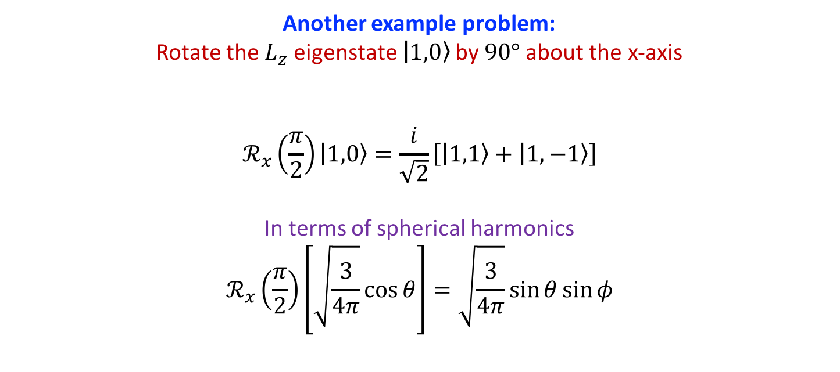
Angular Momentum: Rotations
Another example problem:
Rotate the $L_{z}$ eigenstate $|1,0〉$ by $90°$ about the x-axis
$$ℛ_{x}\left(\frac{π}{2}\right)|1,0〉=\frac{i}{\sqrt{2}}\left[|1,1〉+|1,−1〉\right]$$
In terms of spherical harmonics
$$ℛ_{x}\left(\frac{π}{2}\right)\left[\sqrt{\frac{3}{4π}}\cos{θ}\right]=\sqrt{\frac{3}{4π}}\sin{θ}\sin{φ}$$

Slide 21
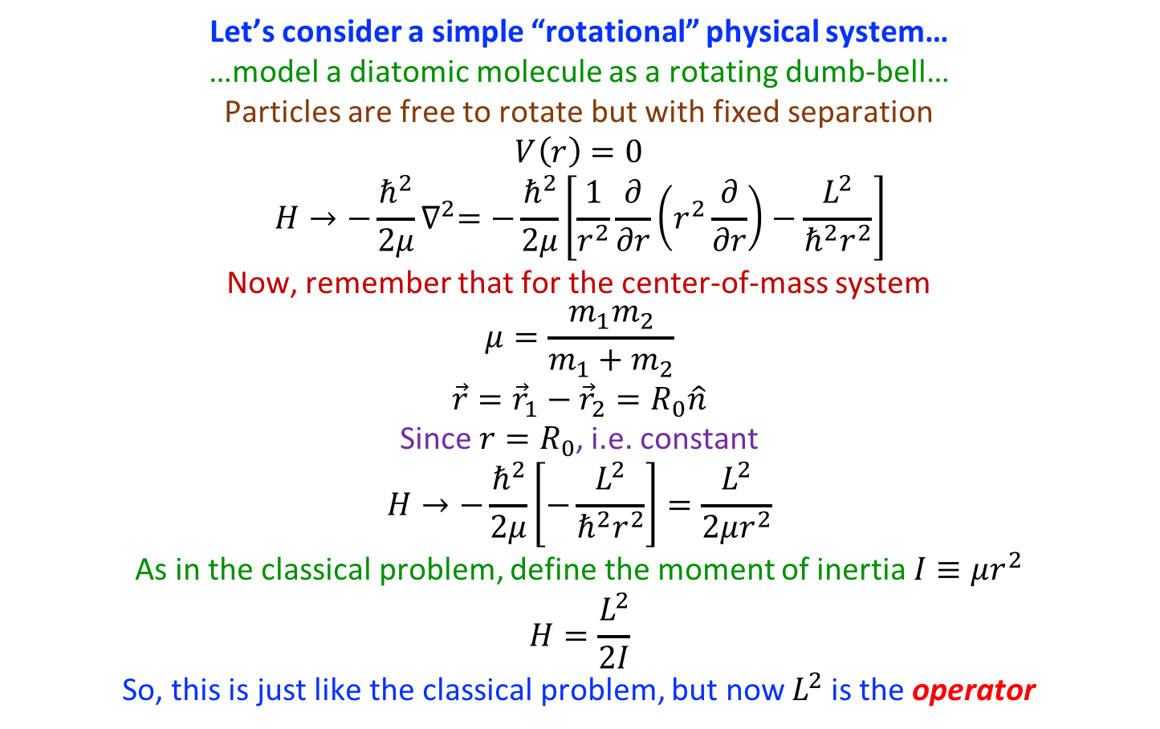



Angular Momentum: Rotations
Let’s consider a simple “rotational” physical system…
…model a diatomic molecule as a rotating dumb-bell…
Particles are free to rotate but with fixed separation
$$V\left(r\right)=0$$
$$H→−\frac{ℏ^{2}}{2μ}∇^{2}=−\frac{ℏ^{2}}{2μ}\left[\frac{1}{r^{2}}\frac{∂}{∂r}\left(r^{2}\frac{∂}{∂r}\right)−\frac{L^{2}}{ℏ^{2}r^{2}}\right]$$
Now, remember that for the center-of-mass system
$$μ=\frac{m_{1}m_{2}}{m_{1}+m_{2}}$$
$$\vec{r}={\vec{r}}_{1}−{\vec{r}}_{2}=R_{0}\hat{n}$$
Since $r=R_{0}$, i.e. constant
$$H→−\frac{ℏ^{2}}{2μ}\left[−\frac{L^{2}}{ℏ^{2}r^{2}}\right]=\frac{L^{2}}{2μr^{2}}$$
As in the classical problem, define the moment of inertia $I≡μr^{2}$
$$H=\frac{L^{2}}{2I}$$
So, this is just like the classical problem, but now $L^{2}$ is the operator
$$z$$
$$R_{0}$$
$$y$$
$$ω$$
$$x$$

Slide 22
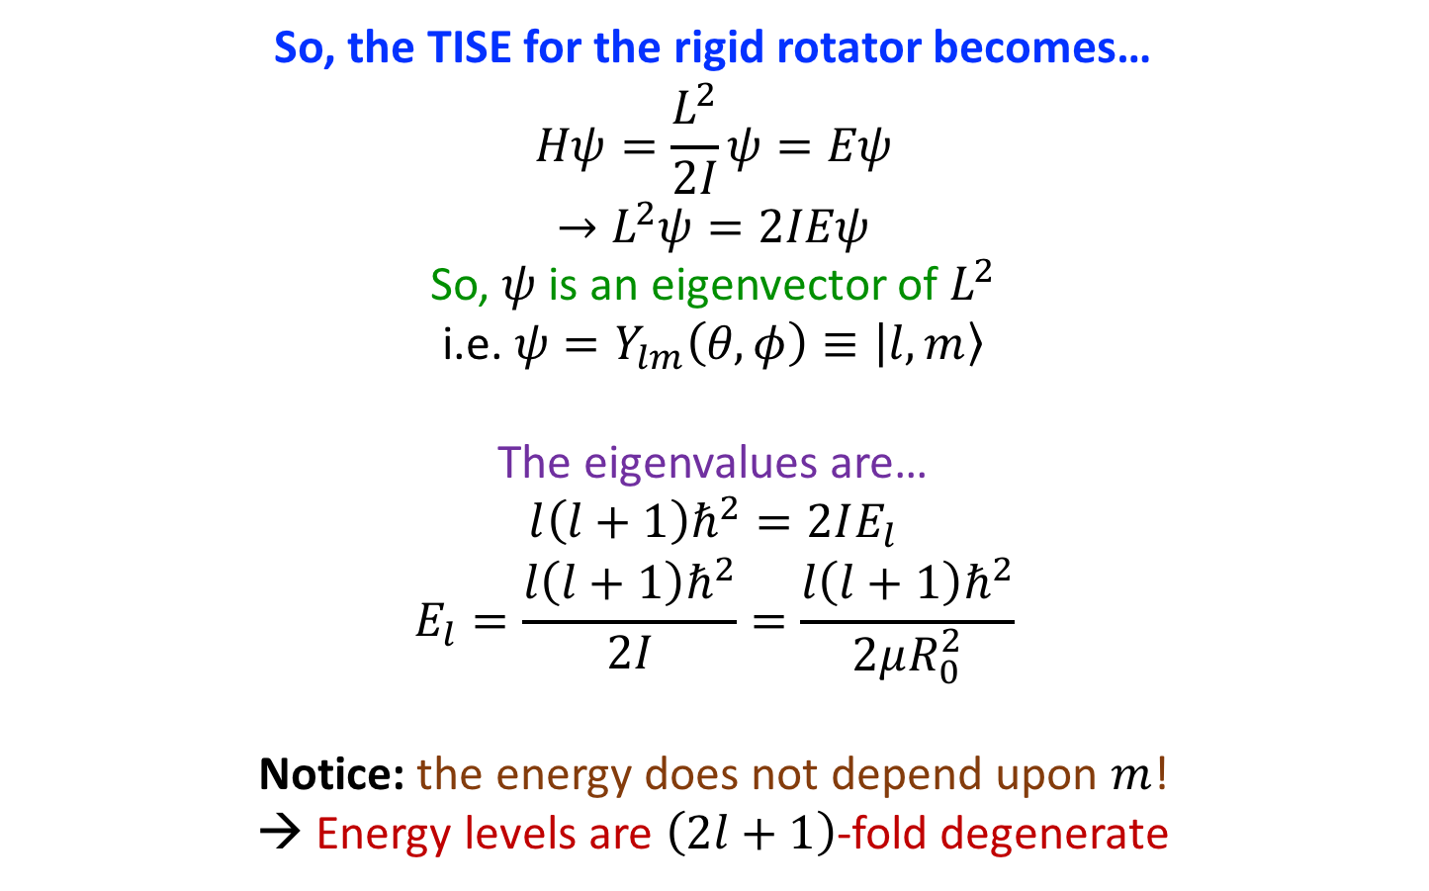
Angular Momentum: Rotations
So, the TISE for the rigid rotator becomes…
$$Hψ=\frac{L^{2}}{2I}ψ=Eψ$$
$$→L^{2}ψ=2IEψ$$
So, $ψ$ is an eigenvector of $L^{2}$
i.e. $ψ=Y_{lm}\left(θ,φ\right)≡|l,m〉$
The eigenvalues are…
$$l\left(l+1\right)ℏ^{2}=2IE_{l}$$
$$E_{l}=\frac{l\left(l+1\right)ℏ^{2}}{2I}=\frac{l\left(l+1\right)ℏ^{2}}{2μR_{0}^{2}}$$
Notice: the energy does not depend upon $m$!
→ Energy levels are $\left(2l+1\right)$-fold degenerate
$$z$$
$$R_{0}$$
$$y$$
$$ω$$
$$x$$

Slide 23
Angular Momentum
…And now…
…for something completely different…

Slide 24
Intrinsic Angular Momentum
Every particle has a peculiar property:
intrinsic angular momentum (“spin”)
Spin is WEIRD!
Stems directly from the quantum mechanical and relativistic nature of particles
In this sense, spin is a particularly useful tool for probing fundamental properties of nature
The intrinsic angular momentum of composite particles is still not well understood and an area of active investigation by global physics community

Slide 25
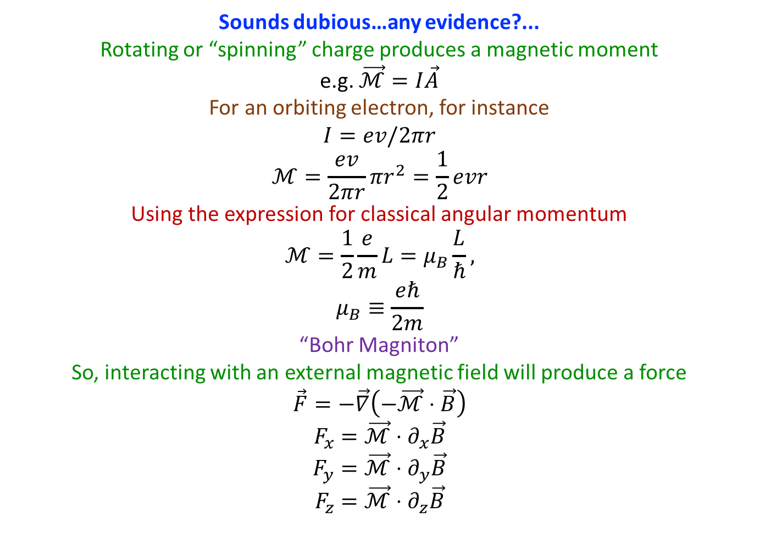
Intrinsic Angular Momentum
Sounds dubious…any evidence?...
Rotating or “spinning” charge produces a magnetic moment
e.g. $\vec{ℳ}=I\vec{A}$
For an orbiting electron, for instance
$$I=ev/2πr$$
$$ℳ=\frac{ev}{2πr}πr^{2}=\frac{1}{2}evr$$
Using the expression for classical angular momentum
$$ℳ=\frac{1}{2}\frac{e}{m}L=μ_{B}\frac{L}{ℏ},$$
$$μ_{B}≡\frac{eℏ}{2m}$$
“Bohr Magniton”
So, interacting with an external magnetic field will produce a force
$$\vec{F}=−\vec{∇}\left(−\vec{ℳ}⋅\vec{B}\right)$$
$$F_{x}=\vec{ℳ}⋅∂_{x}\vec{B}$$
$$F_{y}=\vec{ℳ}⋅∂_{y}\vec{B}$$
$$F_{z}=\vec{ℳ}⋅∂_{z}\vec{B}$$

Slide 26
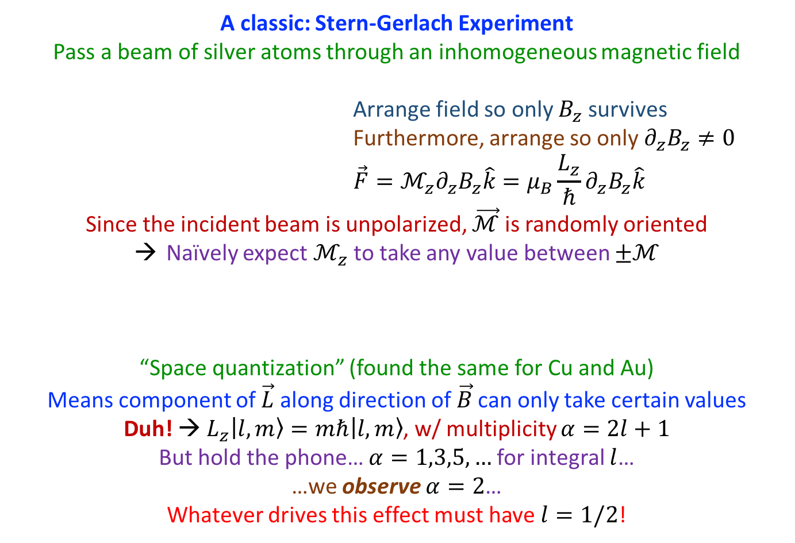
Intrinsic Angular Momentum
A classic: Stern-Gerlach Experiment
Pass a beam of silver atoms through an inhomogeneous magnetic field
                Arrange field so only $B_{z}$ survives
                Furthermore, arrange so only $∂_{z}B_{z}≠0$
                $$\vec{F}=ℳ_{z}∂_{z}B_{z}\hat{k}=μ_{B}\frac{L_{z}}{ℏ}∂_{z}B_{z}\hat{k}$$
Since the incident beam is unpolarized, $\vec{ℳ}$ is randomly oriented
Naïvely expect $ℳ_{z}$ to take any value between $±ℳ$
“Space quantization” (found the same for Cu and Au)
Means component of $\vec{L}$ along direction of $\vec{B}$ can only take certain values
Duh! → $L_{z}|l,m〉=mℏ|l,m〉$, w/ multiplicity $α=2l+1$
But hold the phone… $α=1,3,5,…$ for integral $l$…
…we observe $α=2$…
Whatever drives this effect must have $l=1/2$!
expect
observe

Slide 27
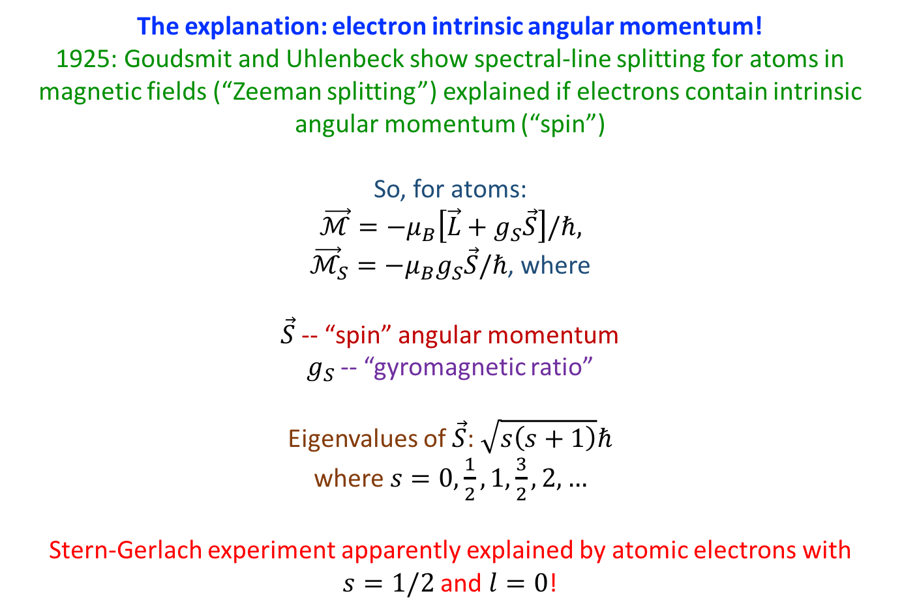
Intrinsic Angular Momentum
The explanation: electron intrinsic angular momentum!
1925: Goudsmit and Uhlenbeck show spectral-line splitting for atoms in magnetic fields (“Zeeman splitting”) explained if electrons contain intrinsic angular momentum (“spin”)
So, for atoms:
$$\vec{ℳ}=−μ_{B}\left[\vec{L}+g_{S}\vec{S}\right]/ℏ,$$
${\vec{ℳ}}_{S}=−μ_{B}g_{S}\vec{S}/ℏ$, where
$\vec{S}$ -- “spin” angular momentum
$g_{S}$ -- “gyromagnetic ratio”
Eigenvalues of $\vec{S}$: $\sqrt{s\left(s+1\right)}ℏ$
where $s=0,\frac{1}{2},1,\frac{3}{2},2,…$
Stern-Gerlach experiment apparently explained by atomic electrons with
$s=1/2$ and $l=0$!

Slide 28
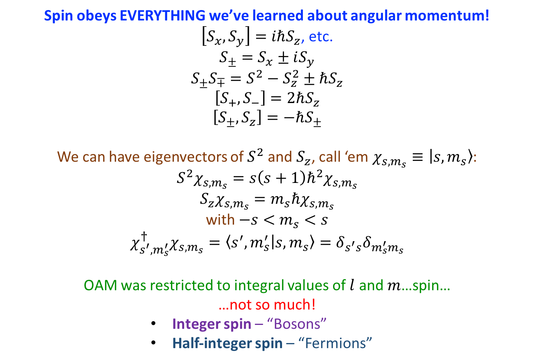
Intrinsic Angular Momentum
Spin obeys EVERYTHING we’ve learned about angular momentum!
$\left[S_{x},S_{y}\right]=iℏS_{z}$, etc.
$$S_{±}=S_{x}±iS_{y}$$
$$S_{±}S_{∓}=S^{2}−S_{z}^{2}±ℏS_{z}$$
$$\left[S_{+},S_{−}\right]=2ℏS_{z}$$
$$\left[S_{±},S_{z}\right]=−ℏS_{±}$$
We can have eigenvectors of $S^{2}$ and $S_{z}$, call ‘em $χ_{s,m_{s}}≡|s,m_{s}〉$:
$$S^{2}χ_{s,m_{s}}=s\left(s+1\right)ℏ^{2}χ_{s,m_{s}}$$
$$S_{z}χ_{s,m_{s}}=m_{s}ℏχ_{s,m_{s}}$$
with $−s<m_{s}<s$
$$χ_{s^{′},m_{s}^{′}}^{†}χ_{s,m_{s}}=〈s^{′},m_{s}^{′} | s,m_{s}〉=δ_{s^{′}s}δ_{m_{s}^{′}m_{s}}$$
OAM was restricted to integral values of $l$ and $m$…spin…
…not so much!
          Integer spin – “Bosons”
          Half-integer spin – “Fermions”

Slide 29
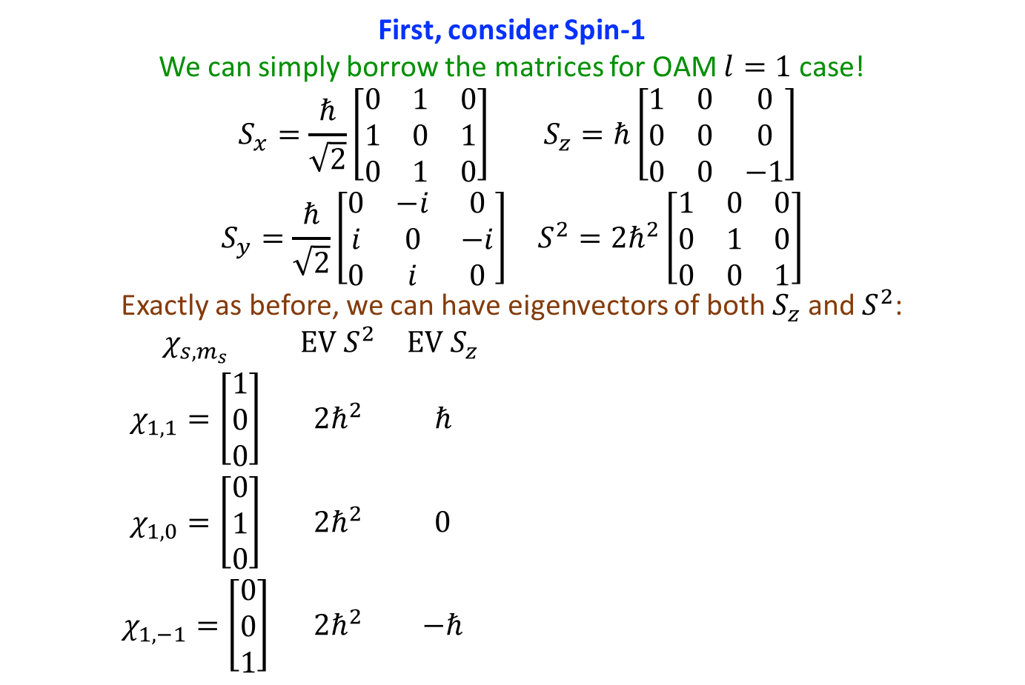







Intrinsic Angular Momentum
First, consider Spin-1
We can simply borrow the matrices for OAM $l=1$ case!
$$\begin{matrix}S_{x}=\frac{ℏ}{\sqrt{2}}\left[\begin{matrix}0 & 1 & 0 \\ 1 & 0 & 1 \\ 0 & 1 & 0\end{matrix}\right] & S_{z}=ℏ\left[\begin{matrix}1 & 0 & 0 \\ 0 & 0 & 0 \\ 0 & 0 & −1\end{matrix}\right] \\ S_{y}=\frac{ℏ}{\sqrt{2}}\left[\begin{matrix}0 & −i & 0 \\ i & 0 & −i \\ 0 & i & 0\end{matrix}\right] & S^{2}=2ℏ^{2}\left[\begin{matrix}1 & 0 & 0 \\ 0 & 1 & 0 \\ 0 & 0 & 1\end{matrix}\right]\end{matrix}$$
Exactly as before, we can have eigenvectors of both $S_{z}$ and $S^{2}$:
    $$\begin{matrix}χ_{s,m_{s}} & EV S^{2} & EV S_{z} \\ χ_{1,1}=\left[\begin{matrix}1 \\ 0 \\ 0\end{matrix}\right] & 2ℏ^{2} & ℏ \\ χ_{1,0}=\left[\begin{matrix}0 \\ 1 \\ 0\end{matrix}\right] & 2ℏ^{2} & 0 \\ χ_{1,−1}=\left[\begin{matrix}0 \\ 0 \\ 1\end{matrix}\right] & 2ℏ^{2} & −ℏ\end{matrix}$$
$$S_{z}$$
$$ℏ$$
$$\sqrt{2}ℏ$$
$$0$$
$$\sqrt{2}ℏ$$
$$−ℏ$$
$$\sqrt{2}ℏ$$

Slide 30
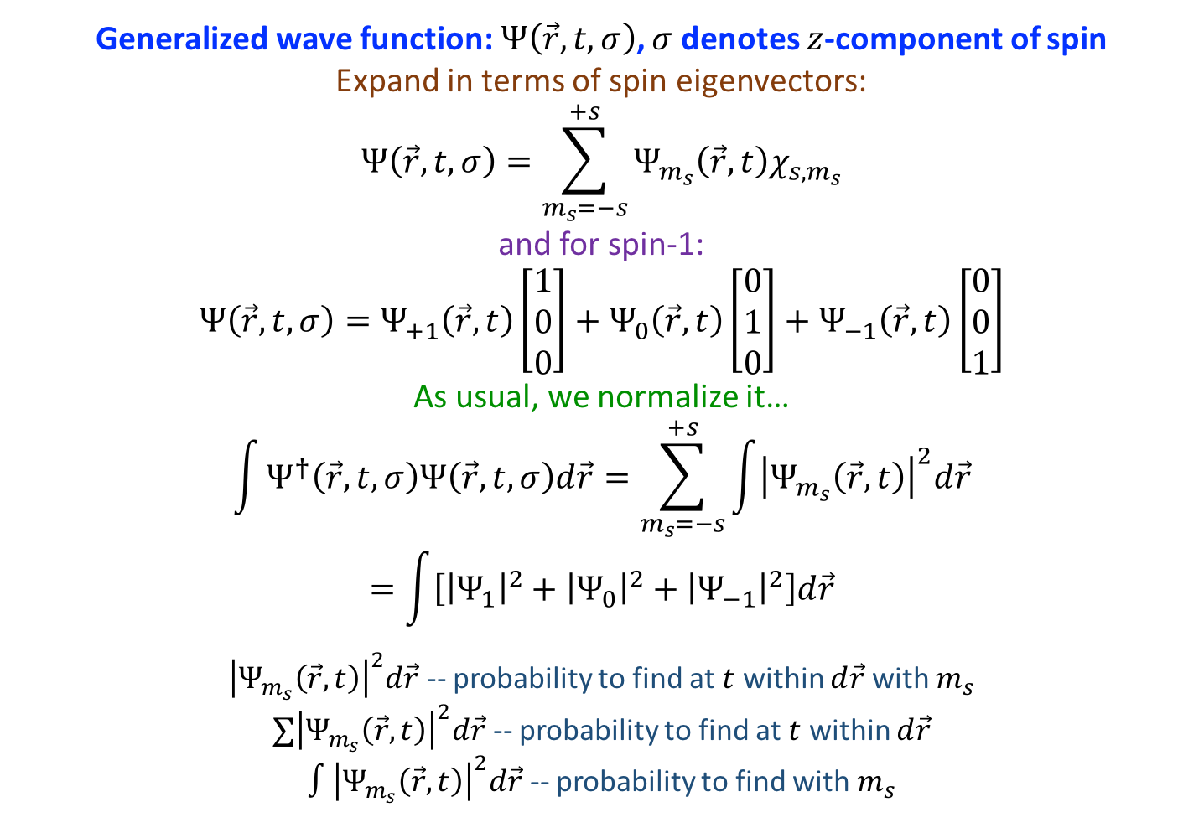
Intrinsic Angular Momentum
Generalized wave function: $Ψ\left(\vec{r},t,σ\right)$, $σ$ denotes $z$-component of spin
Expand in terms of spin eigenvectors:
$$Ψ\left(\vec{r},t,σ\right)=\sum_{m_{s}=−s}^{+s}{Ψ_{m_{s}}\left(\vec{r},t\right)χ_{s,m_{s}}}$$
and for spin-1:
$$Ψ\left(\vec{r},t,σ\right)=Ψ_{+1}\left(\vec{r},t\right)\left[\begin{matrix}1 \\ 0 \\ 0\end{matrix}\right]+Ψ_{0}\left(\vec{r},t\right)\left[\begin{matrix}0 \\ 1 \\ 0\end{matrix}\right]+Ψ_{−1}\left(\vec{r},t\right)\left[\begin{matrix}0 \\ 0 \\ 1\end{matrix}\right]$$
As usual, we normalize it…
$$\int{Ψ^{†}\left(\vec{r},t,σ\right)Ψ\left(\vec{r},t,σ\right)d\vec{r}}=\sum_{m_{s}=−s}^{+s}{\int{{\left|Ψ_{m_{s}}\left(\vec{r},t\right)\right|}^{2}d\vec{r}}}$$
$$=\int{\left[{\left|Ψ_{1}\right|}^{2}+{\left|Ψ_{0}\right|}^{2}+{\left|Ψ_{−1}\right|}^{2}\right]d\vec{r}}$$
${\left|Ψ_{m_{s}}\left(\vec{r},t\right)\right|}^{2}d\vec{r}$ -- probability to find at $t$ within $d\vec{r}$ with $m_{s}$
$∑{\left|Ψ_{m_{s}}\left(\vec{r},t\right)\right|}^{2}d\vec{r}$ -- probability to find at $t$ within $d\vec{r}$
$∫{\left|Ψ_{m_{s}}\left(\vec{r},t\right)\right|}^{2}d\vec{r}$ -- probability to find with $m_{s}$

Slide 31
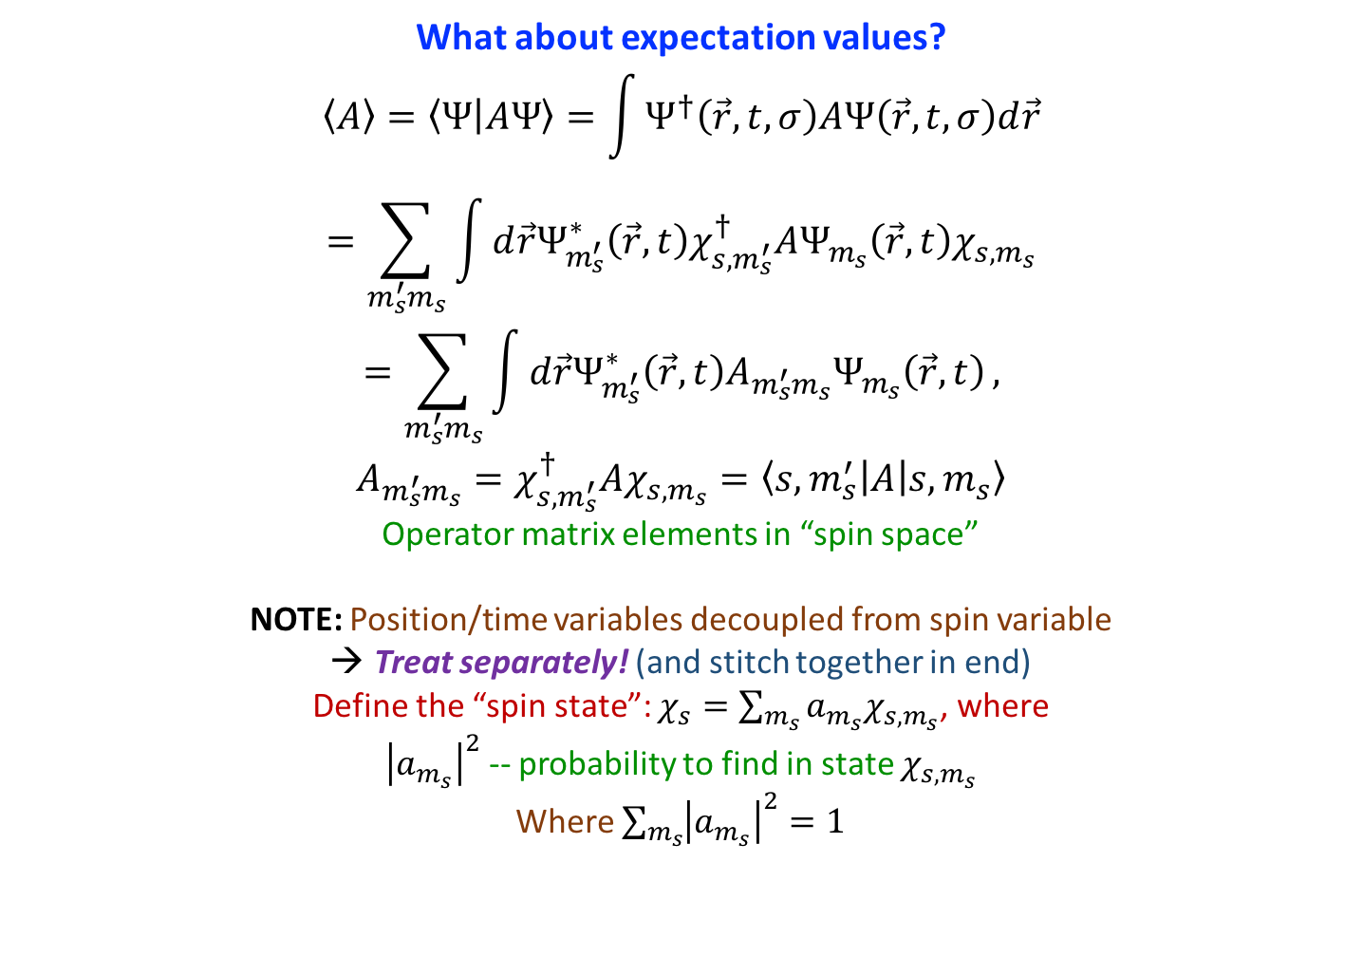
Intrinsic Angular Momentum
What about expectation values?
$$〈A〉=〈Ψ | AΨ〉=\int{Ψ^{†}\left(\vec{r},t,σ\right)AΨ\left(\vec{r},t,σ\right)d\vec{r}}$$
$$=\sum_{m_{s}^{′}m_{s}}{\int{d\vec{r}Ψ_{m_{s}^{′}}^{∗}\left(\vec{r},t\right)χ_{s,m_{s}^{′}}^{†}AΨ_{m_{s}}\left(\vec{r},t\right)χ_{s,m_{s}}}}$$
$$=\sum_{m_{s}^{′}m_{s}}{\int{d\vec{r}Ψ_{m_{s}^{′}}^{∗}\left(\vec{r},t\right)A_{m_{s}^{′}m_{s}}Ψ_{m_{s}}\left(\vec{r},t\right)}},$$
$$A_{m_{s}^{′}m_{s}}=χ_{s,m_{s}^{′}}^{†}Aχ_{s,m_{s}}=\left\langle s,m_{s}^{′} | A | s,m_{s}\right\rangle$$
Operator matrix elements in “spin space”
NOTE: Position/time variables decoupled from spin variable
Treat separately! (and stitch together in end)
Define the “spin state”: $χ_{s}=\sum_{m_{s}}{a_{m_{s}}χ_{s,m_{s}}}$, where
${\left|a_{m_{s}}\right|}^{2}$ -- probability to find in state $χ_{s,m_{s}}$
Where $\sum_{m_{s}}{{\left|a_{m_{s}}\right|}^{2}}=1$

Slide 32
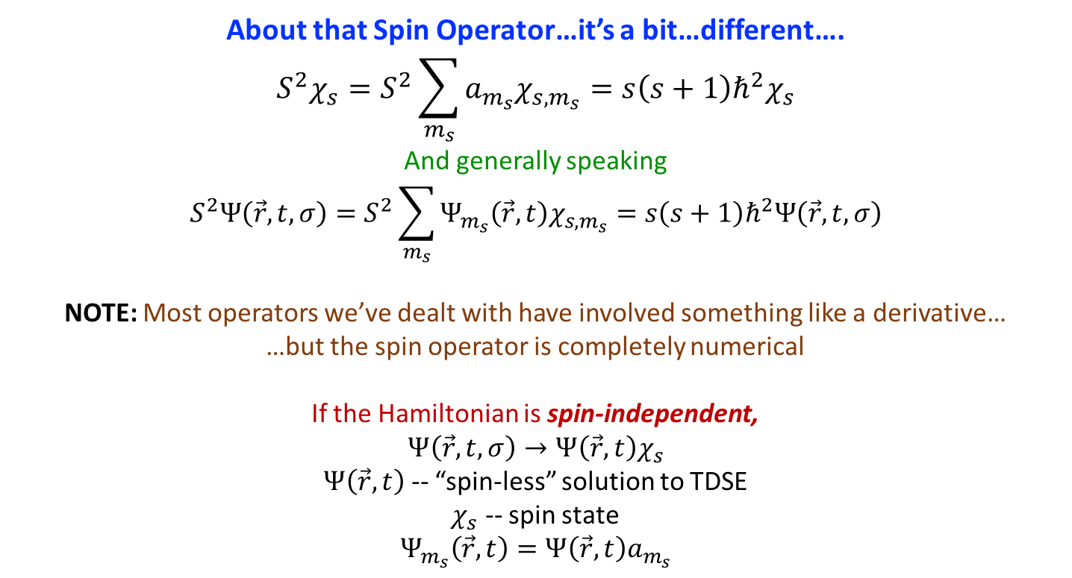
Intrinsic Angular Momentum
About that Spin Operator…it’s a bit…different….
$$S^{2}χ_{s}=S^{2}\sum_{m_{s}}{a_{m_{s}}χ_{s,m_{s}}}=s\left(s+1\right)ℏ^{2}χ_{s}$$
And generally speaking
$$S^{2}Ψ\left(\vec{r},t,σ\right)=S^{2}\sum_{m_{s}}{Ψ_{m_{s}}\left(\vec{r},t\right)χ_{s,m_{s}}}=s\left(s+1\right)ℏ^{2}Ψ\left(\vec{r},t,σ\right)$$
NOTE: Most operators we’ve dealt with have involved something like a derivative…
…but the spin operator is completely numerical
If the Hamiltonian is spin-independent,
$$Ψ\left(\vec{r},t,σ\right)→Ψ\left(\vec{r},t\right)χ_{s}$$
$Ψ\left(\vec{r},t\right)$ -- “spin-less” solution to TDSE
$χ_{s}$ -- spin state
$$Ψ_{m_{s}}\left(\vec{r},t\right)=Ψ\left(\vec{r},t\right)a_{m_{s}}$$

Slide 33
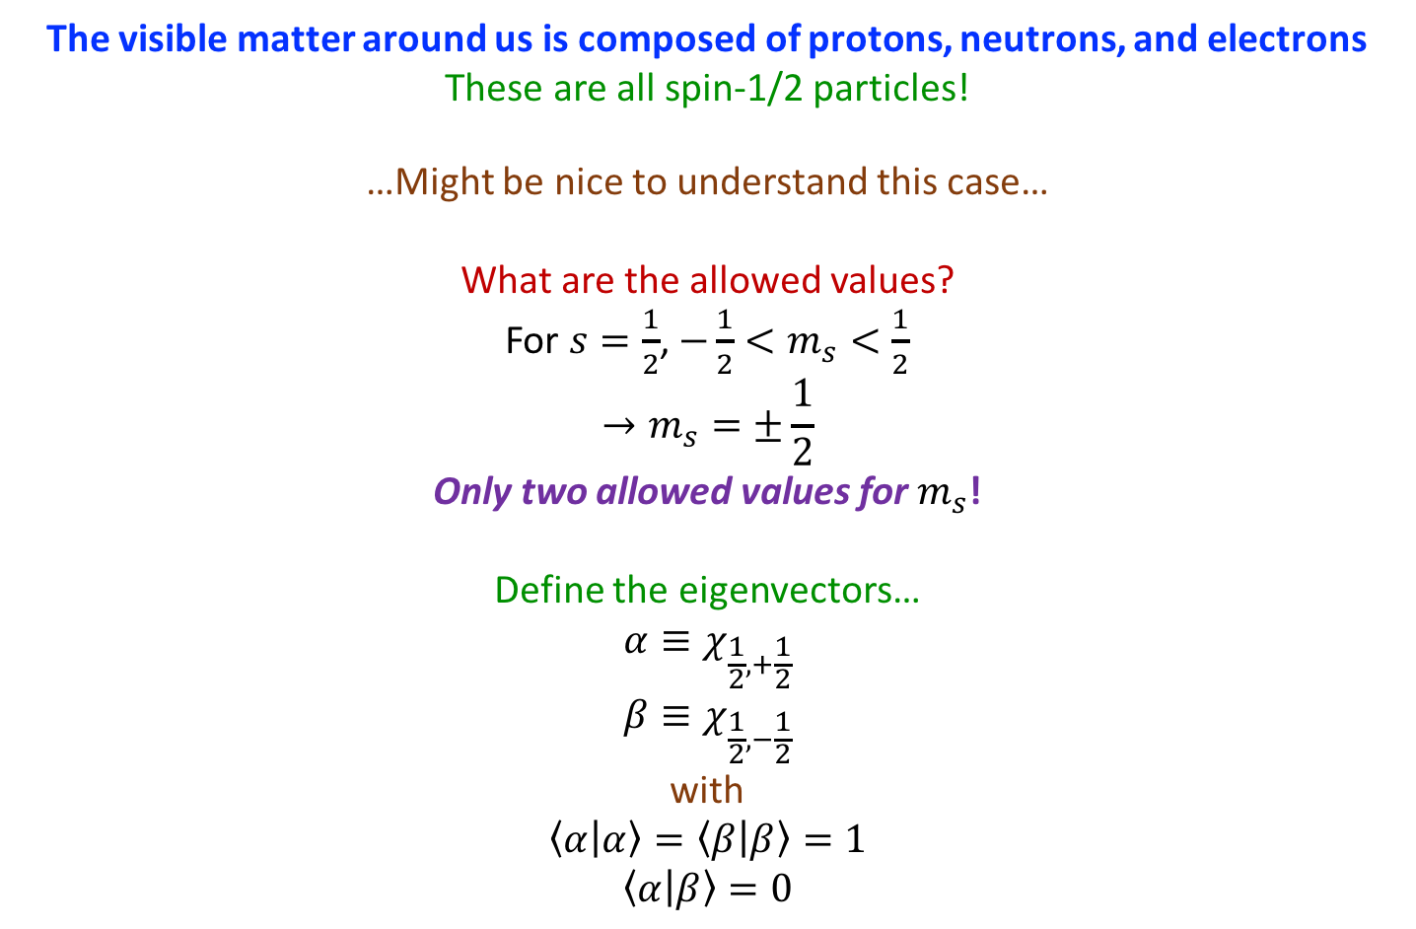
Intrinsic Angular Momentum
The visible matter around us is composed of protons, neutrons, and electrons
These are all spin-1/2 particles!
…Might be nice to understand this case…
What are the allowed values?
For $s=\frac{1}{2}$, $−\frac{1}{2}<m_{s}<\frac{1}{2}$
$$→m_{s}=±\frac{1}{2}$$
Only two allowed values for $m_{s}$!
Define the eigenvectors…
$$α≡χ_{\frac{1}{2},+\frac{1}{2}}$$
$$β≡χ_{\frac{1}{2},−\frac{1}{2}}$$
with
$$〈α | α〉=〈β | β〉=1$$
$$〈α | β〉=0$$

Slide 34



Intrinsic Angular Momentum
Operations become very, very simple!
Since $S_{±}=S_{x}±iS_{y}$…
$$S^{2}α=\frac{3}{4}ℏ^{2}α$$
$$S_{z}α=+\frac{1}{2}ℏα$$
$$S_{+}α=0$$
$$S_{−}α=ℏβ$$
$$S_{x}α=\frac{ℏ}{2}β$$
$$S_{y}α=\frac{iℏ}{2}β$$
$$S_{x}^{2}α=S_{y}^{2}α=S_{z}^{2}α=\frac{ℏ^{2}}{4}α$$
$$S^{2}β=\frac{3}{4}ℏ^{2}β$$
$$S_{z}β=−\frac{1}{2}ℏβ$$
$$S_{+}β=ℏα$$
$$S_{−}β=0$$
$$S_{x}β=\frac{ℏ}{2}α$$
$$S_{y}β=−\frac{iℏ}{2}α$$
$$S_{x}^{2}β=S_{y}^{2}β=S_{z}^{2}β=\frac{ℏ^{2}}{4}β$$

Slide 35
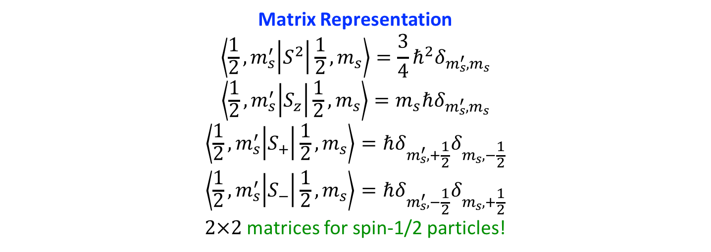
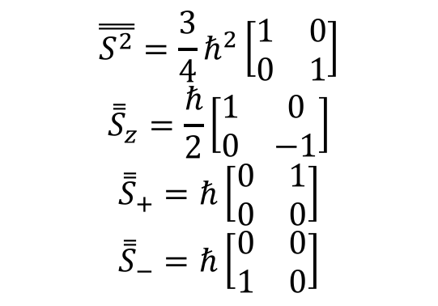
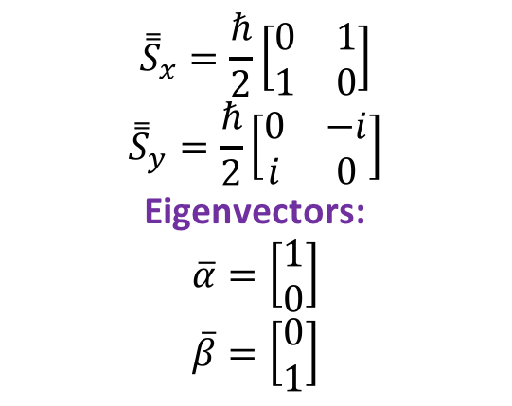
Intrinsic Angular Momentum
Matrix Representation
$$\left\langle \frac{1}{2},m_{s}^{′} | S^{2} | \frac{1}{2},m_{s}\right\rangle =\frac{3}{4}ℏ^{2}δ_{m_{s}^{′},m_{s}}$$
$$\left\langle \frac{1}{2},m_{s}^{′} | S_{z} | \frac{1}{2},m_{s}\right\rangle =m_{s}ℏδ_{m_{s}^{′},m_{s}}$$
$$\left\langle \frac{1}{2},m_{s}^{′} | S_{+} | \frac{1}{2},m_{s}\right\rangle =ℏδ_{m_{s}^{′},+\frac{1}{2}}δ_{m_{s},−\frac{1}{2}}$$
$$\left\langle \frac{1}{2},m_{s}^{′} | S_{−} | \frac{1}{2},m_{s}\right\rangle =ℏδ_{m_{s}^{′},−\frac{1}{2}}δ_{m_{s},+\frac{1}{2}}$$
$2×2$ matrices for spin-1/2 particles!
$$\overset{̿}{S^{2}}=\frac{3}{4}ℏ^{2}\left[\begin{matrix}1 & 0 \\ 0 & 1\end{matrix}\right]$$
$${\overset{̿}{S}}_{z}=\frac{ℏ}{2}\left[\begin{matrix}1 & 0 \\ 0 & −1\end{matrix}\right]$$
$${\overset{̿}{S}}_{+}=ℏ\left[\begin{matrix}0 & 1 \\ 0 & 0\end{matrix}\right]$$
$${\overset{̿}{S}}_{−}=ℏ\left[\begin{matrix}0 & 0 \\ 1 & 0\end{matrix}\right]$$
$${\overset{̿}{S}}_{x}=\frac{ℏ}{2}\left[\begin{matrix}0 & 1 \\ 1 & 0\end{matrix}\right]$$
$${\overset{̿}{S}}_{y}=\frac{ℏ}{2}\left[\begin{matrix}0 & −i \\ i & 0\end{matrix}\right]$$
Eigenvectors:
$$\overline{α}=\left[\begin{matrix}1 \\ 0\end{matrix}\right]$$
$$\overline{β}=\left[\begin{matrix}0 \\ 1\end{matrix}\right]$$

Slide 36
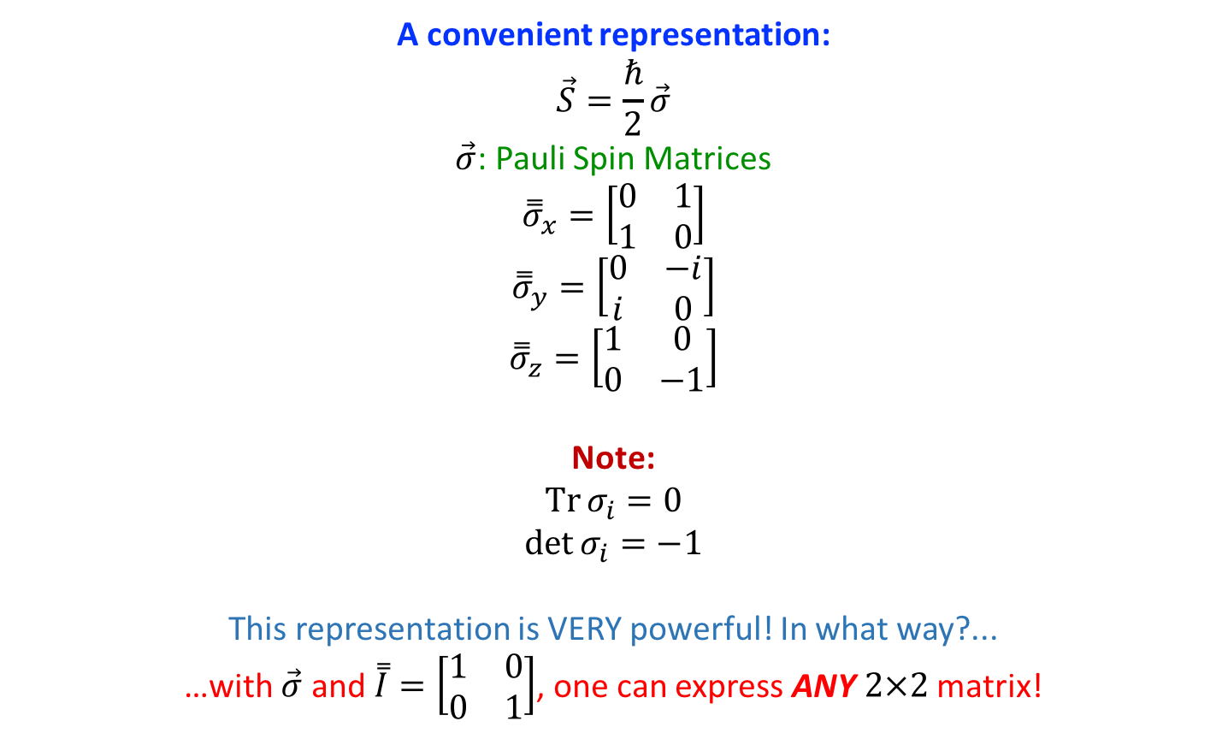
Intrinsic Angular Momentum
A convenient representation:
$$\vec{S}=\frac{ℏ}{2}\vec{σ}$$
$\vec{σ}$: Pauli Spin Matrices
$${\overset{̿}{σ}}_{x}=\left[\begin{matrix}0 & 1 \\ 1 & 0\end{matrix}\right]$$
$${\overset{̿}{σ}}_{y}=\left[\begin{matrix}0 & −i \\ i & 0\end{matrix}\right]$$
$${\overset{̿}{σ}}_{z}=\left[\begin{matrix}1 & 0 \\ 0 & −1\end{matrix}\right]$$
Note:
$$\operatorname{Tr}{σ_{i}}=0$$
$$\det{σ_{i}}=−1$$
This representation is VERY powerful! In what way?...
…with $\vec{σ}$ and $\overset{̿}{I}=\left[\begin{matrix}1 & 0 \\ 0 & 1\end{matrix}\right]$, one can express ANY $2×2$ matrix!

Slide 37
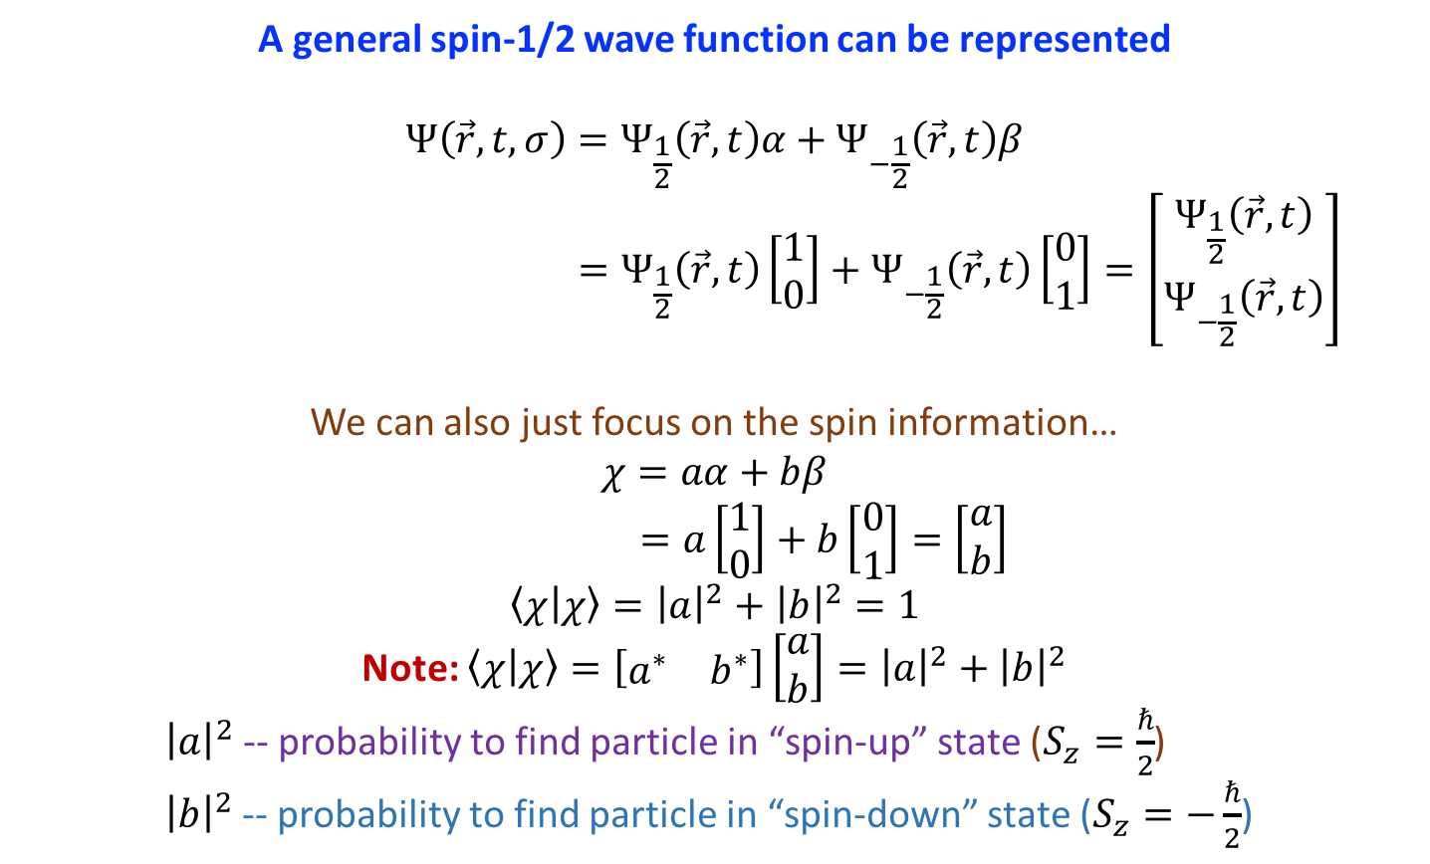
Intrinsic Angular Momentum
A general spin-1/2 wave function can be represented
$$Ψ\left(\vec{r},t,σ\right)=Ψ_{\frac{1}{2}}\left(\vec{r},t\right)α+Ψ_{−\frac{1}{2}}\left(\vec{r},t\right)β$$
$$=Ψ_{\frac{1}{2}}\left(\vec{r},t\right)\left[\begin{matrix}1 \\ 0\end{matrix}\right]+Ψ_{−\frac{1}{2}}\left(\vec{r},t\right)\left[\begin{matrix}0 \\ 1\end{matrix}\right]=\left[\begin{matrix}Ψ_{\frac{1}{2}}\left(\vec{r},t\right) \\ Ψ_{−\frac{1}{2}}\left(\vec{r},t\right)\end{matrix}\right]$$
We can also just focus on the spin information…
$$χ=aα+bβ$$
$$=a\left[\begin{matrix}1 \\ 0\end{matrix}\right]+b\left[\begin{matrix}0 \\ 1\end{matrix}\right]=\left[\begin{matrix}a \\ b\end{matrix}\right]$$
$$〈χ | χ〉={\left|a\right|}^{2}+{\left|b\right|}^{2}=1$$
Note: $〈χ | χ〉=\left[\begin{matrix}a^{∗} & b^{∗}\end{matrix}\right]\left[\begin{matrix}a \\ b\end{matrix}\right]={\left|a\right|}^{2}+{\left|b\right|}^{2}$
    ${\left|a\right|}^{2}$ -- probability to find particle in “spin-up” state ($S_{z}=\frac{ℏ}{2}$)
    ${\left|b\right|}^{2}$ -- probability to find particle in “spin-down” state ($S_{z}=−\frac{ℏ}{2}$)

Slide 38
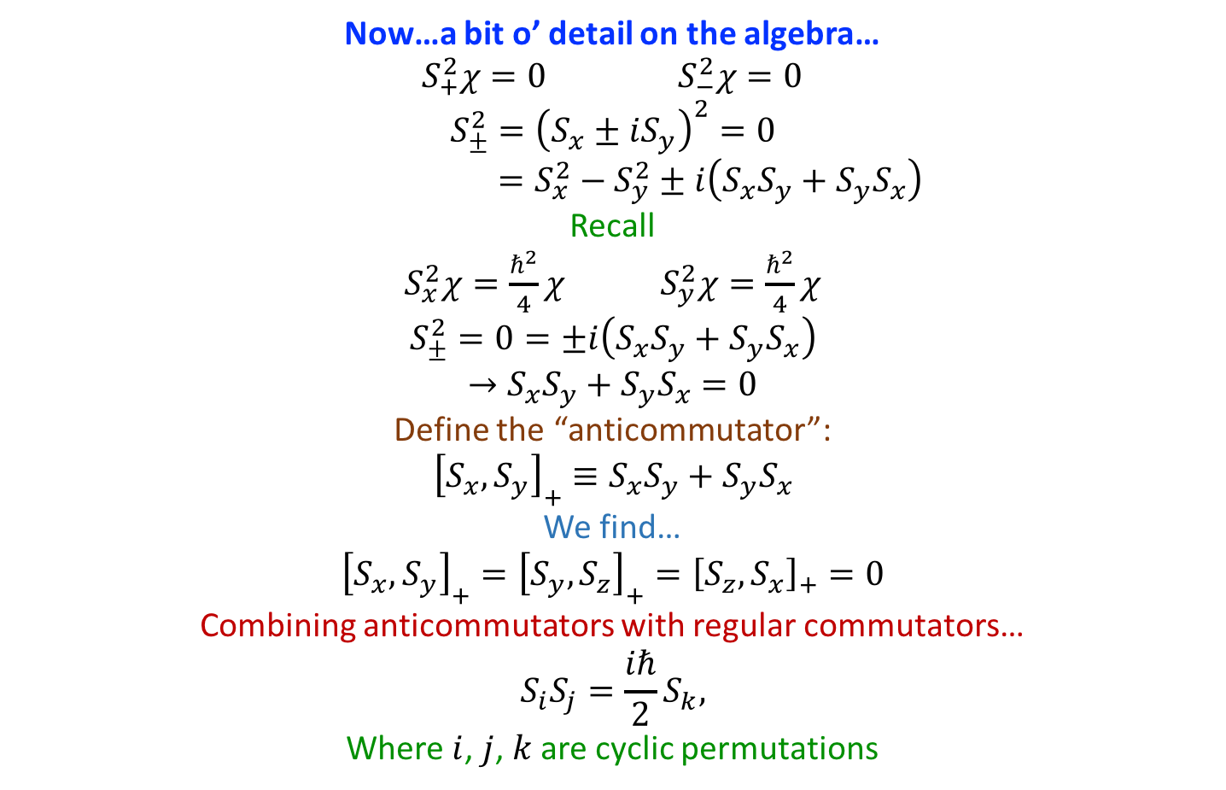
Intrinsic Angular Momentum
Now…a bit o’ detail on the algebra…
$S_{+}^{2}χ=0$ $S_{−}^{2}χ=0$
$$S_{±}^{2}={\left(S_{x}±iS_{y}\right)}^{2}=0$$
$$=S_{x}^{2}−S_{y}^{2}±i\left(S_{x}S_{y}+S_{y}S_{x}\right)$$
Recall
$S_{x}^{2}χ=\frac{ℏ^{2}}{4}χ$ $S_{y}^{2}χ=\frac{ℏ^{2}}{4}χ$
$$S_{±}^{2}=0=±i\left(S_{x}S_{y}+S_{y}S_{x}\right)$$
$$→S_{x}S_{y}+S_{y}S_{x}=0$$
Define the “anticommutator”:
$${\left[S_{x},S_{y}\right]}_{+}≡S_{x}S_{y}+S_{y}S_{x}$$
We find…
$${\left[S_{x},S_{y}\right]}_{+}={\left[S_{y},S_{z}\right]}_{+}={\left[S_{z},S_{x}\right]}_{+}=0$$
Combining anticommutators with regular commutators…
$$S_{i}S_{j}=\frac{iℏ}{2}S_{k},$$
Where $i$, $j$, $k$ are cyclic permutations

Slide 39
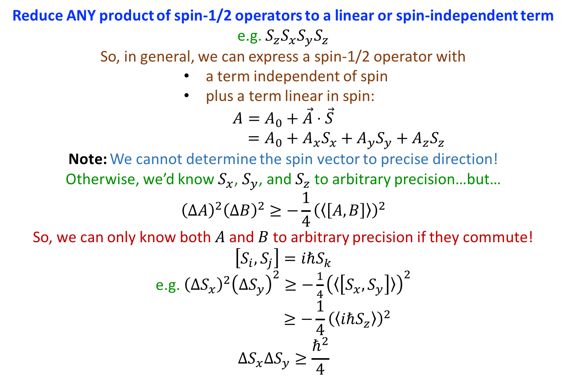
Intrinsic Angular Momentum
Reduce ANY product of spin-1/2 operators to a linear or spin-independent term
e.g. $S_{z}S_{x}S_{y}S_{z}$
So, in general, we can express a spin-1/2 operator with
            a term independent of spin
            plus a term linear in spin:
$$A=A_{0}+\vec{A}⋅\vec{S}$$
$$=A_{0}+A_{x}S_{x}+A_{y}S_{y}+A_{z}S_{z}$$
Note: We cannot determine the spin vector to precise direction!
Otherwise, we’d know $S_{x}$, $S_{y}$, and $S_{z}$ to arbitrary precision…but…
$${\left(ΔA\right)}^{2}{\left(ΔB\right)}^{2}≥−\frac{1}{4}{\left(〈\left[A,B\right]〉\right)}^{2}$$
So, we can only know both $A$ and $B$ to arbitrary precision if they commute!
$$\left[S_{i},S_{j}\right]=iℏS_{k}$$
e.g. ${\left(ΔS_{x}\right)}^{2}{\left(ΔS_{y}\right)}^{2}≥−\frac{1}{4}{\left(〈\left[S_{x},S_{y}\right]〉\right)}^{2}$
$$≥−\frac{1}{4}{\left(〈iℏS_{z}〉\right)}^{2}$$
$$ΔS_{x}ΔS_{y}≥\frac{ℏ^{2}}{4}$$

Slide 40
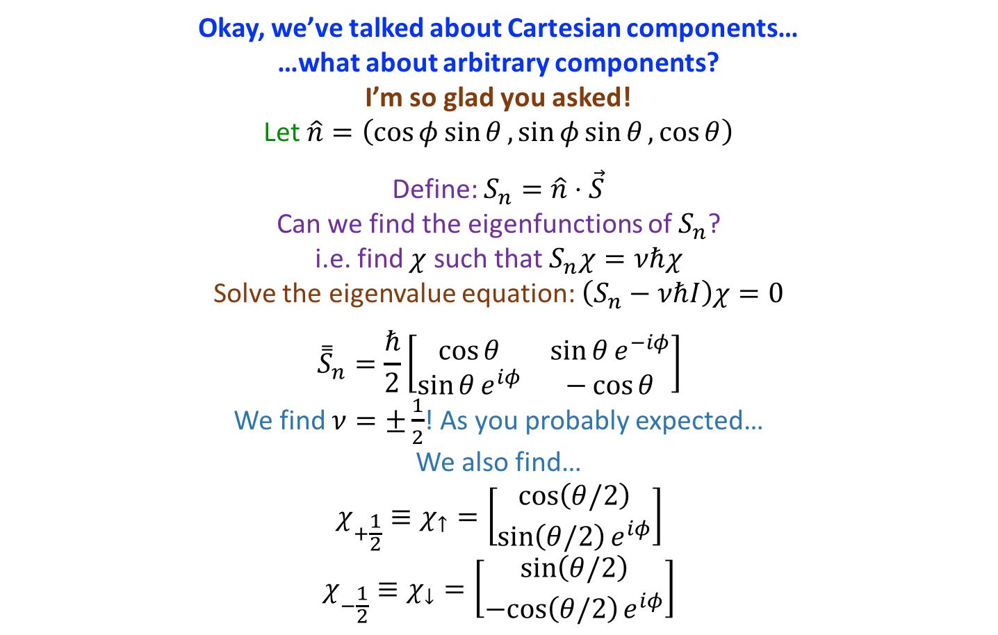
Intrinsic Angular Momentum
Okay, we’ve talked about Cartesian components…
…what about arbitrary components?
I’m so glad you asked!
Let $\hat{n}=\left(\cos{φ}\sin{θ},\sin{φ}\sin{θ}, \cos{θ}\right)$
Define: $S_{n}=\hat{n}⋅\vec{S}$
Can we find the eigenfunctions of $S_{n}$?
i.e. find $χ$ such that $S_{n}χ=νℏχ$
Solve the eigenvalue equation: $\left(S_{n}−νℏI\right)χ=0$
$${\overset{̿}{S}}_{n}=\frac{ℏ}{2}\left[\begin{matrix}\cos{θ} & \sin{θ}e^{−iφ} \\ \sin{θ}e^{iφ} & −\cos{θ}\end{matrix}\right]$$
We find $ν=±\frac{1}{2}$! As you probably expected…
We also find…
$$χ_{+\frac{1}{2}}≡χ_{↑}=\left[\begin{matrix}\cos\left(θ/2\right) \\ \sin\left(θ/2\right)e^{iφ}\end{matrix}\right]$$
$$χ_{−\frac{1}{2}}≡χ_{↓}=\left[\begin{matrix}\sin\left(θ/2\right) \\ −cos\left(θ/2\right)e^{iφ}\end{matrix}\right]$$

Slide 41

Intrinsic Angular Momentum
Assorted Notes…
$χ_{↑}$ -- “Spin-up”
$χ_{↓}$ -- “Spin-down”
Can be shown (for homework!), e.g. for spin-up:
$$〈S_{x}〉=\frac{ℏ}{2}\cos{φ}\sin{θ}$$
$$〈S_{y}〉=\frac{ℏ}{2}\sin{φ}\sin{θ}$$
$$〈S_{z}〉=\frac{ℏ}{2}\cos{θ}$$
Can easily show $χ_{↑↓}$
          orthonormal
          a complete set
          reduce to $χ_{↑}→\left[\begin{matrix}1 \\ 0\end{matrix}\right]$ and $χ_{↓}→\left[\begin{matrix}0 \\ 1\end{matrix}\right]$ for $θ→0$

Slide 42
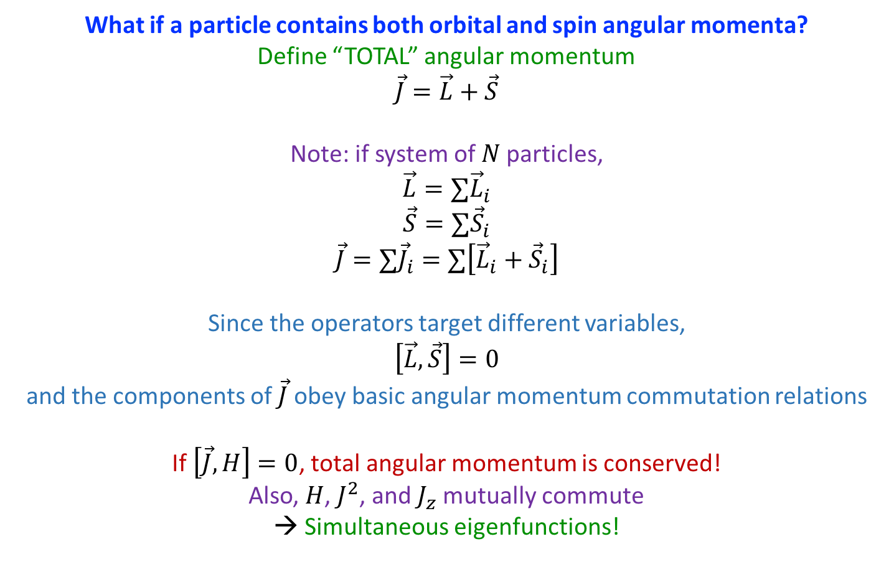
Total Angular Momentum
What if a particle contains both orbital and spin angular momenta?
Define “TOTAL” angular momentum
$$\vec{J}=\vec{L}+\vec{S}$$
Note: if system of $N$ particles,
$$\vec{L}=∑{\vec{L}}_{i}$$
$$\vec{S}=∑{\vec{S}}_{i}$$
$$\vec{J}=∑{\vec{J}}_{i}=∑\left[{\vec{L}}_{i}+{\vec{S}}_{i}\right]$$
Since the operators target different variables,
$$\left[\vec{L},\vec{S}\right]=0$$
and the components of $\vec{J}$ obey basic angular momentum commutation relations
If $\left[\vec{J},H\right]=0$, total angular momentum is conserved!
Also, $H$, $J^{2}$, and $J_{z}$ mutually commute
→ Simultaneous eigenfunctions!

Slide 43
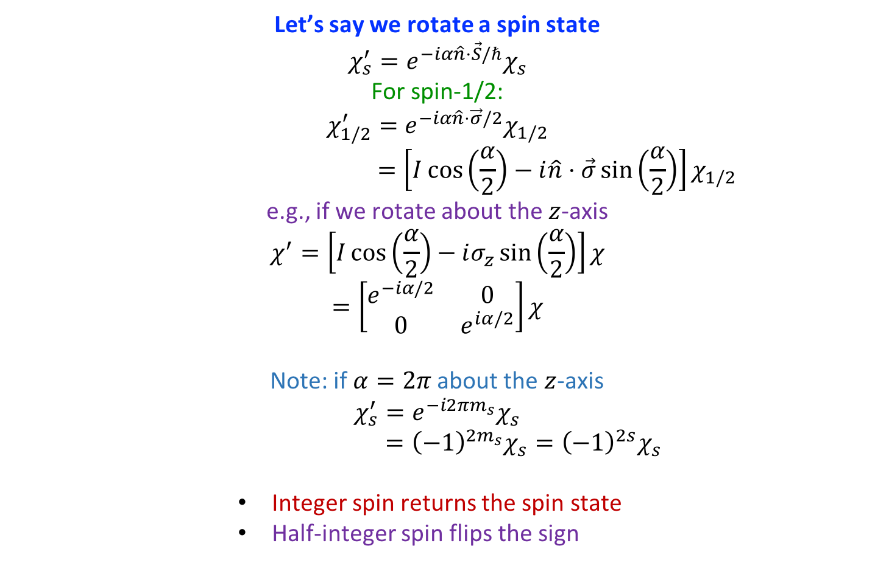
Total Angular Momentum
Let’s say we rotate a spin state
$$χ_{s}^{′}=e^{−iα\hat{n}⋅\vec{S}/ℏ}χ_{s}$$
For spin-1/2:
$$χ_{1/2}^{′}=e^{−iα\hat{n}⋅\vec{σ}/2}χ_{1/2}$$
$$=\left[I\cos\left(\frac{α}{2}\right)−i\hat{n}⋅\vec{σ}\sin\left(\frac{α}{2}\right)\right]χ_{1/2}$$
e.g., if we rotate about the $z$-axis
$$χ^{′}=\left[I\cos\left(\frac{α}{2}\right)−iσ_{z}\sin\left(\frac{α}{2}\right)\right]χ$$
$$=\left[\begin{matrix}e^{−iα/2} & 0 \\ 0 & e^{iα/2}\end{matrix}\right]χ$$
Note: if $α=2π$ about the $z$-axis
$$χ_{s}^{′}=e^{−i2πm_{s}}χ_{s}$$
$$={\left(−1\right)}^{2m_{s}}χ_{s}={\left(−1\right)}^{2s}χ_{s}$$
          Integer spin returns the spin state
          Half-integer spin flips the sign

Slide 44
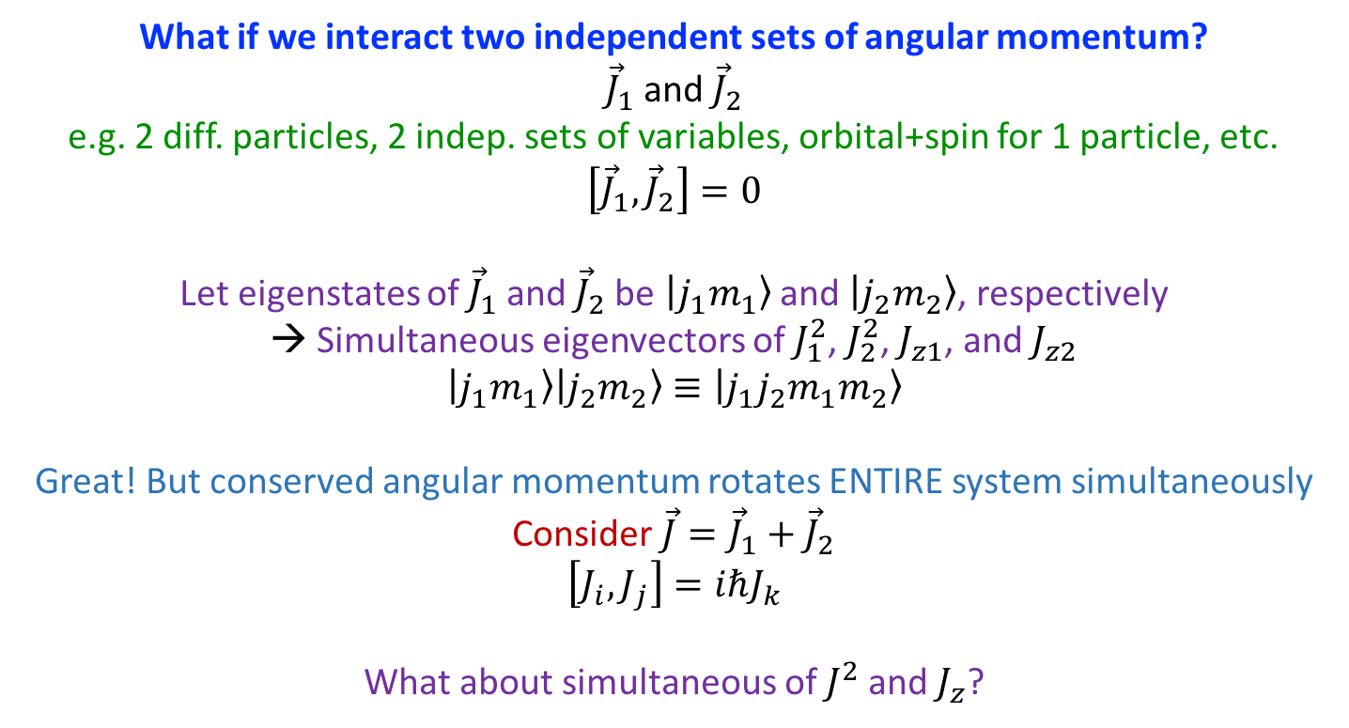
Angular Momentum Addition
What if we interact two independent sets of angular momentum?
${\vec{J}}_{1}$ and ${\vec{J}}_{2}$
e.g. 2 diff. particles, 2 indep. sets of variables, orbital+spin for 1 particle, etc.
$$\left[{\vec{J}}_{1},{\vec{J}}_{2}\right]=0$$
Let eigenstates of ${\vec{J}}_{1}$ and ${\vec{J}}_{2}$ be $|j_{1}m_{1}〉$ and $|j_{2}m_{2}〉$, respectively
→ Simultaneous eigenvectors of $J_{1}^{2}$, $J_{2}^{2}$, $J_{z1}$, and $J_{z2}$
$$|j_{1}m_{1}〉|j_{2}m_{2}〉≡|j_{1}j_{2}m_{1}m_{2}〉$$
Great! But conserved angular momentum rotates ENTIRE system simultaneously
Consider $\vec{J}={\vec{J}}_{1}+{\vec{J}}_{2}$
$$\left[J_{i},J_{j}\right]=iℏJ_{k}$$
What about simultaneous of $J^{2}$ and $J_{z}$?

Slide 45

Angular Momentum Addition
We can quickly note
$$\left[J_{z},J_{1}^{2}\right]=\left[J_{1z}+J_{2z},J_{1}^{2}\right]=0$$
$$\left[J_{z},J_{2}^{2}\right]=\left[J_{1z}+J_{2z},J_{2}^{2}\right]=0$$
$$\left[J_{z},J_{1z}\right]=0$$
$$\left[J_{z},J_{2z}\right]=0$$
What about $J^{2}$?
We find
$$J^{2}=J_{1}^{2}+J_{2}^{2}+2{\vec{J}}_{1}⋅{\vec{J}}_{2}$$
Then,
$$\left[J^{2},J_{1}^{2}\right]=0$$
$$\left[J^{2},J_{2}^{2}\right]=0$$
So, we can diagonalize $J^{2}$, $J_{z}$, $J_{1}^{2}$, and $J_{2}^{2}$, simultaneously!
Cool!
…however…

Slide 46
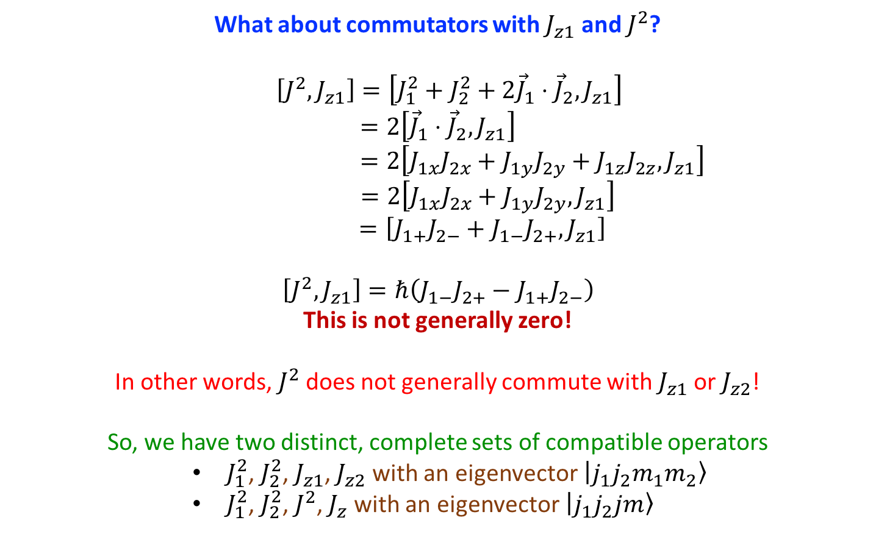
Angular Momentum Addition
What about commutators with $J_{z1}$ and $J^{2}$?
$$\left[J^{2},J_{z1}\right]=\left[J_{1}^{2}+J_{2}^{2}+2{\vec{J}}_{1}⋅{\vec{J}}_{2},J_{z1}\right]$$
$$=2\left[{\vec{J}}_{1}⋅{\vec{J}}_{2},J_{z1}\right]$$
$$=2\left[J_{1x}J_{2x}+J_{1y}J_{2y}+J_{1z}J_{2z},J_{z1}\right]$$
$$=2\left[J_{1x}J_{2x}+J_{1y}J_{2y},J_{z1}\right]$$
$$=\left[J_{1+}J_{2−}+J_{1−}J_{2+},J_{z1}\right]$$
$$\left[J^{2},J_{z1}\right]=ℏ\left(J_{1−}J_{2+}−J_{1+}J_{2−}\right)$$
This is not generally zero!
In other words, $J^{2}$ does not generally commute with $J_{z1}$ or $J_{z2}$!
So, we have two distinct, complete sets of compatible operators
        $J_{1}^{2}$, $J_{2}^{2}$, $J_{z1}$, $J_{z2}$ with an eigenvector $|j_{1}j_{2}m_{1}m_{2}〉$
        $J_{1}^{2}$, $J_{2}^{2}$, $J^{2}$, $J_{z}$ with an eigenvector $|j_{1}j_{2}jm〉$

Slide 47
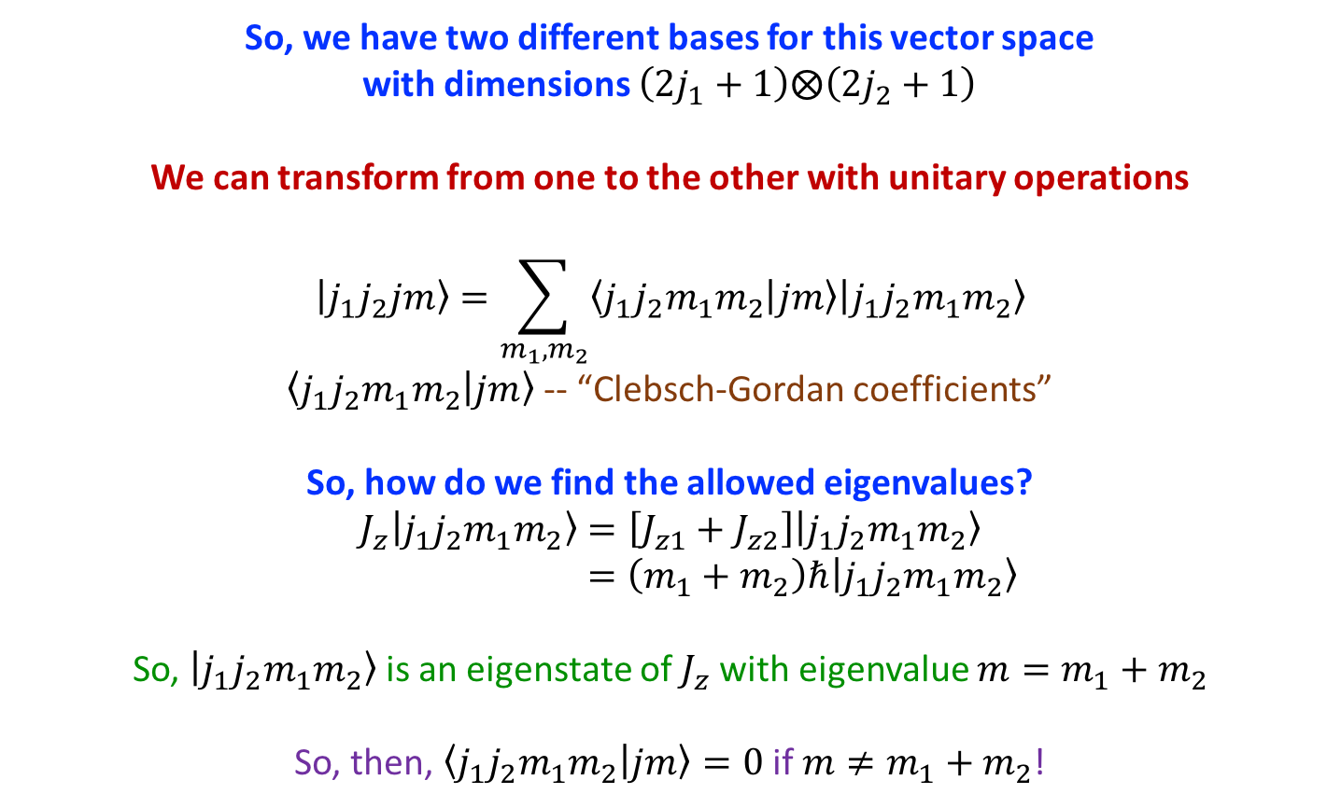
Angular Momentum Addition
So, we have two different bases for this vector space
with dimensions $\left(2j_{1}+1\right)⨂\left(2j_{2}+1\right)$
We can transform from one to the other with unitary operations
$$|j_{1}j_{2}jm〉=\sum_{m_{1},m_{2}}{〈j_{1}j_{2}m_{1}m_{2} | jm〉|j_{1}j_{2}m_{1}m_{2}〉}$$
$〈j_{1}j_{2}m_{1}m_{2} | jm〉$ -- “Clebsch-Gordan coefficients”
So, how do we find the allowed eigenvalues?
$$J_{z}|j_{1}j_{2}m_{1}m_{2}〉=\left[J_{z1}+J_{z2}\right]|j_{1}j_{2}m_{1}m_{2}〉$$
$$=\left(m_{1}+m_{2}\right)ℏ|j_{1}j_{2}m_{1}m_{2}〉$$
So, $|j_{1}j_{2}m_{1}m_{2}〉$ is an eigenstate of $J_{z}$ with eigenvalue $m=m_{1}+m_{2}$
So, then, $〈j_{1}j_{2}m_{1}m_{2} | jm〉=0$ if $m≠m_{1}+m_{2}$!

Slide 48
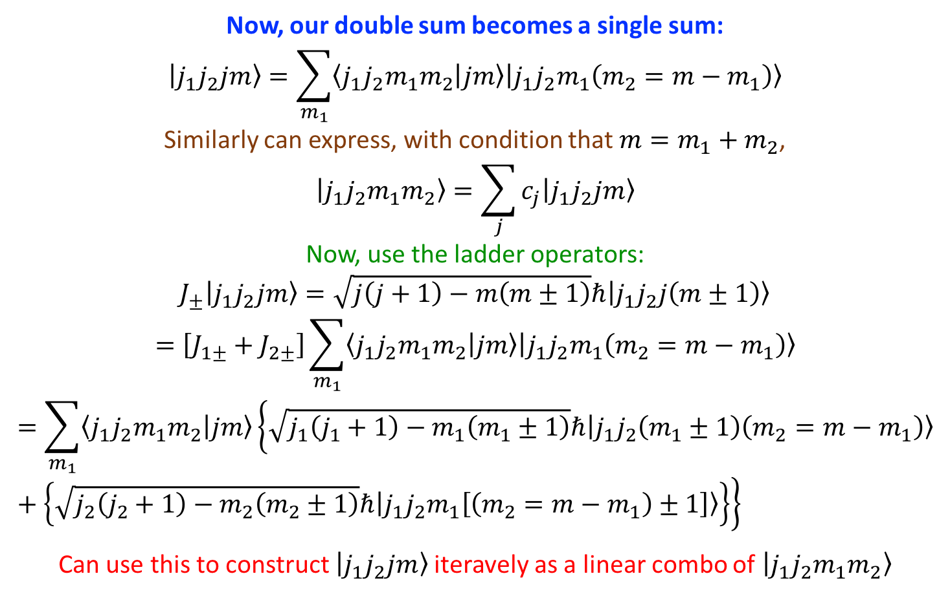
Angular Momentum Addition
Now, our double sum becomes a single sum:
$$|j_{1}j_{2}jm〉=\sum_{m_{1}}{〈j_{1}j_{2}m_{1}m_{2} | jm〉|j_{1}j_{2}m_{1}\left(m_{2}=m−m_{1}\right)〉}$$
Similarly can express, with condition that $m=m_{1}+m_{2}$,
$$|j_{1}j_{2}m_{1}m_{2}〉=\sum_{j}{c_{j}|j_{1}j_{2}jm〉}$$
Now, use the ladder operators:
$$J_{±}|j_{1}j_{2}jm〉=\sqrt{j\left(j+1\right)−m\left(m±1\right)}ℏ|j_{1}j_{2}j\left(m±1\right)〉$$
$$=\left[J_{1±}+J_{2±}\right]\sum_{m_{1}}{〈j_{1}j_{2}m_{1}m_{2} | jm〉|j_{1}j_{2}m_{1}\left(m_{2}=m−m_{1}\right)〉}$$
$$=\sum_{m_{1}}{〈j_{1}j_{2}m_{1}m_{2} | jm〉\left\{\sqrt{j_{1}\left(j_{1}+1\right)−m_{1}\left(m_{1}±1\right)}ℏ|j_{1}j_{2}\left(m_{1}±1\right)\left(m_{2}=m−m_{1}\right)〉+\left\{\sqrt{j_{2}\left(j_{2}+1\right)−m_{2}\left(m_{2}±1\right)}ℏ|j_{1}j_{2}m_{1}\left[\left(m_{2}=m−m_{1}\right)±1\right]〉\right\}\right\}}$$
Can use this to construct $|j_{1}j_{2}jm〉$ iteravely as a linear combo of $|j_{1}j_{2}m_{1}m_{2}〉$

Slide 49
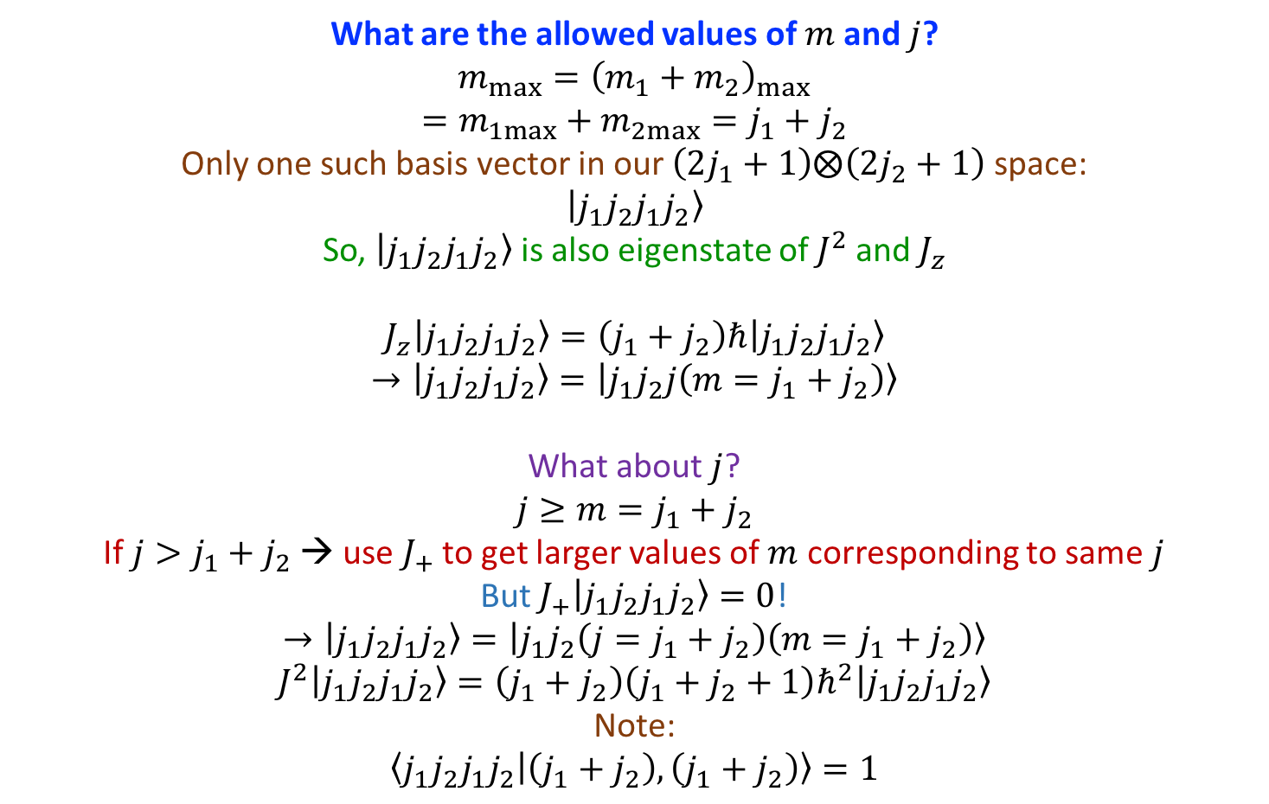
Angular Momentum Addition
What are the allowed values of $m$ and $j$?
$$m_{max}={\left(m_{1}+m_{2}\right)}_{max}$$
$$=m_{1max}+m_{2max}=j_{1}+j_{2}$$
Only one such basis vector in our $\left(2j_{1}+1\right)⨂\left(2j_{2}+1\right)$ space:
$$|j_{1}j_{2}j_{1}j_{2}〉$$
So, $|j_{1}j_{2}j_{1}j_{2}〉$ is also eigenstate of $J^{2}$ and $J_{z}$
$$J_{z}|j_{1}j_{2}j_{1}j_{2}〉=\left(j_{1}+j_{2}\right)ℏ|j_{1}j_{2}j_{1}j_{2}〉$$
$$→|j_{1}j_{2}j_{1}j_{2}〉=|j_{1}j_{2}j\left(m=j_{1}+j_{2}\right)〉$$
What about $j$?
$$j≥m=j_{1}+j_{2}$$
If $j>j_{1}+j_{2}$ → use $J_{+}$ to get larger values of $m$ corresponding to same $j$
But $J_{+}|j_{1}j_{2}j_{1}j_{2}〉=0$!
$$→|j_{1}j_{2}j_{1}j_{2}〉=|j_{1}j_{2}\left(j=j_{1}+j_{2}\right)\left(m=j_{1}+j_{2}\right)〉$$
$$J^{2}|j_{1}j_{2}j_{1}j_{2}〉=\left(j_{1}+j_{2}\right)\left(j_{1}+j_{2}+1\right)ℏ^{2}|j_{1}j_{2}j_{1}j_{2}〉$$
Note:
$$〈j_{1}j_{2}j_{1}j_{2} | \left(j_{1}+j_{2}\right),\left(j_{1}+j_{2}\right)〉=1$$

Slide 50

Angular Momentum Addition
Construct all $|j_{1}j_{2}\left(j=j_{1}+j_{2}\right)m〉$ states via $J_{−}$
→ Linear combo of $|j_{1}j_{2}m_{1}m_{2}〉$ for allowed values of $m=m_{1}+m_{2}$ in range $−\left(j_{1}+j_{2}\right)$ to $j_{1}+j_{2}$
e.g. assume $j_{2}≤j_{1}$ and suppressing $j_{1}$, $j_{2}$
$$\begin{matrix}m=m_{1}+m_{2} & |j_{1}j_{2}m_{1}m_{2}〉 \\ j_{1}+j_{2} & |j_{1}j_{2}〉 \\ j_{1}+j_{2}−1 & |j_{1}−1,j_{2}〉,|j_{1},j_{2}−1〉 \\ j_{1}+j_{2}−2 & |j_{1}−2,j_{2}〉,|j_{1}−1,j_{2}−1〉,|j_{1}−1,j_{2}〉,|j_{1},j_{2}−2〉 \\ ⋮ & ⋮ \\ j_{1}−j_{2} & |j_{1},−j_{2}〉,|j_{1}−1,−j_{2}+1〉,|j_{1}−2,−j_{2}+2〉,…,|j_{1}−2j_{2},j_{2}〉 \\ j_{1}−j_{2}−1 & |j_{1}−1,−j_{2}〉,|j_{1}−2,−j_{2}+1〉,|j_{1}−3,−j_{2}+2〉,…,|j_{1}−2j_{2}−1,j_{2}〉\end{matrix}$$
So, we add an extra term up to $j_{1}−j_{2}$, then same number of possibilities
Allowed values for $j$, generalizing for $j_{1}≤j_{2}$:
$$\left|j_{1}−j_{2}\right|≤j≤j_{1}+j_{2}$$
NOTE: $\left(2j_{1}+1\right)\left(2j_{2}+1\right)$ states

Slide 51















Angular Momentum Addition
Geometric Visualization
$$|j_{1}j_{2}m_{1}m_{2}〉$$
Two vectors:
$\sqrt{j_{1}\left(j_{1}+1\right)}ℏ$ precess about $z$
$\sqrt{j_{2}\left(j_{2}+1\right)}ℏ$ precess about $z$
Different frequencies!
Preserve $m_{1}$ and $m_{2}$
Preserve $m=m_{1}+m_{2}$
$j$ changes in time!
$$m$$
$$m_{2}$$
$$j$$
$$m$$
$$j$$
$$j_{2}$$
$$j_{2}$$
$$m_{2}$$
$$m_{1}$$
$$j_{1}$$
$$m_{1}$$
$$j_{1}$$
$$|j_{1}j_{2}jm〉$$
“Two” vectors:
$\sqrt{j\left(j+1\right)}ℏ$ precess about $z$
$j_{1}$ and $j_{2}$ precess together about $j$
Different frequencies!
Preserve $m=m_{1}+m_{2}$
Preserve $j$
$m_{1}$ and $m_{2}$ change in time!
$$j_{2}$$
$$m_{2}$$
$$m$$
$$m_{2}$$
$$j$$
$$m$$
$$j_{1}$$
$$j_{2}$$
$$m_{1}$$
$$j$$
$$m_{1}$$
$$j_{1}$$

Slide 52

Angular Momentum Addition
An outline for constructing Clebsch-Gordan coefficients:
Construct $|j_{1}j_{2}\left(j_{1}+j_{2}\right)\left(j_{1}+j_{2}−1\right)〉$ as a linear combination of $|j_{1}j_{2}j_{1}\left(j_{2}−1\right)〉$ and $|j_{1}j_{2}\left(j_{1}−1\right)j_{2}〉$ via the lower operator $J_{−}$
Orthogonalize $|j_{1}j_{2}\left(j_{1}+j_{2}−1\right)\left(j_{1}+j_{2}−1\right)〉$ to $|j_{1}j_{2}\left(j_{1}+j_{2}\right)\left(j_{1}+j_{2}−1\right)〉$
Choose the phase so that $〈j_{1}j_{2}j_{1}\left(j_{2}−1\right) | \left(j_{1}+j_{2}−1\right)\left(j_{1}+j_{2}−1\right)〉$ is real and positive
ITERATE
Choose $|j_{1}j_{2}jj〉$ so it is orthogonal to all $|j_{1}j_{2}j^{′}j〉$ and $|j_{1}j_{2}jj^{′}〉$ with $j^{′}>j$
Choose the phase so that $〈j_{1}j_{2}j_{1}\left(j−j_{1}\right) | jj〉$ are real and positive

Slide 53

Angular Momentum Addition
An important example:
$$\frac{1}{2}⨁\frac{1}{2}$$
Summarizing
$$J=1$$
$$|\frac{1}{2}\frac{1}{2}11〉=|\frac{1}{2}\frac{1}{2}\frac{1}{2}\frac{1}{2}〉$$
$$|\frac{1}{2}\frac{1}{2}10〉=\frac{1}{\sqrt{2}}|\frac{1}{2}\frac{1}{2}\frac{1}{2}−\frac{1}{2}〉+\frac{1}{\sqrt{2}}|\frac{1}{2}\frac{1}{2}−\frac{1}{2}\frac{1}{2}〉$$
$$|\frac{1}{2}\frac{1}{2}1−1〉=|\frac{1}{2}\frac{1}{2}−\frac{1}{2}−\frac{1}{2}〉$$
“Triplet”
$$J=0$$
$$|\frac{1}{2}\frac{1}{2}00〉=\frac{1}{\sqrt{2}}|\frac{1}{2}\frac{1}{2}\frac{1}{2}−\frac{1}{2}〉−\frac{1}{\sqrt{2}}|\frac{1}{2}\frac{1}{2}−\frac{1}{2}\frac{1}{2}〉$$
“Singlet”

