Slide 1
Scaffolding Clinical Experiences for First Year Graduate Students
Lynette Austin, Ph.D.
Diana Taylor, M.A.
Abilene Christian University
CAPCSD 2013

Slide 2
Disclosure Statement
The presenters have no relevant financial or non-financial relationships to disclose.

Slide 3

Initial Clinical Practicum Assignment: Sink or Swim?
Notes:
ASHA convention, Lorio & Bendroth (Southeastern Louisiana University) -- 2011--survey of 240 respondents– Do Undergraduate Clinical Experiences Increase Confidence in Graduate School Clinicians? Approximately 74% of respondents with no clinical experience said “disagree” when asked if UG studies prepared them for clinic (obvious); more surprisingly 75% of those who DID have undergrad clinical experience still said that they felt unprepared! Students face the onset of clinical practicum with awe – dare I say fear? And we’ve usually put that fear into them with discussions of things like EBP, legislation, etc.
Our own little inhouse survey of 30 graduating seniors (20 responding) – I asked them what their expectations were of their initial experiences in terms of degree of guidance they would receive during therapy sessions. 52% expect to be guided VERY closely. 47% expect to have support readily available even if they are working independently. NO ONE expects to be thrown in at the deep end, and yet. . . It happens.
When I say thrown in at the deep end, I mean – the student begins with multiple clients (more than 1), at the beginning of the semester when they have not yet been introduced to much theory/academic content, and may be expected to function independently in planning, carrying out, and reporting on treatment.

Slide 4
Rationale for “Dive-Right-In” Model
Hours
Active Learning Opportunities
Student expectations

Slide 5
Problems
Ethical considerations
Client experience
Student learning experience

Slide 6
Realization: Collecting Hours is
Not a Race!
ACU Program Expectations for
Clinical Clock Hours
Semester | Range of Hours
I – Fall | 10 - 25
II – Spring | 50 - 75
III – Summer (7 wk full time externship) | 100 +
IV – Fall | 100 +
V – Spring (7 wk full time externship) | 100 +
*Opportunities for additional hours: During winter breaks, extension of summer externship | Varies according to need

Slide 7
We can make time. . . for carefully designed and managed clinical learning!

Slide 8
Scaffolding
Managed, intentional clinical learning resulting in continually increasing competence
Notes:
Diana and I realized that when we think of scaffolding learning, we envision that analogy 2 working in 2 different ways – I think of providing a structure that lets the students gradually reach higher levels of proficiency in knowledge and practice; Diana – we hold the scaffolding and as their skills grow we gradually remove the supports so that they are able to stand on their own.

Slide 9
Cognitive Load Theory and Clinical Learning
Notes:
As we consider designed, intentional, scaffolded learning via clinical experiences, we have to consider what types of experiences are going to result in quality learning on the part of the student. van Merrie¨nboer & Sweller (2010) discuss the advent of Cognitive Load Theory, first developed in the 1980s, was intended to address complex learning tasks that place a high cognitive load on the learner. CLT theorists, in considering educational design, dealt with issues such as how to prevent the application of cognitive resources to unnecessary aspects of a task, and how to stimulate learners to actually use available cognitive resources for learning what is most important. These authors actually developed the conversation of how CLT applies to the health professions, in the context of authentic learning tasks such as clinical practica. (real-life tasks that have many different potential solutions and cannot be mastered in a single session), Sound familiar?
This “oops” slide is intended to make us reflect on what happens when we experience cognitive overload – oops moments, right? So going back to our ethical concerns

Slide 10
The Architecture of Learning
Working memory
Working memory
Long-term memory→
Notes:
CLT draws heavily from cognitive psychology, particularly research on memory. The emphasis is on getting new information into storage in long-term memory. Working memory, as we know, is limited in capacity and duration – when dealing with new information. It’s when information is stored in long-term memory via rehearsal, association, and organization that the learner can actually do something with the information.

Slide 11
Long-Term Memory →
Schema Storage→ Expertise
Schema
Schema
Schema
Notes:
When we talk about developing expertise, we are talking about organization of information (that began as new pieces of working memory) into schemas – knowledge that has been mindfully created by the learner through creation of complex ideas from simple ones. Once knowledge has organized in this fashion it can be retrieved as a single element of working memory and utilized “on-line.” Which explains why many of us can provide a complex theoretical explanation for the development of language, but can’t remember our spouse’s telephone number (if its more than 7 elements).
Fully automated schemas are developed as a function of extensive practice and can act as a central executive, organising information or knowledge that
needs to be processed in working memory. Under these circumstances there are no limits to working memory. (van Merrie¨nboer & Sweller (2010)
For example, an experienced SLP may be able to classify an aphasia by simply listening to a client, and associate it with a probable site of lesion, and consider various likely therapy options—in less than a minute. By contrast, for a student, the individual demonstrates a long list of behaviors– an unorganized set of communication problems.
We want our students to develop schemas for different communication disorders, for assessment and treatment strategies, and so on. Clinical learning is intended to provide them with the opportunity to do this. But students often report feeling stressed, overwhelmed, uncertain, confused, etc., by client contact.

Slide 12
Cognitive Load in the Process of Learning
Intrinsic
Load
Germane Load
Extrinsic Load
Notes:
So, we’re getting to the heart of this presentation – the reason why early clinical practice should be carefully designed, and involve working with few or one patient – the role of different types of cognitive load in schema development.
CLT discusses 3 types of load that the learner has to manage as they try to get information from working memory into organized schemas. First – intrinsic load – the content/nature of what is to be learned. Secondly, extrinsic load – the manner in which the content is presented – how it is taught, for example. Extrinsic load is impacted by the procedures attached to working with the intrinsic load – for example, having to work via trial and error without guidance significantly increases extrinsic load. Finally, germane load – that’s what is actually learned (organized) after intrinsic load and extrinsic load interact. If extrinsic load takes up a lot of resources, then germane load may not be as relevant to the content as one would hope.
This is because intrinsic load and extrinsic load appear to be additive. SO, if intrinsic load is low, a high extrinsic load may not be too much of a problem. However, for teaching complex tasks, the sum of the loads may overwhelm working memory, and schema development may not happen.
In the case where this appears to be happening, those designing learning experiences should find ways to decrease the extrinsic load, and may need to decrease the intrinsic load as well to make the total cognitive load manageable. However, the more extraneous load can be reduced, the more resources are freed up to deal with the intrinsic load and hopefully induce more germane load, or learning.
Are you connecting the dots? The premise of this presentation, and the design of the first semester program that we are going to present to you, is that “throwing them in at the deep end” in clinical practicum results in unmanageable cognitive load for effective learning. If you’re a new student, you’re dealing with intrinsic load composed of content regarding the communication disorders of each of your clients, the Evidence-based practices you’re supposed to be utilizing for both assessment and treatment (not to mention clinical procedures for documentation, billing, and so on). You have not had an opportunity to automate any of this knowledge yet – you’re just starting to build schemas. And you may be expected to independently figure out how you’re supposed to treat the client, how to manage the computer system for client records and for your hours, and so on – your extraneous load.
Who is this effective for? The client? I highly doubt that they are getting the highest quality treatment under these circumstances. The student? With likely cognitive overload occurring, very little schema building may be happening for the things you want them to learn.

Slide 13
Purpose: Manage Cognitive Load to Support Schema-Building
(van Merrienboer & Sweller, 2010)
Intrinsic Load | Germane Load | Extrinsic Load
Simple – to –complex ordering of learning tasks | Apply “contextual interference” | Reduce redundancy
Work from low – to – high fidelity environments | Increase variability over tasks | Employ goal-free tasks (worked examples, completion tasks)
 | Evoke self-explanation (reflection) | Use multiple modalities
Notes:
The authors previously mentioned provide some evidence-based strategies for managing cognitive load in learning – ways to manage intrinsic load, reduce extrinsic load, and increase germane load. These are just a few.
First, I’m going to suggest that we have to manage intrinsic load by limiting clinical experience that first semester. You’re going to see a single client model. Other options might be that they see a few clients who have very similar communication disorders – for example, treating two clients with oromyofunctional disorders.
This table outlines a few of the strategies that the authors give for managing cognitive load. We’re going to focus on managing intrinsic load in ways other than reducing it, and optimising germane load through self-explanation and reflection– and we want you to see examples of how we do that in the first semester of our first year.– in this way, scaffolding the learning that they achieve through initial clinical experiences.

Slide 14
Scaffolded Clinical Experiences:
Key Components
Front-loading of foundational academic content
Clinical assignments of graduated difficulty (integrated into coursework)
  Simulated patients, computer simulation,
  Single client assessment/intervention experience (last half of the semester)
Debriefing and individual reflection with feedback

Slide 15
Semester Snapshot: Part 1 -- Assessment
Foundational Knowledge: ComP 659 -- Seminar in Diagnostic and Therapeutic Theory
Weeks 1 – 2 (12 hours of instruction) | Ethical Practice Principles of Assessment Fundamentals of Assessment Standardized & Informal Measures Case history collection/interviewing
Week 3 (6 hours) | Assessment of Speech Mechanism Assessment of Speech Sound Disorders (pediatric)
Weeks 4 – 5 (12 hours) | Assessment of Child Language
Week 6 (6 hours) | Screening: Voice and Fluency Specialized Assessment Strategies Intellectual Disability Autism
Week 8 (6 hours) | Assessment to Intervention, EBP
Notes:
Structure of our semester

Slide 16
Clinical Skill Acquisition: During class time, out of class, and during Clinic Forum
Week 1- 2 | Group analysis of an evaluation report (seeking answers to specific questions) development of a cohort list of questions
Week 3 | In-class oral mechanism screenings (4 – 6) Oral Anatomy ‘check out’ in Forum Comprehensive OME of colleague with “identified” disorder or deviation written up as a report Initiate 1st SimuCase evaluation (specific)
Week 4 | Submit completed SimuCase evaluation with reflection; Begin SimuCase 2 (choice)
Week 5 | Standardized test administration to peer (prepare podcast, submit summary/reflection; viewing log with reflections) In class case studies: (pairs) MLU analysis, analysis using SALT software, narrative analysis
Week 6 | Preparation of assessment plan for client (pairs)
Week 7 | Conduct assessment: carry out all procedures and make adjustments, score/analyze all data, arrive at initial diagnosis, present at grand rounds Submit report Submit completed SimuCase 2 evaluation/reflect
Notes:
Diana– to review

Slide 17
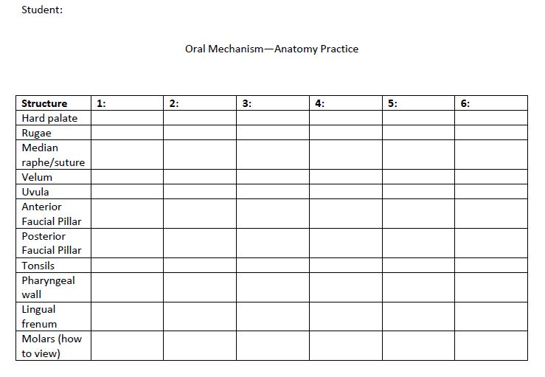
Simple → Complex Tasks,
Low → High Fidelity Environments

Slide 18
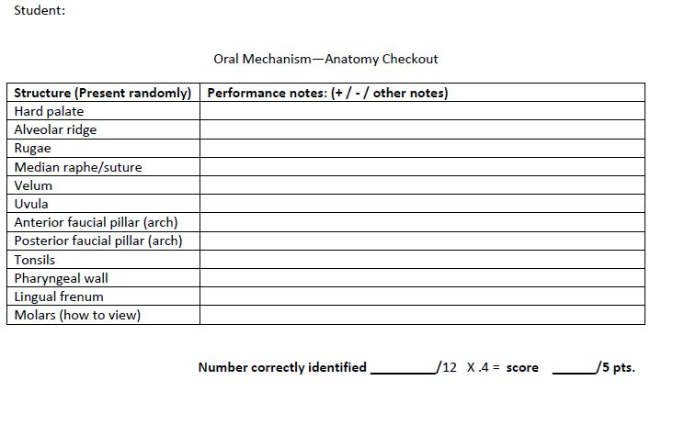

Slide 19
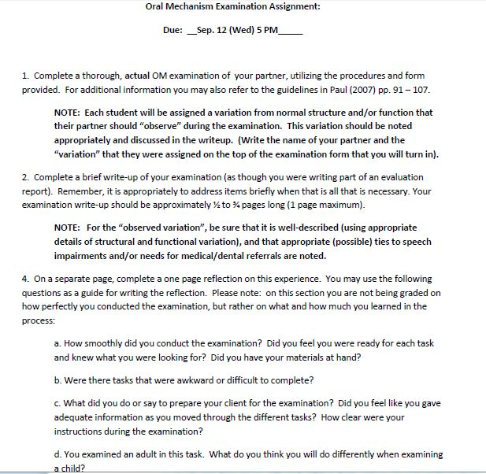

Slide 20
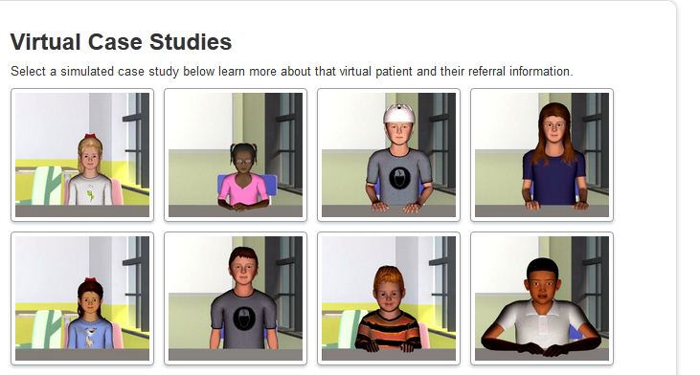
Notes:
I am thankful for simulated assessments that allow me to learn and make mistakes on a computer before I get thrown out into the real world!
The challenge scared me at first, but as I went through it, I realized that I am beginning to gain some tools that can help me work through the process. I feel I did better in some areas on this case than I did on the prior case. For that reason, I feel SimuCase is beneficial to my ability to apply what I am learning in class to real situations, with the added benefit of it being a simulated experience.
Overall I feel that this case led to significant improvement on my part. I moved up a category to developing competency, I was happy to see that. . . .Aside from my big mistake I have already acknowledged, which apparently affected my case history score, there is notable room for improvement in my assessment and recommendation areas. . . .. My most significant improvement was seen in both the collaboration and diagnostic areas.

Slide 21
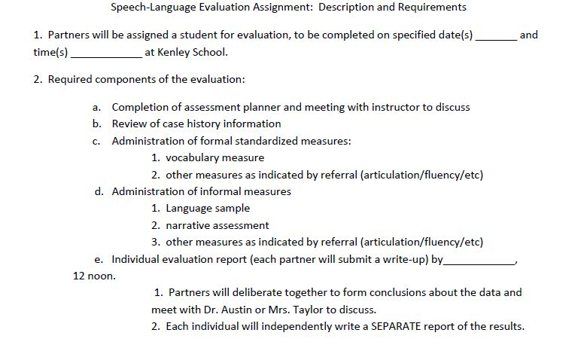

Slide 22
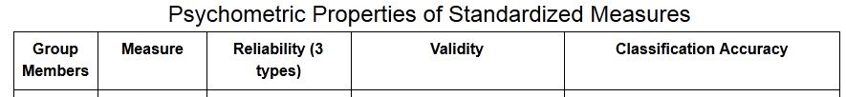
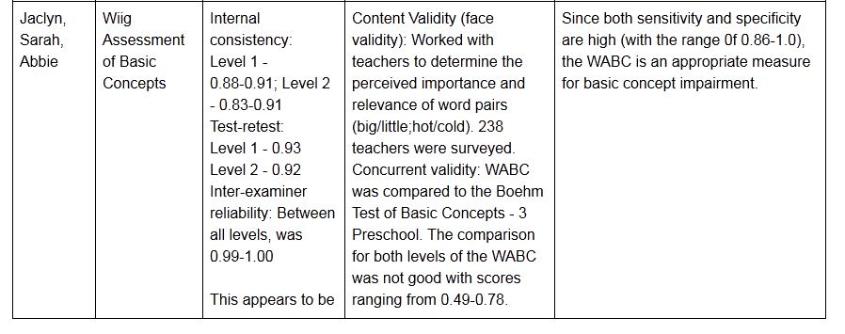
Another Example

Slide 23
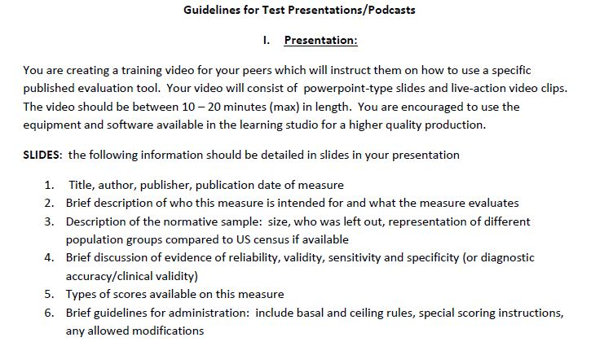
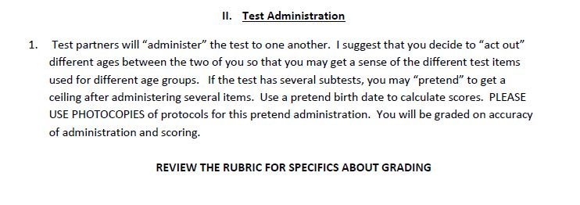

Slide 24
Part 2 -- Intervention
Foundational Knowledge: ComP 610 Advanced Study of Language Disorders in Children
Week 8 (6 hrs→) | Models of language impairment Neurobiological bases of language Principles of Intervention; How therapy works
Week 9 | Intervention at the prelinguistic; emerging language levels Introduction to intervention for language disorders in school-aged children
Week 10* | Intervention for school-aged children (*practicum begins)
Week 11 | Intervention for school-aged children
Week 12 | Language/learning disabilities
Week 13 | Language disorders in adolescence
Week 14 | Language/communication and autism; intellectual disabilities
Week 15 | Language and hearing impairment
Week 16 | Prevention of language disorders; ECI

Slide 25
Clinical Skill Acquisition/Clinical Practicum
Week 9 | Pairs’ creation of therapy plan for case study of child in emerging language stage; presentations
Week 10 | Baseline data collection for (actual) assigned school-aged client; (including children assessed and previously identified clients—one per student) Creation of therapy plan (group and individual therapy)
Week 11 - 14 | Therapy program (2 hours per week outside of class); creation of weekly therapy plans, feedback and debriefing in class and forum Weekly therapy documentation
Week 15 | Preparation of client progress reports/parent letters Submission of Therapy Program Journal: All documentation Reflection paper requiring responses to specific prompts regarding what was learned in areas such as: baseline collection, rapport establishment, documentation, etc. In groups: creation of therapy plan for case study of child with autism; presentation
Notes:
Film clips: from 11/15 – 2, 6, 14, 16
If more – from 11/8- 1, 5, 7

Slide 26
What’s Different?
Frontloading of key knowledge—BEFORE any actual client contact
“Low stakes” opportunities to practice and acquire skills
Single-client focus in short but intensive therapy program
Required reflection and debriefing

Slide 27
Student Reflections
. . .It was really nice to have had last semester to do a little experimenting under supervision with lots of feedback. It has made me much more comfortable this semester with what I am doing. . . There is definitely a comfort level and confidence that results from having had the past semester under our belts...and that has transferred to other clients in other settings as well.

Slide 28
Re: documentation
My documentation evolved with therapy,. . .. I started with a list of vocabulary words and an area to tally my listed objectives. The first session seemed to be a bit of a disaster as far as my documentation was concerned. I was never sure when to tally or write on my clipboard and that made keeping track of progress difficult. . . .I added some specifics; each objective had a level of prompting where I could easily tally the amount required and vocabulary words received a check or a level of prompting. This made tracking much easier. . . .The best implementation was learning when to actually track his progress. Certain activities were better for observing specific objectives, so tracking one thing at a time was easier than trying to track everything simultaneously through the whole session. Sharing different types of documentation with the cohort in class was also helpful.

Slide 29
Re: Cueing/Scaffolding
I included the type and level of scaffolding I would provide for my client on each week’s therapy plan. When specifically addressing scaffolding on the plan, I said that I would wait for answers from my client, and then prompt her with a question, then a partial answer, then a pause before the answer. I would also repeat her answer with any corrections that needed to be made. My client usually required minimum to moderate prompting; a question was typically used to clarify responses and then a partial response was given to elicit a response from the client. I would track and measure these by writing down the level of prompting required for each goal throughout the therapy session, if any. As the four weeks went on, I noticed that my client needed less scaffolding in, not every area, but a few key areas we worked on consistently.

Slide 30
Re: feedback to clients (1)
A strategy we learned about in class is providing meaningful feedback to the students’ responses. In the beginning I was hesitant to act confused when she said something that did not make sense because I did not want to hurt her feelings or embarrass her. I wanted her to feel comfortable, especially given her extremely quiet and withdrawn behavior. I knew it was an important strategy, however, so I began implementing it into my therapy sessions. I realized quickly that you cannot “tip-toe” around these students trying not to hurt their feelings; they need you to be direct and honest with them. Once I began implementing this strategy, my student soared. She was able to notice when I was confused and would think back on what she had said and self-correct. I now feel more comfortable implementing this strategy and I know that it is helpful with clients because it is very real and natural.

Slide 31
Re: feedback to clients (2)
As the sessions continued, I found that I had a better grasp of how to balance this hybrid approach. I felt that I was constantly making changes to the techniques and strategies I was using to accomplish a task. I felt more confident in the approach I was using, because the feedback I received on a daily basis was specific, so that I knew what areas to work on. I found it challenging to recognize when to give enough time and take the “awkward silence” versus when to jump in for a “mini-lesson”. The main area I struggled with in the hybrid approach was not using the word “no” for a response, but to take the answer, use that answer to pull more language (from her) , and then to lead the client to another answer that might be more appropriate.
If I were to change anything in my delivery, it would be how I received the answers and then lead the client to a better answer.

Slide 32
Outcomes
Client progress
Student report of increased confidence in clinical service provision
Enhanced retention of content and concepts covered in academic coursework

Slide 33
Challenges
Organizing coursework in modules – to allow for intensive instruction needed to prepare for practicum experience
Identification of clients with communication impairment associated with current coursework (e.g. language disorders)
  Our unique setting
Teaming with other faculty; sharing teaching time and supervision responsibilities

Slide 34
Generalizing to Your Program: Principles
Plan for intensive instruction (faculty pairing)
  Consider the Clinical Methods course
Target a disorder area course where clinical practice can be integrated into the class as the “other half” of the pairing
Design assignments that control for cognitive load
Use low-risk, low–to–high fidelity contexts for early clinical learning
Focus on reflective learning with one client vs. short-term retention of information to serve multiple clients

Slide 35
Selected References
  Posiask, F., Morrison, G., & Reid, K. (2013). Managing cognitive load while teaching human gait to novice health care science students. Journal of Physical Therapy Education, 27, 58 – 69.
  van Merrienboer, J. and Sweller, J. (2010). Cognitive load theory in health professional education: Design principles and strategies. Medical Education, 44, 85 – 93.

