Slide 1

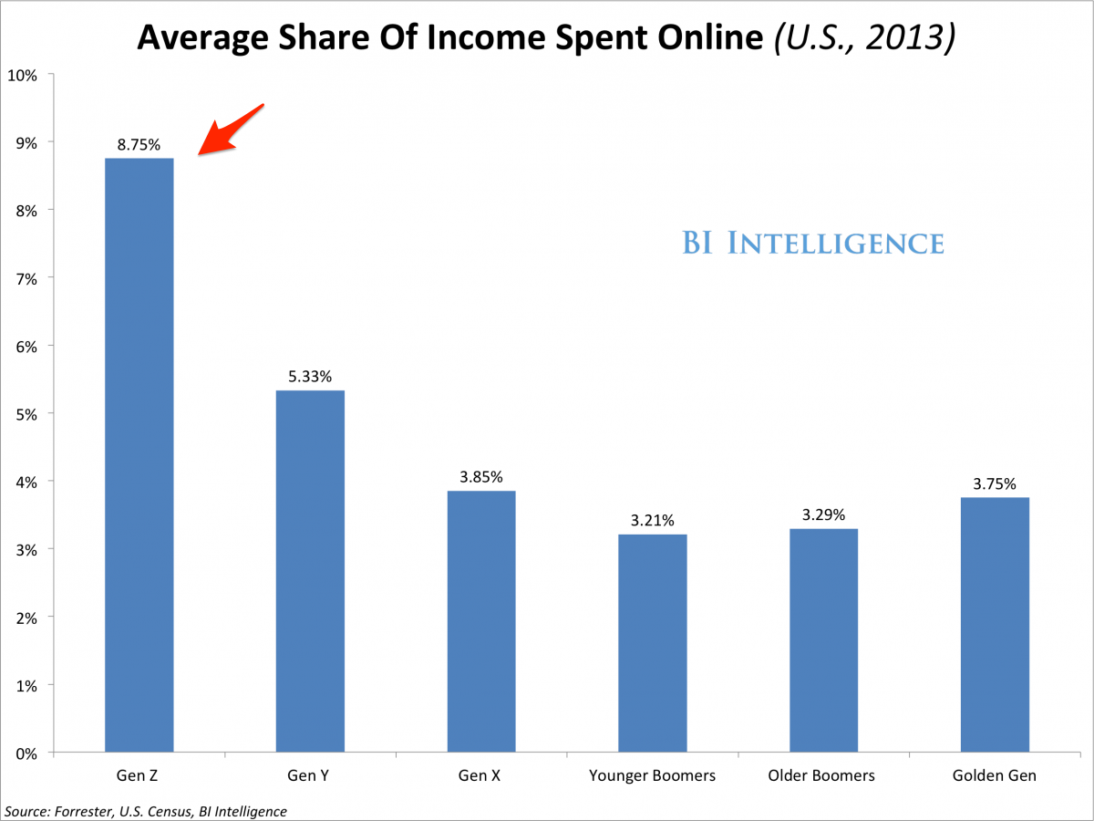
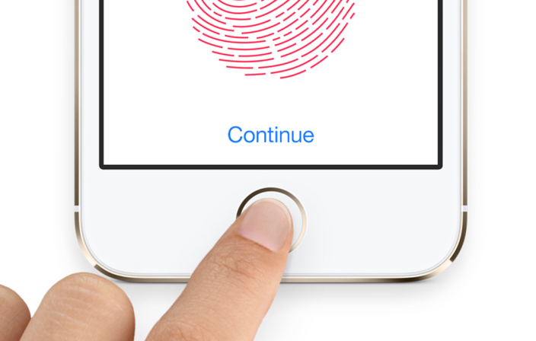
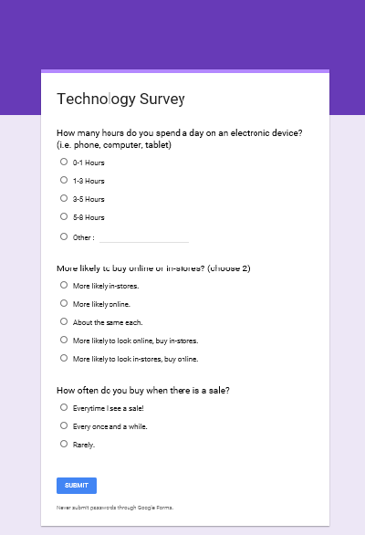
Biometrics and Psychometrics in Yahoo!Data
How does the prevalence of technology impact retail sales?
What has been the psychological transformation from the use of technology by Millennials and Generation Z?
Christy Duke, Orneita Burton
Interest
How can knowing the impact technology will have on consumer behavior change strategies to increase sales in the fulfillment process? New approaches in marketing, sales and distribution and finance will impact purchasing patterns in the coming generations.
Useful Data
Yahoo advertisements/amount of clicks
Point of Sale data
Buying patterns of different economic areas
Search History
Website visits leading to sales
Cell phone wifi tracking
Platform based pricing
Anticipated Outcomes
Identify purchasing patterns for Millennials vs. Generation Z.
Ability to analyze unique data types using high performance computing.
Compare in-store vs. online buying patterns.
Assess psychological impact of technology on consumers.
Conclusion
This proposal will address questions needed to enhance the fulfillment process in businesses. Biometrics in thumbprints on phones and security passes allow technology to track a consumer’s every move. Data collecting services and access to better testing is allowing this information to become more readily available. More and richer data sets will improve research and analysis to identify behavioral patterns. This information can be used to predict changes in consumer behavior and inform our next choice in the fulfillment process.
Collect Data
Survey
Demographics
Compare Data
Computer Programming
Patterns
Compare Observations
Test results
Collect More Data
Psychological Testing
Service Pricing
References

Slide 2
New iPhone picks up a lot of data. Without our knowledge
Thumbprint- all biometric data. Yahoo and fFB collecting that data. Yahoo has some data looking for . School testing- psychological testing. Add and adhd
Becoming more available promising more data sets. To the point we can determine a lot about behavior patterns. Use yo predict our next choice.

