Slide 1

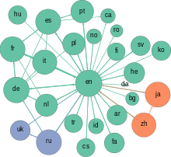
Re-engineering Corporate Social Responsibility and Sustainability in the Justice System
Discovery, The Challenge of Emergent Truth:
ORNEITA BURTON, ABILENE CHRISTIAN UNIVERSITY
Christian Scholars conference, 2018

Slide 2

Myth or Fact?

Slide 3
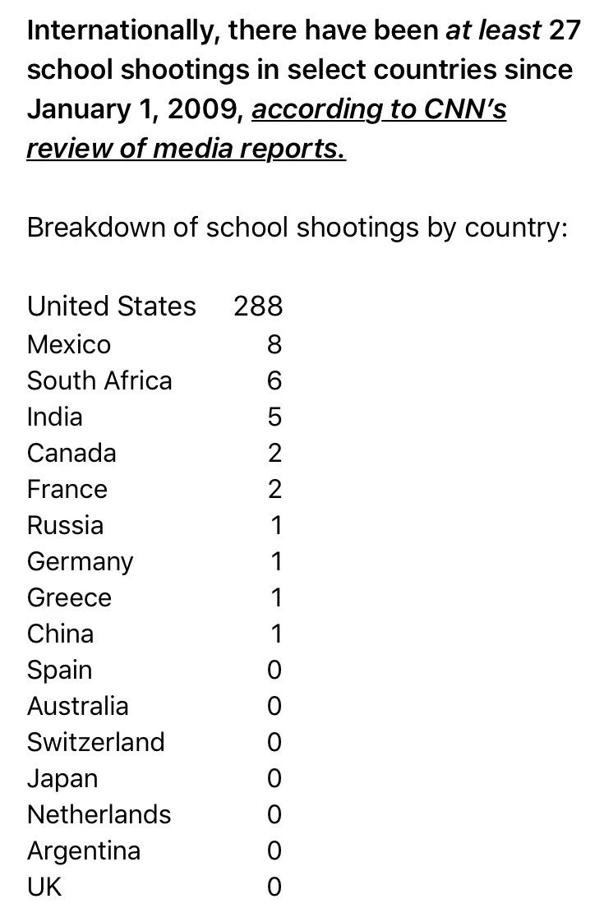

Slide 4
Research Reference
Result?
During the last two decades, the large-scale use of incarceration to solve social problems has combined with the fall-out of globalization to produce an ominous trend: prisons have become a ‘growth industry’ in (rural) America.

Slide 5
Example: Prison Communities
“We struggled, myself and a brother, two sisters, my
mother there, to keep the farm in the family and
keep it going. And we barely made a living. So
That's what made me appreciate the job so much,
that it was a lot easier and the money was secure.
Before I even started the job, they was always
telling me, the worse things get out in the world, the
better things get in jail. You’ll always have a job.”
T. Flegel, Family Farmer and Retired
Prison Guard, Coxsackie, New York

Slide 6
Research Reference
Huling, T. 2002. BUILDING A PRISON ECONOMY IN RURAL AMERICA. Marc Mauer and Meda Chesney-Lind, Editors. The New Press.
From Invisible Punishment: The Collateral Consequences of Mass Imprisonment.
In the United States today, there are more prison(er)s than farm(er)s.
In the United States today, 1 in 3 adults have a criminal record, yet
…the US experienced many times more school shootings (288) between 2009 and 2018 than 27 other countries combined.

Slide 7
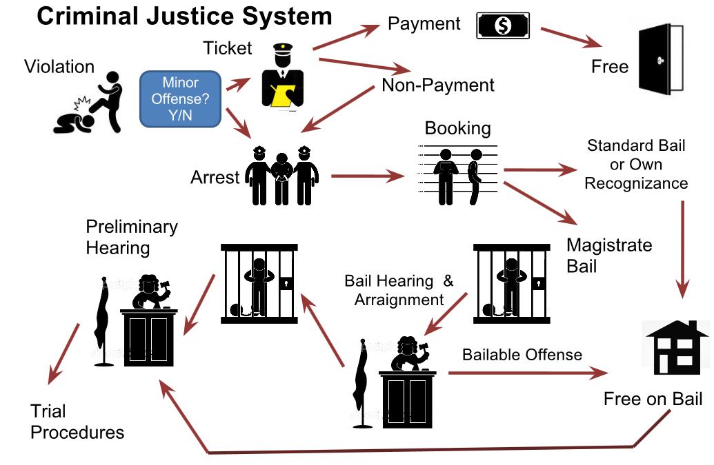
Criminal Justice System

Slide 8
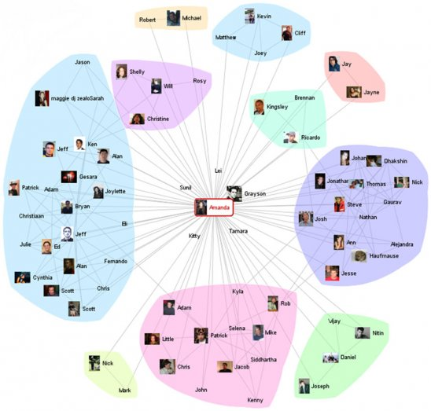

Slide 9
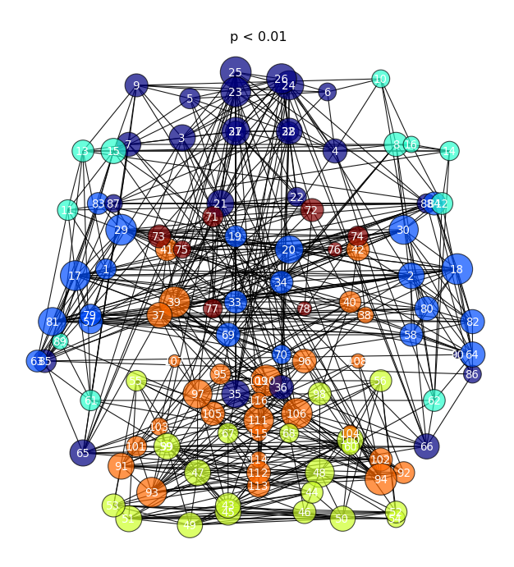
Ordered or Random System?

Slide 10
Observation:
We cannot interpret a system’s behavior without fully accounting for the structure of the network behind it.

Slide 11
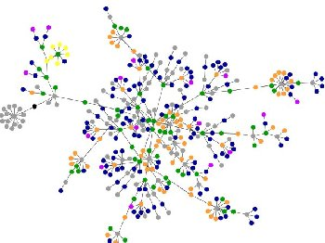
Community Structure
Focus on Flourishing Community
Node Types, Size and Distance in Healthy Communities:
Financial
Academic
Business
Employment
Health

Slide 12
Community Structure
Focus in a Dying Community structure
Existence of Nodes Types, Size and Distance in Relatively Unhealthy, Communities AND source and level of connectivity –embedded node:
Financial
Academic
Business
Employment
Health
Justice – embedded, non-integrated network

Slide 13
Research Question:
“What is the structure and impact of the justice system network as it interacts within the local community?”

Slide 14
Network Measures
Networks are measured in terms of three characteristics:
network size (many contacts increase the likelihood of…opportunities),
network density (strong connections between contacts lower the likelihood of … opportunities)
network centralization or hierarchy (one or a few contacts connected to the other contact

Slide 15
Research: Case Study No. 1
Thriving community
Growth from population of 30,000 to 500,000
Removal of predatory systems (holes) (Galbraith, 2008)
Change in focus, node types, size

Slide 16

Network Density

Slide 17
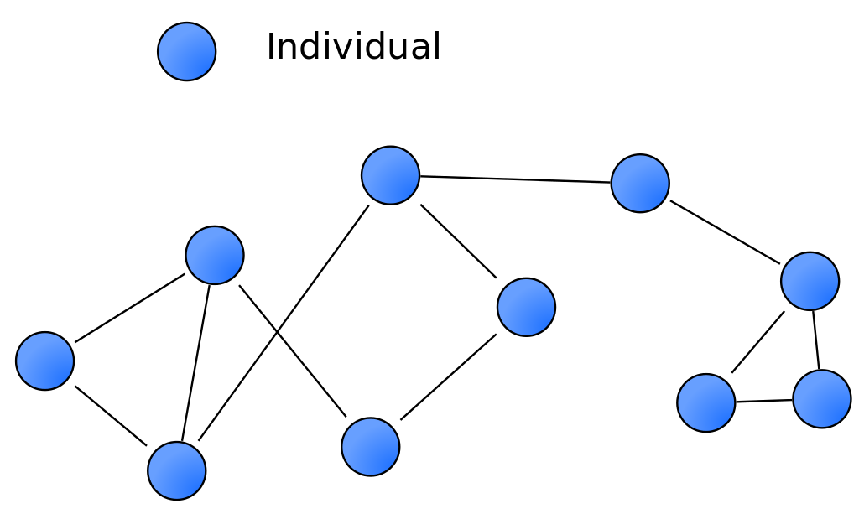

Slide 18
(Burt, 2015)
Holes in social structure are variably reinforced by the social organization around the hole.
The more reinforced the hole, the greater the difficulty in bridging it, but,…
The more likely a successful bridge will carry information (that is) novel, and so potentially valuable, to people on the other side.

Slide 19
Concepts/Claims from Network Theory:
1. Networks create social capital for individuals (Burt 1992; Bourdieu 1985) and communities (Putnam 2000; Portes & Sensenbrenner 1993)
2. Networks create status (Podolny 1993) and category (Zuckerman 1999) differences in markets
3. Network forms of organization are an alternative to markets and hierarchies (Powell 1990)
4. Networks are the defining feature of “innovative regions” such as Silicon Valley (Saxenian 1984; Owen-Smith & Powell 2004; Fleming et al 2007)
5. Networks are the locus of innovation in high-technology industries (Powell et. Al 1996; Stuart et. Al 1999; Ahuja 2000; Owen-Smith et. al 2002)
Jason Owen-Smith, Network Theory: The Basics. https://www.oecd.org/sti/inno/41858618.pdf

Slide 20
Concepts/Claims from Network Theory:
6. Networks create trust and increase forbearance (Piore & Sabel 1984; Uzzi 1997)
7. Networks inspire conformity in thought and action (Galaskiewicz 1991;Mizruchi 1992)
8. Networks shape the diffusion of technologies (Rodgers 1962; Coleman et al 1966) and organizational practices (Davis 1991; Strang & Macy 2001)
9. Networks create individual tastes and preferences (Mark 1998)
10. Networks ‘embed’ transactions in a social matrix, creating markets (White 1981; Baker 1984; Granovetter 1985)
Jason Owen-Smith, Network Theory: The Basics. https://www.oecd.org/sti/inno/41858618.pdf

Slide 21
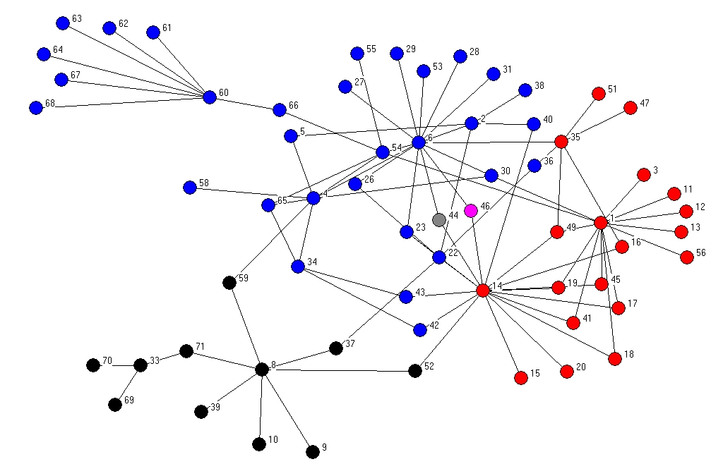
Holes in social structure are variably reinforced by the social organization around the hole.
The more reinforced the hole, the greater the difficulty in bridging it, yet…
…the more likely a successful bridge will carry information (that is) novel, and so potentially valuable, to people on the other side.

Slide 22
Clusters, node location, size, type, relative distances (Barabasi, 2016)
Planning Approaches:
RE-ENGINEERING
Enterprise/Systems Architecture
Community Design/Social Engineering

Slide 23
Research: Case Study No. 2
Stagnate Community
Redistribution of resources within/between nodes
Absence of supportive nodes (holes)
Presence of predatory nodes – prison economy
Black hole effect in use of community resources

Slide 24
Measures - Social Network Structure
Social Constructs – paternalism, social distinctions (outward appearance, circumstances), inclusion (all or some), individual vs common good
Financial Constructs – availability and use of debt financing, cost of living, wealth standard deviation
Academic Constructs – acceptance rates, social segmentations
Health Constructs – social vs private access to health care
Economic Constructs – unemployment rate, type of employment, demographics of employment by job

Slide 25
Network Analysis
What nodes exist (structure)
What comparative nodes are missing (holes)
Identify instances of positive nodes – contribute to thriving community
Identify instances of negative nodes – take away from the community
Measures of size, distance (linkages), location (equitable, efficient distribution of resources)
Strength (power) of association (linkages)

Slide 26
Network Analysis – Structural Equation Modeling (SEM)
Statistical method that fit networks of constructs to data
SEM is commonly justified in the social sciences because of its ability to impute relationships between unobserved constructs (latent variables) from observable variables.
SEM therefore allows the researcher to diagnose which observed variables are good indicators of the latent variables

Slide 27
Network Analysis – Support Vector Model (SVM) in Machine Learning
The paths in a SEM could reasonably be replaced with SVM (Support Vector Machine) or Neural Network (NN), allowing for more complex nonlinear designs that include latent variables.
With SEM, the objective is primarily to estimate the model parameters, whereas with machine learning the objective is usually prediction accuracy

Slide 28
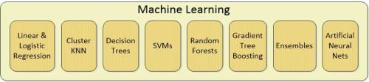
Machine Learning – Neural Networks & Support Vector Machine (SVM)

Slide 29
Machine Learning – Neural Networks & Support Vector Machine (SVM)
In machine learning, Support Vector Machines (SVMs) are supervised learning models with associated learning algorithms that analyze data used for classification and regression analysis
Support Vector Machines (SVMs) provide a powerful method for classification (supervised learning). Use of SVMs for clustering (unsupervised learning) is now being considered in a number of different ways
SVM and NN build a 'separator hyperplane' with data available in order to later automatically classify new data. In other words, given labeled training data (supervised learning), the algorithm outputs an optimal hyperplane which categorizes new examples.
SVM is very convenient for data split in 2 classes (-1 and 1); Neural networks are more polyvalent providing different outputs.

Slide 30
Network Analysis – SEM vs Neural Networks & SVM
Biggest difference is that SEMs are easy to interpret and good for inference.
SVMs and NN are like black boxes which spit right answers.
Prediction accuracy vs interpretability is an important distinction for choosing the correct model

Slide 31
Network Analysis – Paths/Linkages are Key
How revenue is generated - R
What service model is followed - S
What supply chain is followed - SC
What social externalities are generated in justice operations - SE
Impact on other nodes – I (latent variable)

Slide 32
Selected References
Ahuja, G. 2000. Collaborative networks, structural holes, and innovation: A longitudinal study . Administrative Science Quarterly, 45: 425-455
Albert, R. A., Jeong, H., Barabasi, A. L. 2000. Error and attack tolerance of complex networks. Nature, 406: 378-482.
Barabasi, A. L. 2016. Network Science. Cambridge: Cambridge University Press.
Bollobas, B. 2001. Random Graphs. Cambridge: Cambridge University Press.
Burt, E. S. 2015. Reinforced structural holes. Social Networks, 43: 149-161.
Erdos, P. and Renyi, A. 1959. On random graphs. Publicationes Mathematicae (Debrecen), 6: 290-297.
Galbraith, J. K. 2008. The Predator State. New York: Free Press.
Granovetter, M. S. 1973. The strength of weak ties. American Journal of Sociology, 78: 1360.
Kaufmann, S. 1993. Origins of Order: Self-Organization and Selection in Evolution. Oxford: Oxford University Press.
Westland, J. C. 2015. Structural Equation Modeling: From Paths to Networks. New York: Springer.

Slide 33
QUESTIONS?

